Slide 1
Go green
English lesson

Slide 2
Earth

Slide 3
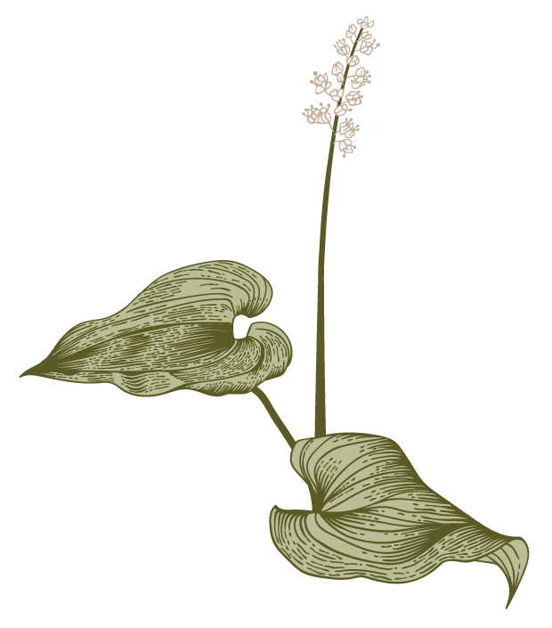
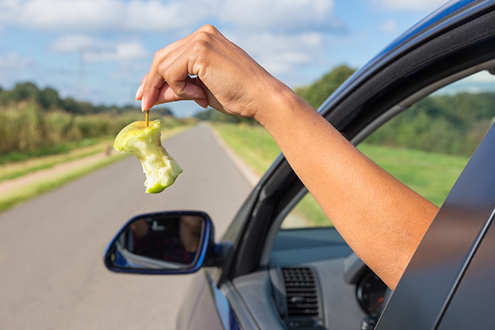
Is it good or bad?
Go green

Slide 4
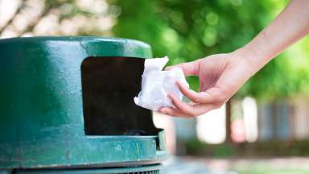
Is it good or bad?
Go green

Slide 5
Vocabulary
Drop litter
Land pollution
Water pollution
Air pollution
Turn off/on
Recycle
Unplug
Sort out

Slide 6
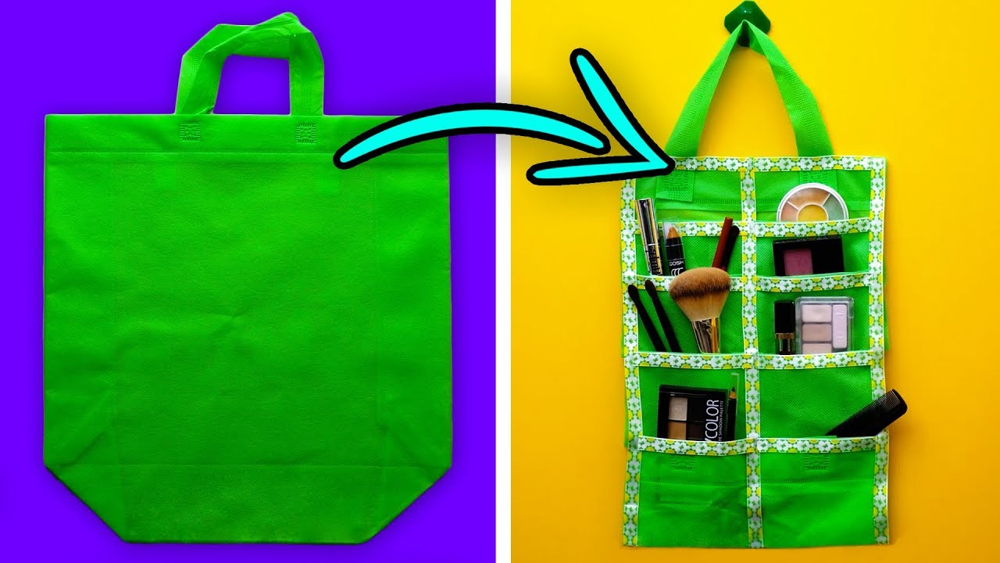
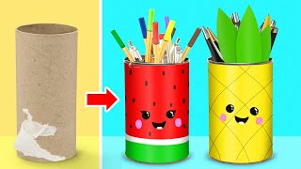
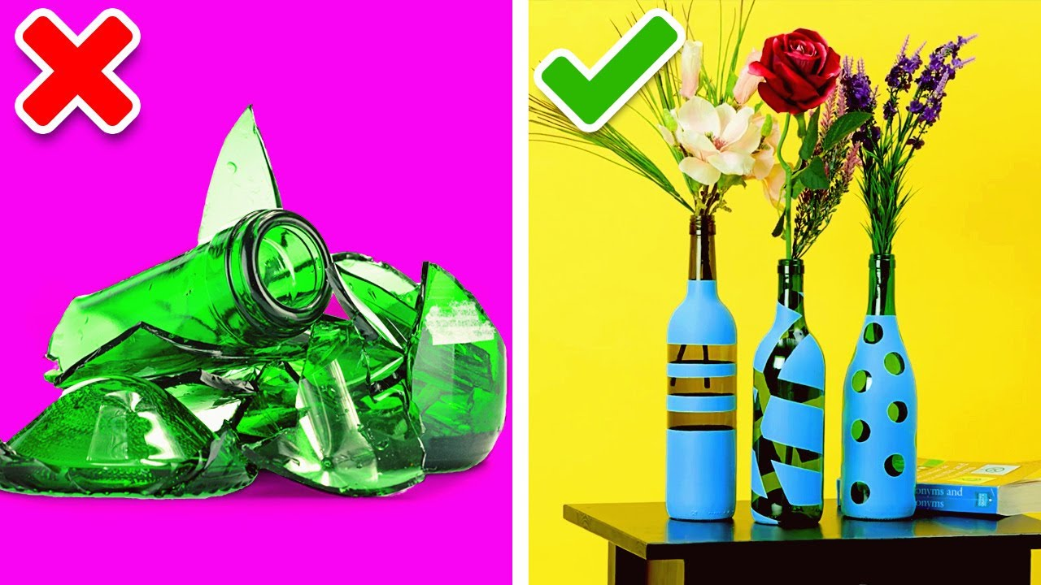
Recycling
With recycling we can make new things out of old ones. Recycling can help save the planet.

Slide 7
1. Cut a hole in the upper side of the bottle. 2. Glue coloured paper around the bottle. 3. Stick a recycling label on the bottle. 4. Hang recycling bins in the classroom.

Slide 8
Homework: make a “Go green” poster.
Thank you

