Slide 1
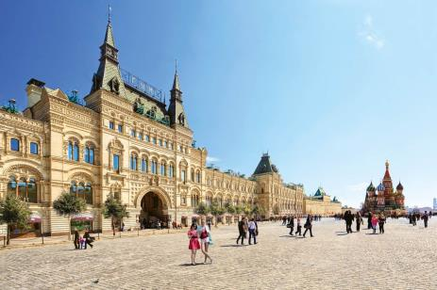
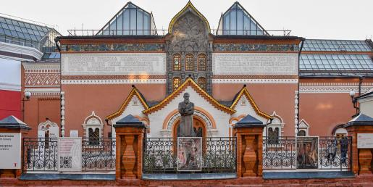
What city do the pictures come from?

Slide 2
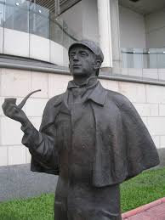
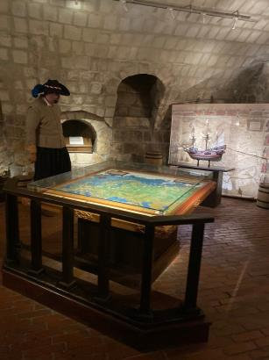
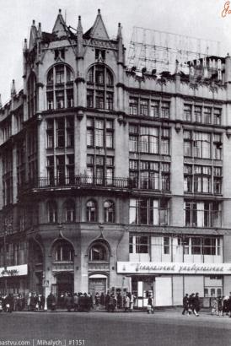
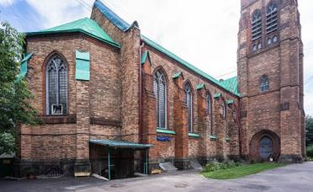
Can you find these places in Moscow?

Slide 3
Virtual tour “British places in Moscow”

Slide 4
The Old English Court

Slide 5
The museum was opened in 1994.

Slide 6
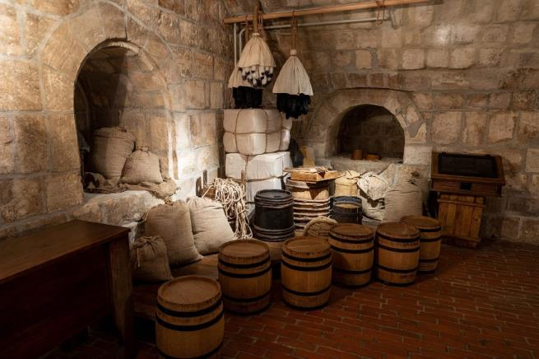
In the basement …

Slide 7
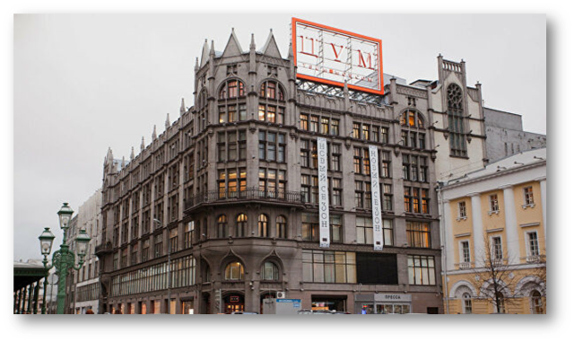
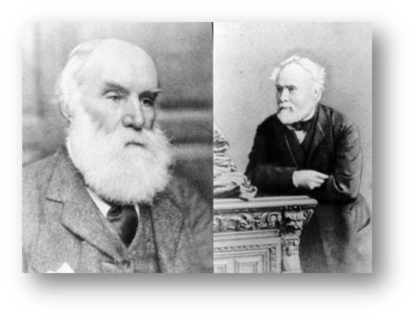
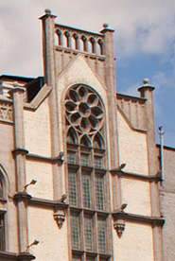
TSUM
Founded in 1908
Its former name: Muir and Mirrielees

Slide 8
Did you know that…
this invention scared people in TSUM?
this Russian writer named his dogs Muir and Mirrielees?

Slide 9
St. Andrew’s Anglican Church

Slide 10
The monument to Sherlock Holmes and Dr Watson in Moscow

