Slide 1
Today
we will talk about…

Slide 2
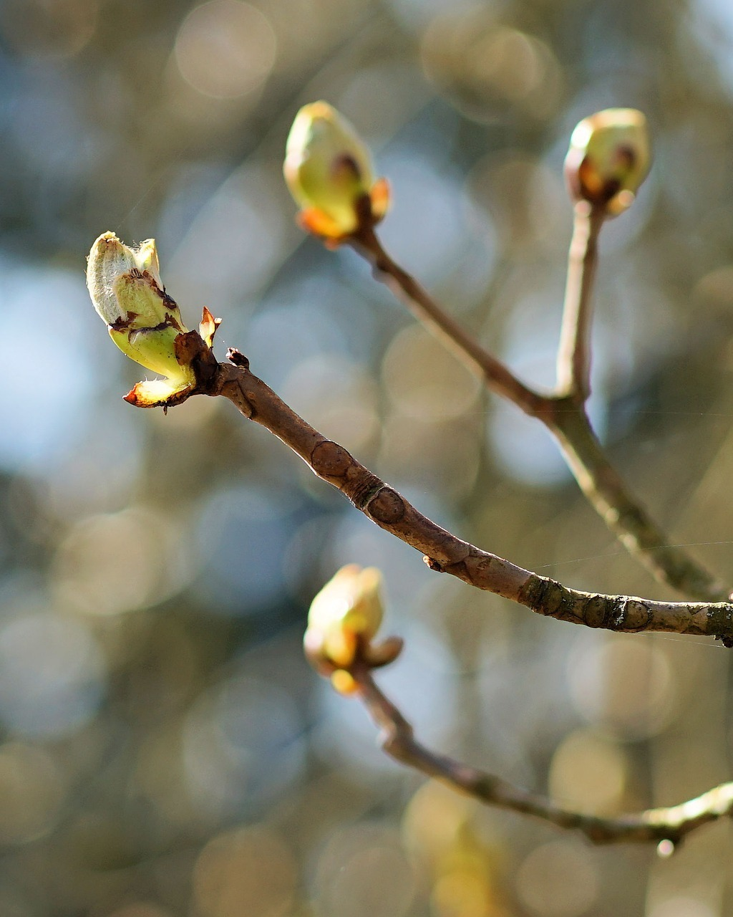
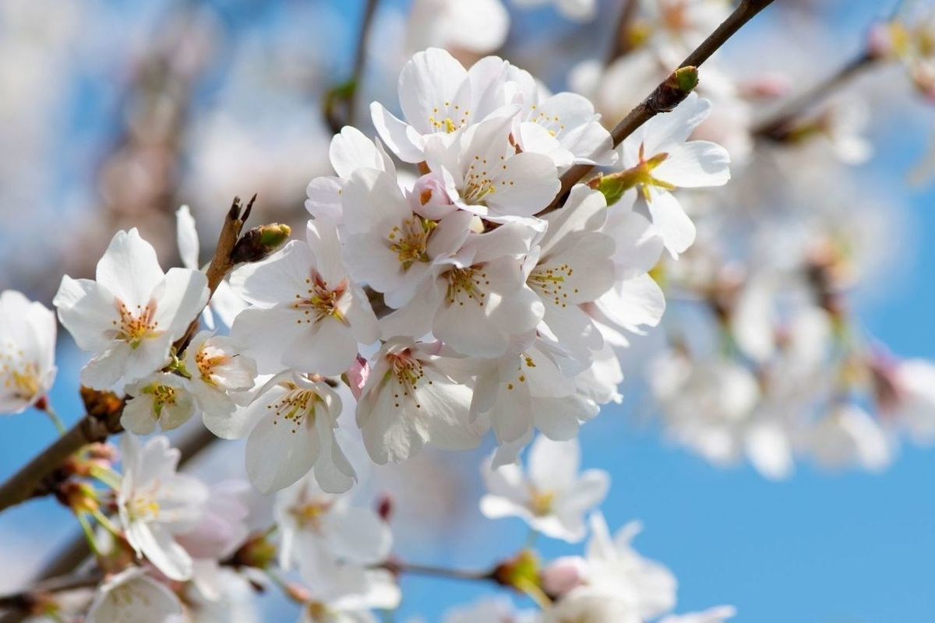
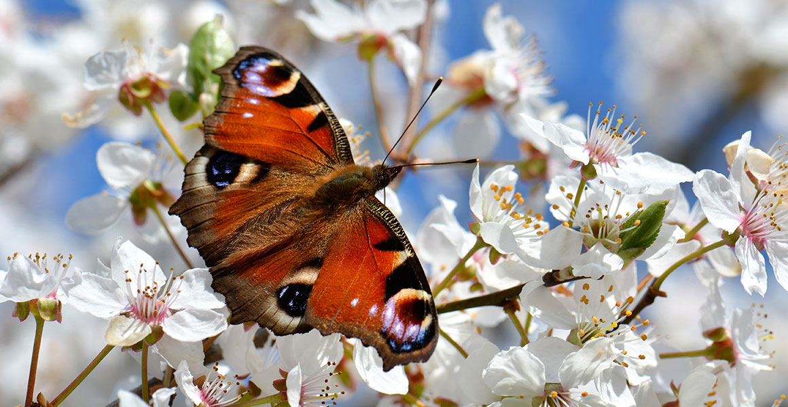
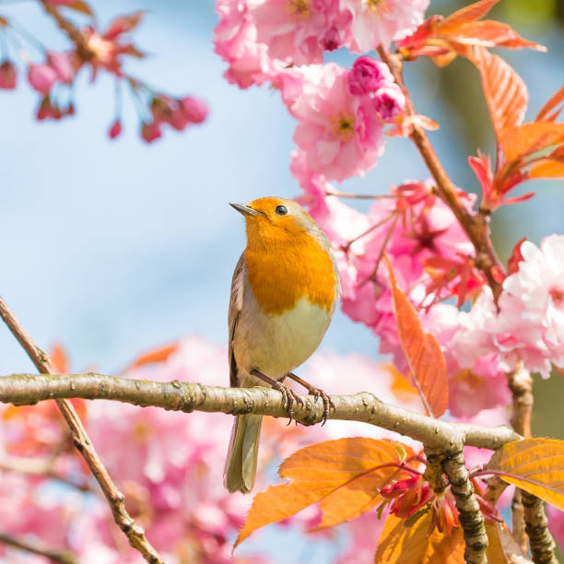
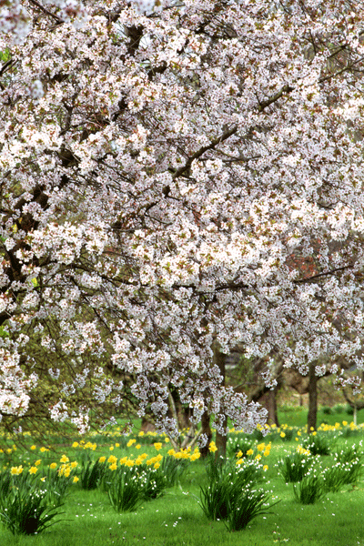
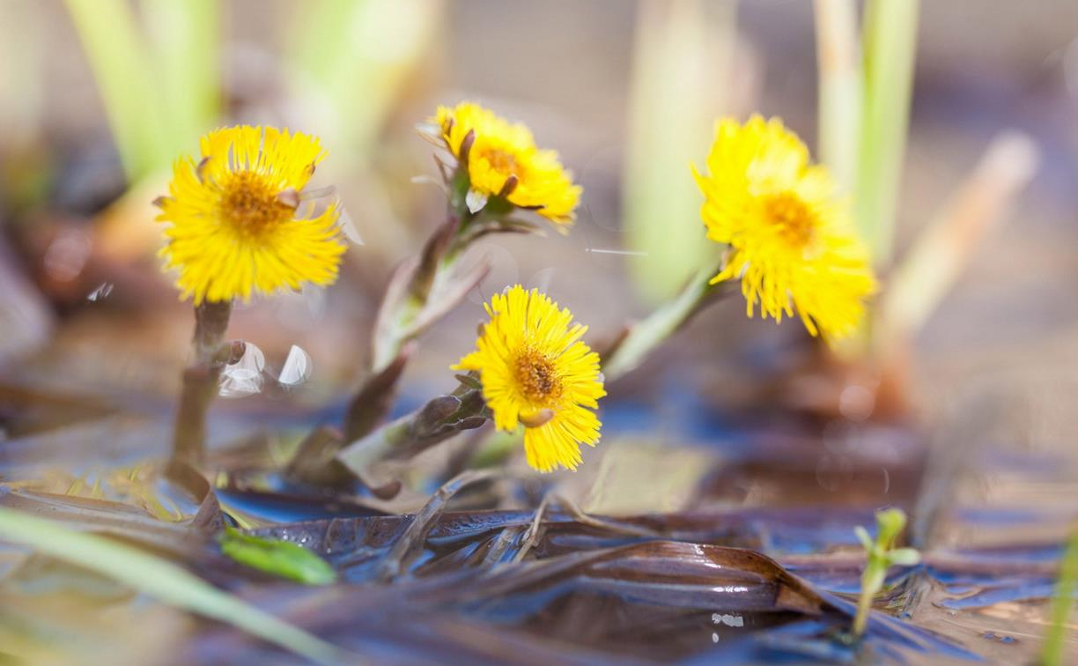
Guess the topic!

Slide 4
SEASONS
Spring comes only once a year
The birds sing loud for all to hear.
Summer soon will arrive
The sun shines down and lovely flowers thrive.
Autumn brings the changing of the leaves
Beautiful colors falling from the trees.
Winter blows in with cold winds abound
Snow piling up on the frozen ground.

Slide 5
spring summer autumn winter
It is ________.
Let’s go outside!
Let’s go outside!
Fast sleds and snowmen.
Hot cocoa and mittens.
It is __________.
(By Little Learning Corner)
I see rain clouds. I see birds’ nests,
Butterflies, too! Flowers, too!
Everything is growing.
The wind is gently blowing
____________ is here!
(By Little Learning Corner)
I can’t wait for _________, when school days are done, to spend the days playing outside in the sun. I won’t have to study. No homework, no tests. Just afternoons spent on adventures and quests.
(By Kenn Nesbitt)
___________ is the time of year when changes start to happen here. The days grow short. It’s cold outside. The birds fly south. The squirrels hide. The leaves fall off of all the trees. The garden pond begins to freeze.
(By Kenn Nesbitt)

Slide 6
Watch the video and answer the questions:
Questions:
What do plants do?
What do birds do?
What do butterflies do?
What color are the leaves?
What do flowers do?
Are days long or short?

Slide 7
Complete the sentences:
Sunsets are ____________ (beautiful) in spring.
Birds are ___________ (happy) in spring.
The month I love ________ (much) is May.
The __________ (good) season is spring.
The __________ (nice) flower of spring is lilac.

Slide 8
“SPRING” mind map
Trees are green
The sky is bright
The weather is good
Warm and sunny
beautiful
March, April, May
Flowers are blooming
Butterflies are flying
We play outside
Birds are singing
It makes us happy
Summer is coming
All birds are nesting
Holidays are coming soon
We love the spring very much

Slide 9
A haiku
A Japanese poem – short an beautiful.
The first line has 5 syllables,
the second line - 7
the third line - 5.
Haiku do not rhyme.

Slide 10
Create your own haiku poem about spring! Use our mind map ☺

Slide 12
Видео в конце для позитивного завершения урока:
https://youtu.be/Qhv29_M-P5Q

