Slide 1
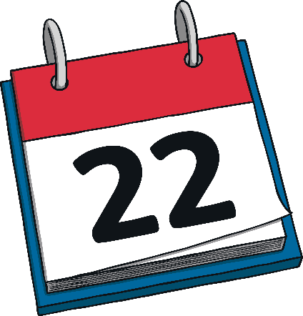

When is Earth Day?
Earth Day is on the 22nd of April every year.

Slide 2
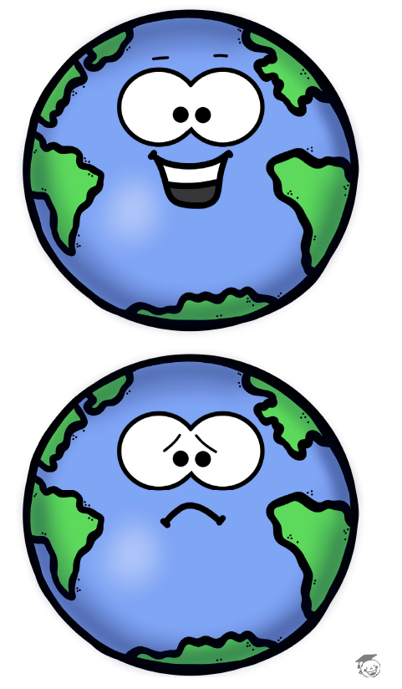
Happy planet- sad planet game

Slide 3
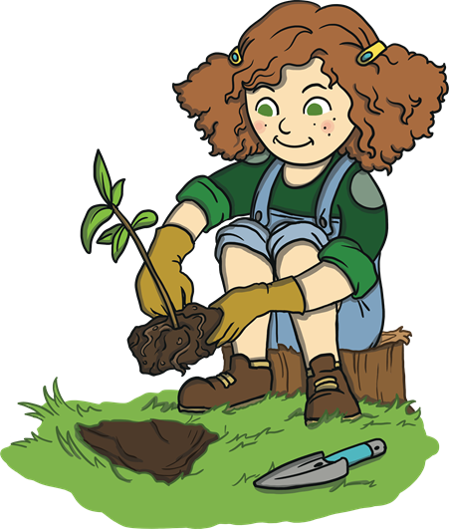

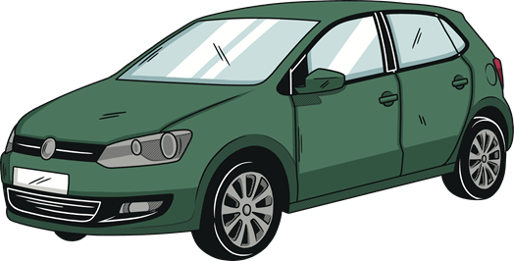
Good or bad for the Earth?
Planting trees driving cars

Slide 4
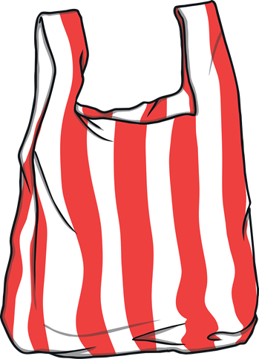
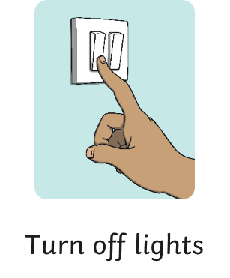
Good or bad for the Earth?
Using plastic bags

Slide 5
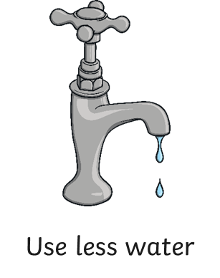

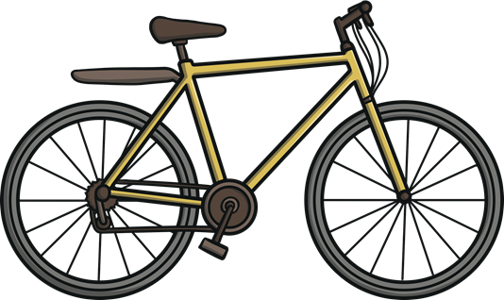
Good or bad for the Earth?
Riding a bike

Slide 6
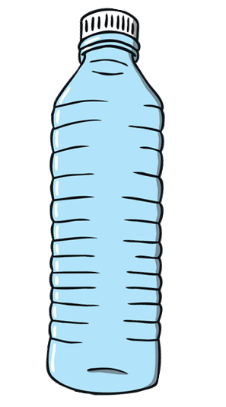
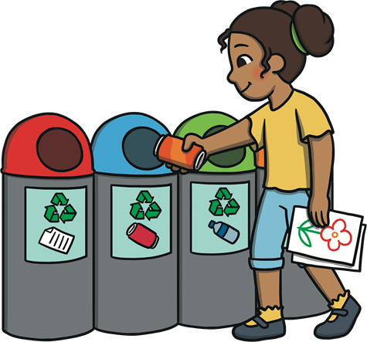

Good or bad for the planet?
Using plastic bottles recycling waste

Slide 7


Good or bad for the planet?
Cutting down trees turning off the computer

Slide 8
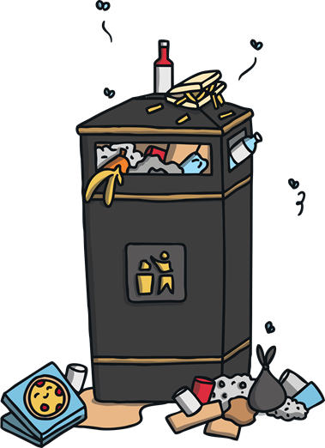

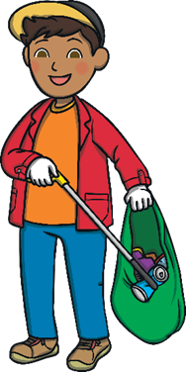
Good or bad for the planet?
Throwing away the rubbish picking up the rubbish

Slide 9

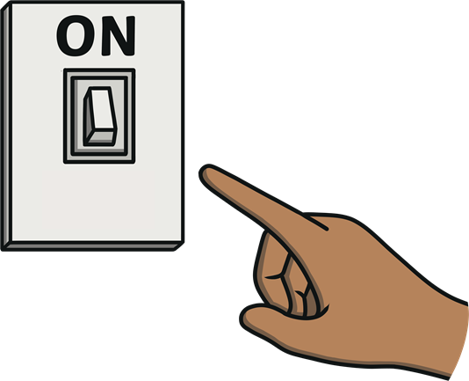
turning on the light turning off the light

Slide 10
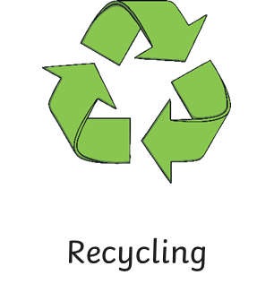
Good or bad for the planet?

Slide 11
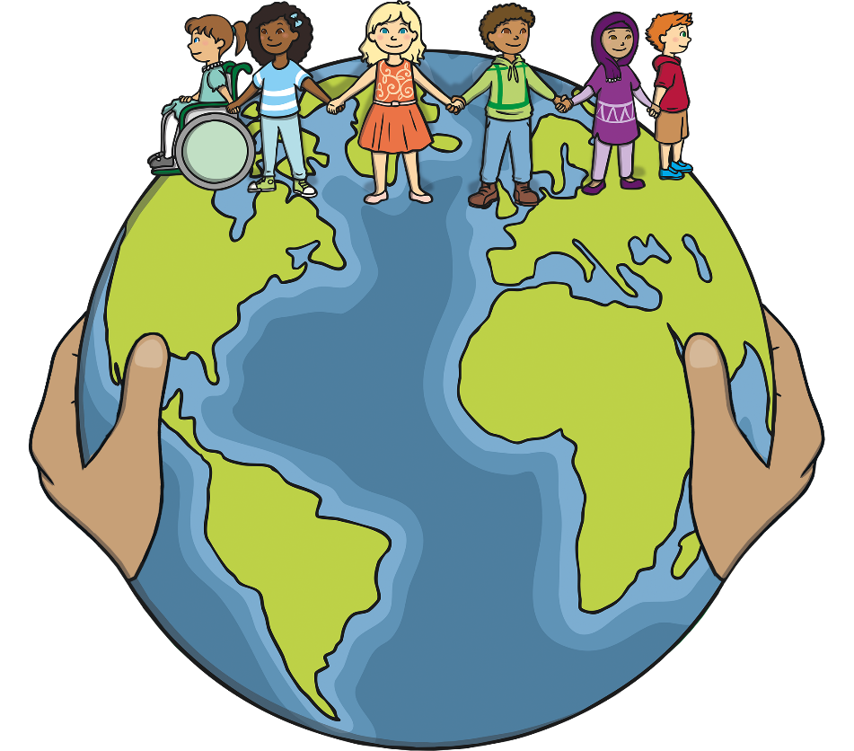
What Did You Learn?
What did you learn about Earth Day?
Tell a friend about something you are going to do to help look after our planet. Make a list!

