Slide 1
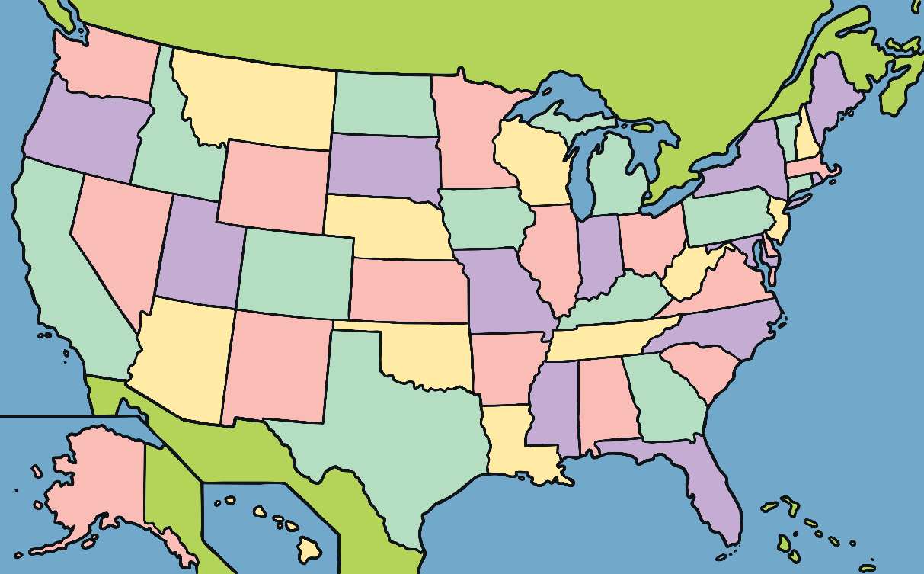
What is Earth Day?
The first Earth Day was held in 1970 in America.
On Earth Day people come together to help our planet

Slide 2
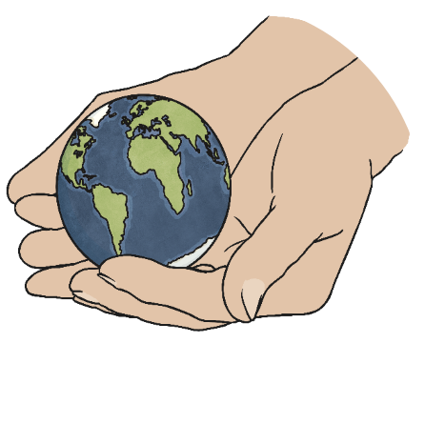
When is Earth Day?
Earth Day is held on the 22nd April every year.

Slide 3
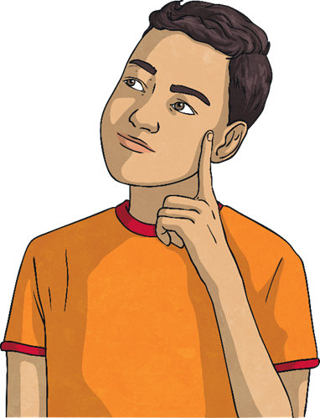
“We have forgotten how to be good guests, to walk lightly on the earth as its other creatures do.” - Barbara Ward

Slide 4
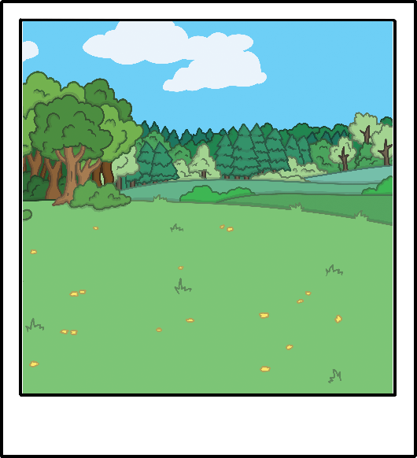
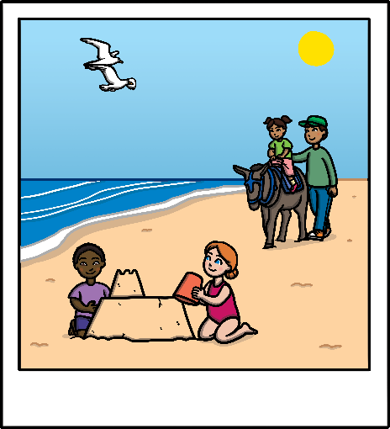
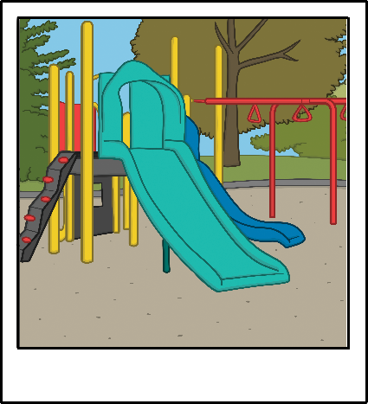
Our planet is amazing and beautiful.
What is your favourite place?
Is it the seaside? The countryside? A park? Why?

Slide 5
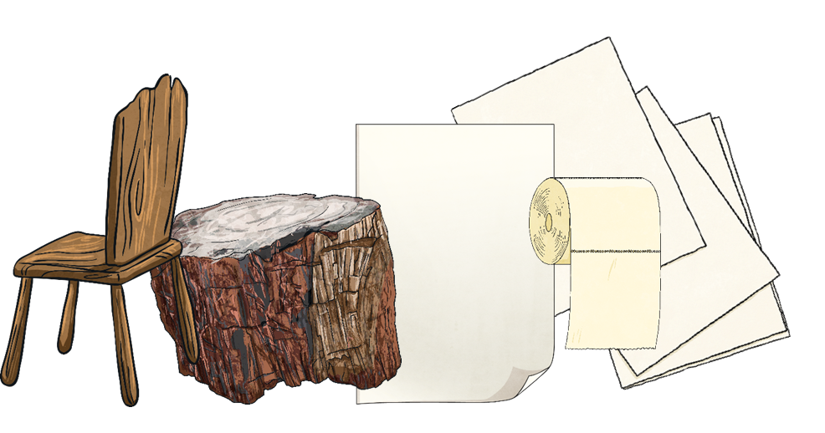
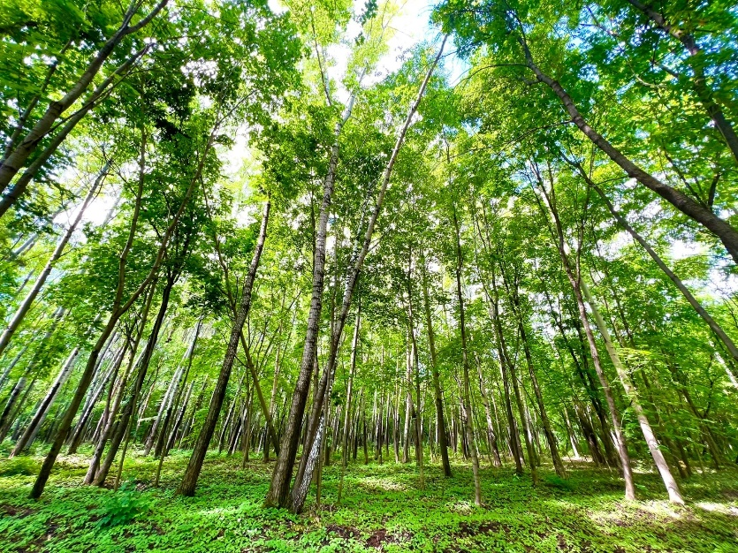
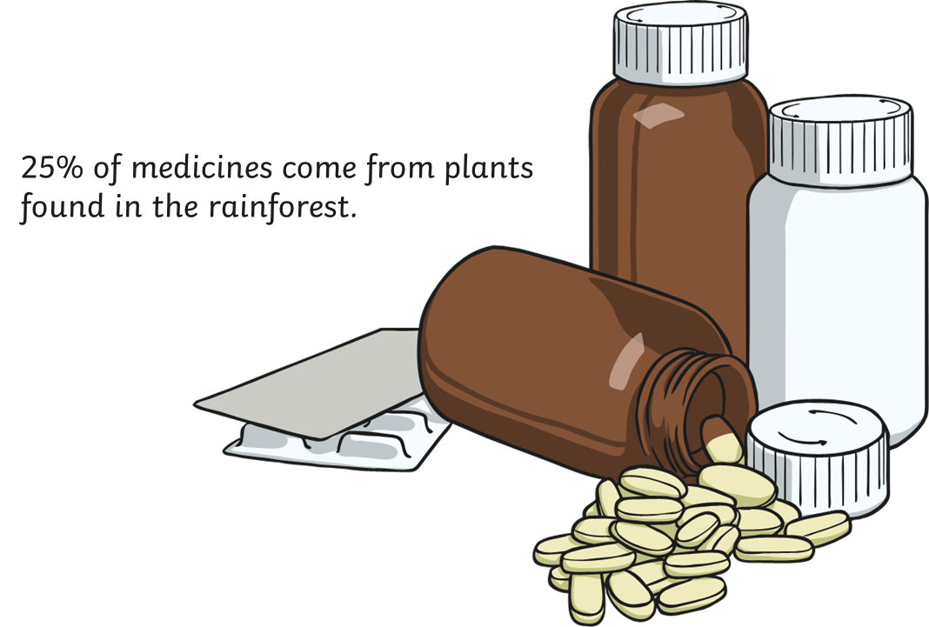
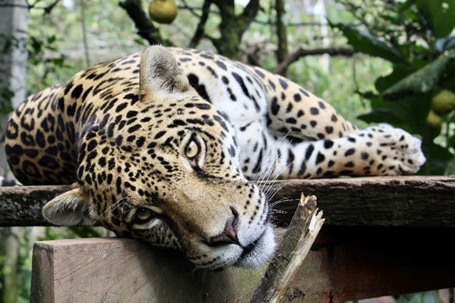
Why are trees important?
Trees give us wood to build houses
Trees give us oxygen to breathe fresh air
Trees give a lot of animals and birds home
People make paper from trees
Trees give us food: fruit, nuts
Trees give us medicine
➢We feel happy and safe in the forest
We can play and ski in the forest

Slide 6
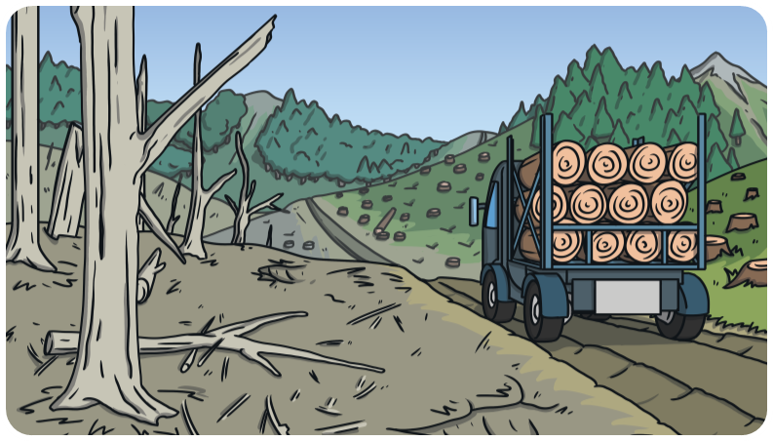
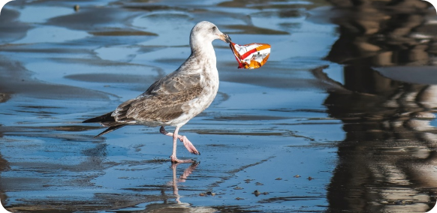
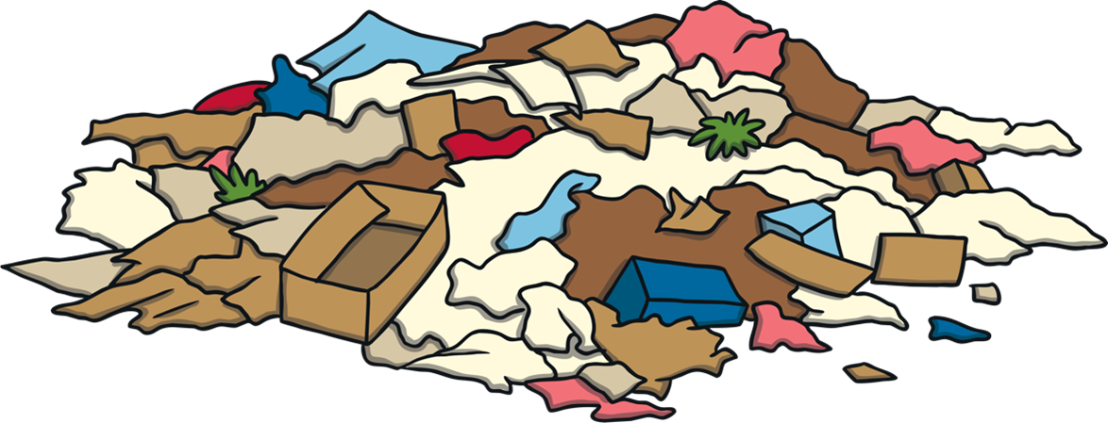
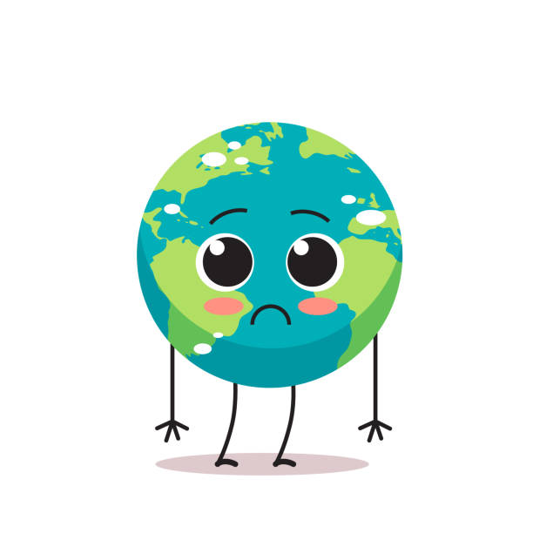
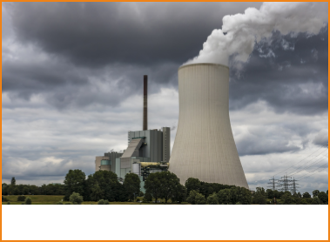
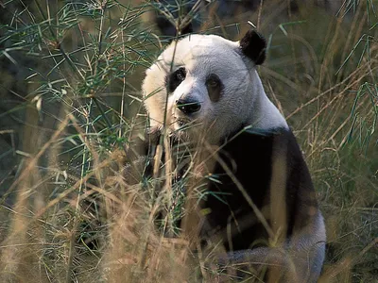
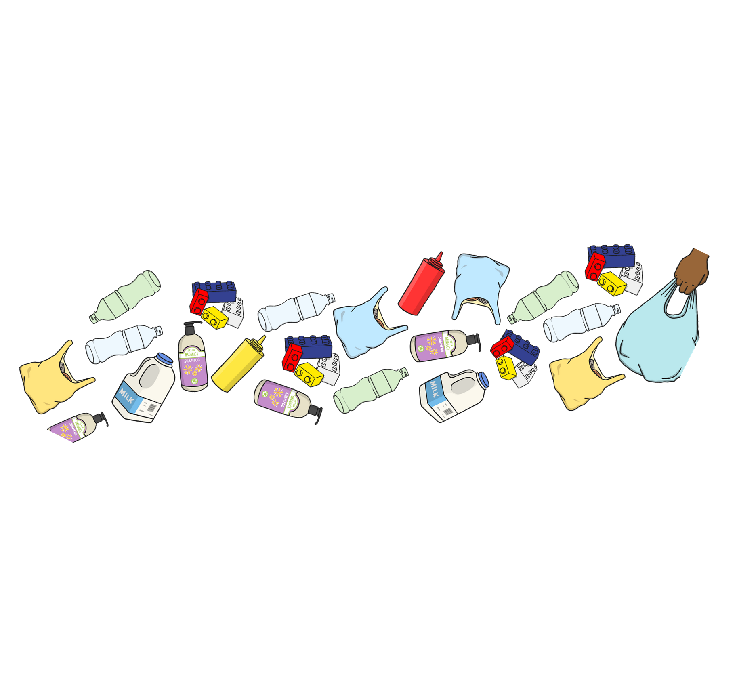
What problems can you see?

Slide 7
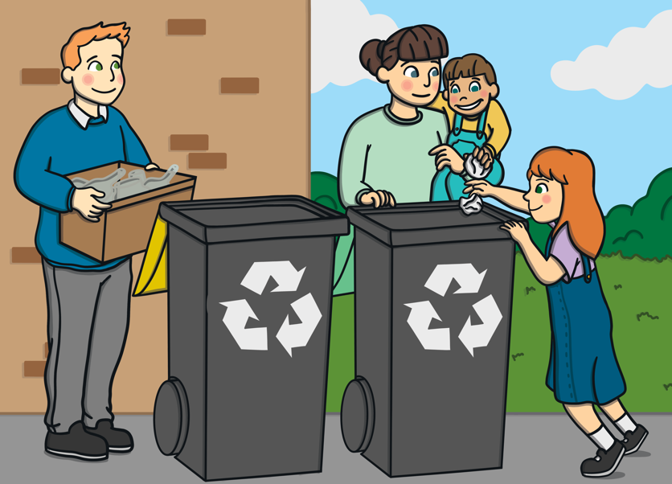
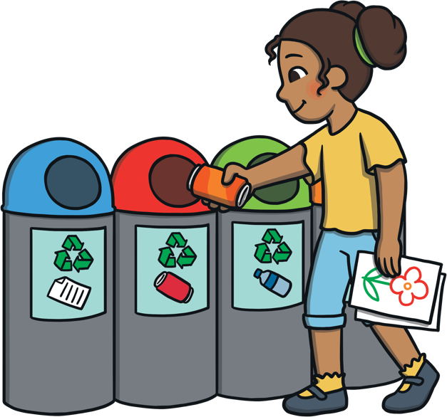
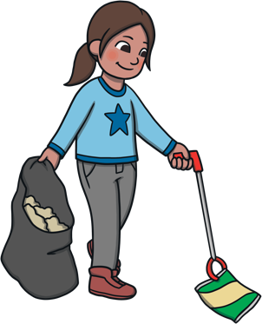
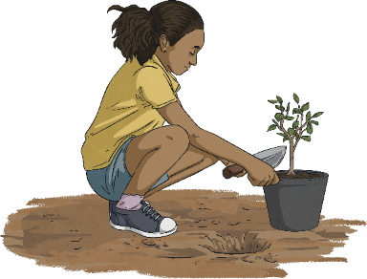
Match
Sort the rubbish
Pick up the rubbish
Plant trees
Save energy
Recycle

Slide 8
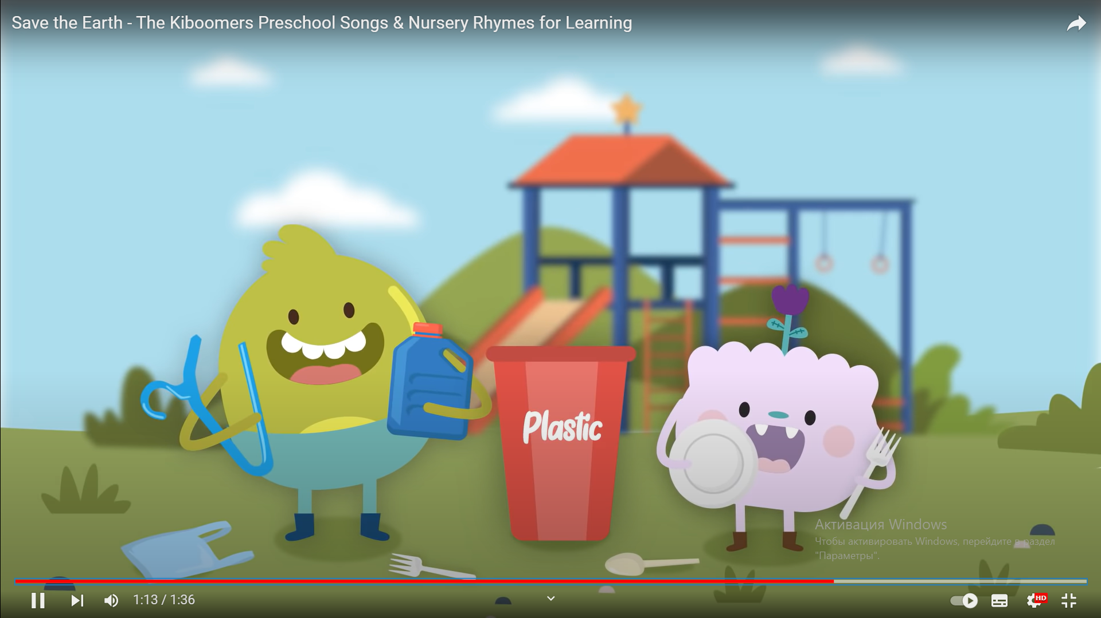
Song “Save the Earth” Save, save, save the cans Put them in the bin We can help to save the Earth If we all pitch in! If we all pitch in! What next? Paper!! Save, save, save the paper Put it in the bin We can help to save the Earth If we all pitch in! If we all pitch in! What next? Bottles!! Save, save, save the bottles Put them in the bin We can help to save the Earth If we all pitch in! If we all pitch in! What next? Plastic!! Save, save, save the plastic Put it in the bin We can help to save the Earth If we all pitch in! If we all pitch in! If we all pitch in!

Slide 9
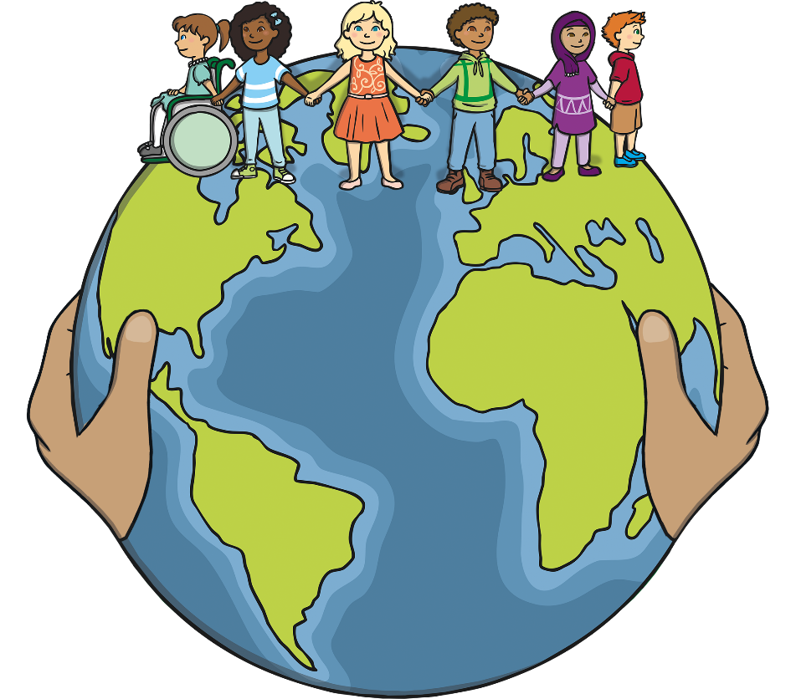
What Did You Learn?
What did you learn about Earth Day?
Tell a friend about something you are going to do to help look after our planet.

