Slide 1
I like children. I teach them at school. Who am I?
I am a teacher.

Slide 2
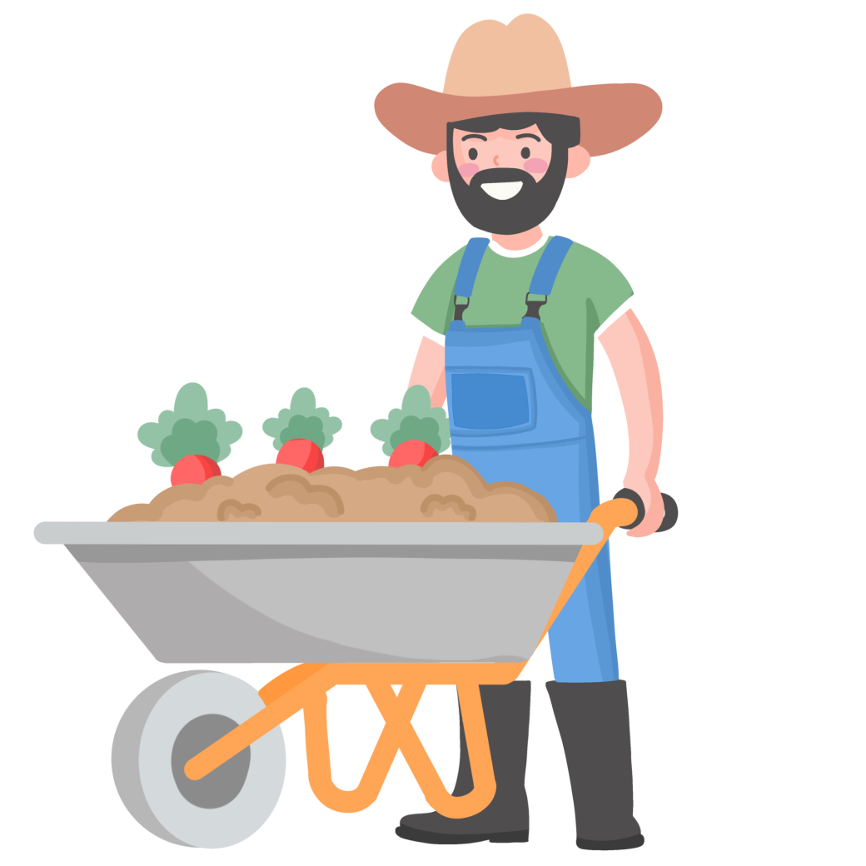
I like animals. I have a big farm. Who am I?
I am a farmer.

Slide 3
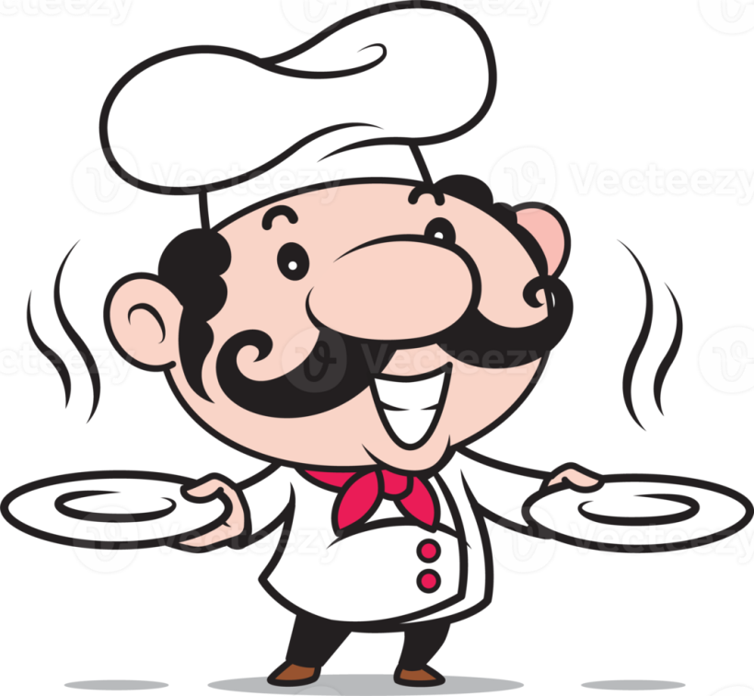
I cook very well. People like to eat my food in a cafe. Who am I?
I am a cook.

Slide 4
I have books at home. I like to read them. Who am I?
I am a reader.

Slide 5
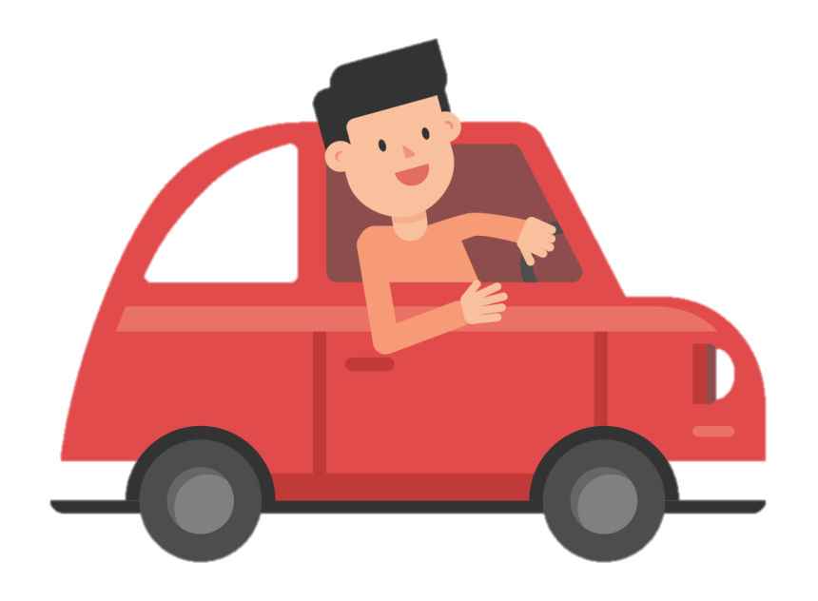
I have a car. It’s new and nice. I like to drive my car. Who am I?
I am a driver.

Slide 6
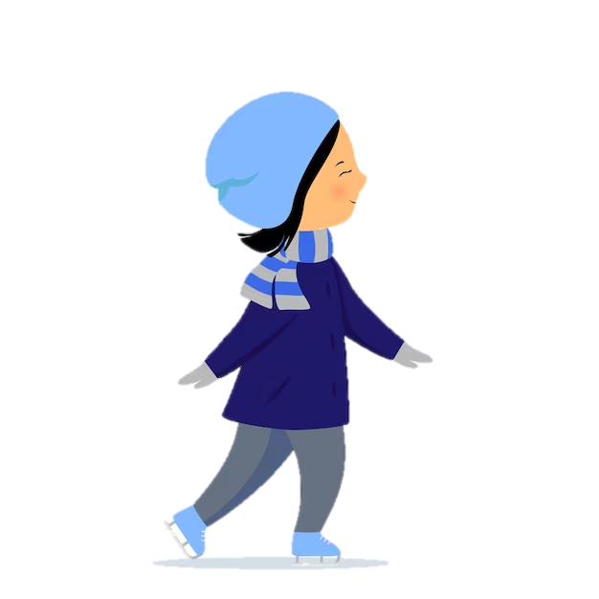
I go to the skating rink in the morning. I like to skate. I can skate very well. Who am I?
I am a skater.

Slide 7
Тема: Jobs
Цель: повторить названия профессий и деятельности, а также то, как строятся общие вопросы.
Задачи:
1) повторить названия профессий;
2) повторить, когда мы используем Do/ Does;
3)повторить, как строятся вопросы в английском языке и как на них отвечать.

Slide 8
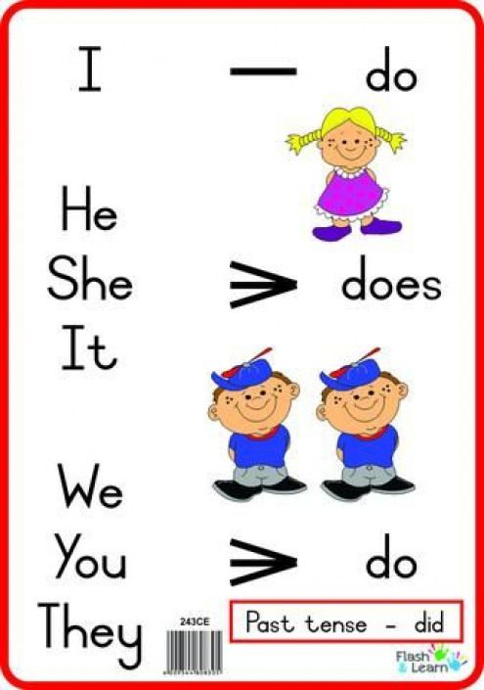

Slide 9
https://wordwall.net/resource/35652972

Slide 10
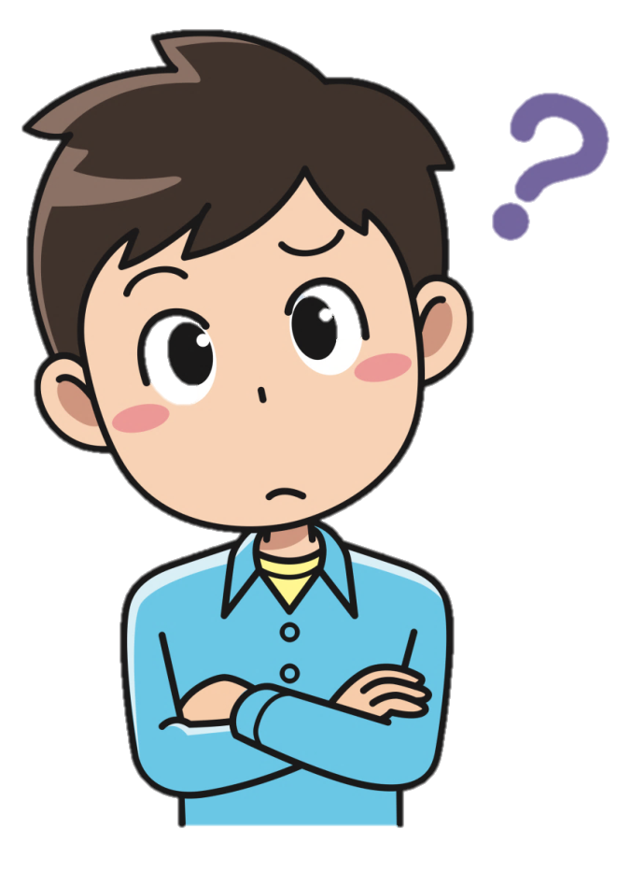
Are you a doctor?
No, I’m not.

Slide 11
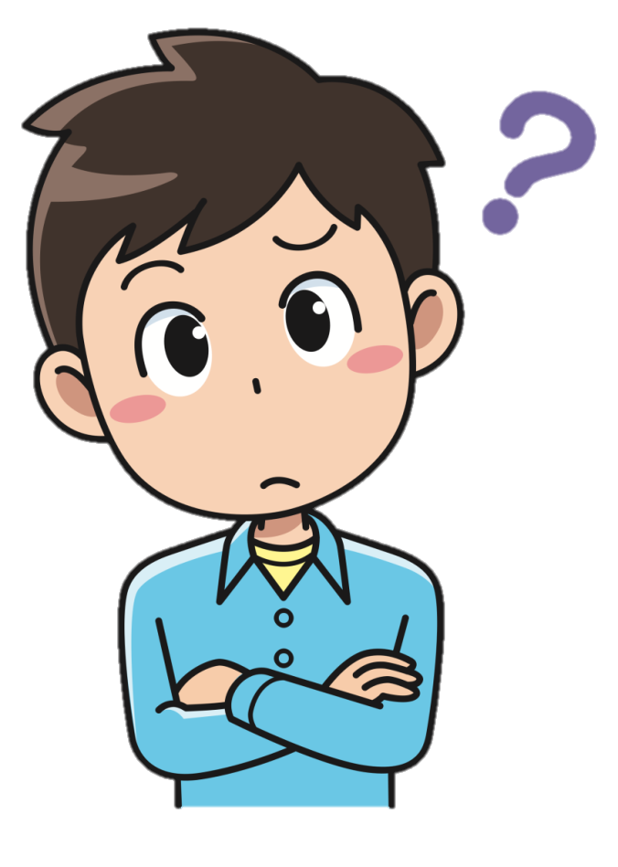
Is she a teacher?
Yes, she is.

Slide 12
Can your father drive a car?
Yes, he can.

Slide 13
Does she swim?
No, she doesn’t.

Slide 14
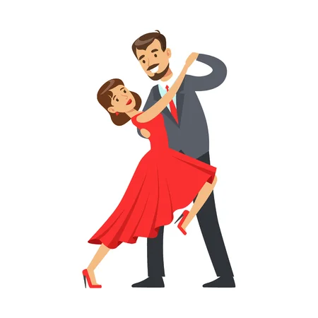
Do they dance?
Yes, they do.

Slide 15
Is Mary sick?
Yes, she is.

Slide 16
Do we have two pets?
Yes, we do.

Slide 17
Does he like to cook?
No, he doesn’t.

Slide 18
Can they speak English?
Yes, they can.

Slide 19
Are your friends sad?
No, they aren’t.

Slide 20
Does he read?
Yes, he does.

Slide 21
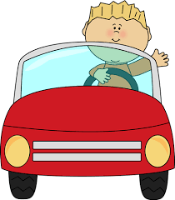
Can he drive well?
Yes, he can.

Slide 22
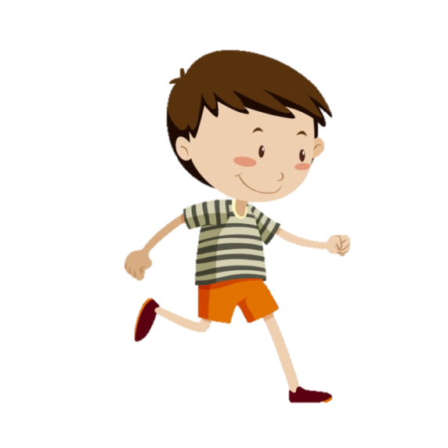
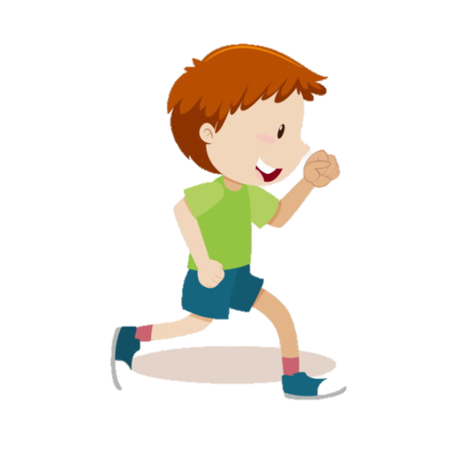
Are they runners?
Yes, they are.

Slide 23
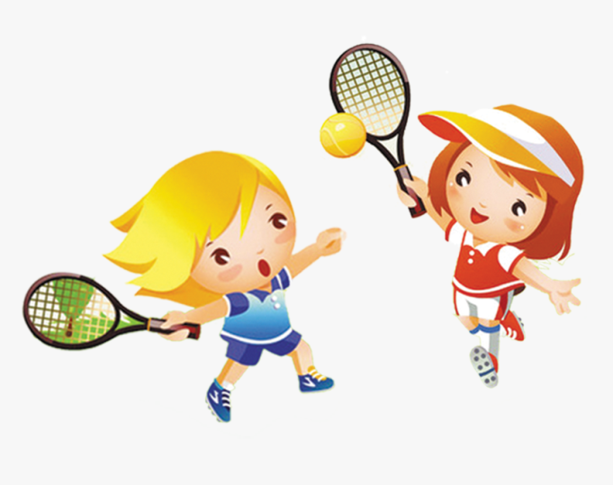
Do they play tennis?
Yes, they do.

Slide 24
Сделай эти предложения вопросительными и напиши их.
General Green has a phone.
Gwen is in the gym.
The boys can ride horses.
The dancers are on the stage.
You like to play ping-pong.

Slide 25
Homework
Написать о деятельности или профессиях членов семьи, что они умеют делать хорошо, а что не очень хорошо (8 предложений), и нарисовать рисунок к своему сочинению.
Например: My mother is a driver. She can drive very well. She likes to cook. She can cook but not very well.

