Slide 1
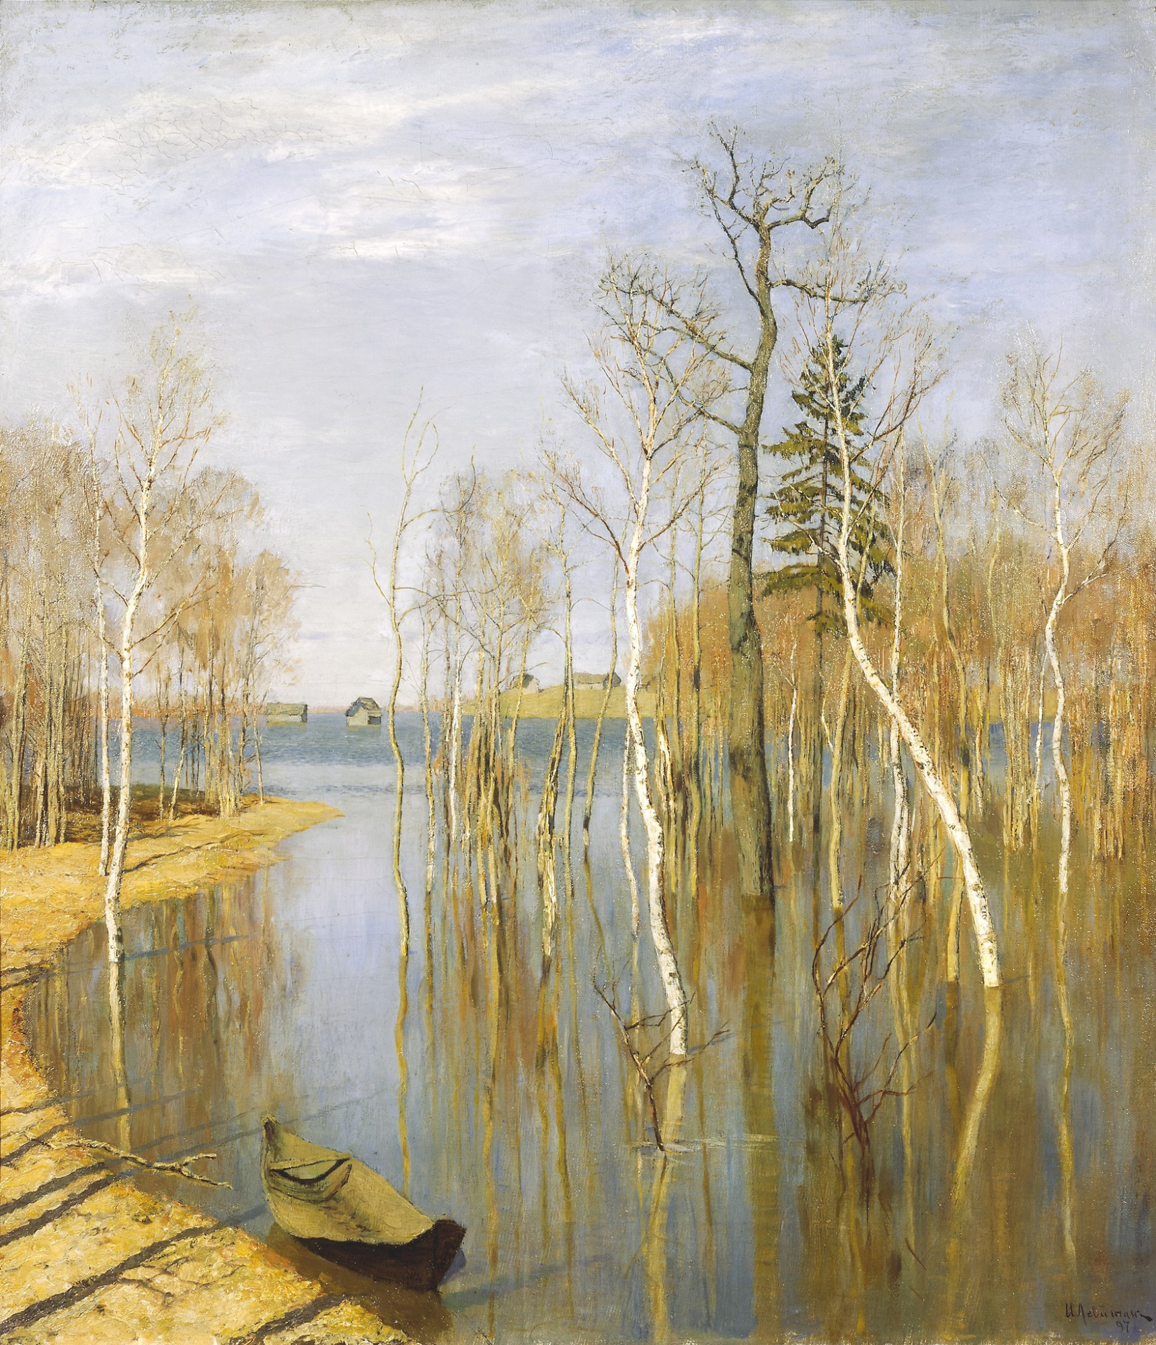
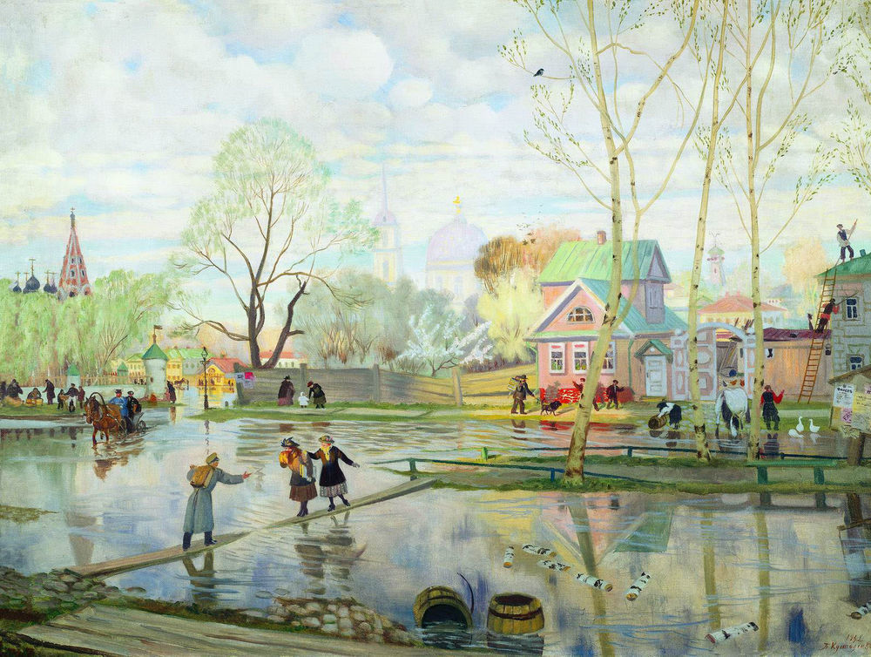
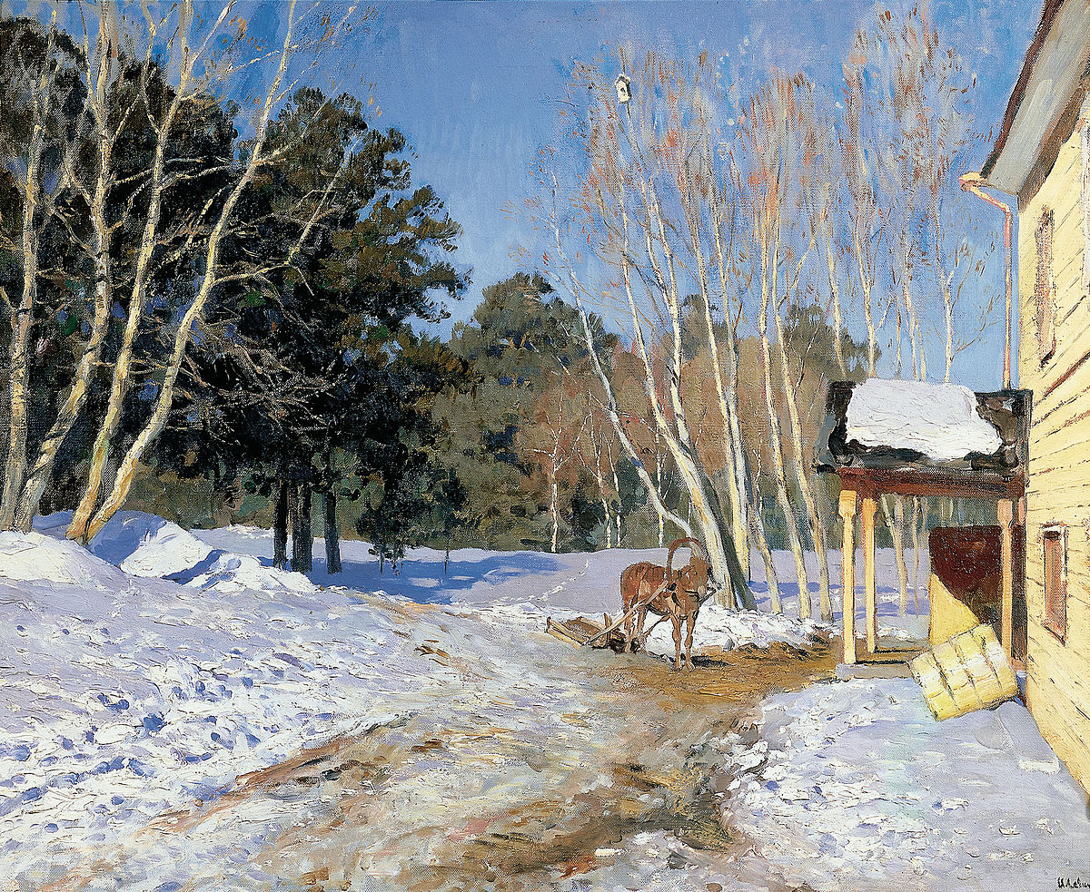
In the art gallery
What season do the pictures show and why?

Slide 2
Spring. B. Kustodiev

Slide 3
Spring. Big water. I. Levitan

Slide 4
March. I. Levitan

Slide 5
Antonio Vivaldi, the greatest Italian composer

Slide 6
Let’s make spring painting

