Slide 1
“THE STAR HOUR”

Slide 2
“What we know
about English speaking countries”.

Slide 3
THE I ROUND

Slide 4
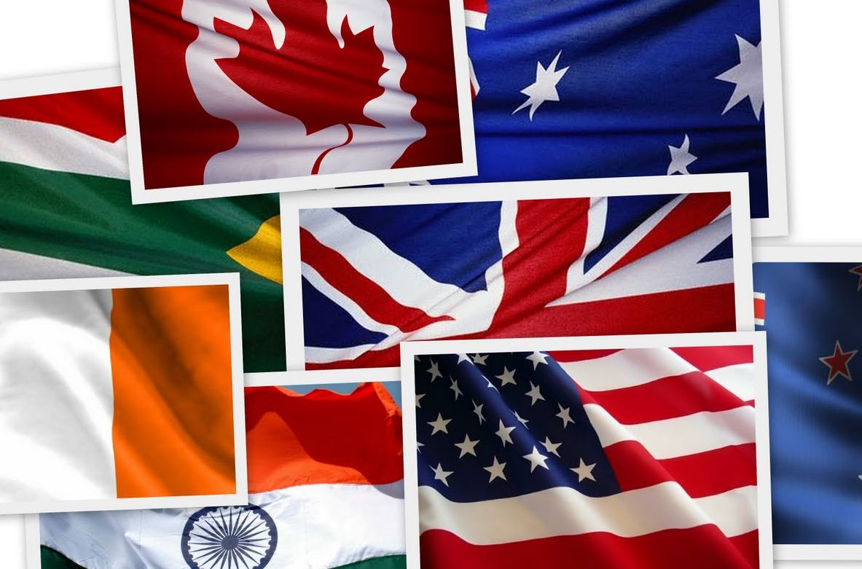
“From London to NY

Slide 5
“FLAGS”
1
4
2
5
6
3

Slide 6
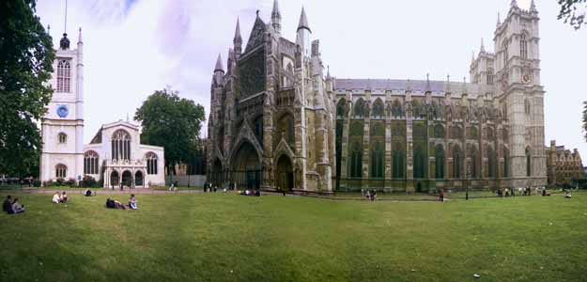
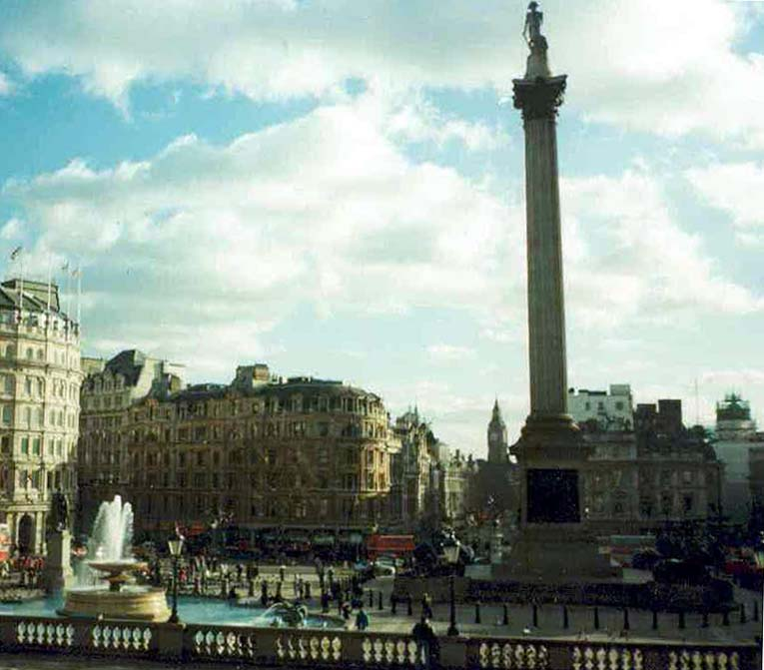
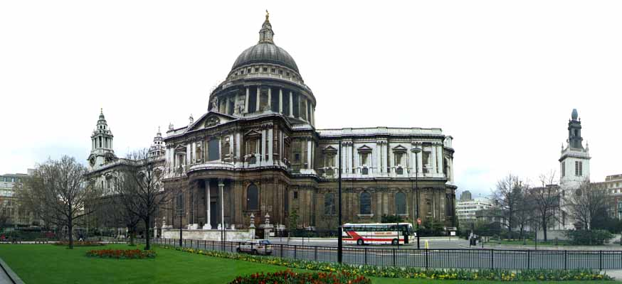
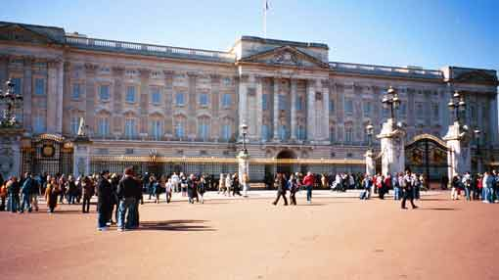
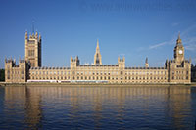
“LONDON SIGHTS”
4
1
Westminster Abbey
Trafalgar square
5
2
St. Paul’s Cathedral
Buckingham Palace
6
3
Tower of London
The Houses of Parliament

Slide 7
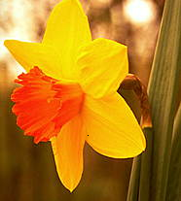
“SYMBOLS”
1
4
3
rose
daffodil
thistle
2
5
shamrock
The bald eagle

Slide 8
“HOLIDAYS”
1. CHRISTMAS
2. ST. VALENTINE’S DAY
3.EASTER
4.MOTHER’S DAY
5. HALLOWEN
6. FATHER’S DAY

Slide 9
THE II ROUND

Slide 10
“KEY DATES AND EVENTS”
1. 1800
2. 1605
3. 1840
4.1666
5.1603
6. 1066

Slide 11
“FAMOUS PEOPLE”
1. NILL ARMSTRONG
2. ISAAC NEWTON
3. ALEXANDER BELL
4. ARTHUR CONAN DOYLE
5. AGATHA CHRISTIE
6. WILLIAM SHAKESPEARE

Slide 12
THE III ROUND

Slide 13
1. shall/will + V 2. V1-Vs 3. Am, is, are + Ving 4.Ved /V2

Slide 14
THE IV ROUND

Slide 15
“ROOMS”
1. DINING ROOM
2.LIVING ROOM
3. BEDROOM
4. KITCHEN
5. BATHROOM
6. STUDY

Slide 16
“HOME LIBRARY WRITERS”
1. ARTHUR CONAN DOYLE
2. LEWIS CARROL
3. TRAVELS
4. ALAN MILNE
5. DANIEL DEFOE

Slide 17
“HOME READING CHARACTERS”
1. ALICE
2. GULLIVER
3. PETER PAN
4. SHERLOCK HOLMES
5. DOCTOR DOOLITTLE
6. ROBINSON CRUSOE

Slide 18
FINAL SPORTSMEN

