Slide 1
Trough the Pages of British Literature

Slide 2
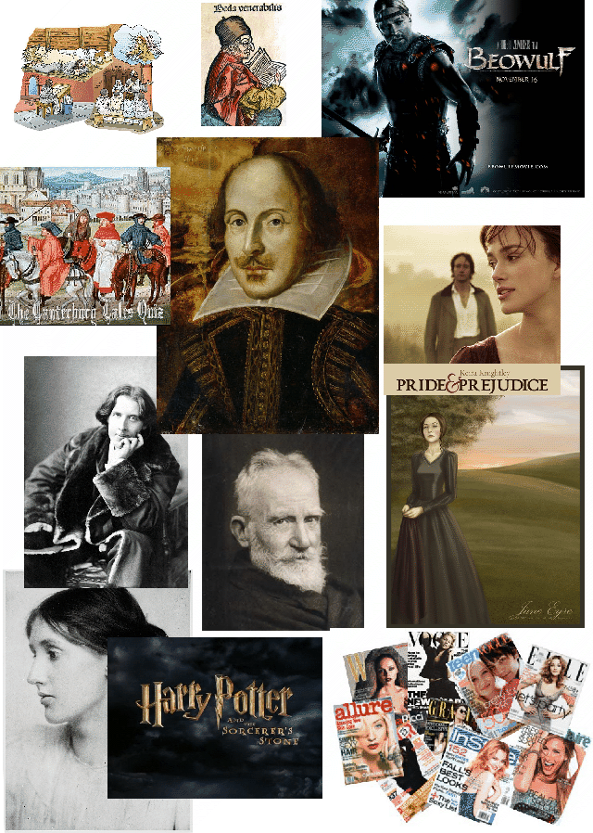

Slide 3
Listening

Slide 4
Famous Writers

Slide 5
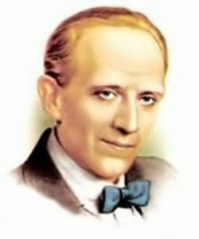
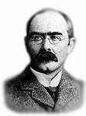
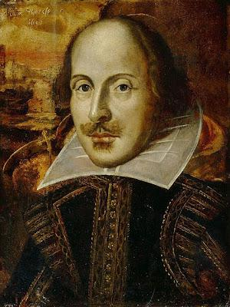
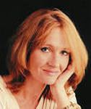
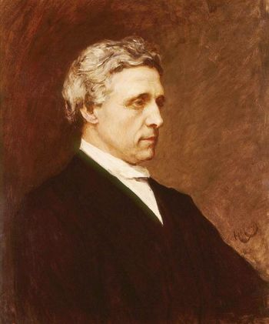
1
2
3
4
5
a. Joanne Rowling b. Alan Alexander Milne c. Lewis Carroll
d. William Shakespeare e. Rudyard Kipling

Slide 6
Alan Alexander Milne
Rudyard Kipling
William Shakespeare
Joanne Rowling
Lewis Carroll

Slide 7
Book Titles

Slide 8
Books and Authors

Slide 9
Do you know?

Slide 10
Facts

Slide 11
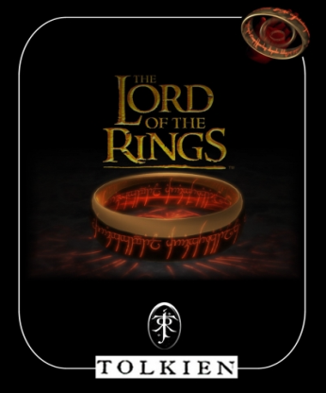
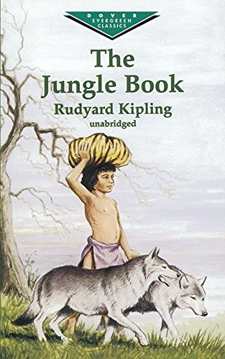
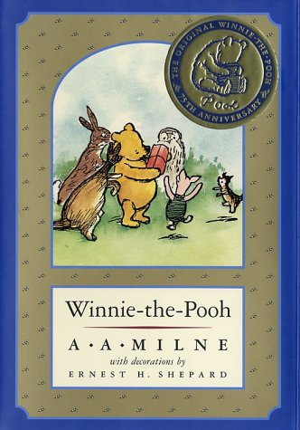
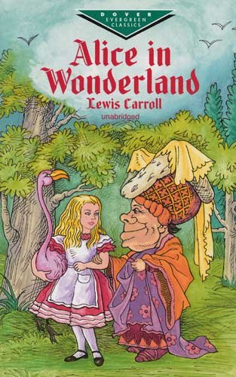
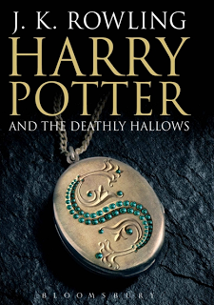
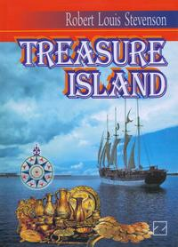

Slide 12
Reading a Story

Slide 13
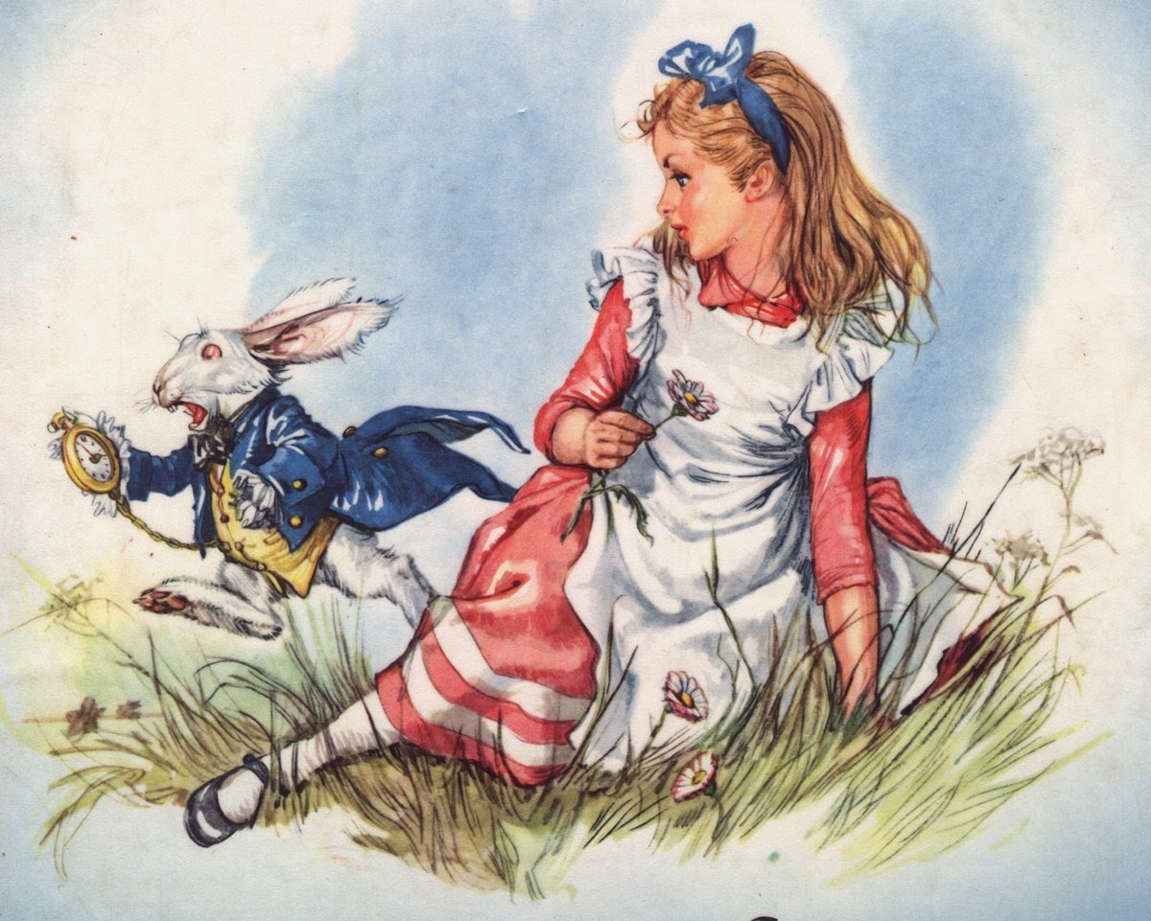

Slide 14
A good book is the best of friends, the same today and forever. ... Martin Tupper
A house without books is like a room
without windows.
Horace Mann

