Slide 1
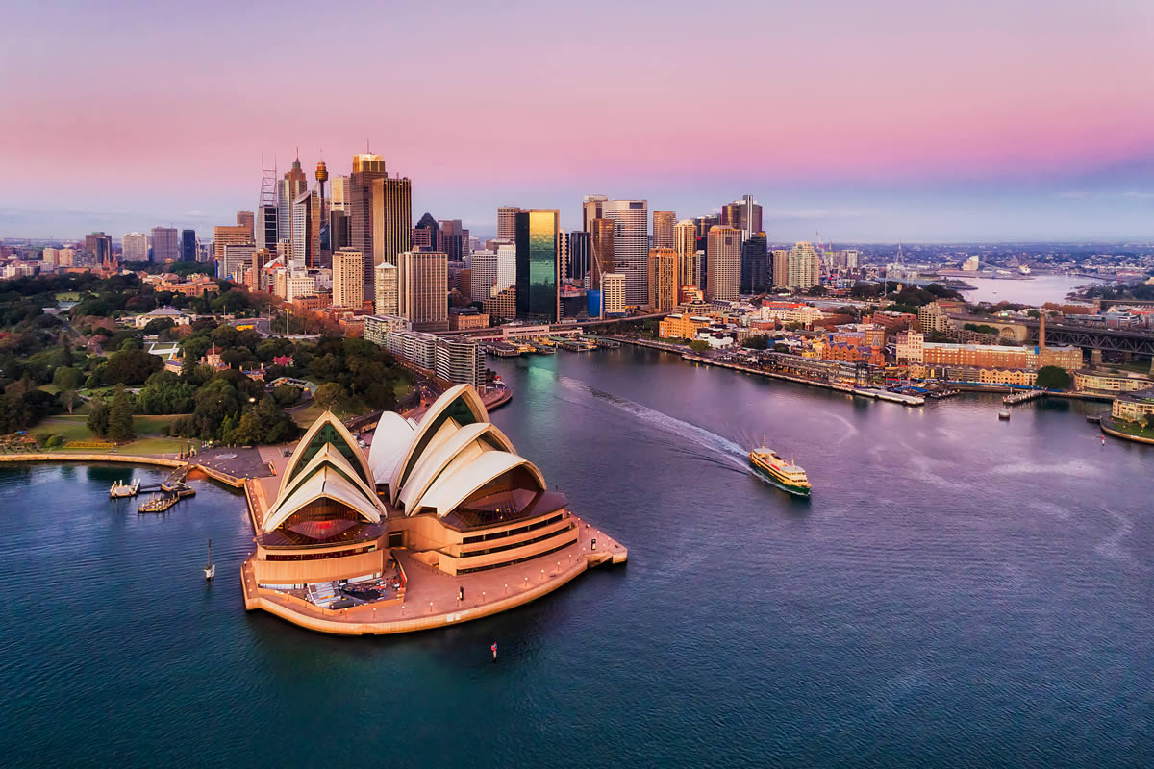
Australia
Jeopardy

Slide 2
History | 20 | 30 | 40 | 50
Geography | 20 | 30 | 40 | 50
Landmarks | 20 | 30 | 40 | 50
Animals | 20 | 30 | 40 | 50
Symbols | 20 | 30 | 40 | 50

Slide 3
Who discovered Australia?

Slide 4
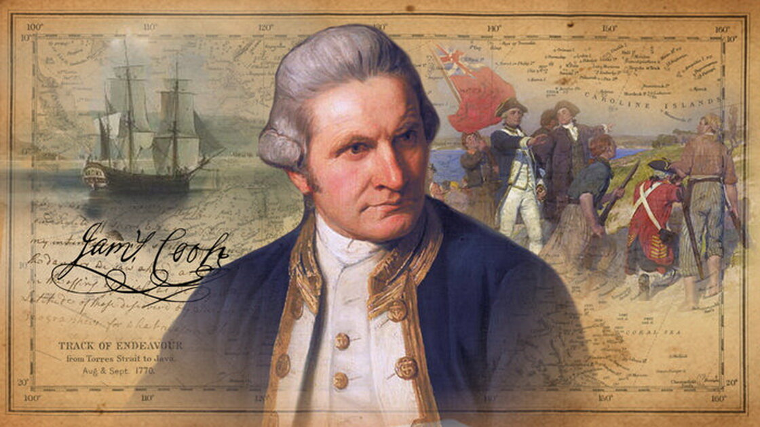
Captain Cook

Slide 5
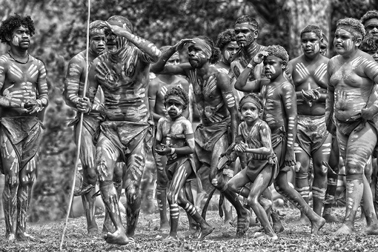
When did the Aborigines come to Australia?

Slide 6
About 50,000 years ago

Slide 7
When did Europeans settle in Australia?

Slide 8
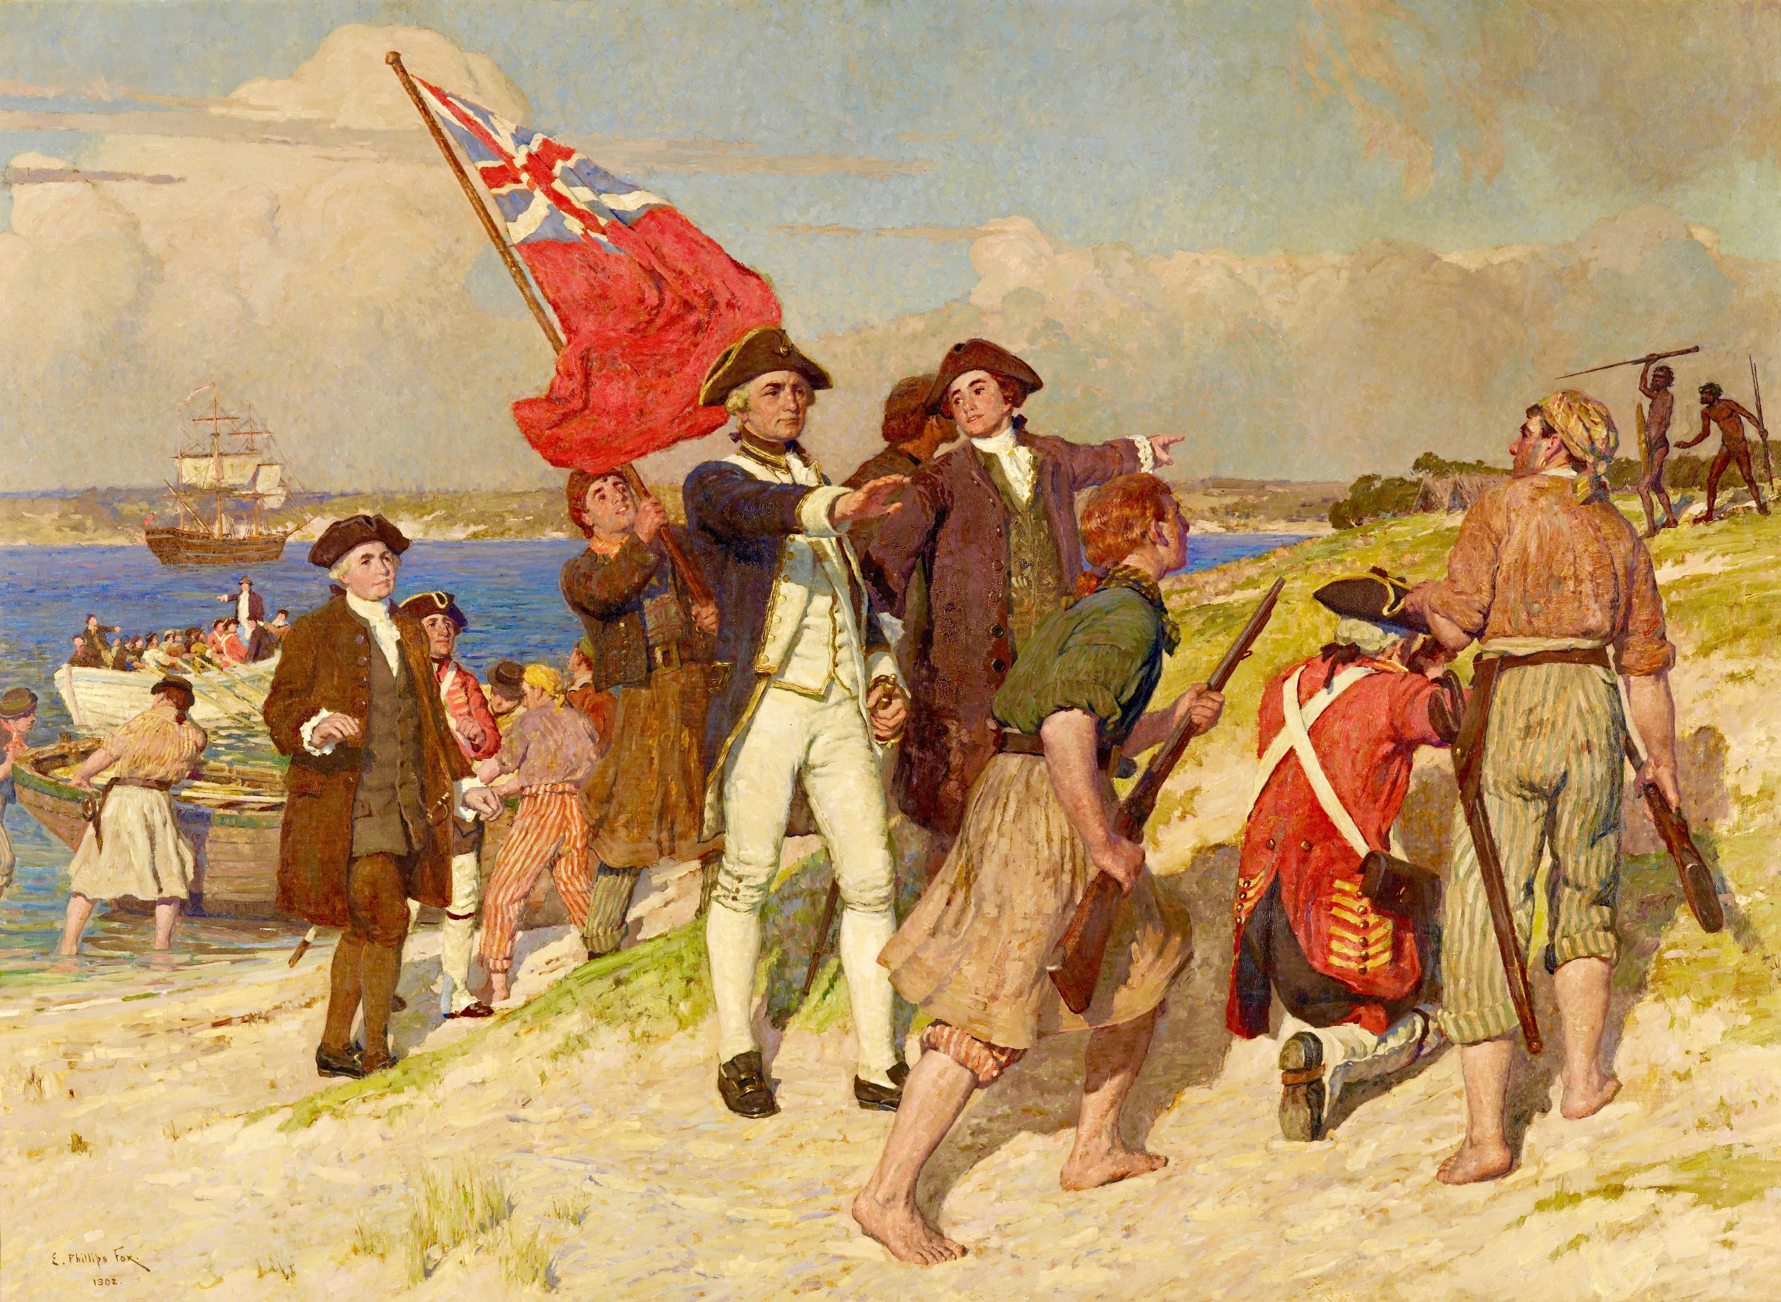
1788

Slide 9
When did the Gold Rush start in Australia?

Slide 10
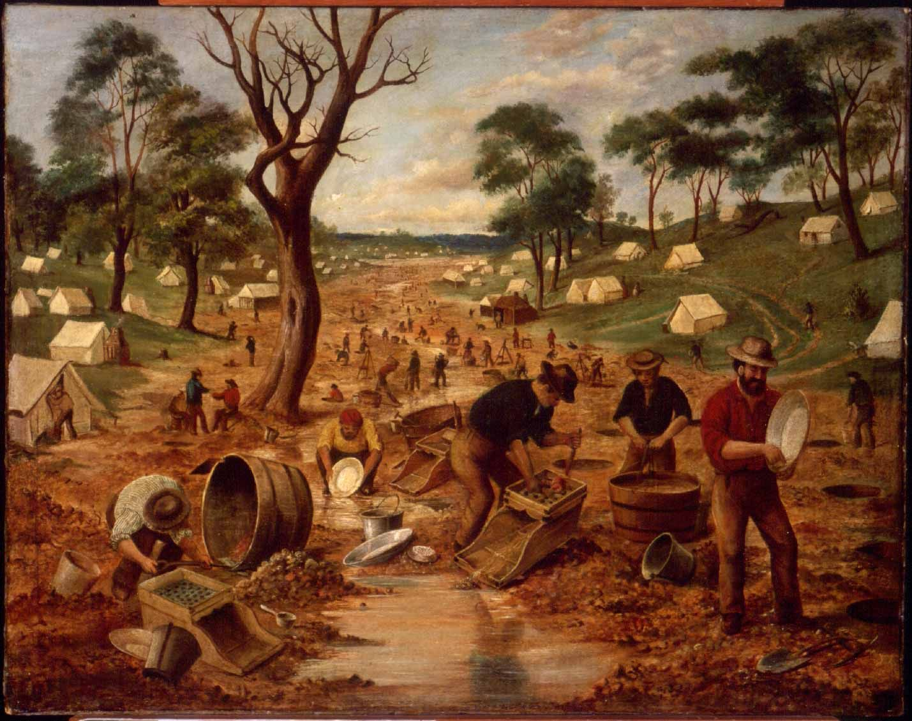
1851

Slide 11
What is the capital of Australia?

Slide 12
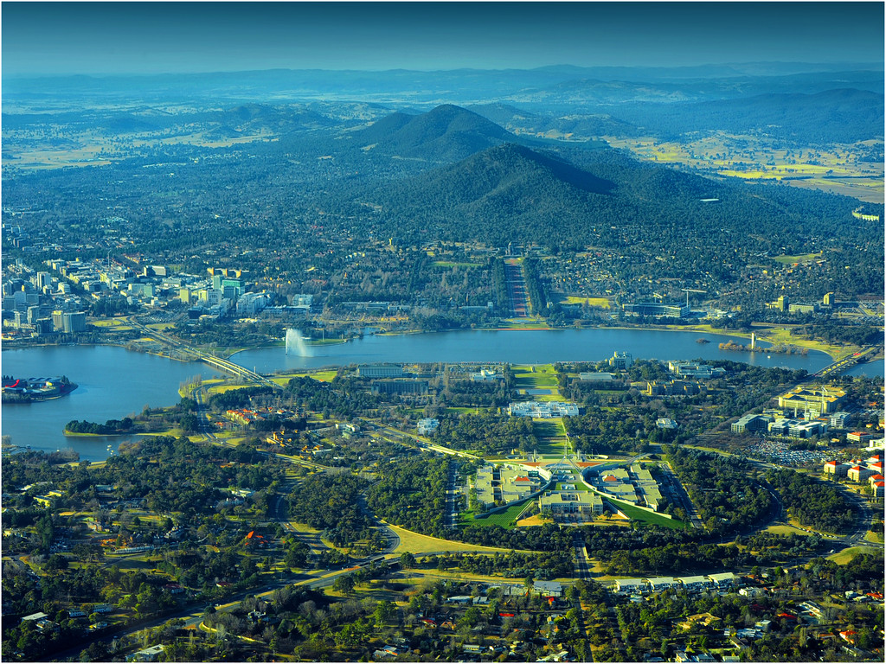
Canberra

Slide 13
How many states and territories is Australia divided into?

Slide 14
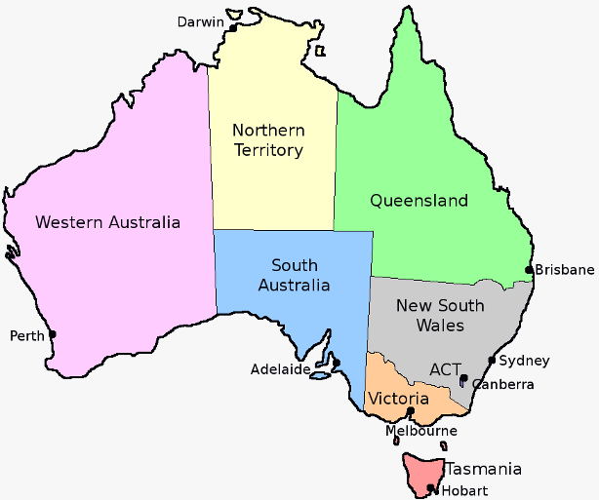
Six states and two territories

Slide 15
There are three deserts in Australia: the Great Sandy Desert, the Great Victoria Desert and …

Slide 16
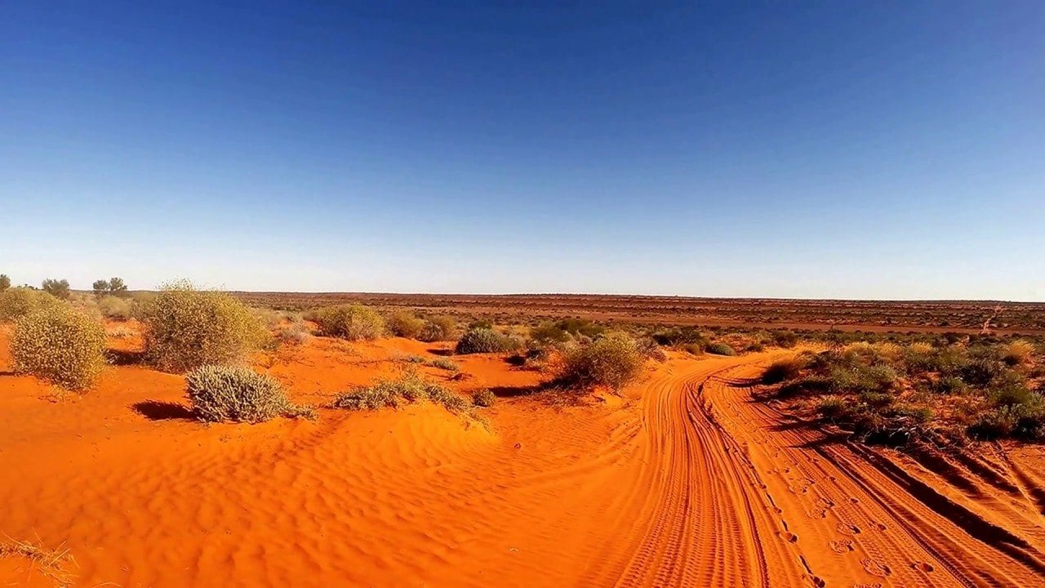
The Gibson Desert

Slide 17
What is the highest mountain in Australia?

Slide 18
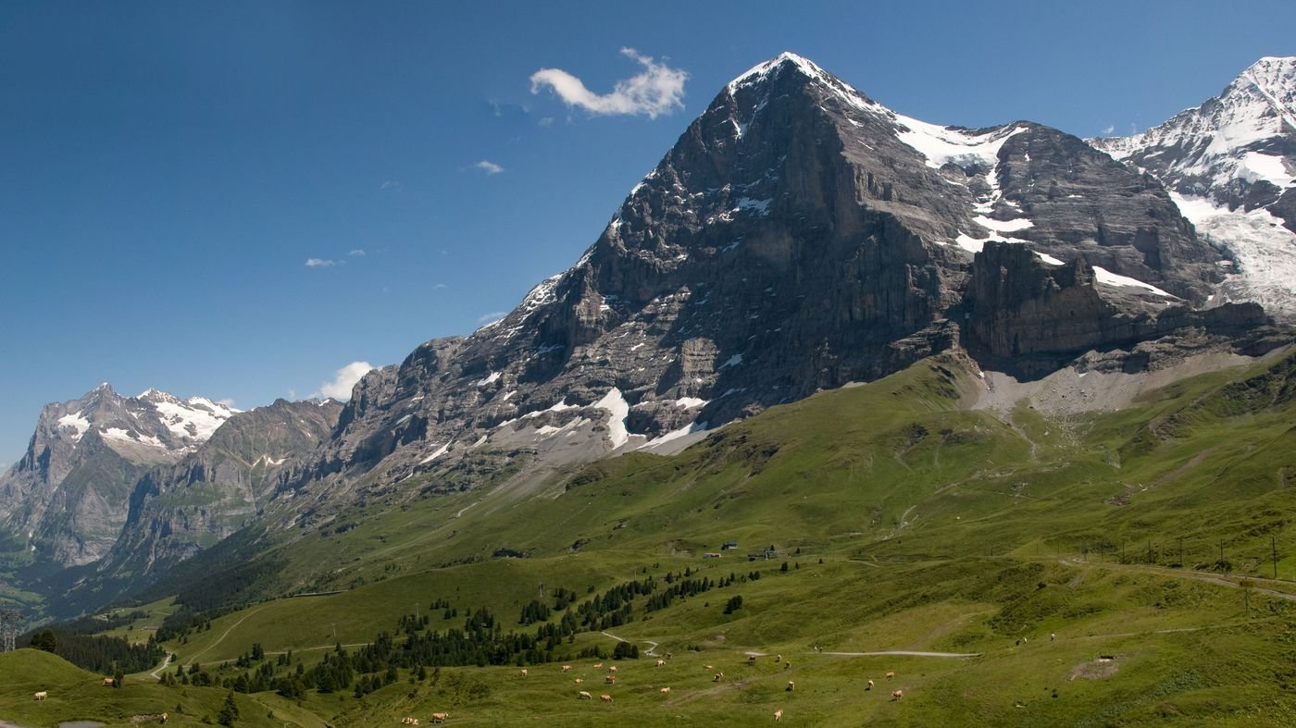
Kosciuszko

Slide 19
What is the name of the famous bridge in Sidney?

Slide 20
The Sydney Harbour Bridge

Slide 21
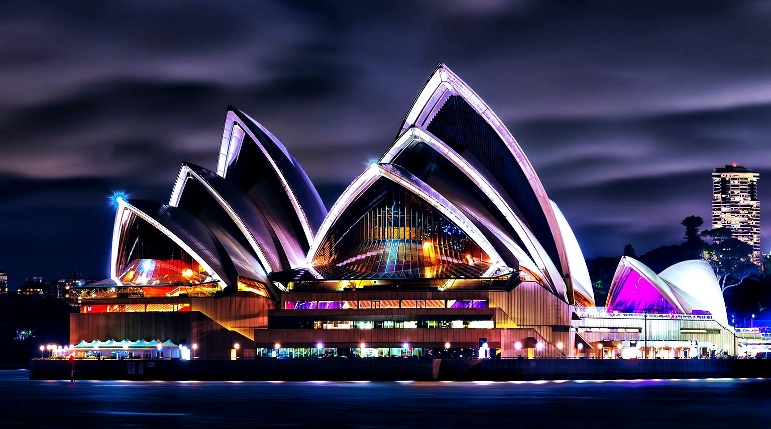
What is the most popular sight in Sydney?

Slide 22
The Opera House

Slide 23
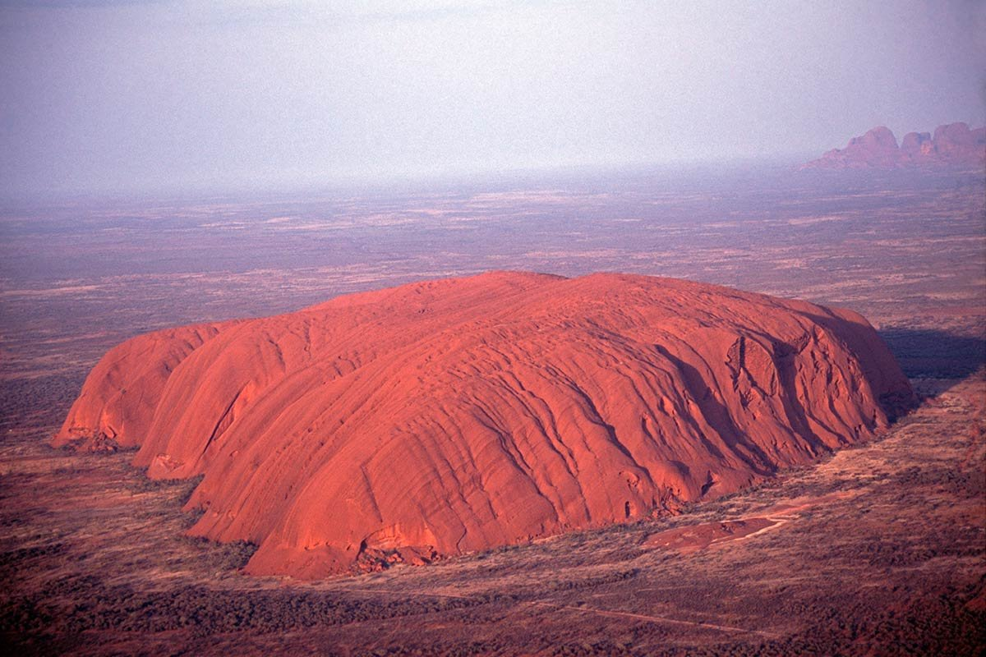
What is it?

Slide 24
Uluru (Ayers Rock)

Slide 25
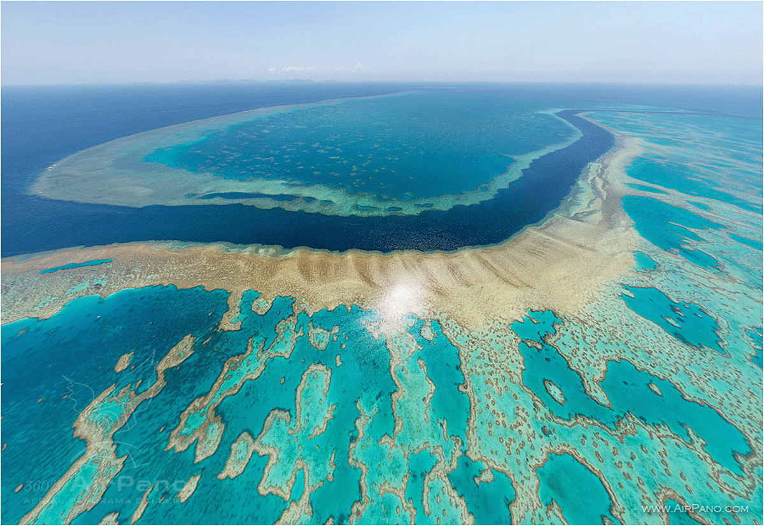
What is the world's biggest single structure made by living organisms?

Slide 26
The Great Barrier Reef

Slide 27
Which animals resemble teddy bears and eat eucalyptus leaves?

Slide 28
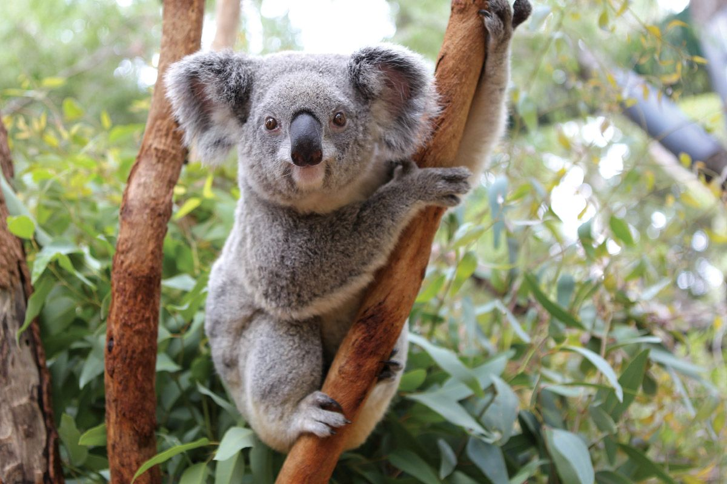
Koalas

Slide 29
What are two native-Australian mammals that lay eggs?

Slide 30
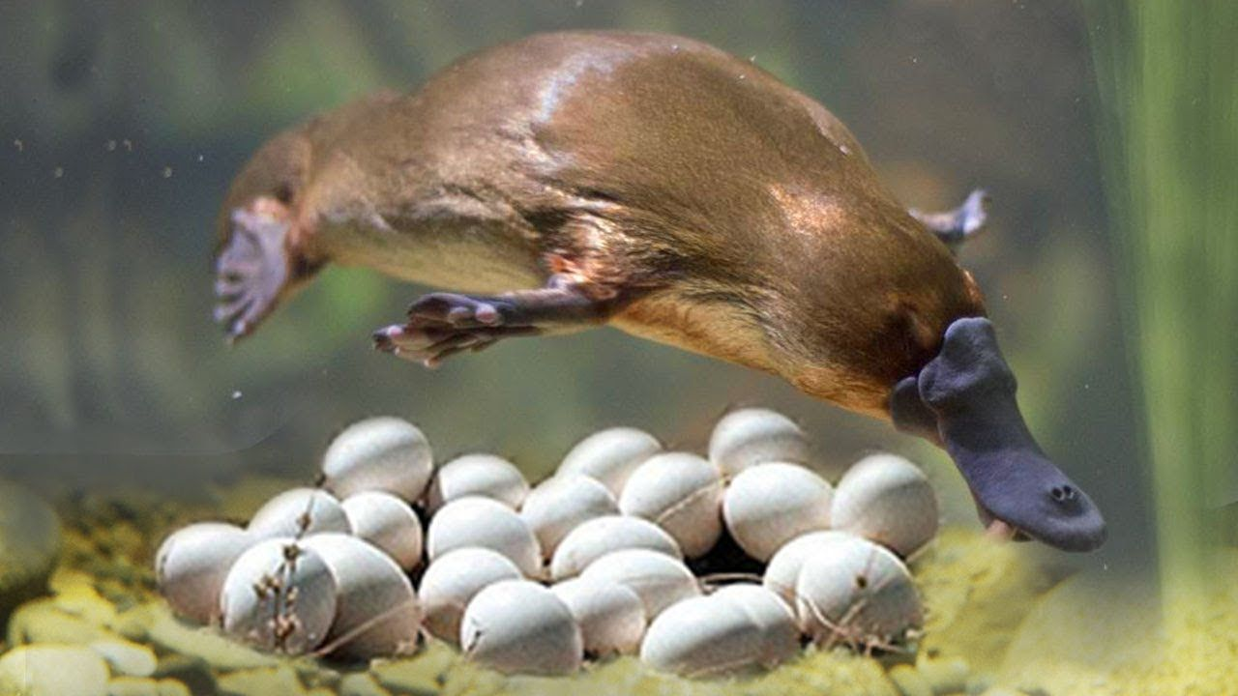
The platypus (duckbill) and the echidna (spiny anteater)

Slide 31
What Australian animals are born the size of a large bean and then grow taller than a man?

Slide 32
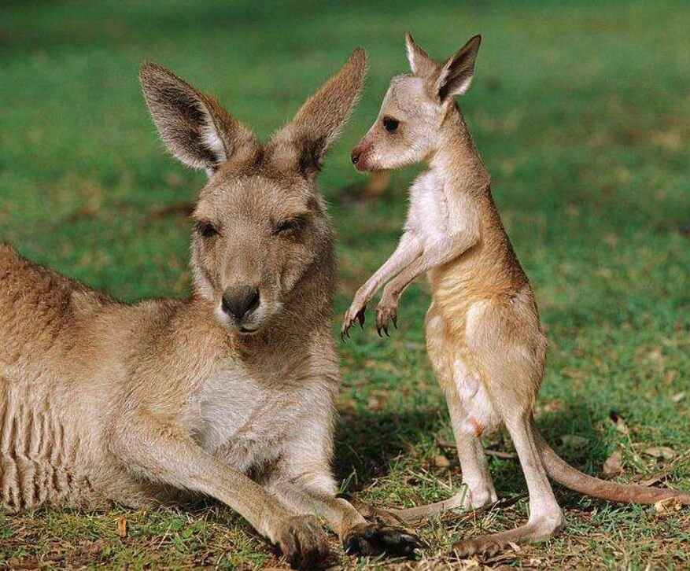
Kangaroos

Slide 33
What spider is considered the deadliest in Australia, and possibly the world?

Slide 34
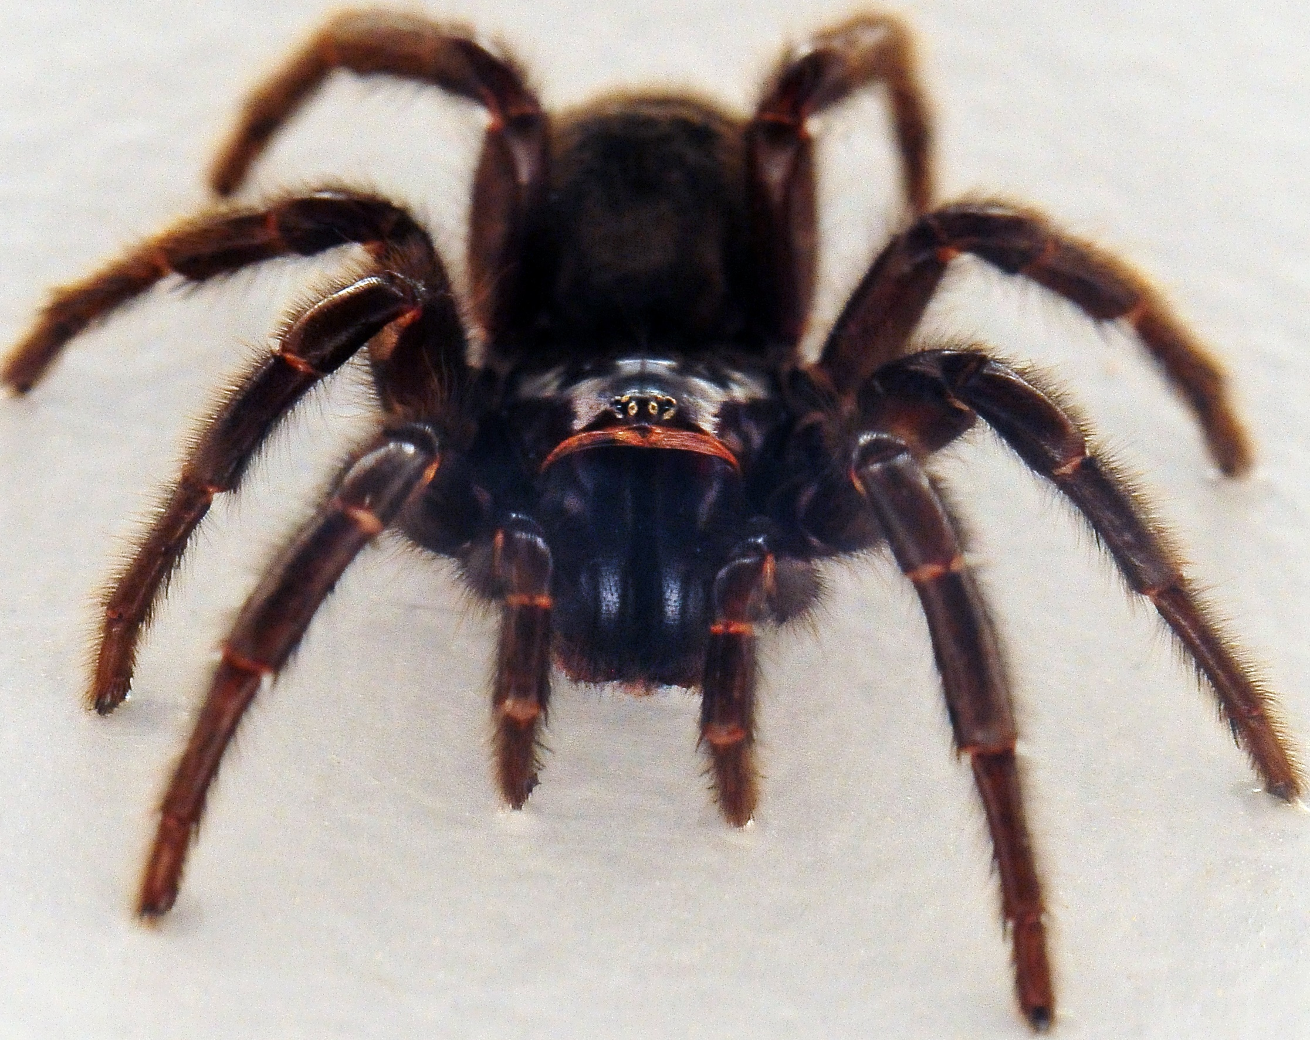
The Sydney Funnel-web Spider

Slide 35
What is Australian currency?

Slide 36
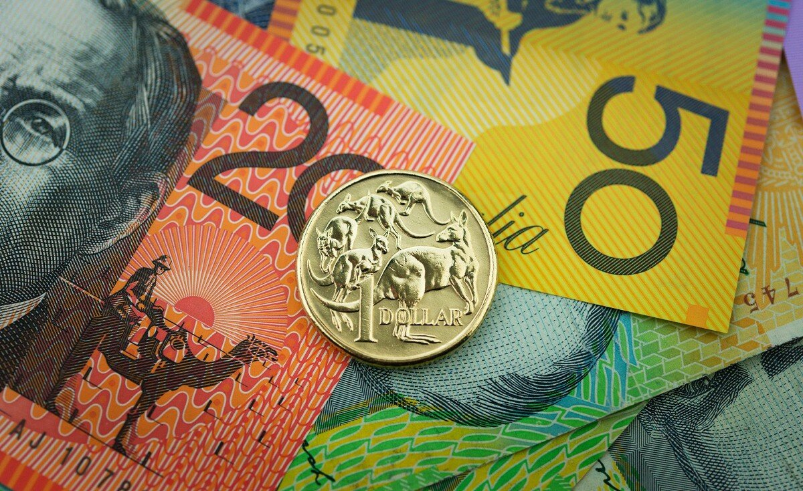
Australian dollar

Slide 37
What animals are on the coat-of-arms?

Slide 38
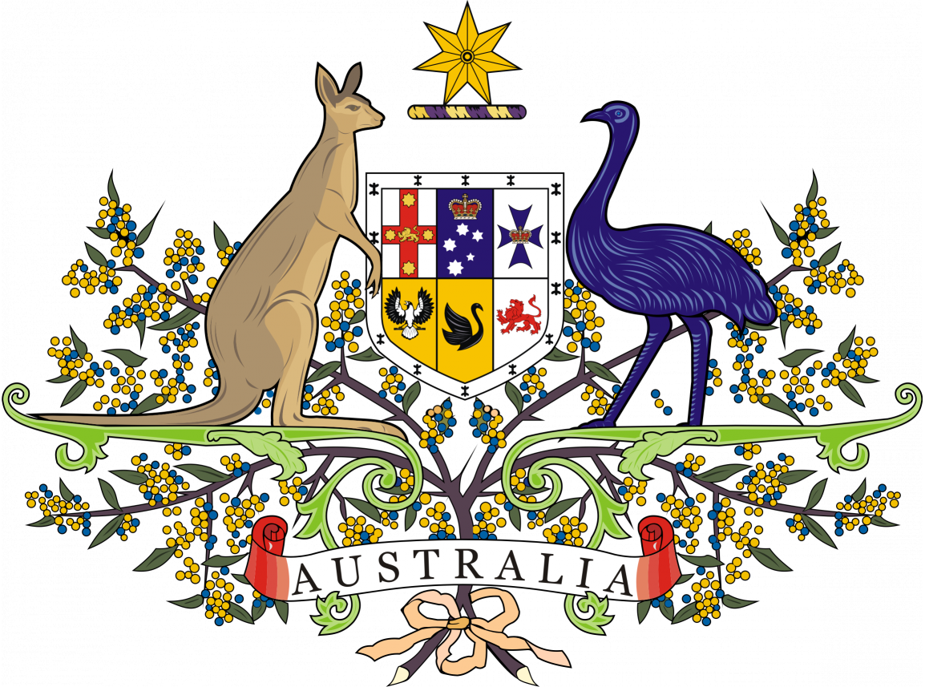
The kangaroo and the emu

Slide 39
What does the flag of Australia consist of?

Slide 40
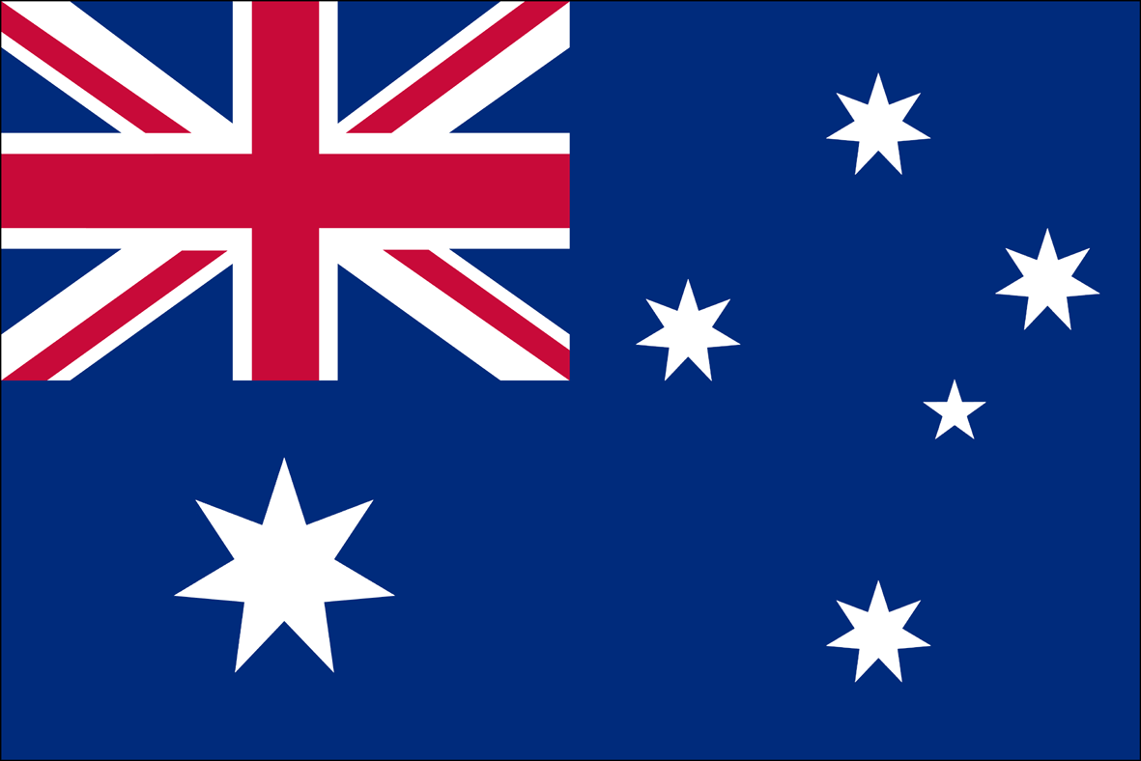
The British flag (the Union Jack) and six white stars

Slide 41
What is the name of the national anthem?

Slide 42
Advance Australia Fair

