Slide 1
Виды прямых вопросов
(Direct Questions)

Slide 2
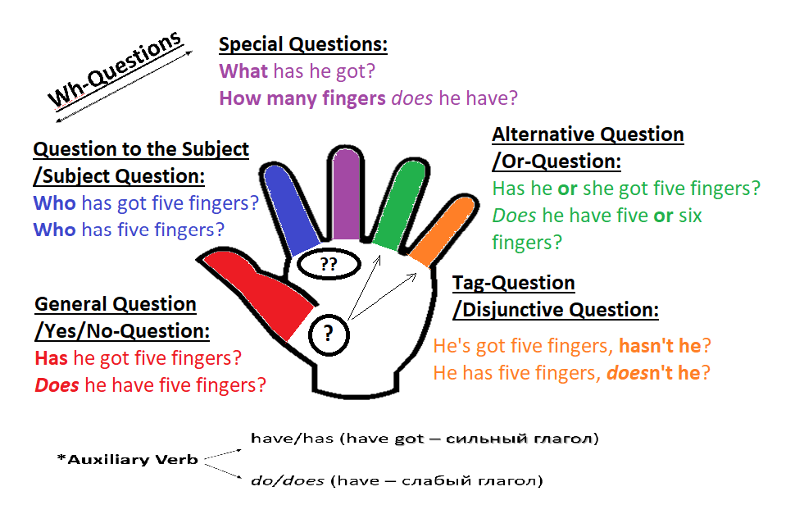
Идея “Question Palm” с сайта http://ucheba.relod.ru/

Slide 3
1. Общий вопрос (General Question)
- ответ: Да./Нет.
2. Альтернативный вопрос (Alternative Question)
- выбор через «или»
3, 4 – Специальные вопросы (WH-Questions)
- со слов «почемучек»
3. Вопрос к подлежащему (Question to the Subject)
4. Специальные вопросЫ (Special QuestionS)
5. Разделительный/Хвостатый вопрос
(Disjunctive Question / Tag-Question)
- с хвостиком «…, не так ли/не правда ли?»

Slide 4
1. Общий вопрос
(General Question)
начинается с глагола (Auxiliary Verb) –
вспомогательного или самостоятельного
Can you swim well? | Do you go to school?

Slide 5



Auxiliary Verbs
Cамостоятельные/
Сильные глаголы
Вспомогательные глаголы
←Present→
Simple
Do/Does (для he/she/it)
Past Future
Did Shall (для I/we)/Will (для всех)

Slide 6

« иметь в наличии»
have got

Slide 7


1 |  |  |  | 2 | 3 | 4
General Question ( Общий вопрос )
глагол … (Auxiliary Verb) |  |  |  | подле-жащее (исполни-тель действия) | …остальная часть сказуемого (V1 или другие части речи) | … ? (по смыслу без ответа на этот вопрос)
вспомогательный глагол (простые времена) | ИЛИ |  | самостоятельный глагол
Do/Does Did |  | Can Must May Am/Is/Are… Could Should Would Was/Were… Shall/Will 1ое слово составного глагольного сказуемого

Slide 8
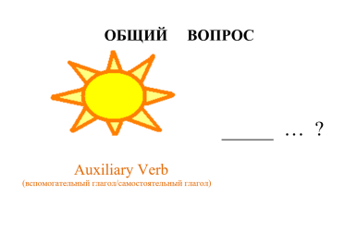
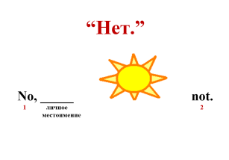
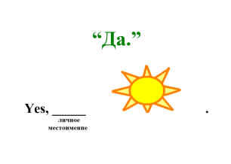
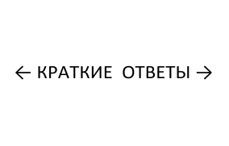
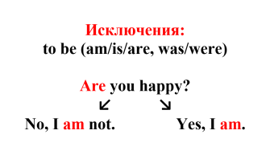

Slide 9
2. Альтернативный вопрос
(Alternative Question)
образуется от Общего вопроса,
но можно поставить выбор к любому члену предложения
Do you go to school or shopping ?
Can you swim or dance well ?

Slide 10
3, 4 – Специальные вопросы
(WH-Questions)

Slide 11
3. Вопрос к подлежащему
(Question to the Subject)
чаще всего начинается с Who (Кто?) /What ( Что? Кто по профессии?);
порядок слов как в повествовательном предложении;
Who/What аналогично местоимениям he/she/it;
вопрос, при котором подлежащее будет в ответе
Who goES to school ? Who can swim well?
What eats mice?
Which teacher gives you the most homework?
How many people live there?

Slide 12
4. Специальные вопросЫ
(Special QuestionS)
начинаются со специальных вопросительных слов + начало Общего вопроса
How can you swim? Where can you swim well? … | Where do you go to? Why do you go to school? …

Slide 13
1 | 2 |  |  |  | 3 | 4 | 5
 | General Question ( Общий вопрос )
Специальное вопросительное слово/-а | глагол … (Auxiliary Verb) |  |  |  | подле-жащее (исполни-тель действия) | …остальная часть сказуемого (V1 или другие части речи) | … ? (по смыслу без ответа на этот вопрос)
 | вспомогательный глагол (простые времена) | ИЛИ |  | самостоятельный глагол
Who ?/ Whom ? Whose + сущ.? What ? What + сущ.? What colour ? What kind of + сущ. ? What time? At what time? Which (of) + сущ. ? When ? Where ? Where … from ? Where … to ? Why ? How ? How + прил. ? How old ? How much ? How much + сущ. ? How many + сущ. ? | do/does did |  | can must may am/is/are… could should would was/were… shall/will 1ое слово составного Глагольного сказуемого

Slide 14
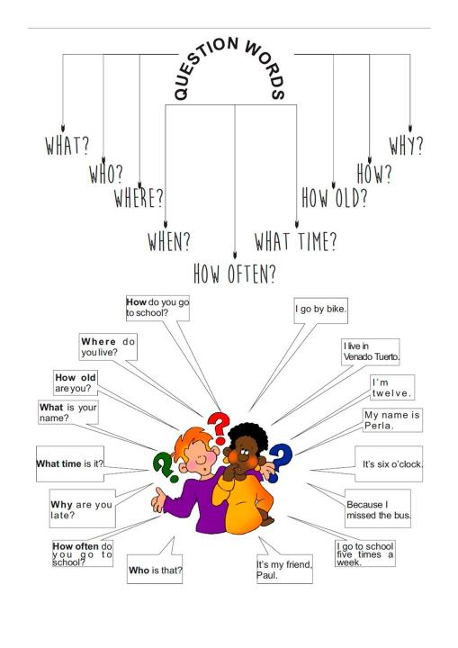

Slide 15


Read and translate the questions:
What do you like? – I like lollipops.
2) What is your father? – He is a lawyer.
3) What is the weather like? – It’s awful.

Slide 16
4 способа как спросить «Какой…?»
What + cущ-ое …?
What + форма to be + ___________ + like ?
What kind of + сущ-ое … ?
Какого рода/свойства?
4. Which + сущ-ое … ?
Который (из нескольких) ?

Slide 17
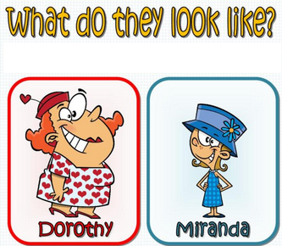
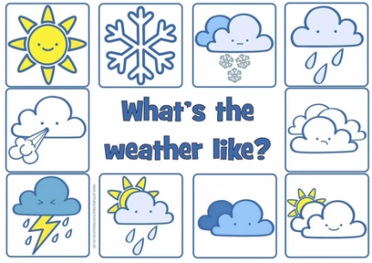
Personality

Slide 18
Personality
Appearance
to look like – быть каким-то внешне
Character
to be like – быть каким-то по характеру

Slide 19
Let’s train!
Translate and answer the questions:
What food do you like?
What animals don’t you like?
What are your parents?
What is your sister/brother?
What are you like?
What does your friend look like?
What is your friend like?
Which subject is your favourite?
What kind of games do you like?

Slide 20
5. Разделительный/Хвостатый вопрос
(Disjunctive Question / Tag-Question)
Повествовательное предложение, не так ли/не правда ли?»
You go to school, don’t you?
Mary can’t swim, can she?
…, Auxiliary Verb ± not + личное местоимение ?

Slide 21

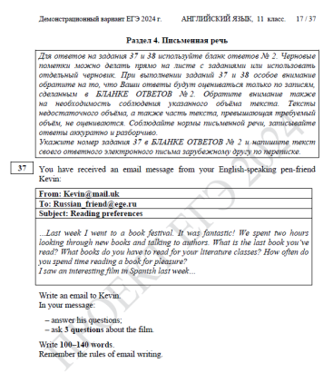
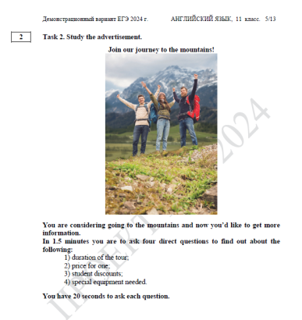

Slide 22
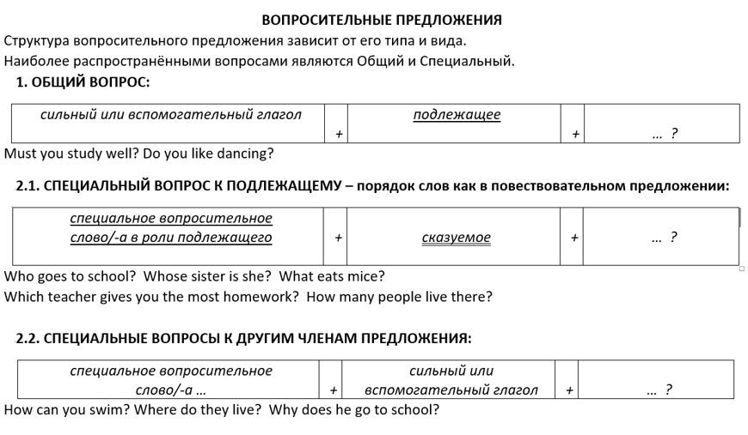

Slide 23
Exercises
Classwork

Slide 24
Direct Questions (5) of Simple/Indefinite Tenses

Slide 25
① Определите вид вопроса и объясните почему:
1. The boys could have a party on Sunday, couldn’t they?
2. How much is your beautiful dress?
3. Who wears a uniform?
4. Will you get “A” or “B” this school term?
5. Have you got many relatives?

Slide 26
② Найдите сказуемое и подберите к нему
Auxiliary Verb , то есть самостоятельный
ИЛИ вспомогательный глагол:
1. It sleeps under the bed.
2. My English-pen friend visited Westminster Abbey last year.
3. I would like to be a vet in the future.
4. There was no hot water there.
5. We shall meet them later.

Slide 27
③ Составьте общий или разделительный вопрос к данному краткому ответу:
1. Yes, he does.
2. No, we didn't.
3. Yes, she will.
4. No, they can’t.
5. Yes, I was.

Slide 28
④ Подберите специальное вопросительное слово из рамочки к выделенным словам в предложении:
Who ?
Whom ?
Whose ?
What (…)?
What colour ?
What kind of … ?
What time?
At what time?
Which (of) … ?
When ?
Where ?
Where … from ?
Where … to ?
Why ?
How ?
How long/… ?
How old ?
How much (…) ?
How many … ?
1. I like the second book most of all.
2. The party lasted three hours.
3. Your grandparents have got a nice garden.
4. My parents usually come home from work at six p.m.
5. Her hamster was so nice and little that we wanted to have a pet too.

Slide 29
⑤ Задайте специальный вопрос к выделенному слову (к подлежащему или к другим членам предложения):
ОБЩАЯ СХЕМА специальнЫХ вопросОВ:
специальное вопросительное слово/-а … | + | глагол | + | … ?
1. She has got a new toy. ← … ?
2. He went to Scotland. ← … ?
3. Our family wants porridge with bananas for breakfast. ← … ?
4. We learnt English because we like to travel around the world. ← … ?
5. The weather will be fine tomorrow. ← … ?

Slide 30
Exercises
Homework task – version I

Slide 31
① Определите вид вопроса:
1. Where would you like to live in?
2. He wasn’t at school, was he?
3. Is the ball under the table?
4. Which film did you like then?
5. Are you hardworking or lazy?

Slide 32
② Найдите сказуемое и подберите к нему
Auxiliary Verb , то есть самостоятельный
ИЛИ вспомогательный глагол:
1. The children couldn’t write last year.
2. He often speaks with his friends during the lesson.
3. There are many shops in the streets.
4. We wouldn’t like to go to the dentist.
5. My mum ate a lot of fruits that summer.

Slide 33
③ Подберите специальное вопросительное слово /слова к выделенным словам в предложении:
1. Mrs Smith always pays by credit card.
2. The lesson starts at 8 o’clock.
3. He spends his days off in the country.
4. They could dance well.
5. Kate is the cleverest pupil because she always does her homework.

Slide 34
Exercises
Homework task

Slide 35

Date: …
Grammar: Direct Questions (5) of Simple/Indefinite Tenses
I v. /II v.
①
1.
2.
3. ВИД ВОПРОСА на РЯ!
4.
5.
②
1.
2.
3. выписать сказуемое → 1ое слово: сильный гл. / нужна помощь →
4.
5.
③
1.
2.
3. написать только вопросительное слово
4.
5.

Slide 36
Exercises
Homework task – version II

Slide 37
① Определите вид вопроса:
1. Should she stay home or go to school?
2. Can the boys speak English well?
3. There are four chairs in the kitchen, aren’t there?
4. When were you born?
5. What kind of music is your favourite?

Slide 38
② Найдите сказуемое и подберите к нему
Auxiliary Verb , то есть самостоятельный
ИЛИ вспомогательный глагол:
1. The Smiths have a new house.
2. She doesn’t like playing football.
3. I was there last week.
4. We could understand everything then.
5. I’ll meet her tomorrow.

Slide 39
③ Подберите специальное вопросительное слово /слова к выделенным словам в предложении:
1. We study English Grammar.
2. She puts on her red coat.
3. Jane makes coffee every morning.
4. They will buy a lot of dictionaries because they learn three foreign languages.
5. The Ivanovs’ cat is so funny!

Slide 40
Exercises
Project “Question Palm”
- an individual work with a narrative sentence

Slide 41


Slide 43
General Q.
Alternative Q.
Q. to the Subject
Special Q -s
5. Tag – Q./Disjunctive Q.
WH-Questions

Slide 44
Алгоритм (порядок действий):
Найти грам. основу (подлежащее, сказуемое)
Время глагола → первый глагол в сказуемом: сильный или требует помощи?
Вид вопроса → построение согласно правильному порядку слов

Slide 45
1. Sorry, I haven’t written you for so long!

Slide 46
2. I came to this school three years ago.

Slide 47
3. We’ll go to the river to
swim and fish every day.

Slide 48
4. You can keep hand luggage with you.

Slide 49
5. You have to look at the screen
when driving.

Slide 50
have to/has to/had to → do/does/did
5. You have to look at the screen
when driving.

Slide 51
6. I’d rather go to the cinema
than to the theatre.

Slide 52
…’d … → had + V3 / would + V1
6. I’d rather go to the cinema
than to the theatre.

Slide 53
7. She has got so little money with her
that she couldn’t afford any breakfast.

Slide 54
have got → сильный глагол have → слабый глагол
7. She has got so little money with her
that she couldn’t afford any breakfast.

Slide 55
8. He’s got many photos taken
under the water.

Slide 56
…’s … → has / is
8. He’s got many photos taken
under the water.

Slide 57
9. There were two reasons
for the leaning tower.

Slide 58
There → no Subject Question
9. There were two reasons
for the leaning tower.

Slide 59
10. It is going to be rainy
because there are so many
quick dark clouds in the sky.

Slide 60
It / There → no Subject Question
10. It is going to be rainy
because there are so many
quick dark clouds in the sky.

Slide 61
11. The fire was caused
by closing (замыкание контакта)
in a plug box (розетка).

Slide 62
… by?
11. The fire was caused
by closing (замыкание контакта)
in a plug box (розетка).

Slide 63
12. Clear windows have been used since the invention of glass to cover small openings in a building.

Slide 64
… for?
12. Clear windows have been used since the invention of glass to cover small openings in a building.

Slide 65
13. I feel upset because
they couldn’t invite us for the party.

Slide 66
14. The teacher was reading
a story to the class.

Slide 67
15. They have already finished writing the article speaking of that strike.

