Slide 1
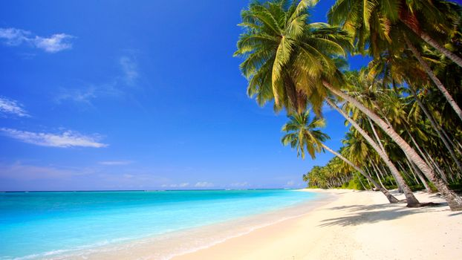
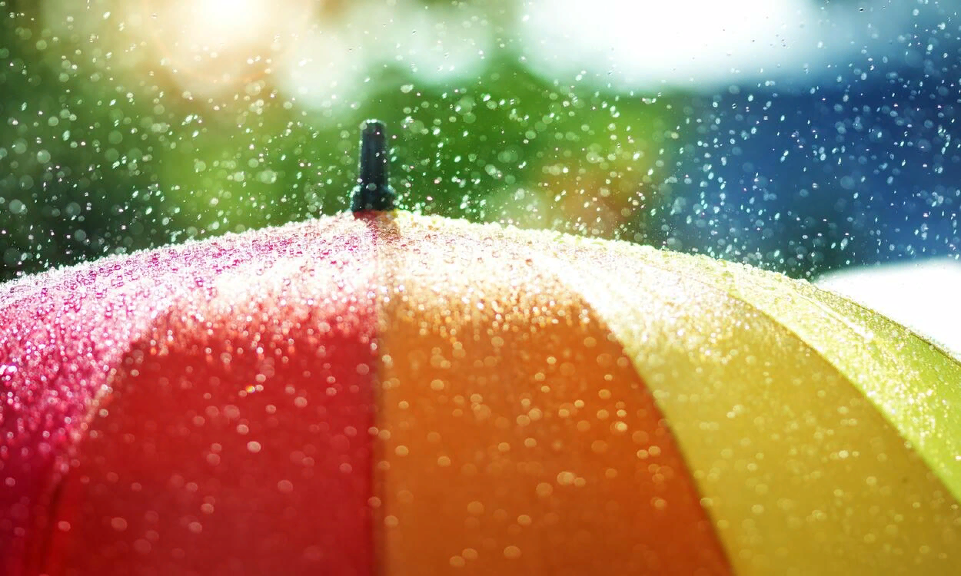
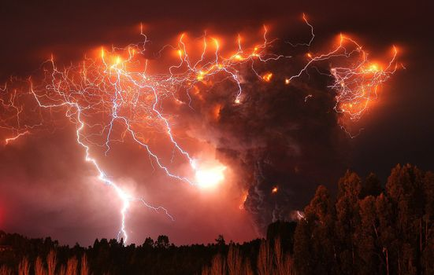
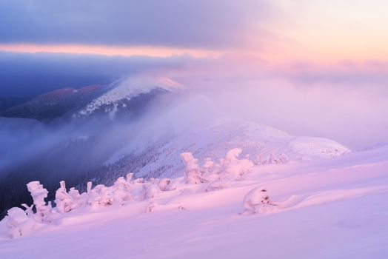
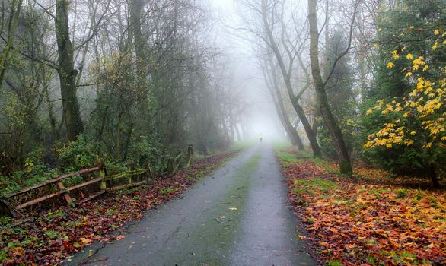
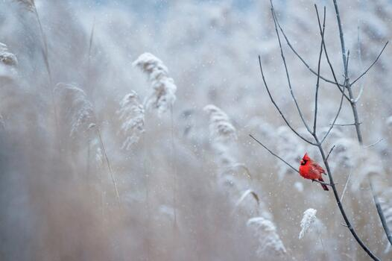

Slide 2
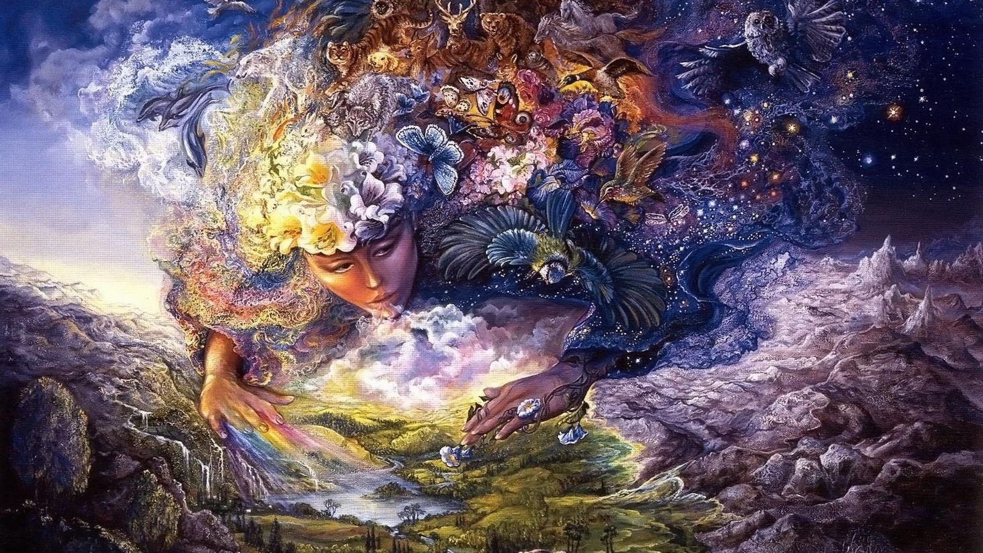
Module 3
Mother Nature

Slide 3
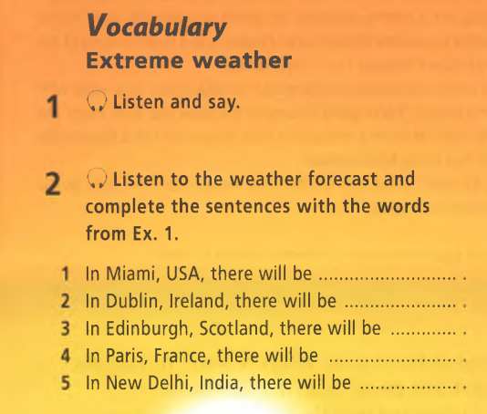
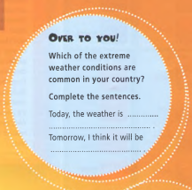
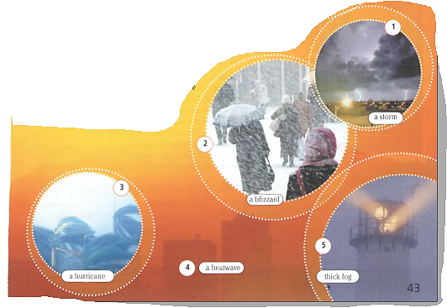
What weather do
you like?
a hurricane
thick fog
a blizzard
a storm
a heatwave

Slide 4
Example:
1. This picture shows a city, perhaps in the UK. It is probably autumn or winter. There is a storm. The sky is full of dark clouds and there is a lightning striking all around. I think people are all indoors, keeping away from the storm. They probably feel glad to be safe inside. People probably feel scared when there is such a storm.

Slide 5
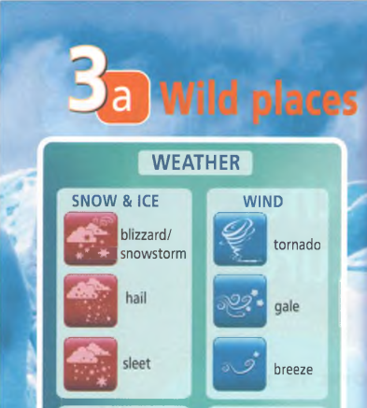
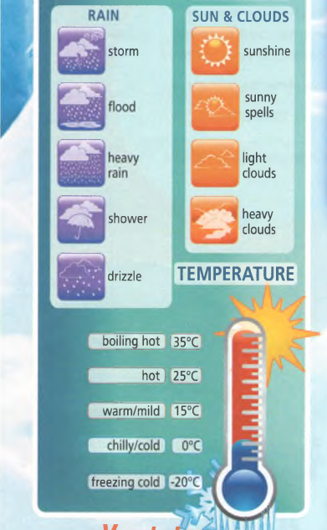
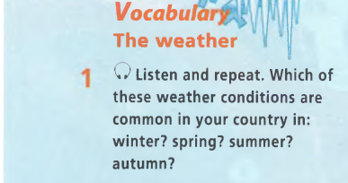
Град
Солнечный свет
Метель/ снежный шторм
Наводнение
Тепло/ умеренно тепло
Перистые облака
Шторм
Лёгкий ветер
Нестерпимо жарко
Ливень
Ураган
Дождь со снегом
Изморось
Временами солнечно
Прохладно/ холодно
Буря
Жарко
Сильный ливень
Тучи
Сильный мороз

Slide 6
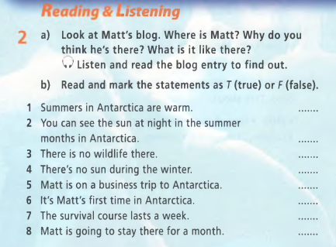
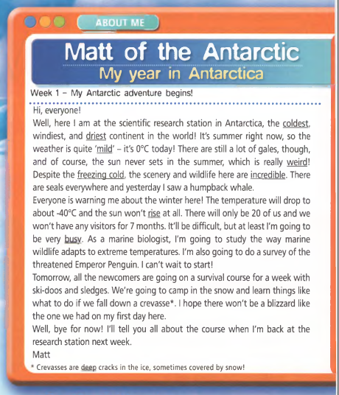
F
T
F
T
F
T
T
F
1. It’s summer right now, so the weather is quite mild.
3. The wildlife is incredible.
Weird – странный
Incredible – невероятный
Busy – занят, занятой
5. As a marine biologist.
8. A week.

Slide 7
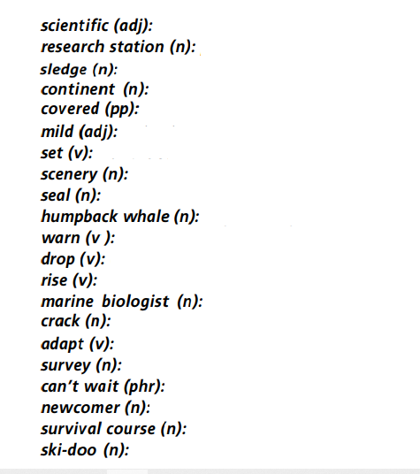
relating to science
recent arrival
(for the sun) to go below the horizon
place where research is carried out
not extreme
long to
landscape
single huge land mass (e.g. Africa, Europe, etc)
to adjust to different conditions
sea mammal that breeds on land
(for the temperatures) to get lower
person who studies animals that live in water
transport usually pulled by dogs over snow
narrow opening
large endangered sea mammal
a detailed investigation
having a layer of sth on top
lessons about staying alive
type of transport used in snowy areas
(like a jet ski for snow)
to make aware of danger
(for the sun) to go above the horizon

Slide 8
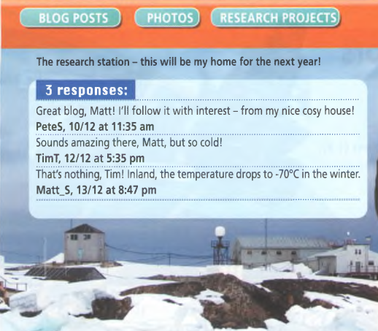
research
survival
freezing
drop
humpback
sets
marine
Idle –
Wettest –
Ordinary –
Intense –
set common hottest boiling hot
shallow idle wettest ordinary intense
rise
weird
coldest
freezing cold
deep
busy
driest
incredible
mild

Slide 9
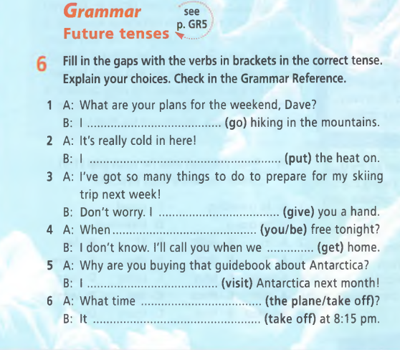
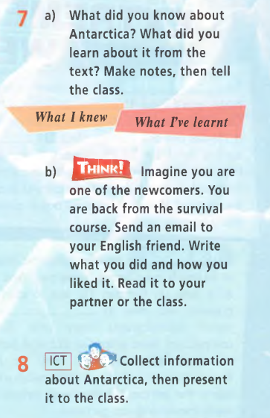
am going
will put
will give
will you be
get
am visiting
does the plane off
takes off
1. plan
2. On-the-spot decision
3. offer
4.A. Information about
the future
4.B. time clause
5. fixed arrangement
6. timetable

