Slide 1
Do you know the story?

Slide 2
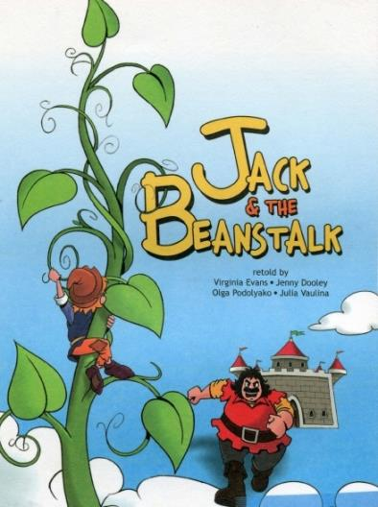
Jack and the Beanstalk

Slide 3
background - происхождение
fairy tale - сказка
date back to - датироваться
fairy - фея
poor - бедный
cow – корова
market - рынок
to sell (sold, sold) - продавать
to use - использовать
clever - умный
instead of - вместо того, чтобы
handful - горсть
magic - волшебный
bean - боб, фасоль
be angry with - сердиться на
silly – глупый
to throw (threw, thrown) – бросать
out of the window - из окна
to grow (grew, grown) - расти
huge – огромный
beanstalk - бобовый стебель
to decide – решать
top - вершина
to find (found, found) - находить
land - земля
castle - замок
giant - великан
hen - курица
lay golden eggs - нести золотые яйца
to steal (stole, stolen) - украсть
chase after - гнаться за,
преследовать
get back - вернуть, вернуться
to escape - сбежать, убежать
to happen - случаться
plot - сюжет

Slide 4
1. Background
Mark the sentences as T (true) or F (false).
1 The story comes from England. ___
2 Jack and the beanstalk is a story about fairies. ___
3 The story dates from 1734. ____

Slide 5
1. Background
Mark the sentences as T (true) or F (false).
1 The story comes from England. T
2 Jack and the beanstalk is a story about fairies. ___
3 The story dates from 1734. ____

Slide 6
1. Background
Mark the sentences as T (true) or F (false).
1 The story comes from England. T
2 Jack and the beanstalk is a story about fairies. F
3 The story dates from 1734. ____
2 Jack and the beanstalk is a story about a boy and his mother.

Slide 7
1. Background
Mark the sentences as T (true) or F (false).
1 The story comes from England. T
2 Jack and the beanstalk is a story about fairies. F
3 The story dates from 1734. T
2 Jack and the beanstalk is a story about a boy and his mother.

Slide 8
2. The Plot
Choose the correct word.
1 Jack Trott and his mother are rich / poor.
Jack Trott and his mother are poor.
2 They live in the town / country.
They live in the country.

Slide 9
Choose the correct word.
3 They take their cow/beans to market.
They take their cow to market.
4 The next day there is a huge
castle/beanstalk in their garden.
The next day there is a huge beanstalk in their garden.

Slide 10
Choose the correct word.
5 The giant has got a magic/golden hen.
The giant has got a magic hen.
6 Jack steals/chases the hen.
Jack steals the hen.

Slide 11
3. The Characters
Who’s …
1 kind?
Giantess
2 scary?
Giant
3 loving and caring?
Mrs Trott

Slide 12
3. The Characters
Who’s …
4 lazy?
Jack
5 not very clever?
Jack

Slide 14
1. Jack Trott
Which of these things can you see in the pictures?
Cupboard
Table
Honey
Bread
Cow
Milk
Dog
Bed
Chair

Slide 15
1. Jack Trott
Which of these things can you see in the pictures?
Cupboard
Table
Honey
Bread
Cow
Milk
Dog
Bed
Chair

Slide 16
1. Jack Trott
True or False?
1 Jack is working in his bedroom.
2 Jack and his mother have got bread and honey to eat.
3 They haven’t got any money.
4 The cow’s name is Trott.
5 Jack is happy to sell the cow.

Slide 17
1. Jack Trott
True or False?
1 Jack is working in his bedroom. F
2 Jack and his mother have got bread and honey to eat.
3 They haven’t got any money.
4 The cow’s name is Trott.
5 Jack is happy to sell the cow.

Slide 18
1. Jack Trott
True or False?
1 Jack is working in his bedroom. F
2 Jack and his mother have got bread and honey to eat. F
3 They haven’t got any money.
4 The cow’s name is Trott.
5 Jack is happy to sell the cow.

Slide 19
1. Jack Trott
True or False?
1 Jack is working in his bedroom. F
2 Jack and his mother have got bread and honey to eat. F
3 They haven’t got any money. T
4 The cow’s name is Trott.
5 Jack is happy to sell the cow.

Slide 20
1. Jack Trott
True or False?
1 Jack is working in his bedroom. F
2 Jack and his mother have got bread and honey to eat. F
3 They haven’t got any money. T
4 The cow’s name is Trott. F
5 Jack is happy to sell the cow.

Slide 21
1. Jack Trott
True or False?
1 Jack is working in his bedroom. F
2 Jack and his mother have got bread and honey to eat. F
3 They haven’t got any money. T
4 The cow’s name is Trott. F
5 Jack is happy to sell the cow. F

Slide 22
2. Jack sells the cow
Read the words:
on the way
meet
old man
nod
swap
shake
special
mean
scream
по пути
встречать
старик
кивать
обмен
трясти
особый
значить, иметь ввиду
кричать

Slide 23
2. Jack sells the cow
Answer the questions:
1) Where is Jack going? Why?
Jack walks into town to sell the cow because they haven’t got any money.
2) Whom does he meet and where?
On the way into town he meets an old man.
2) What does the old man want?
The old man wants to swap the cow for beans.
3) Why does Jack take the beans?
Jack takes the beans because they are magic.
4) Why is Mrs. Trott angry?
Mrs. Trott is angry because she doesn’t want beans and they can’t buy food with them.

Slide 24
3. The beanstalk
Silly
Joke
Excited
Worried
Careful
Top
Глупый, глупо
Шутка
Взволнованный
Обеспокоенный
Осторожный
Вершина

Slide 25
3. The beanstalk
Fill in the correct word:
1) Mrs Trott is very … because …
they haven’t got any money for the cow.
2) Jack says the beans are … but …
his mother just laughs.
3) She throws the … out of the window because …
she thinks they can’t be magic and it is a silly idea.
4) The beans land in the … .
angry
magic
beans
garden

Slide 26
3. The beanstalk
Fill in the correct word:
5) When Jack wakes up he sees
a … .
6) The beanstalk is … .
7) Jack wants to … it because…
he is very excited.
8) Mrs Trott is … and tells Jack to … on the way to … .
beanstalk outside.
taller than the house.
climb
worried
be careful
the top

Slide 27
4. Jack climbs up the beanstalk
Through the clouds – через облака
Reach - достигать
Surprised - удивлен
Knock - стучать
Hungry - голодный
Scared - напуганный
Shake – трясти
Follow - следовать
Let - позволять

Slide 28
4. Jack climbs up the beanstalk
Answer the questions:
1) Where is Jack in the first picture?
What is he doing?
2) Who lives in the castle?
3) How does Jack feel in the first picture?
Jack climbs the beanstalk through the clouds
and reaches the top.
A giantess and her husband live in the castle.
Jack feels surprised and hungry.

Slide 29
4. Jack climbs up the beanstalk
Answer the questions:
4) Who is the woman in the second picture?
5) How does Jack feel in the second picture?
6) Where is Jack in the second picture? What is he doing?
The woman on the second picture is a surprised giantess.
Jack feels scared in the second picture.
Jack is in the kitchen in the second picture.
He hides in the oven behind the cake.

Slide 30
Put the events in the correct order.
1 Jack follows the giantess.
2 He knocks on the door.
3 The castle is shaking.
4 Jack climbs up the beanstalk. 1
5 The giantess runs into the kitchen.
6 She tells him he can’t come in.
7 She tells him to hide in the oven.
8 A giantess opens the door.
9 He sees a castle.
10 Jack is very scared.
11 He reaches the top.
12 She closes the oven door and wits for her husband.

Slide 31
Put the events in the correct order.
1 Jack follows the giantess.
2 He knocks on the door.
3 The castle is shaking.
4 Jack climbs up the beanstalk. 1
5 The giantess runs into the kitchen.
6 She tells him he can’t come in.
7 She tells him to hide in the oven.
8 A giantess opens the door.
9 He sees a castle.
10 Jack is very scared.
11 He reaches the top. 2
12 She closes the oven door and wits for her husband.

Slide 32
Put the events in the correct order.
1 Jack follows the giantess.
2 He knocks on the door.
3 The castle is shaking.
4 Jack climbs up the beanstalk. 1
5 The giantess runs into the kitchen.
6 She tells him he can’t come in.
7 She tells him to hide in the oven.
8 A giantess opens the door.
9 He sees a castle. 3
10 Jack is very scared.
11 He reaches the top. 2
12 She closes the oven door and wits for her husband.

Slide 33
Put the events in the correct order.
1 Jack follows the giantess.
2 He knocks on the door. 4
3 The castle is shaking.
4 Jack climbs up the beanstalk. 1
5 The giantess runs into the kitchen.
6 She tells him he can’t come in.
7 She tells him to hide in the oven.
8 A giantess opens the door.
9 He sees a castle. 3
10 Jack is very scared.
11 He reaches the top. 2
12 She closes the oven door and wits for her husband.

Slide 34
Put the events in the correct order.
1 Jack follows the giantess.
2 He knocks on the door. 4
3 The castle is shaking.
4 Jack climbs up the beanstalk. 1
5 The giantess runs into the kitchen.
6 She tells him he can’t come in.
7 She tells him to hide in the oven.
8 A giantess opens the door. 5
9 He sees a castle. 3
10 Jack is very scared.
11 He reaches the top. 2
12 She closes the oven door and wits for her husband.

Slide 35
Put the events in the correct order.
1 Jack follows the giantess.
2 He knocks on the door. 4
3 The castle is shaking.
4 Jack climbs up the beanstalk. 1
5 The giantess runs into the kitchen.
6 She tells him he can’t come in. 6
7 She tells him to hide in the oven.
8 A giantess opens the door. 5
9 He sees a castle. 3
10 Jack is very scared.
11 He reaches the top. 2
12 She closes the oven door and wits for her husband.

Slide 36
Put the events in the correct order.
1 Jack follows the giantess.
2 He knocks on the door. 4
3 The castle is shaking.
4 Jack climbs up the beanstalk. 1
5 The giantess runs into the kitchen.
6 She tells him he can’t come in. 6
7 She tells him to hide in the oven.
8 A giantess opens the door. 5
9 He sees a castle. 3
10 Jack is very scared. 7
11 He reaches the top. 2
12 She closes the oven door and wits for her husband.

Slide 37
Put the events in the correct order.
1 Jack follows the giantess.
2 He knocks on the door. 4
3 The castle is shaking. 8
4 Jack climbs up the beanstalk. 1
5 The giantess runs into the kitchen.
6 She tells him he can’t come in. 6
7 She tells him to hide in the oven.
8 A giantess opens the door. 5
9 He sees a castle. 3
10 Jack is very scared. 7
11 He reaches the top. 2
12 She closes the oven door and wits for her husband.

Slide 38
Put the events in the correct order.
1 Jack follows the giantess.
2 He knocks on the door. 4
3 The castle is shaking. 8
4 Jack climbs up the beanstalk. 1
5 The giantess runs into the kitchen. 9
6 She tells him he can’t come in. 6
7 She tells him to hide in the oven.
8 A giantess opens the door. 5
9 He sees a castle. 3
10 Jack is very scared. 7
11 He reaches the top. 2
12 She closes the oven door and wits for her husband.

Slide 39
Put the events in the correct order.
1 Jack follows the giantess. 10
2 He knocks on the door. 4
3 The castle is shaking. 8
4 Jack climbs up the beanstalk. 1
5 The giantess runs into the kitchen. 9
6 She tells him he can’t come in. 6
7 She tells him to hide in the oven.
8 A giantess opens the door. 5
9 He sees a castle. 3
10 Jack is very scared. 7
11 He reaches the top. 2
12 She closes the oven door and wits for her husband.

Slide 40
Put the events in the correct order.
1 Jack follows the giantess. 10
2 He knocks on the door. 4
3 The castle is shaking. 8
4 Jack climbs up the beanstalk. 1
5 The giantess runs into the kitchen. 9
6 She tells him he can’t come in. 6
7 She tells him to hide in the oven. 11
8 A giantess opens the door. 5
9 He sees a castle. 3
10 Jack is very scared. 7
11 He reaches the top. 2
12 She closes the oven door and wits for her husband.

Slide 41
Put the events in the correct order.
1 Jack follows the giantess. 10
2 He knocks on the door. 4
3 The castle is shaking. 8
4 Jack climbs up the beanstalk. 1
5 The giantess runs into the kitchen. 9
6 She tells him he can’t come in. 6
7 She tells him to hide in the oven. 11
8 A giantess opens the door. 5
9 He sees a castle. 3
10 Jack is very scared. 7
11 He reaches the top. 2
12 She closes the oven door and wits for her husband. 12

Slide 42
4. Jack climbs up the beanstalk
What does Jack feel at the end of the episode?
tired
alone
happy
scared
sad
angry
sorry
small

Slide 43
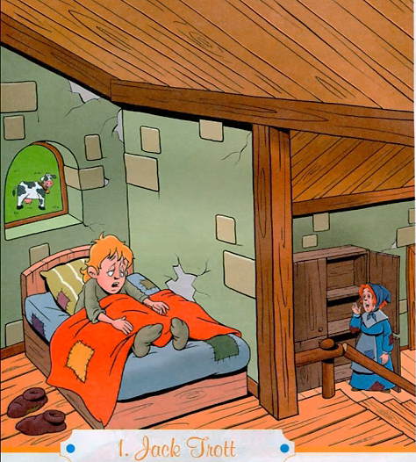

Slide 44
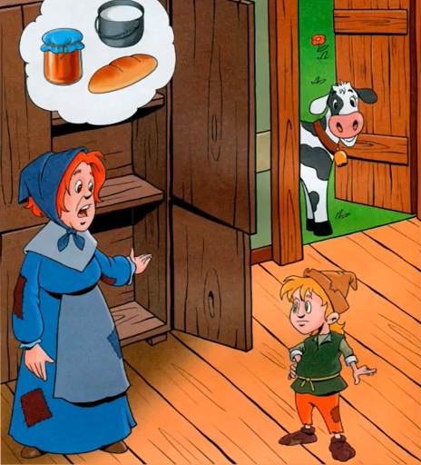

Slide 45
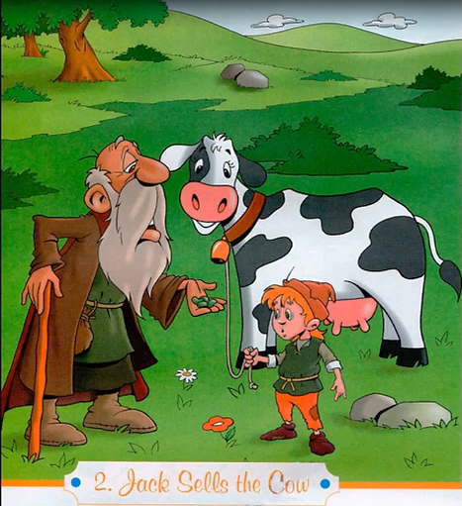

Slide 46
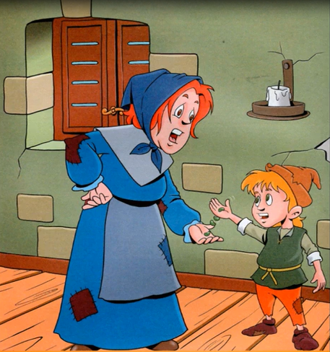

Slide 47
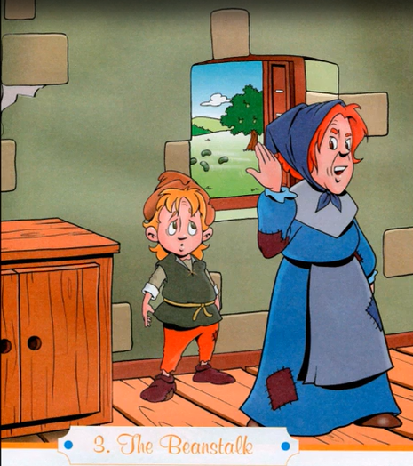

Slide 48
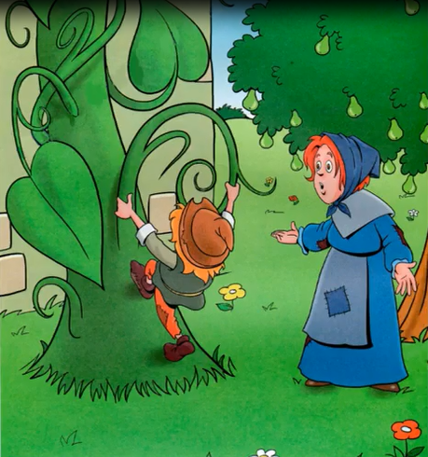

Slide 49
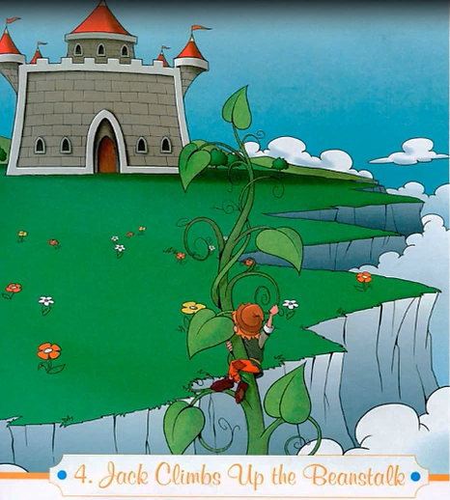

Slide 50
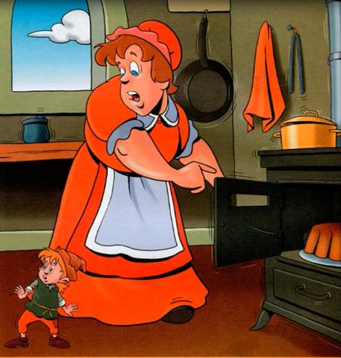

Slide 51
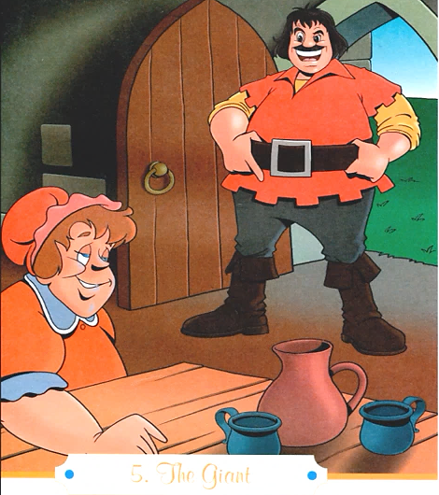

Slide 53
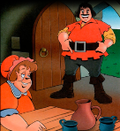
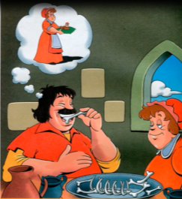
5. The Giant
Look around – оглядеться
Smell – нюхать/чуять
Silly - глупый
Meat – мясо
Leave – покидать/оставлять
Bone – кость

Slide 54
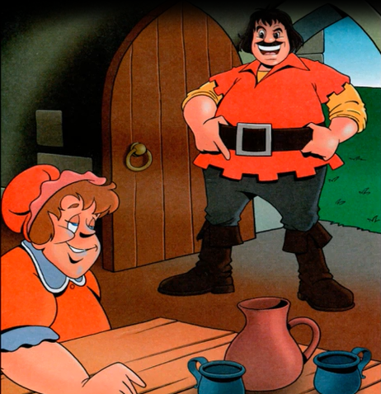
5. The Giant
Which of these things can you see in the pictures?
bones hat
cup beanstalk
oven boots
hen wife
table meat

Slide 55
5. The Giant
Which of these things can you see in the pictures?
bones hat
cup beanstalk
oven boots
hen wife
table meat

Slide 56
Correct the words in bold.
1 The giant says he can hear a
young boy.
The giant says he can smell a
young boy.
2 His wife says there aren’t any
sheep there.
His wife says there aren’t any
boys there.

Slide 57
Correct the words in bold.
3 The giantess brings the giant’s
dinner.
The giantess brings the giant’s
breakfast.
4 The giant is never ready to eat.
The giant is always ready to eat.

Slide 58
Correct the words in bold.
5 The giant eats a hen.
The giant eats a sheep.
6 The giantess brings the giant a
little black hen.
The giantess brings the giant a
little brown hen.

Slide 59
6. The hen that lays golden eggs
Lay – нести яйца
Through a hole – через отверстие
Golden – золотой
Meal – прием пищи
Fall asleep – уснуть
Get ready – готовиться
Hold – держать
(be) going to - собираться

Slide 60
6. The hen that lays golden eggs
Answer:
1) Where is Jack?
2) What is he doing in the first picture?
3) What is he holding in the second picture?
4) What is special about the hen?
5) What do you think Jack is going to do with the hen?

Slide 61
Fill in the missing word:
1) Jack looks through a ……
in the oven door.
2) The hen is ……….. .
3) The eggs are ………… .
4) The giant is ……….. after his meal.
hole
golden
magic
tired
oven
5) Jack gets out of the ………… .
6) Jack ………… the hen.
7) Jack is very ………… .
takes
quiet

Slide 63
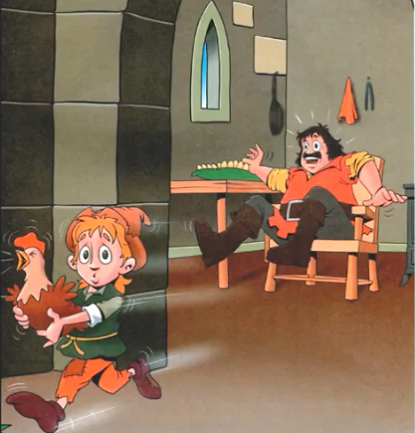
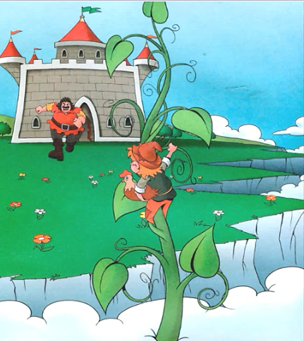
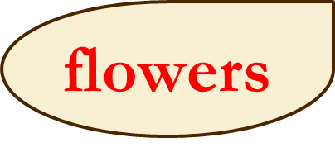
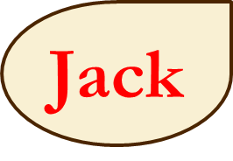
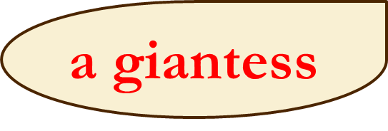
7. Jack tries to escape
Which of these things can you see in the pictures?

Slide 64
7. Jack tries to escape
A loud sound – громкий звук
To run out – выбежать
To chase after – гнаться за
Ground - земля
Quickly – быстро
An arm – рука
To catch - ловить

Slide 65
7. Jack tries to escape
Complete the sentences and put them in order:
1) ________ chases __________ .
2) ________ shouts at ________ .
3) ________ wakes up ______.
4) ________ makes a loud sound.
5) ________ climbs down the beanstalk with the _________ .
6) ________ is very happy.
The giant
Jack
5
The giant
Jack
4
The hen
the giant
3
The hen
2
Jack
hen
6
Jack
1

Slide 66
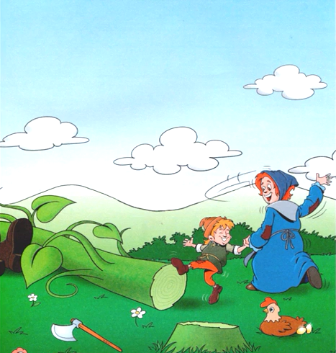
8. Jack chops down the beanstalk What do you think happen in this episode?

Slide 67
8. Jack chops down the beanstalk What is different from the 1st picture to the 2nd ?

Slide 68
8. Jack chops down the beanstalk
Thief - вор
Almost - почти
Chop – рубить
Axe – топор
Terrible – ужасный

Slide 69
8. Jack chops down the beanstalk
Who says what?
1) “Come back here, you little thief!”
2) “The giant is coming!”
3) “We’re safe now!”
4) “We’re reach now, too!”
5) “I’m going to eat you!”
giant
Jack
Mrs Trott
Jack
giant

Slide 70
What does Jack shout to his mother?
What must Jack do with the beanstalk?
What happens with the Giant?
Why is Jack and his mother happy now?
Jack shouts to bring an axe.
Jack must chop down the beanstalk.
The Giant is dead as he falls down
to the ground with a terrible sound.
The are happy because they are safe
and rich now, they have a big house
and buy Daisy back.

Slide 71
8. Jack chops down the beanstalk
Do you feel sorry for (жалеть) the giant? Why (not)?
Do you think it is good for Jack and his mother to be rich? Why (not)?
What can you do if (если) you suddenly (вдруг) become rich?

