Slide 1
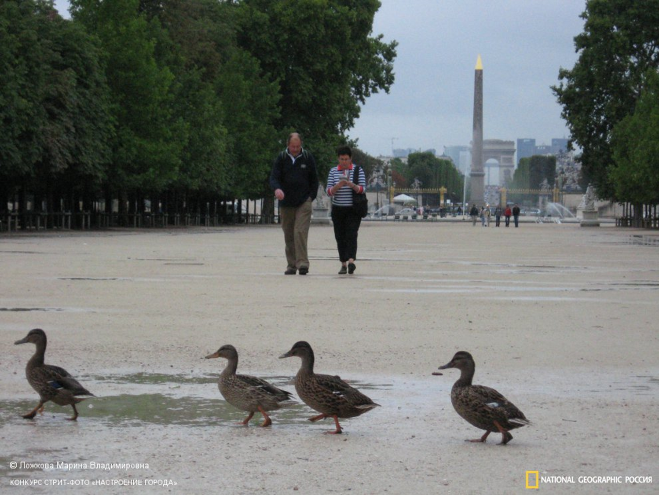
Speaking. Describing a picture.
What do you see on the board?

Slide 2
What do you see?
Who do you see?
What bird is it?
Where are they?

Slide 3
Introduction
Place
Action
Opinion

Slide 4
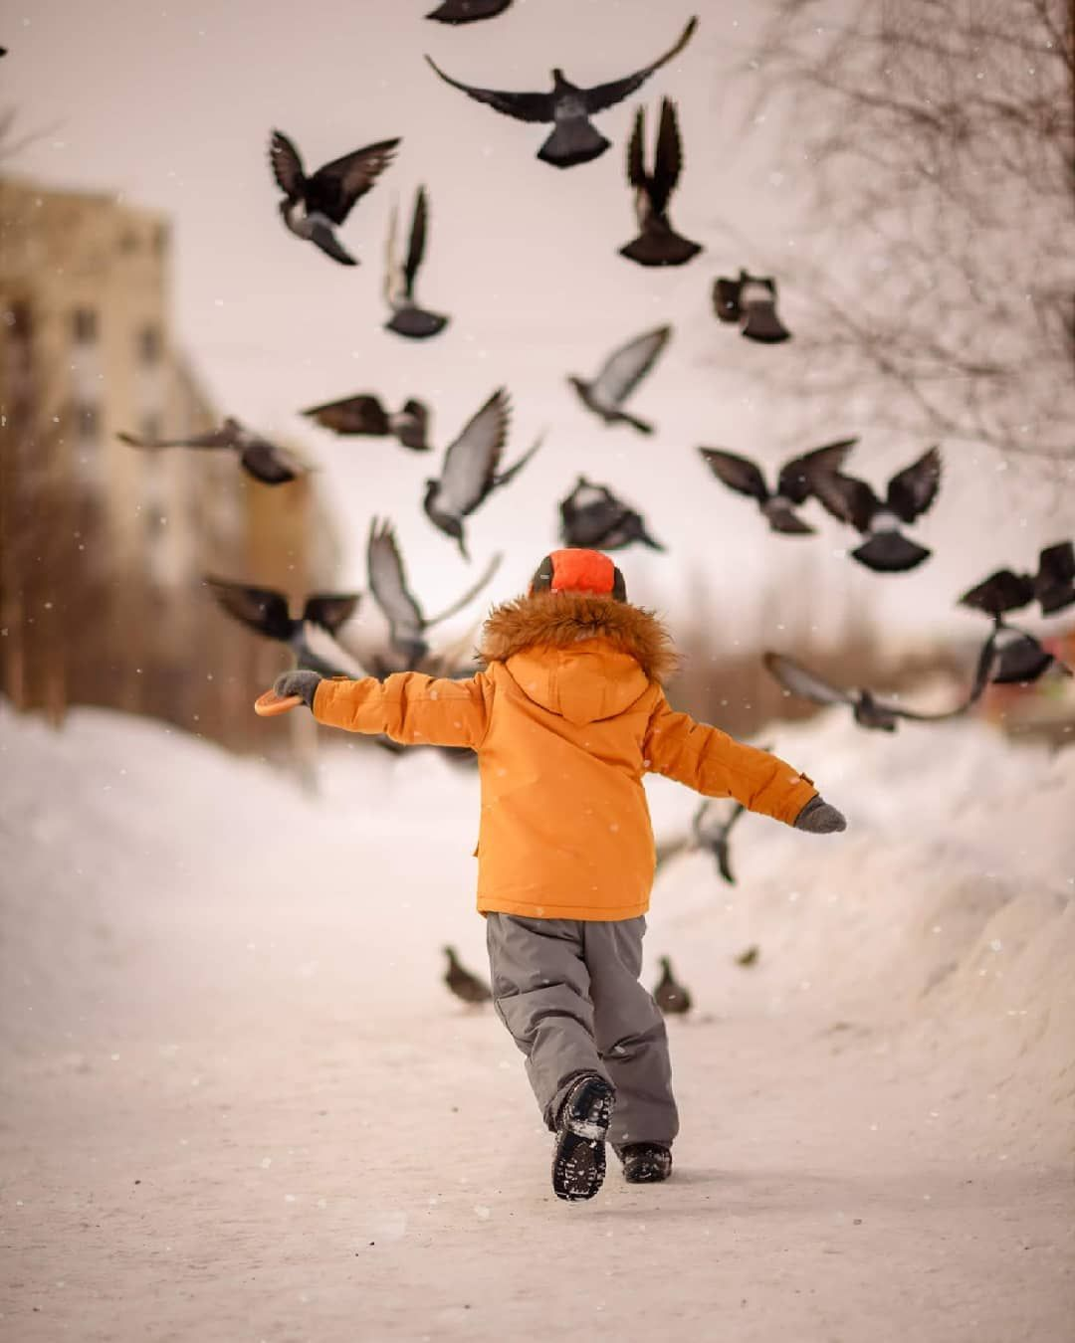
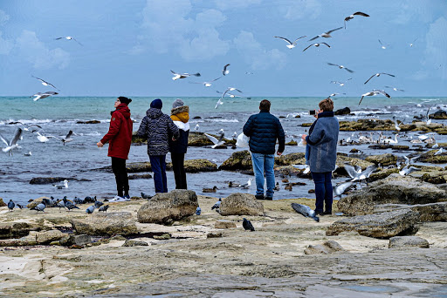
Now do it yourself.

