Slide 1
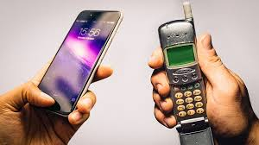
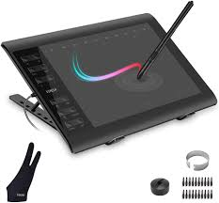

Slide 2
1.What is the lesson about? 2.Where can I use this information? 3.What can I use it for?

Slide 8
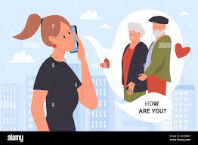
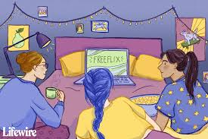
(+) advantages

Slide 9
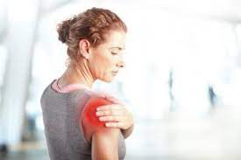
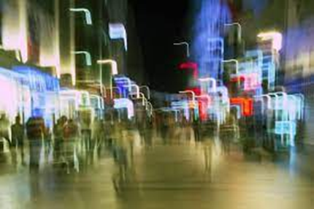
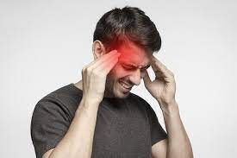
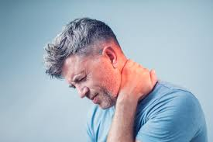
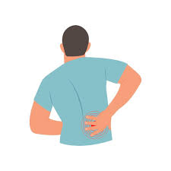
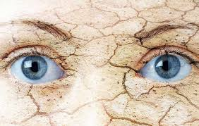
(-) disadvantages

Slide 10
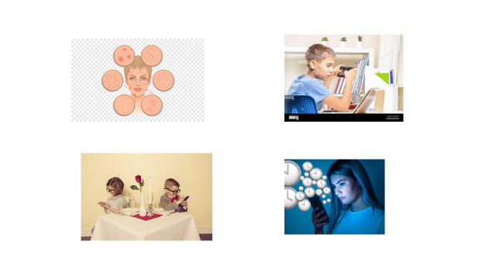

Slide 11
He/she has …….. because……..
He/she suffers from…… because ………

Slide 12
I think
I guess
we should….or it can cause....
To my mind
In my opinion

Slide 13
(+) (-)
Yes, I completely agree I completely disagree
with you
Yes, You are right No, it’s wrong
Yes, it’s true I am not sure

Slide 14
I think
I guess
on the one hand…but on the other hand …
To my mind
In my opinion

Slide 15
I think
In my opinion
To my mind
1.The lesson is about……
2. I can use this information…
3. I can use it to…..

