Slide 1
Hello!

Slide 2
Unit 3. Performing Arts: Cinema

Slide 3
Make your best shot!

Slide 4
Alice said: I will find the book.
Alice said she would find a book.

Slide 5
The 18th of January
1.Nick said: “The technical problems happen some time”.
1. Nick said the technical problems happened some time.
2.Olga asked: “Did you watch “Home Alone” yesterday?”
2. Olga asked if I had watched HA the day before.
3.Lina said: “She is watching a silent film”.
3. Lina said she was watching a silent film.

Slide 6
Will – would
Shall – should

Slide 7
Reported speech changes
I
We
is, am
are
will
shall
go/watch (глагол в первой форме)
went/watched (глагол в 2 форме или оконч -ed)
have/has V3/Ved
have/has been Ving
he/she
they
was
were
would
should
went/watched (глагол в 2 форме или оконч -ed)
had V3/Ved (глагол в 3 форме или оконч -ed)
had V3/Ved
had been Ving

Slide 8
Ex. 3, p. 16 Sentences 1, 3, 8
Peter: What film will you see at the Odeon?
1. Peter asked what film I would see at the Odeon?
3. Val: I shall go to the cinema in the evening.
3. Val said he should go to the cinema in the evening.
8. Miss Fox: Who will play in this comedy?
8. Miss Fox asked who would play in these comedy?

Slide 9
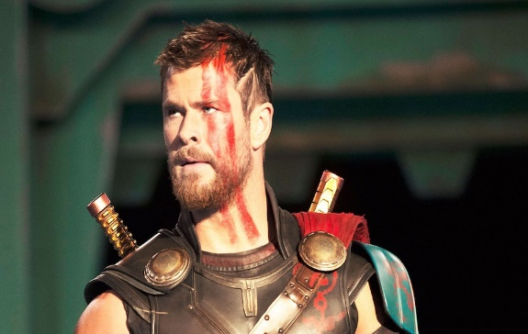
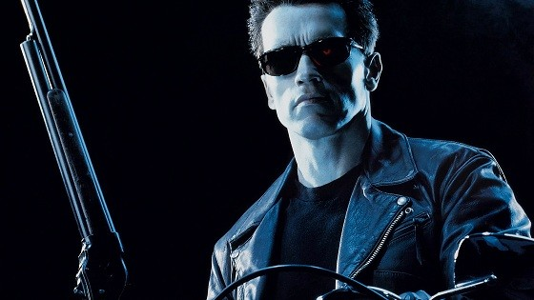
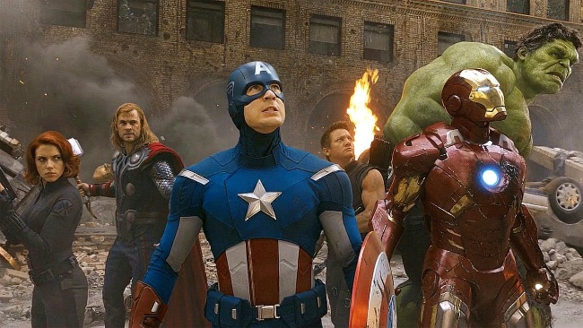
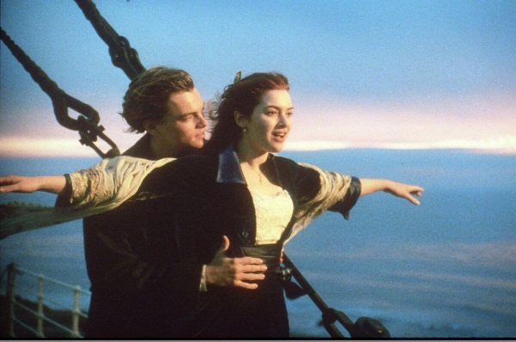
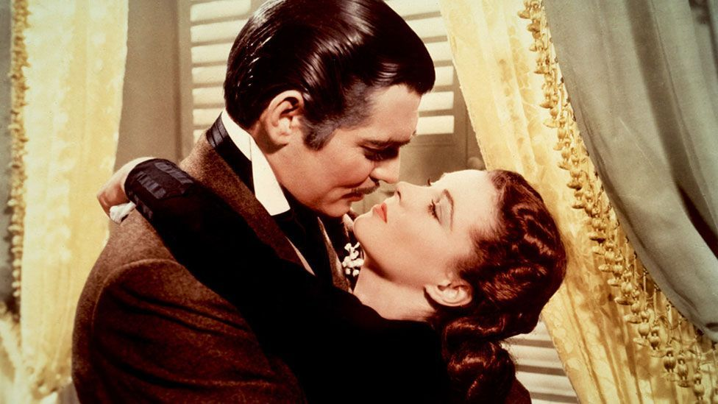
What film is it?
Harry Potter
Thor: Ragnarok
Terminator
Avengers
Titanic
Gone with wind

Slide 10
Report sentences
George said: “I will go to the cinema tomorrow”.
Melissa said: “What will we do after the cinema tomorrow?”
Don said: “We won’t shoot a short video”

Slide 11
Do the exercise from file

