Slide 1
The game
«The Present Simple / The Present Continuous»
Oh, lucky you!
Created by Usoltseva Svetlana Victorovna
English teacher
Moscow academic art college
Notes:
Переход ко второму слайду производится щелчком мышью на поле слайда.

Slide 2
The pairs’ numbers
1
2
3
4
5
6
7
8
Notes:
Навигация на слайдах осуществляется при помощи управляющих кнопок и гиперссылок.
Через гиперссылки на кружки с цифрами происходит переход к началу игры для каждой пары.
Кнопка «Выход» предоставляет возможность закончить игру в любой момент.

Slide 3
1
I … drawing at the moment.
am
are
is
do
50/50
Notes:
Выбор варианта ответа осуществляется по щелчку на него.
При выборе правильного ответа происходит переход к слайду с ответом и иллюстрацией к нему.
При выборе неверного ответа происходит переход на слайд «Окончание игры».
Кнопка «50/50» даёт возможность убрать два неверных варианта во время ответа на любой вопрос, но лишь один раз за раунд игры каждой пары.

Slide 4
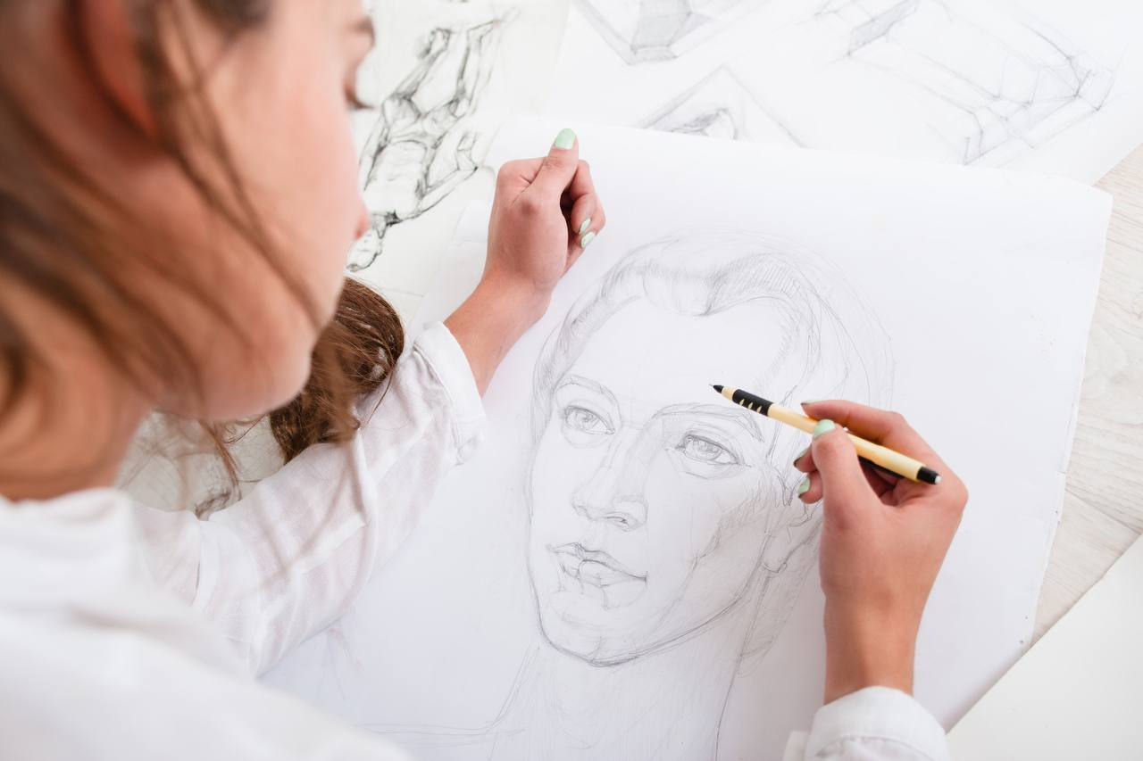
1
I am drawing at the moment.
am
Notes:
Кнопка «Далее» установлена для перехода к следующему вопросу игры.

Slide 5
2
Students … every other day.
are
painting
paint
paints
50/50

Slide 6
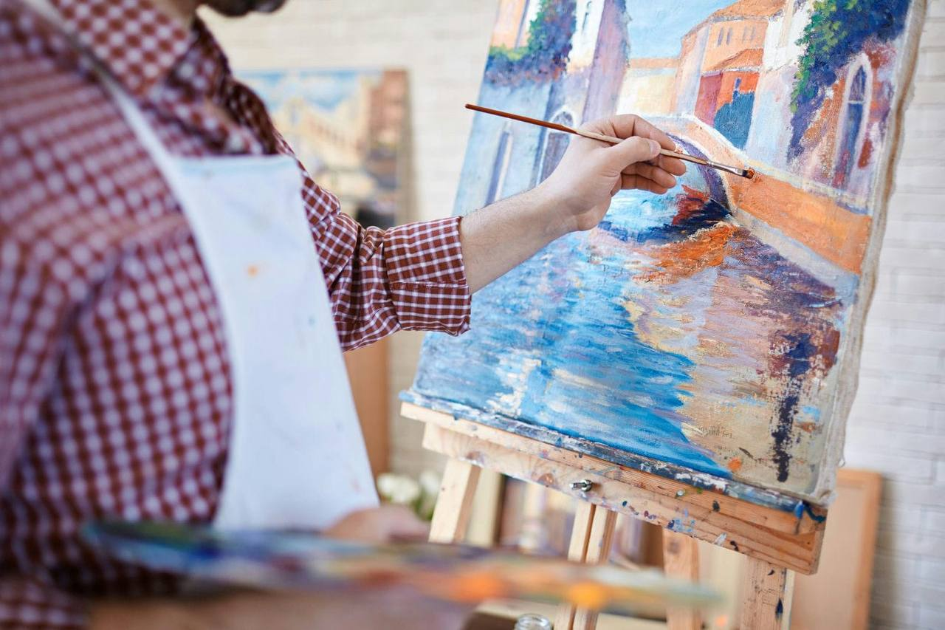
2
They paint every other day.
paint

Slide 7
3
He … important decisions.
does
makes
is doing
is
50/50

Slide 8
3
He makes important decisions.
makes

Slide 9
4
Look out! She … superglue.
are using
uses
use
is using
50/50

Slide 10
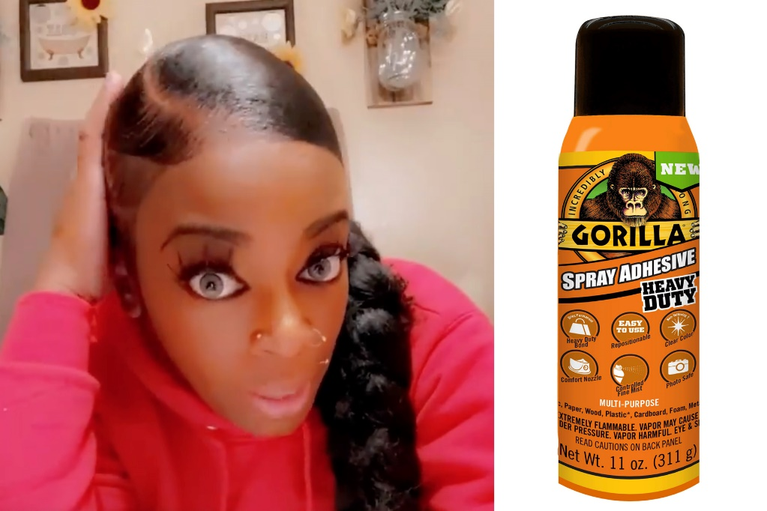
4
Look out! She is using superglue.
is using

Slide 11
5
She is … with light and shadow.
plaing
plaiing
playing
play
50/50

Slide 12
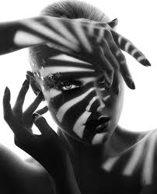
5
She is playing with light and shadow.
playing

Slide 13
6
He always … up his studio.
tidy
tidys
is tidying
tidies
50/50

Slide 14
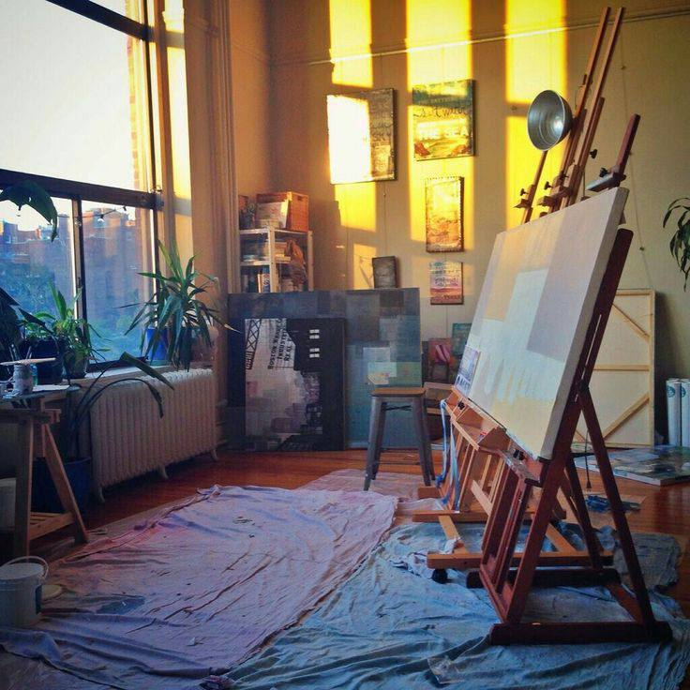
6
He always tidies up his studio.
tidies
Notes:
Кнопка «Домой» позволяет перейти к началу игры следующей пары игроков.

Slide 15
1
I … thinking at the moment.
is
are
am
do
50/50

Slide 16
1
I am thinking at the moment.
am

Slide 17
2
An elephant never … .
forget
forgets
don’t forget
is forgetting
50/50

Slide 18
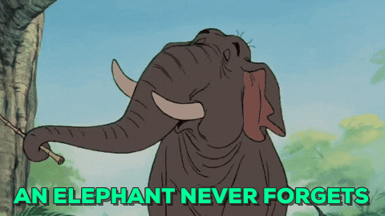
2
An elephant never forgets.
forgets

Slide 19
3
Artists … paints to get different hues.
mix
mixes
are
mixing
50/50

Slide 20
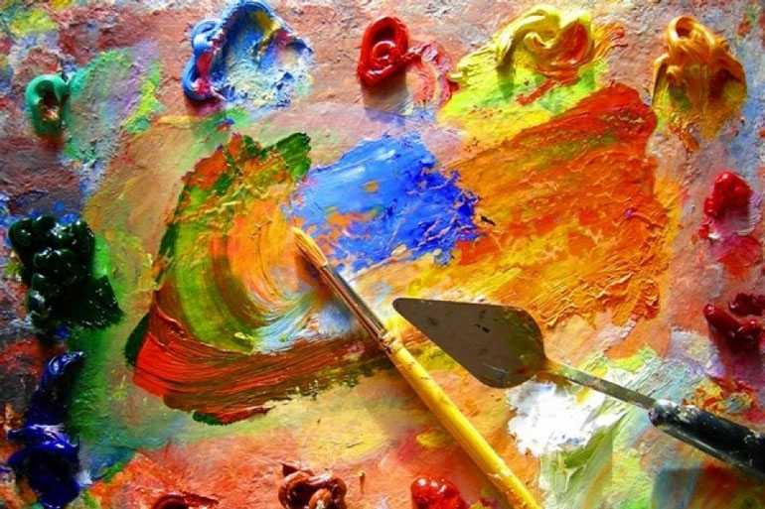
3
Artists mix paints to get different hues.
mix

Slide 21
4
Be quiet! He … .
studys
is studying
studies
is studing
50/50

Slide 22
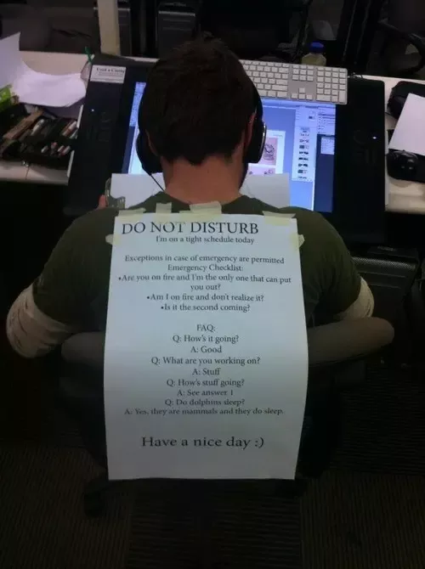
4
Be quiet! He is studying.
is studying

Slide 23
5
She … know the answer.
doesn’t
does
don’t
is
50/50

Slide 24
5
She doesn’t know the answer.
doesn’t

Slide 25
6
They … brushes before leaving.
are cleaning
cleans
clean
are cleanning
50/50

Slide 26
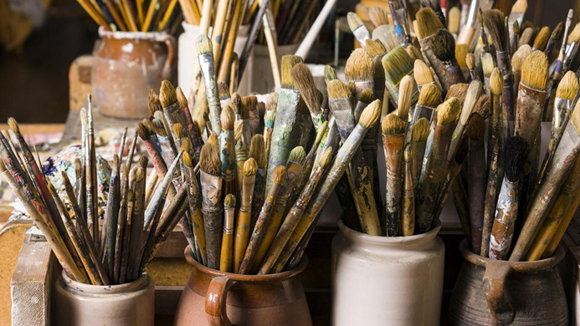
6
They clean brushes before leaving.
clean

Slide 27
1
A student … never late for class.
am
are
do
is
50/50

Slide 28
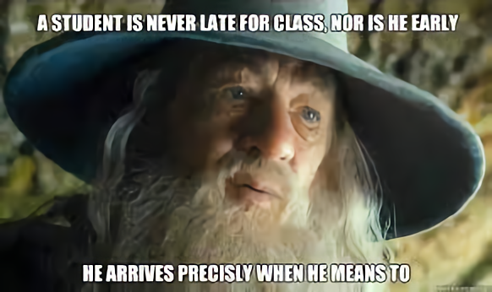
1
A student is never late for class.
is

Slide 29
2
He … sculptures out of clay.
make
makes
don’t make
is making
50/50

Slide 30
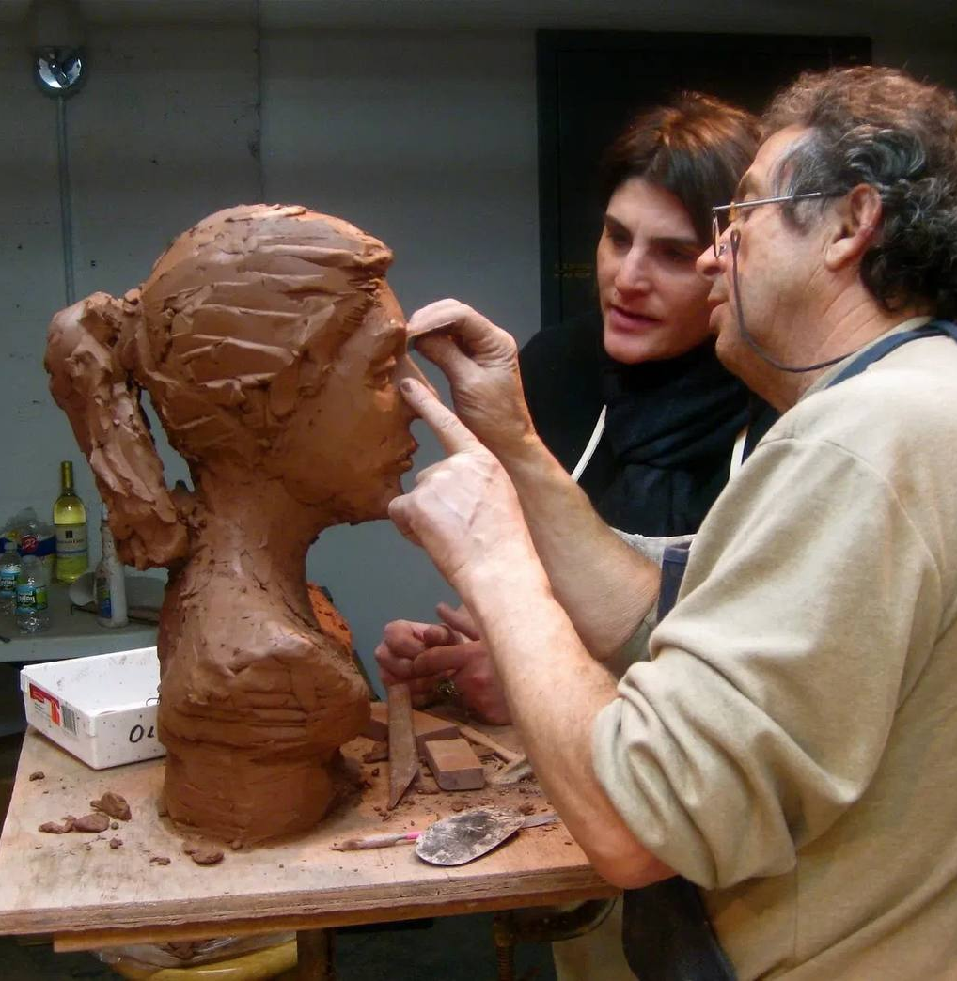
2
He makes sculptures out of clay.
makes

Slide 31
3
He … at the moment.
is sketching
sketches
sketch
are sketching
50/50

Slide 32
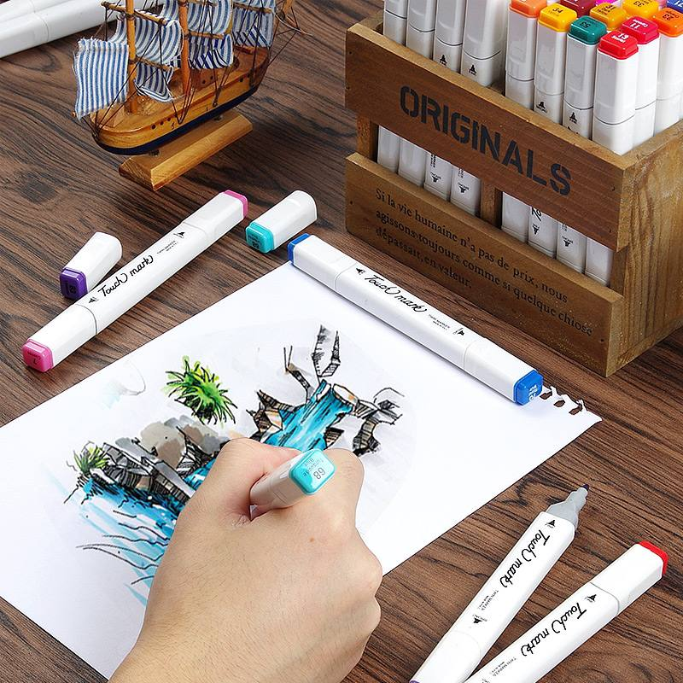
3
He is sketching at the moment.
is sketching

Slide 33
4
They are … the art contest.
wining
win
winning
wins
50/50

Slide 34
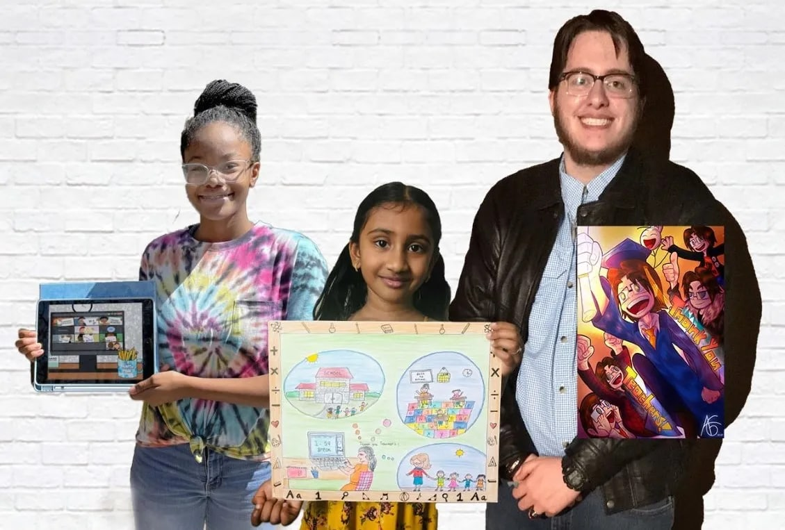
4
They are winning the art contest.
winning

Slide 35
5
You know, sometimes even students … films.
are making
are makeing
makes
make
50/50

Slide 36
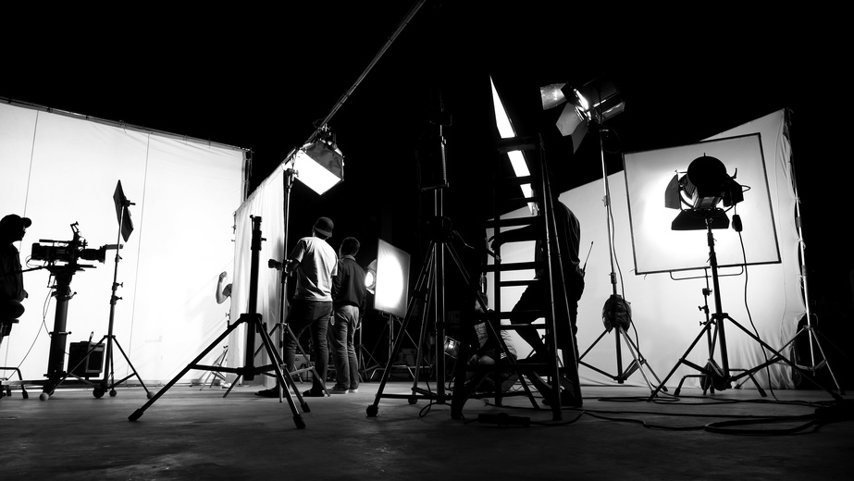
5
You know, sometimes even students make films.
make

Slide 37
6
Listen! I … English.
speak
am speaking
say
am telling
50/50

Slide 38
6
Listen! I am speaking English.
am speaking

Slide 39
1
He … messaging.
does
is
are
am
50/50

Slide 40
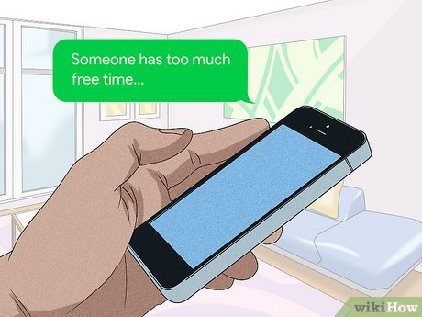
1
He is messaging.
is

Slide 41
2
We … any free time at all.
doesn’t have
have
has
don’t have
50/50

Slide 42
2
We don’t have any free time at all.
don’t have

Slide 43
3
Dogs … eat students’ homework.
sometimes
now
some time
not
50/50

Slide 44
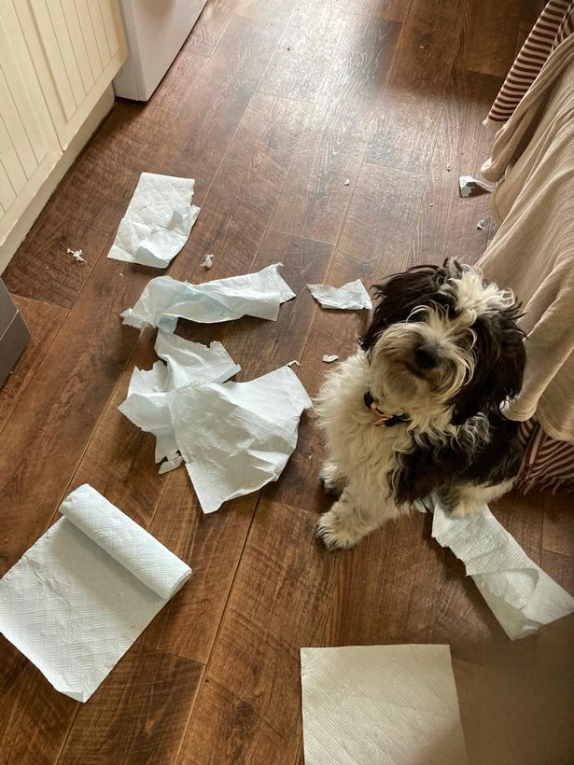
3
Dogs sometimes eat students’ homework.
sometimes

Slide 45
4
What … to be the problem?
does seem
seem
seems
is seeming
50/50

Slide 46
4
What seems to be the problem?
seems

Slide 47
5
It … colder and colder every day.
gets
is getting
get
is geting
50/50

Slide 48
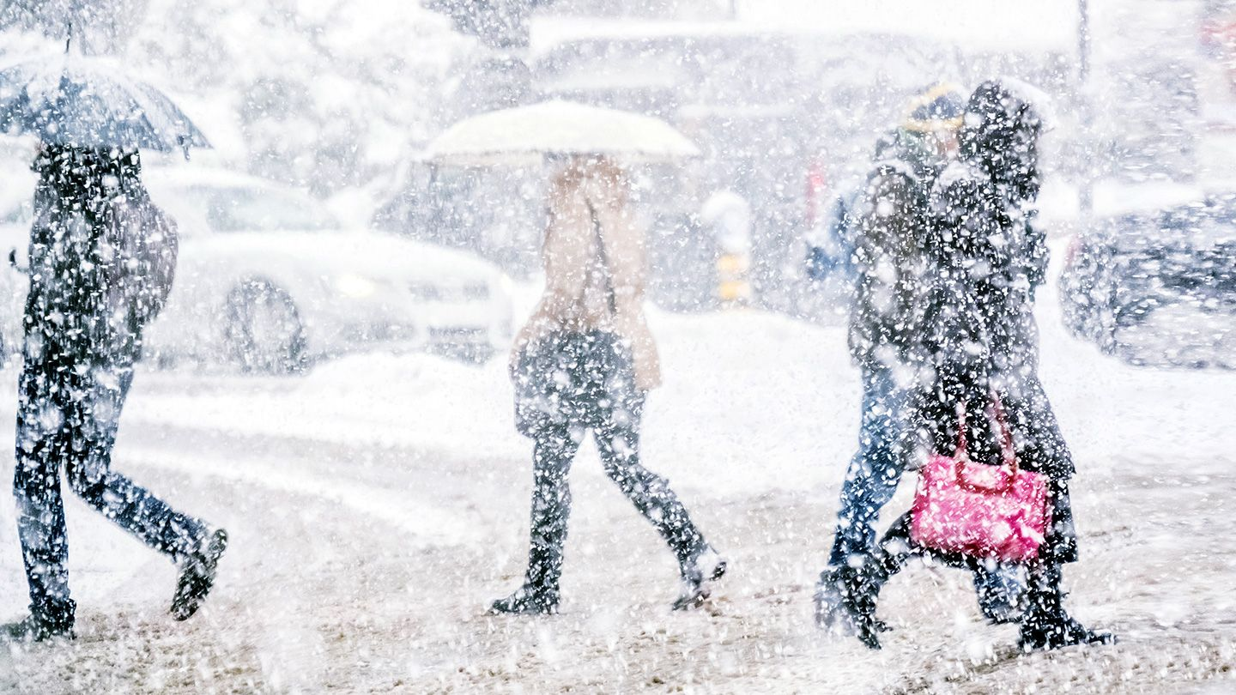
5
It is getting colder and colder every day.
is getting

Slide 49
6
Students always … polite conversations.
make
are … making
makes
are making
50/50

Slide 50
6
Students always make polite conversations.
make

Slide 51
1
This homework … hard.
look
looks
don’t look
is looking
50/50

Slide 52
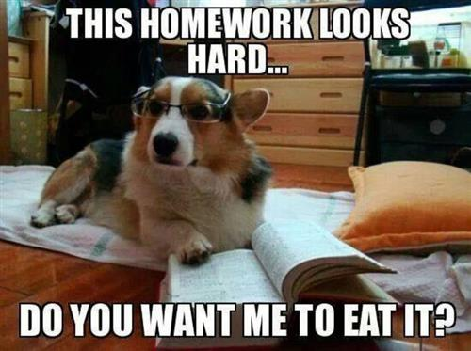
1
This homework looks hard.
looks

Slide 53
2
It … exercising.
are
does
do
is
50/50

Slide 54
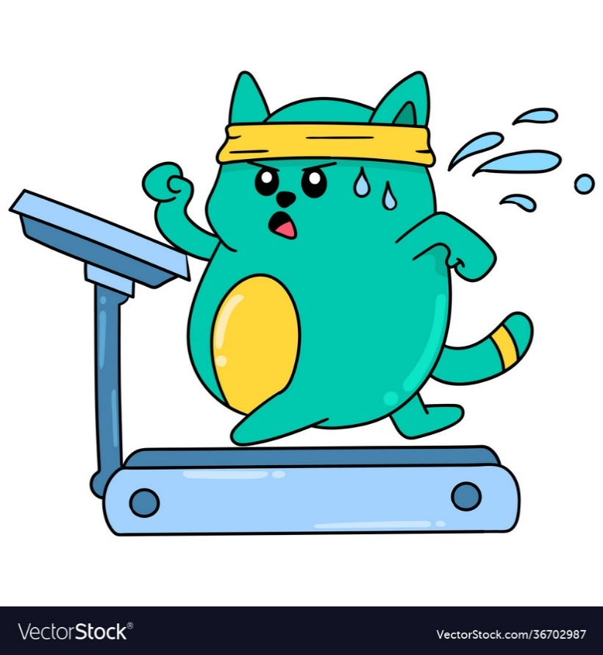
2
It is exercising.
is

Slide 55
3
Designers … again and again to get the right image.
try
are trying
tries
is trying
50/50

Slide 56
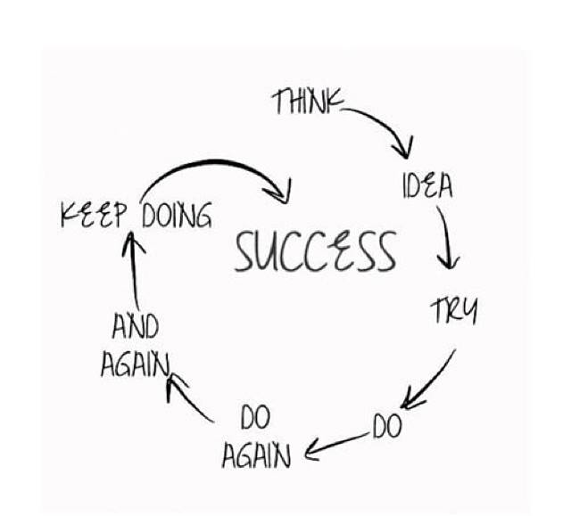
3
Designers try again and again to get the right image.
try

Slide 57
4
Don’t disturb it! It … busy.
is being
be
is
bee
50/50

Slide 58
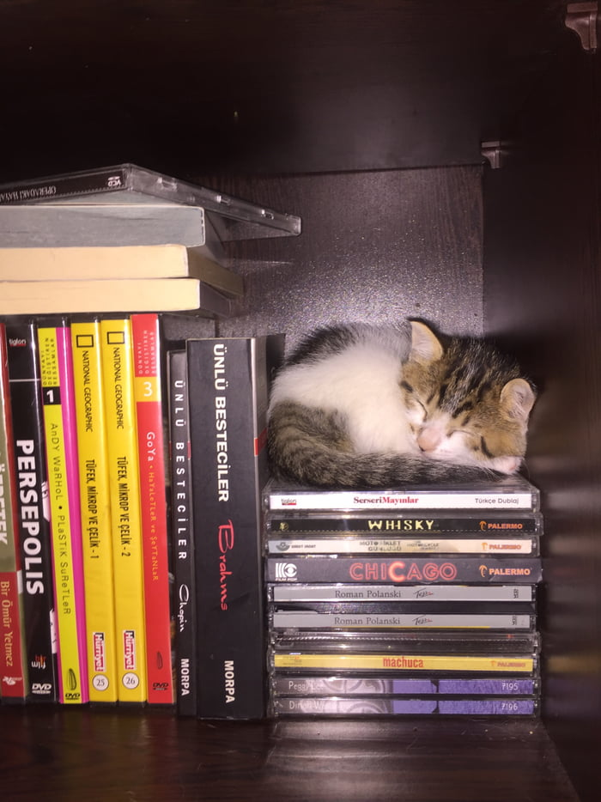
4
Don’t disturb it! It is busy.
is

Slide 59
5
He currently … an old icon.
restore
restores
is restorring
is … restoring
50/50

Slide 60
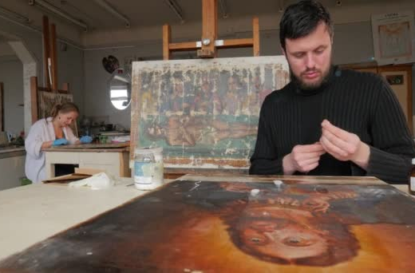
5
He is currently restoring an old icon.
is … restoring

Slide 61
6
Students usually… a good job!
do
does
dos
are doing
50/50

Slide 62
6
Students usually do a good job!
do

Slide 63
1
Students’ life … always rosy.
are
is
aren’t
isn’t
50/50

Slide 64
1
Students’ life isn’t always rosy.
isn’t

Slide 65
2
I … to fail.
don’t want
want
doesn’t want
am wanting
50/50

Slide 66
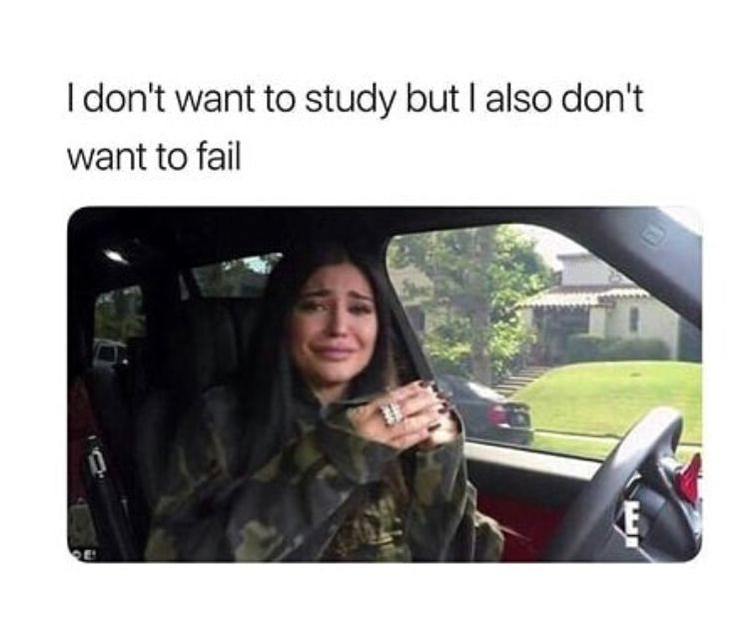
2
I don’t want to fail.
don’t want

Slide 67
3
Our curriculum … theoretical subjects.
is including
include
includes
don’t include
50/50

Slide 68
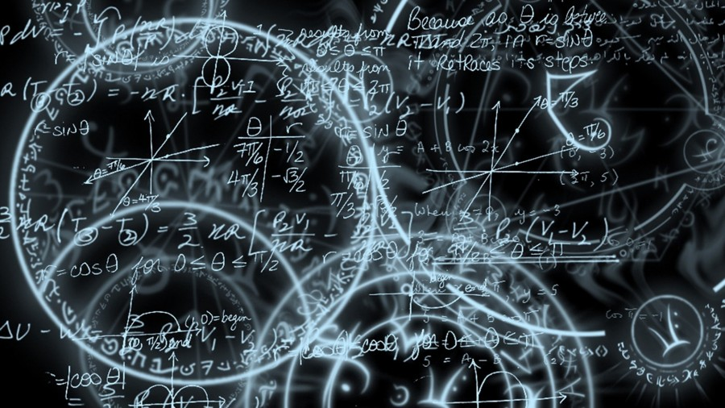
3
Our curriculum includes theoretical subjects.
includes

Slide 69
4
Art … popularity these days.
is
is gaining
does
gains
50/50

Slide 70
4
Art is gaining popularity these days.
is gaining

Slide 71
5
Street art … the public.
entertain
is entertaining
entertains
not entertains
50/50

Slide 72
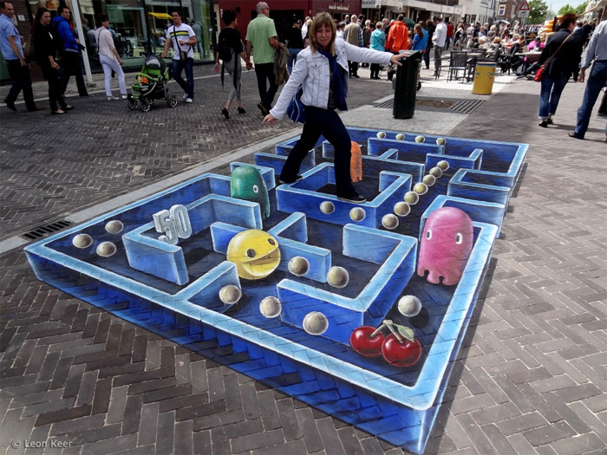
5
Street art entertains the public.
entertains

Slide 73
6
Young artists always … their best.
are doing
make
are making
do
50/50

Slide 74
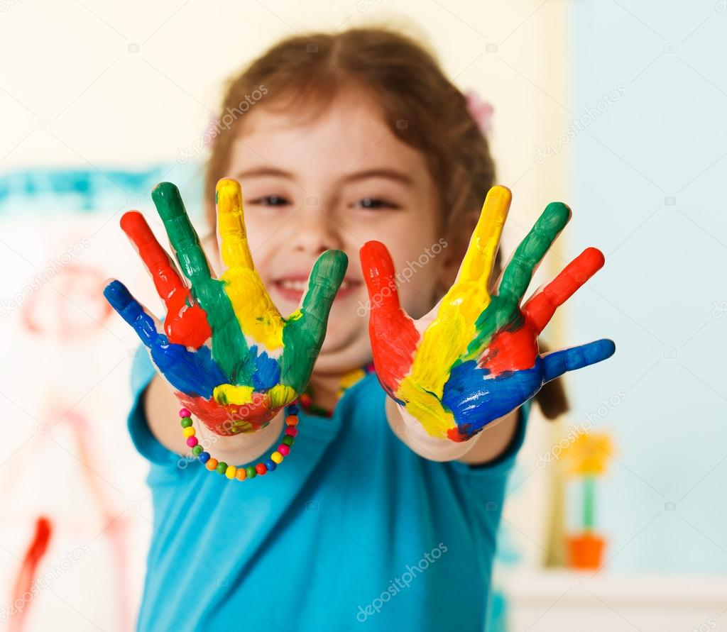
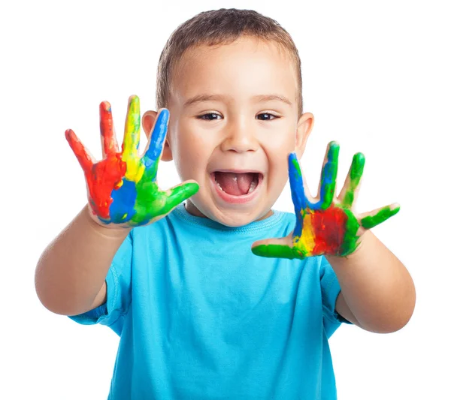
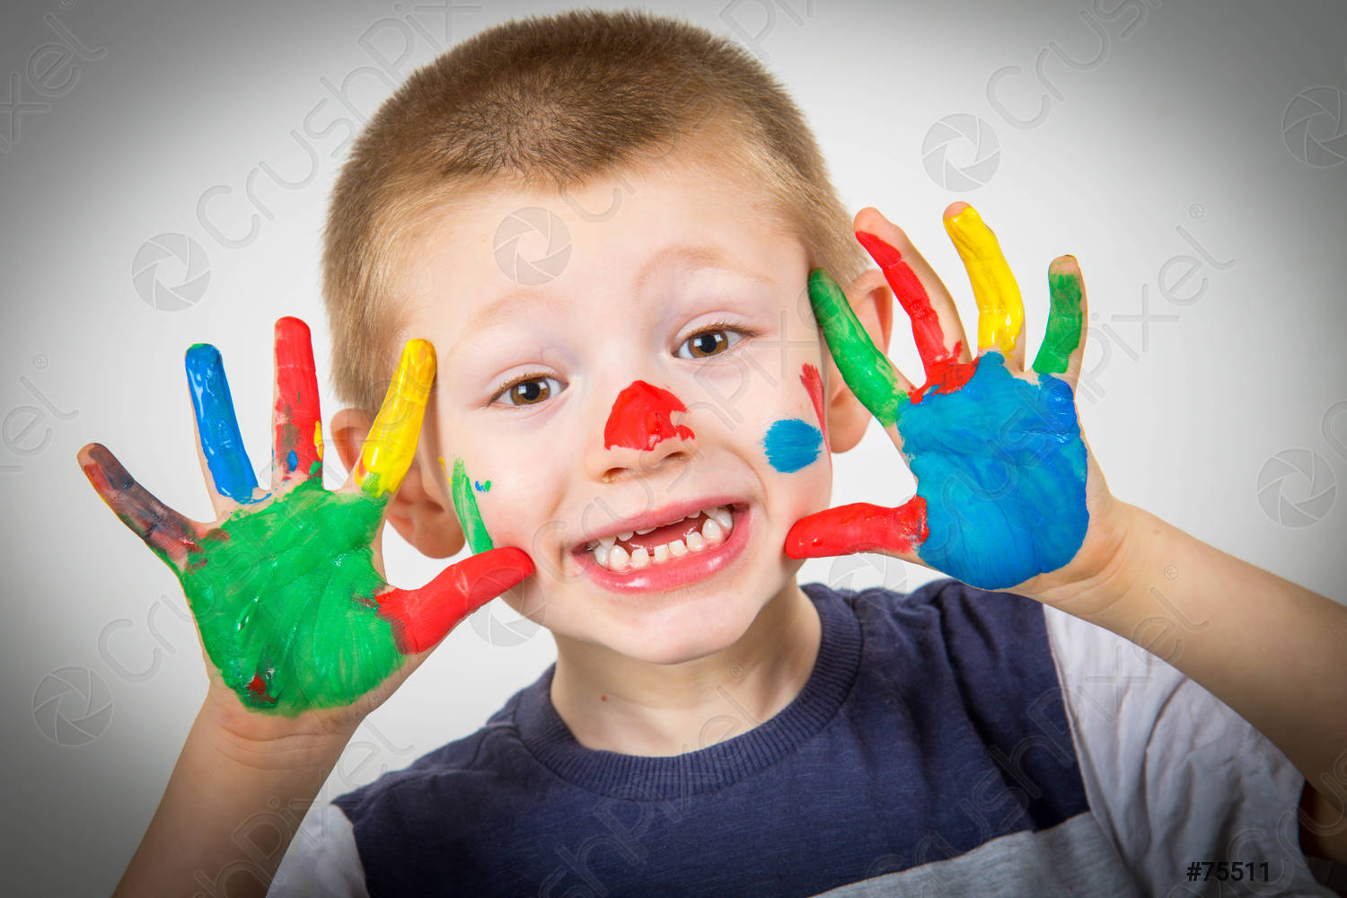
6
Young artists always do their best.
do

Slide 75
1
Future artists … in plein air.
paints
are painting
is painting
are paintining
50/50

Slide 76
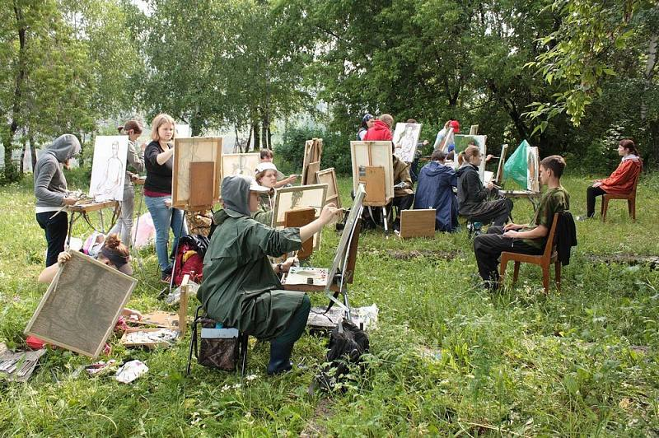
1
Future artists are painting in plein air.
are painting

Slide 77
2
English … learning.
worth
is worth
worths
is worthing
50/50

Slide 78
2
English is worth learning.
is worth

Slide 79
3
I … talented.
have
am being
be
am
50/50

Slide 80
3
I am talented.
am

Slide 81
4
Artists … much money.
don’t make
doesn’t make
make
are making
50/50

Slide 82
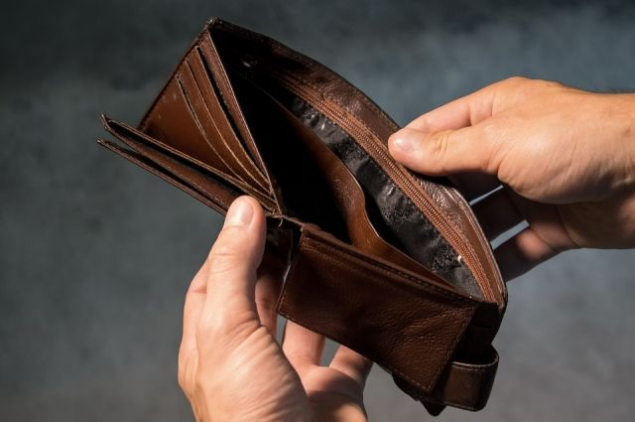
4
Artists don’t make much money.
don’t make

Slide 83
5
This student seldom … deadlines.
meet
meat
meets
doesn’t meet
50/50

Slide 84
5
This student seldom meets deadlines.
meets

Slide 85
6
A brilliant student even … in the English language.
dreams
is dreaming
dream
are dreaming
50/50

Slide 86
6
A brilliant student even dreams in the English language.
dreams

Slide 87
1
Hush! They … .
sleep
slip
are sleeping
slipping
50/50

Slide 88
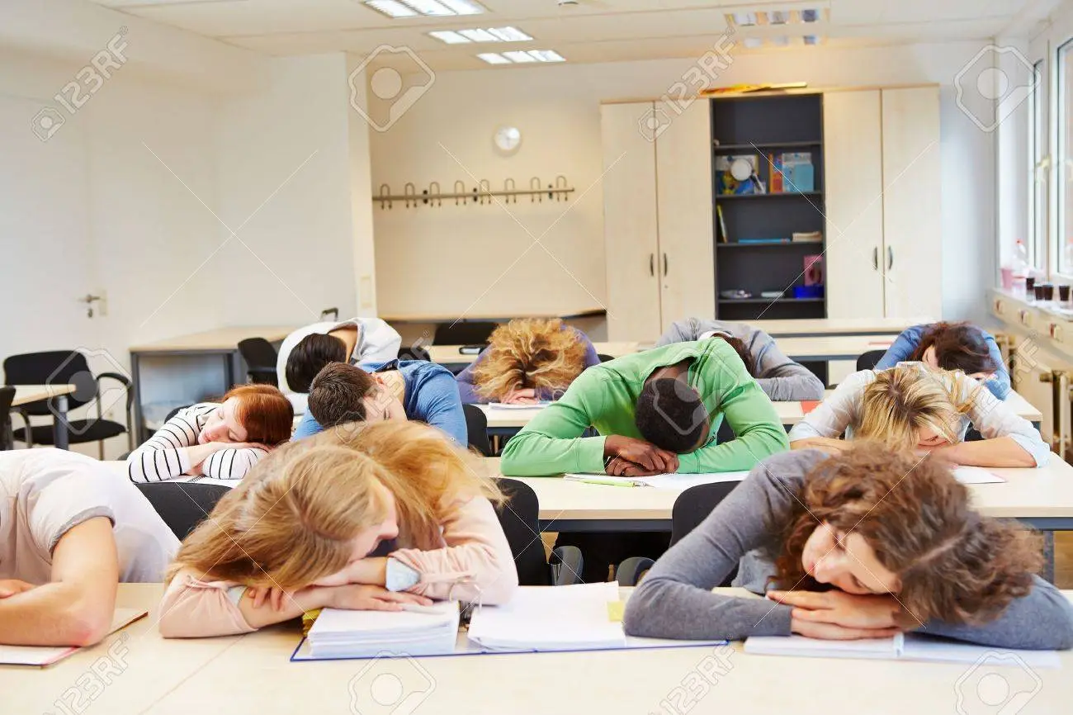
1
Hush! They are sleeping.
are sleeping

Slide 89
2
We … to pass all the exams.
hop
hopes
are hopping
hope
50/50

Slide 90
2
We hope to pass all the exams.
hope

Slide 91
3
Clients … picky!
is
are
be
are being
50/50

Slide 92
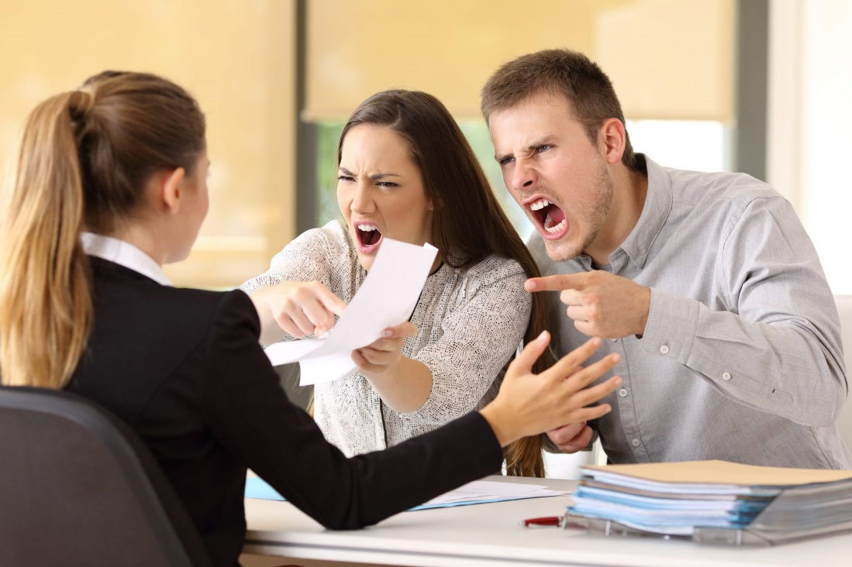
3
Clients are picky!
are

Slide 93
4
She … her to buy it.
is adviseing
advise
is advising
advises
50/50

Slide 94
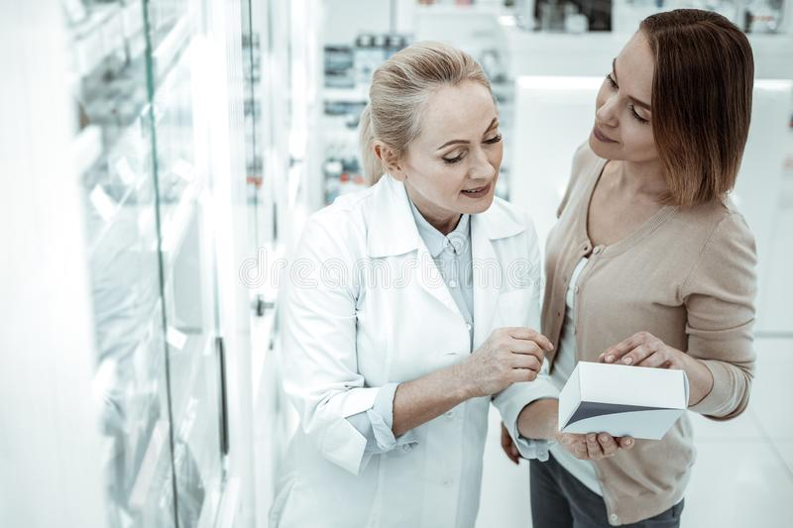
4
She advises her to buy it.
advises

Slide 95
5
Misunderstandings … .
is hapenning
happen
is happening
happens
50/50

Slide 96
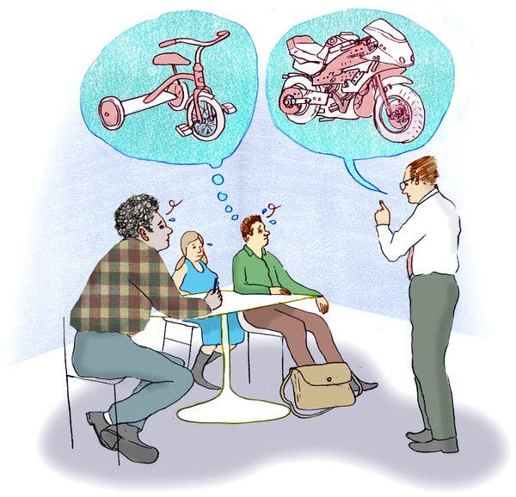
5
Misunderstandings happen.
happen

Slide 97
6
The young … the mould.
break
breaks
is breaking
are breaking
50/50

Slide 98
6
The young break the mould.
break

Slide 99
The game is over!

