Slide 1
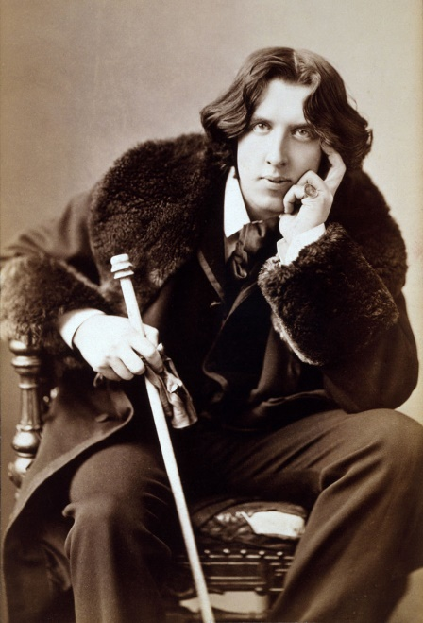
Oscar Wilde: one of the most talented writers
Prepared by 8A grade students
Yaroslav Ageev and Dmitriy Ismailov
School 10, Angarsk
28/04/2021

Slide 2
Childhood
Oscar Wilde was born in Dublin on October the 18th, 1854.
His father was a well-known doctor and an author of many scientific works. His mother was a fine lady, who wrote poems about Ireland.

Slide 3
Childhood
The boy’s childhood was connected with poetry and theatre, which had a huge impact on his future literary career and lifestyle. At nine years old, Oscar started attending the Royal School. Oscar ‘s elder brother William was two years older. Wilde's sister, Isola, was born in 1857 and died at age of nine of meningitis. Wilde's poem "Requiescat" is written to her memory.
"Tread lightly, she is near
Under the snow
Speak gently, she can hear
the daisies grow"
Impact - влияние
Attending – посещать
Meningitis -менингит
Gently – тихо, нежно
Daisies -ромашки
«Requiescat» - «Отдых»(лат.)

Slide 4
Education at college
Magdalen College in Oxford
At the age of 17 in 1871 he entered Trinity College in Dublin. After having graduated from Trinity College he entered Magdalen College in Oxford. There he improved his pronunciation. He was one of the best students. He graduated from this college in 1878. He showed an outstanding academic result.
Pronunciation - произношение
Graduate – закончил обучение
Outstanding -выдающийся

Slide 5
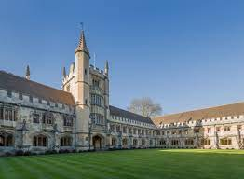
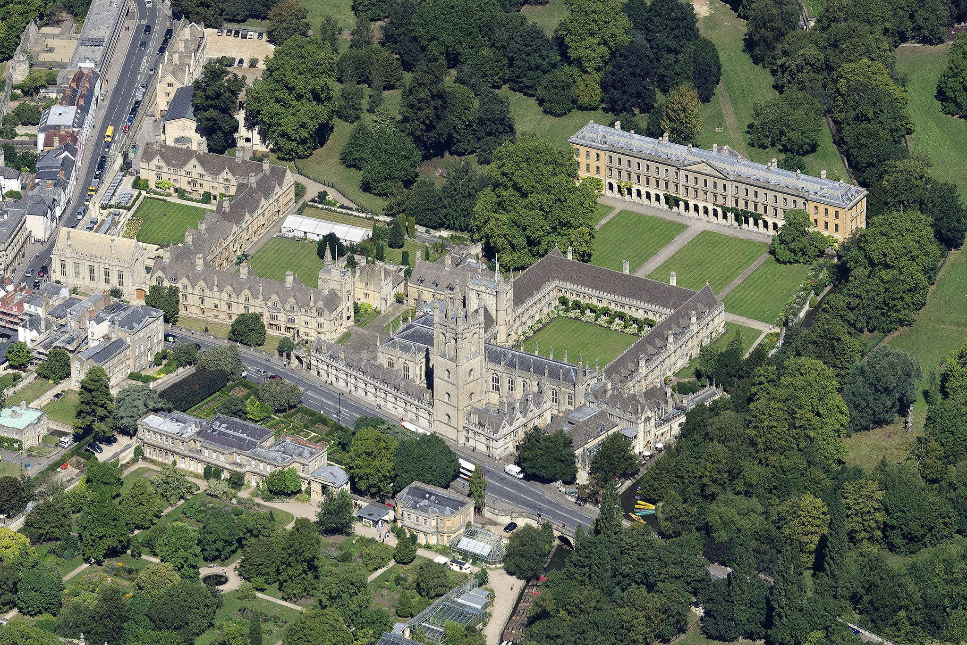
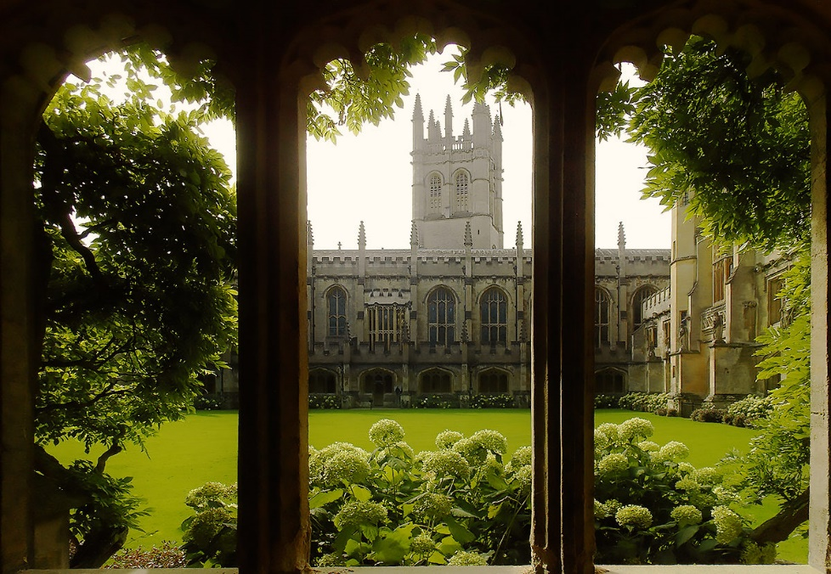
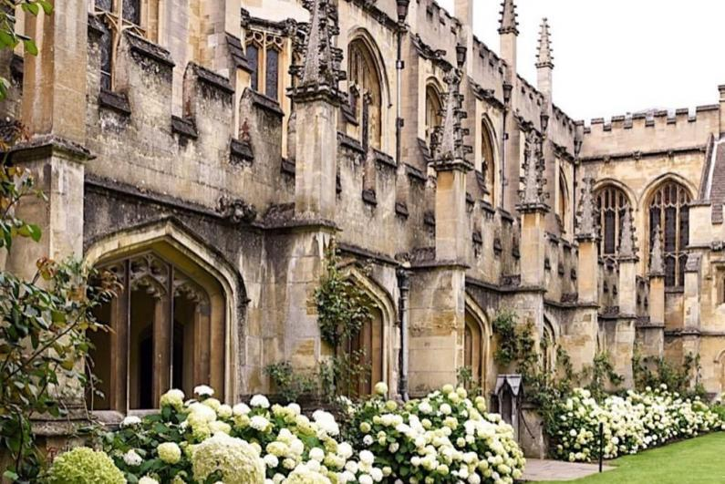
literary – литературный
Career - карьера
Review -обзор
After that, he moved to Chelsea in London (1879) to start literary career. In 1881, he published his first collection of poetry – “Poems” that received mixed reviews by critics.

Slide 6
Work of Oscar Wilde
Glorifies - прославляет
Despises - презирает
Egotism - эгоизм
Greed - жадность
Wealth - богатство
Poverty - бедность
Oscar Wilde glorified beauty. He admired unselfishness, kindness, and generosity. He despised egotism and greed. Oscar showed the contrast between wealth and poverty.

Slide 7
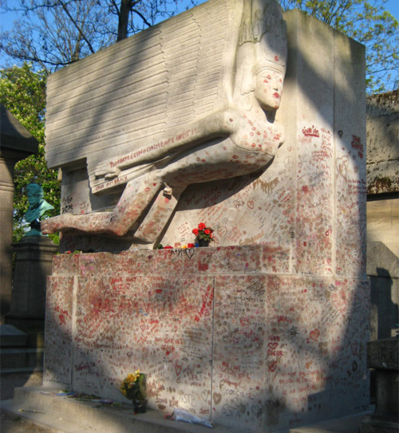
Wilde’s last years
Cemetery - кладбище
Wilde died of meningitis on 30 November 1900 penniless in a cheap Paris hotel. His grave is at Pere Lachaise Cemetery.
Penniless – без гроша в кармане
Grave -могила
Grave of Oscar Wilde

Slide 8
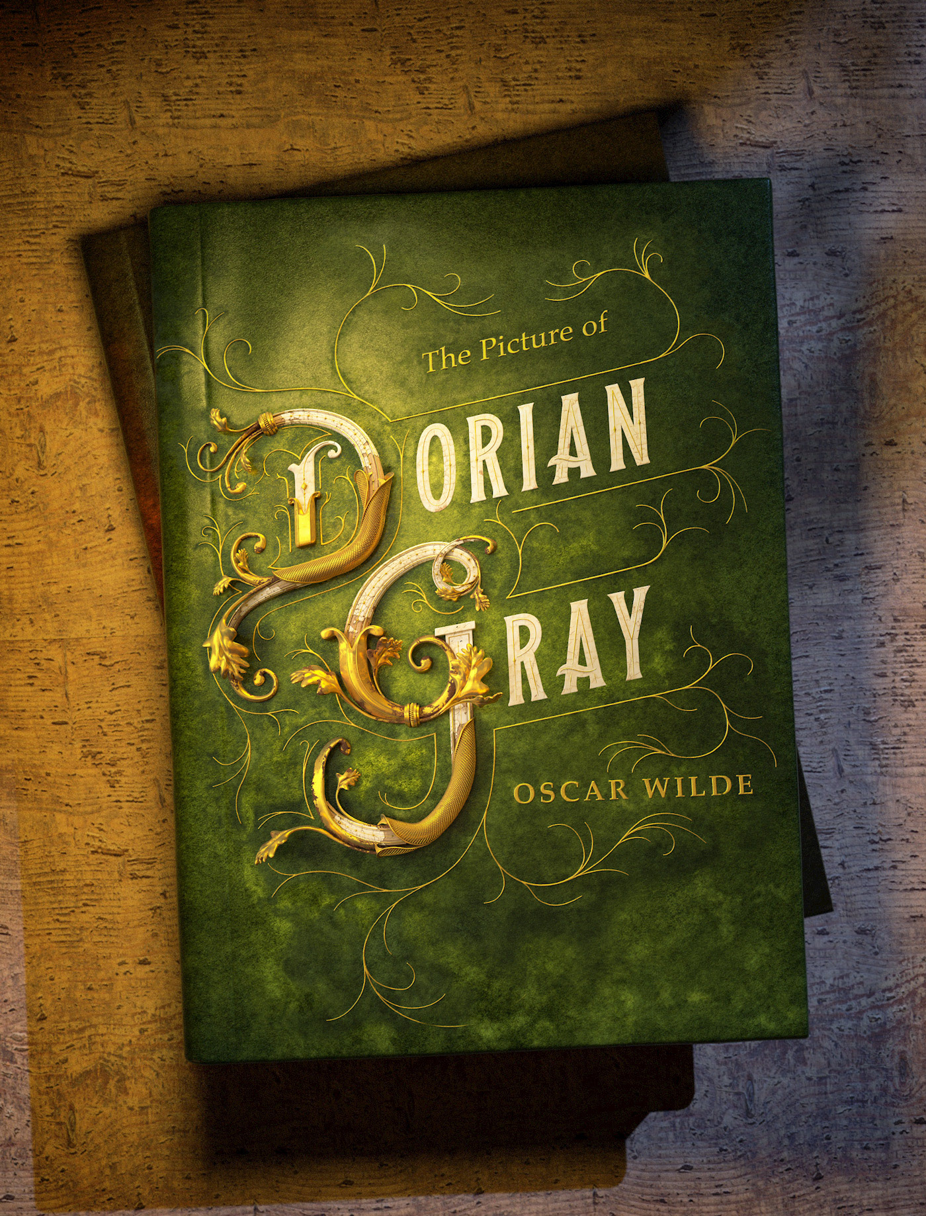
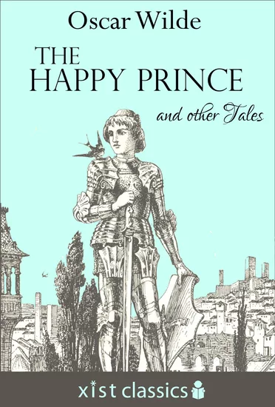
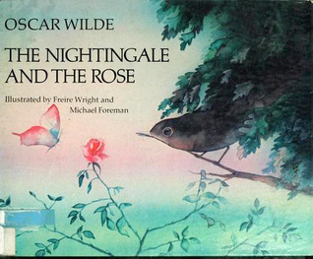
Thanks for attention!

