Slide 1
Starlight 11
Презентацию подготовила
Учитель английского языка МБОУ г. Иркутска СОШ№19
Мурашева Елена Владимировна

Slide 2
Unit 2.12 Across Cultures
National Treasures
Objectives:
You will learn about different national parks, some of the attractions that each park has, what you can see and do there.

Slide 3
Every year millions of people visit national parks to vacation and learn about history of countries. National parks belong to you and to me. They belong to all of us. Each national park protects something special. These places have been set aside because they are important for people to know about. Some parks have special natural features, special plants, hot springs and geysers, lakes, etc.
All of these very different places have one thing in common. Each represents an important example of our country’s natural and cultural history. They are a legacy, an inheritance, saved for you and for your children, and for all the future generations.

Slide 4
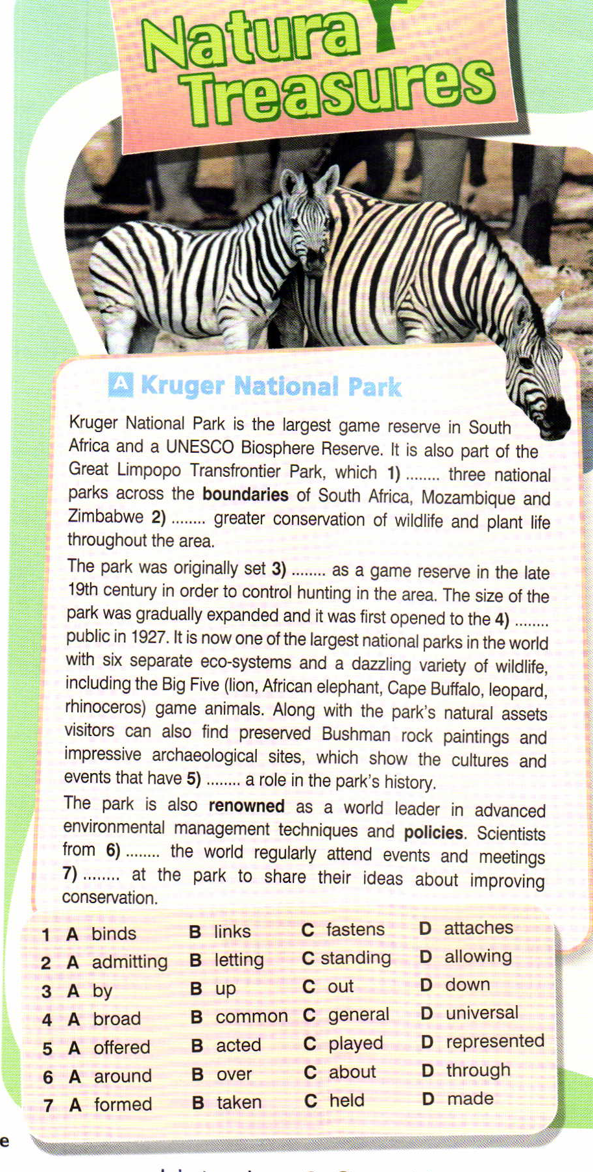
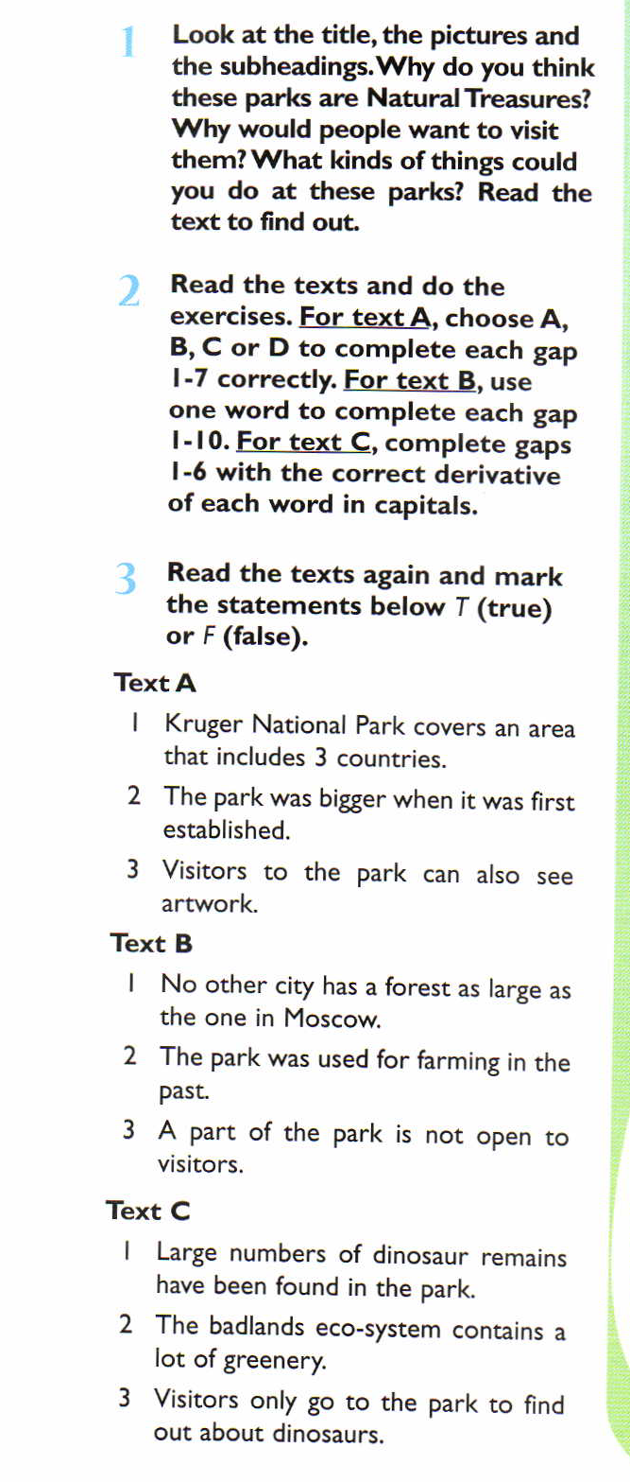

Slide 5
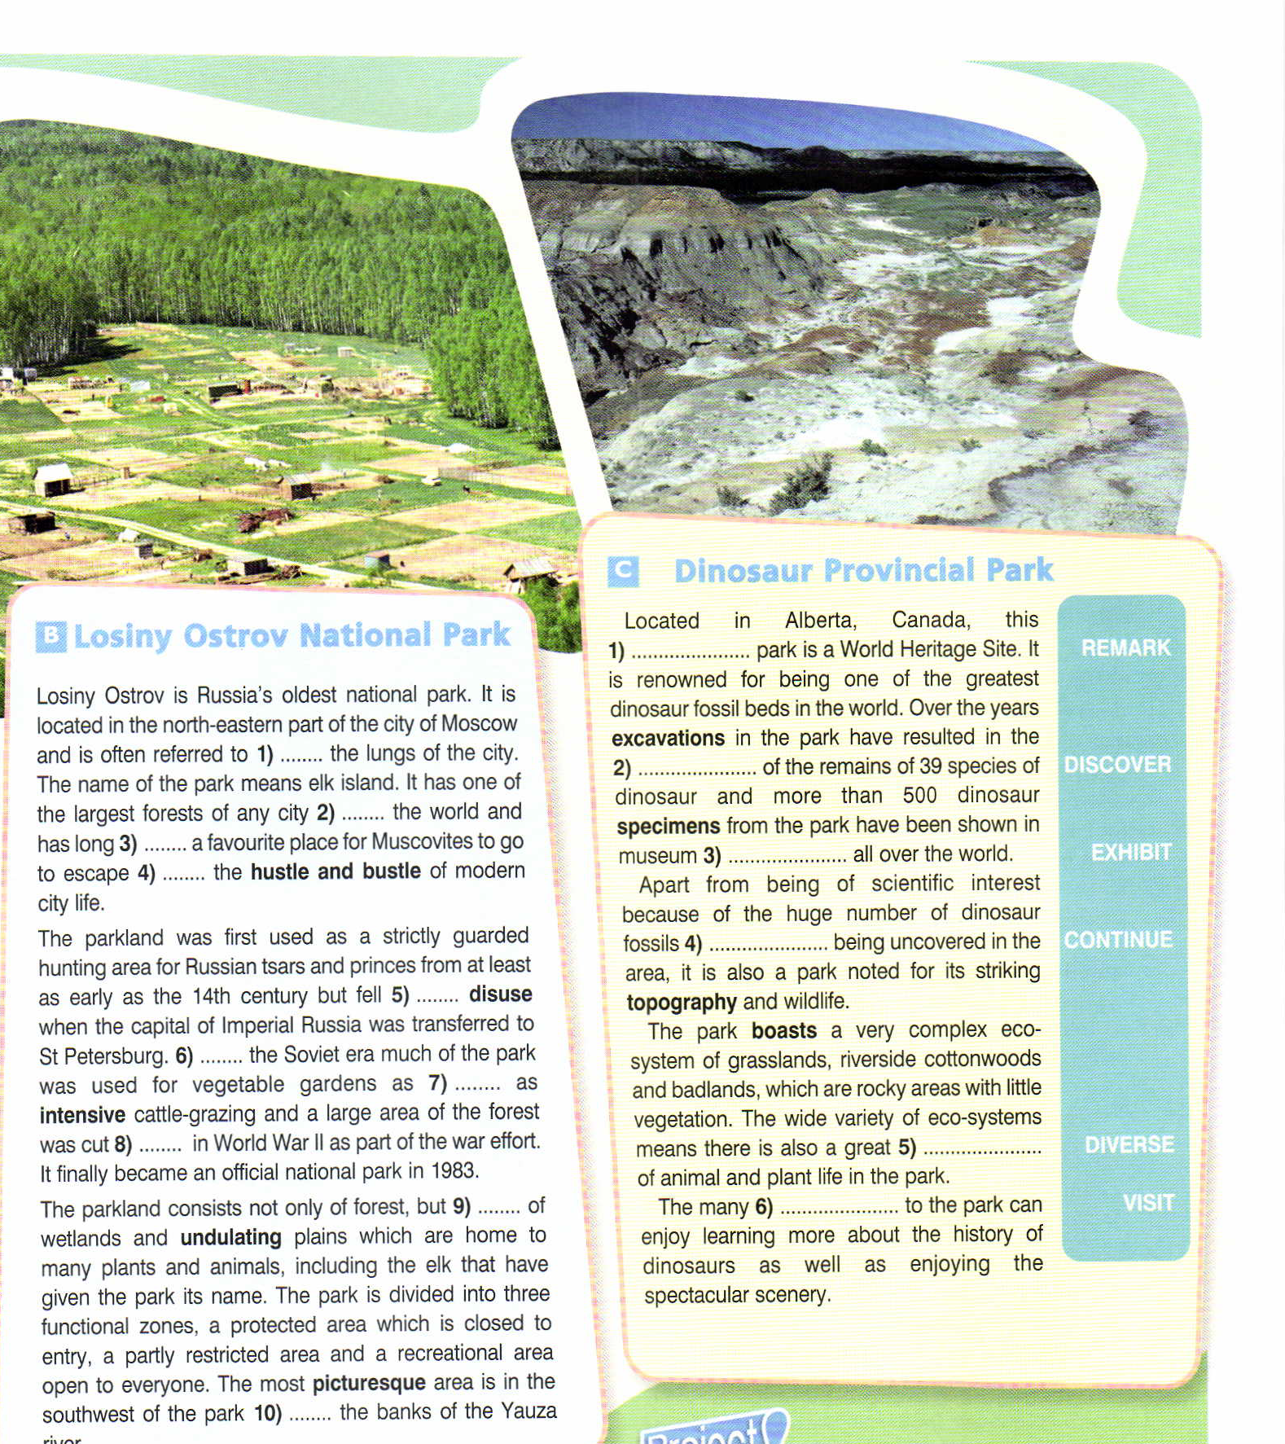

Slide 6
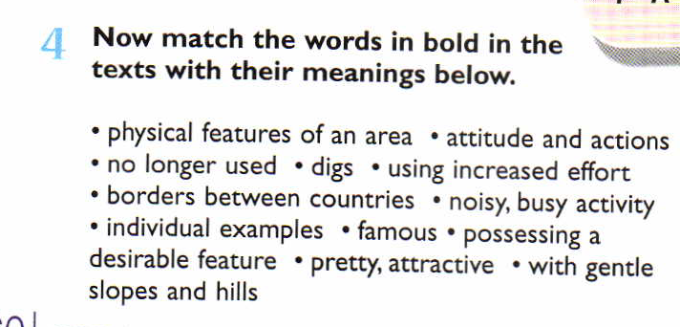
Vocabulary
boundaries, renowned, policies, hustle and bustle, disuse, intensive, undulating, picturesque, excavations, specimens, topography, boasts.

Slide 7
Pribaikalsky National Park covers the southwest coast of Lake Baikal in southern Siberia. The coastal strip includes some mountain ridges to the west as well as offshore islands such as Olkhon Island to the east . It is about 50 km southeast of the city of Irkutsk, Irkutsk oblast. The park is managed with three other nature reserves, and is a major component of the UNESCO World Heritage Site “Lake Baikal”.

Slide 8
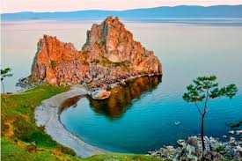
Homework. Collect information about the Pribaikalsky National Park . Find out what people can see and do there. Make a presentation to the class.
Find the following information:
1. interesting facts
2. climate
3. topography
(mountains, rivers)
4. plants
5. animals, birds, fishes
6. amazing places
7. tourism

Slide 9
Answer the following questions:
What is the season that you think would be a good time of the year to go to this national park? (spring, summer, winter, autumn)
Which kinds of activities could you do at this national park? (hiking, camping, swimming, skiing, go boating, fishing, learning about history, etc.)
What is historic about your park?(a famous person was born there, a famous person lived there, a famous battle happened there, an important event took place there)
What job would you like to do at this place?
Do you think that changes in the weather, pollution, any other are threats to this national park?

Slide 10
Thanks for your attention and good work!

