Slide 1
Sports & Hobbies
Starlight 5

Slide 2
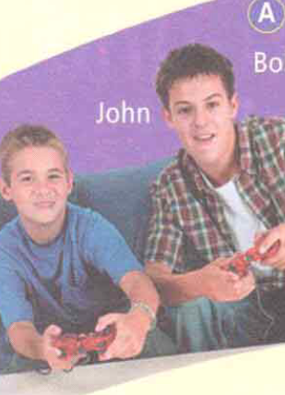
Guess a hobby or a sport
Playing computer games

Slide 3
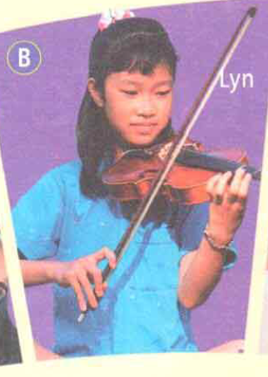
Guess a hobby or a sport
Playing music

Slide 4

Guess a hobby or a sport
Reading

Slide 5
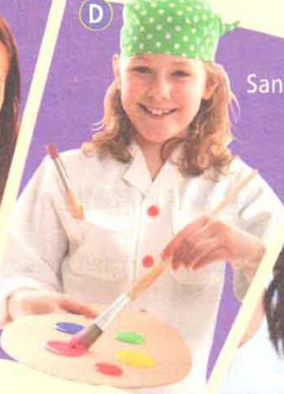
Guess a hobby or a sport
Drawing

Slide 6
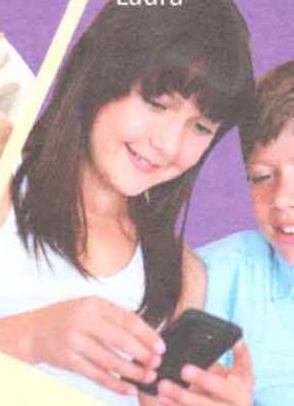
Guess a hobby or a sport
Photography

Slide 7

Guess a hobby or a sport
Horse riding

Slide 8
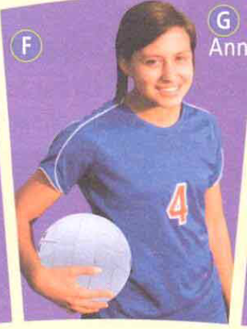
Guess a hobby or a sport
Volleyball

Slide 9
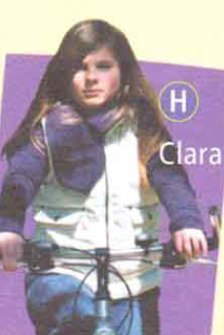
Guess a hobby or a sport
Cycling

Slide 10

Guess a hobby or a sport
Writing

Slide 11
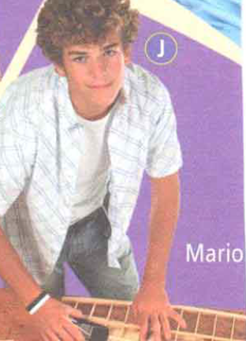
Guess a hobby or a sport
Woodwork

