Slide 1
Study now be proud later

Slide 2
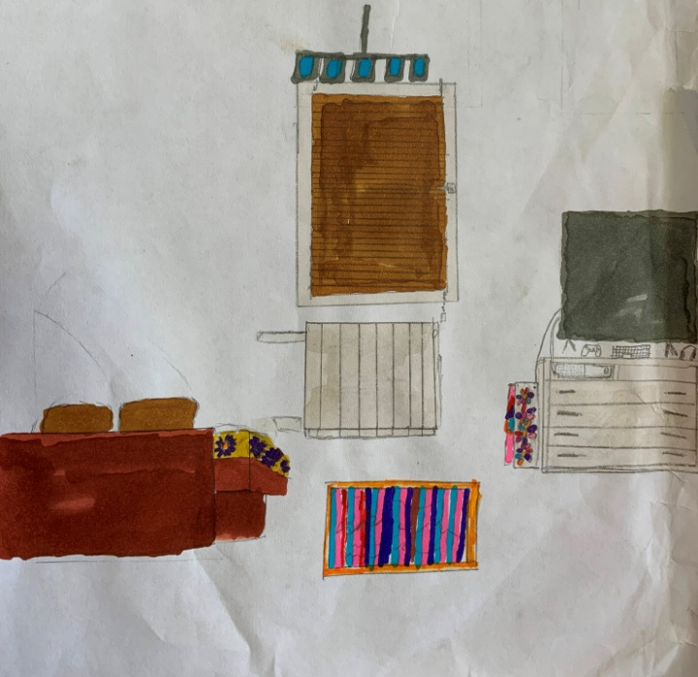
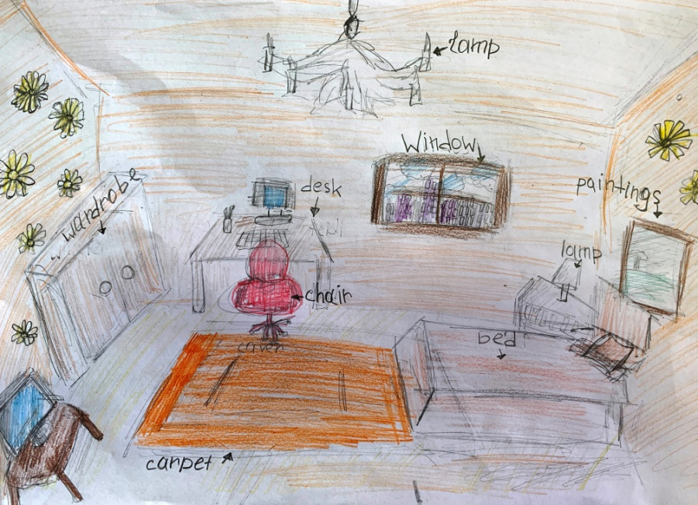
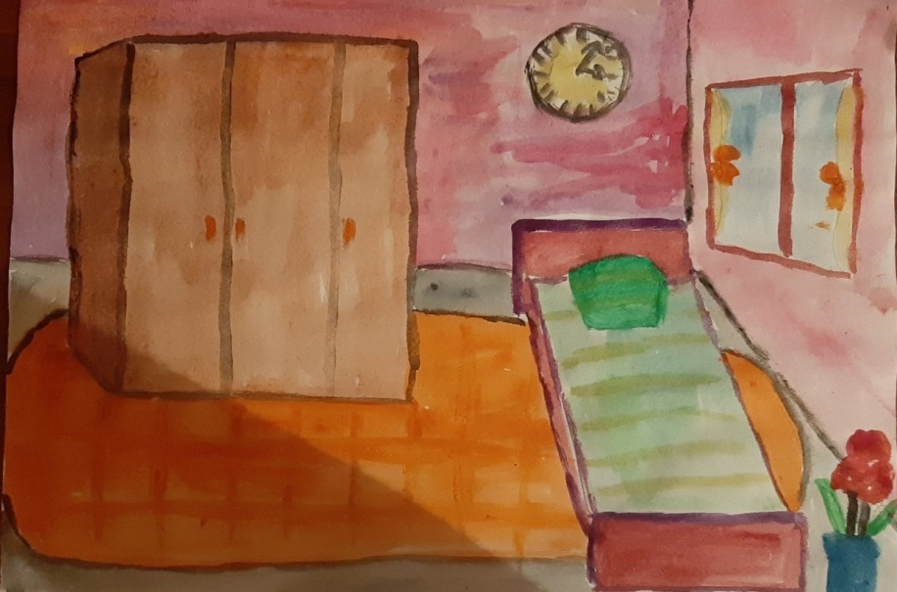
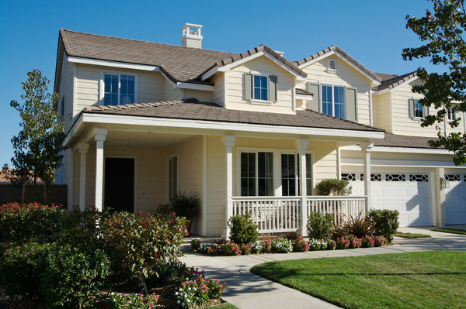

Slide 5
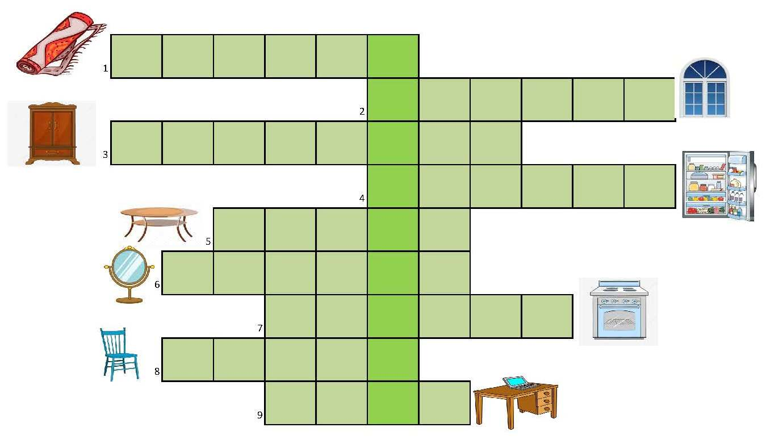
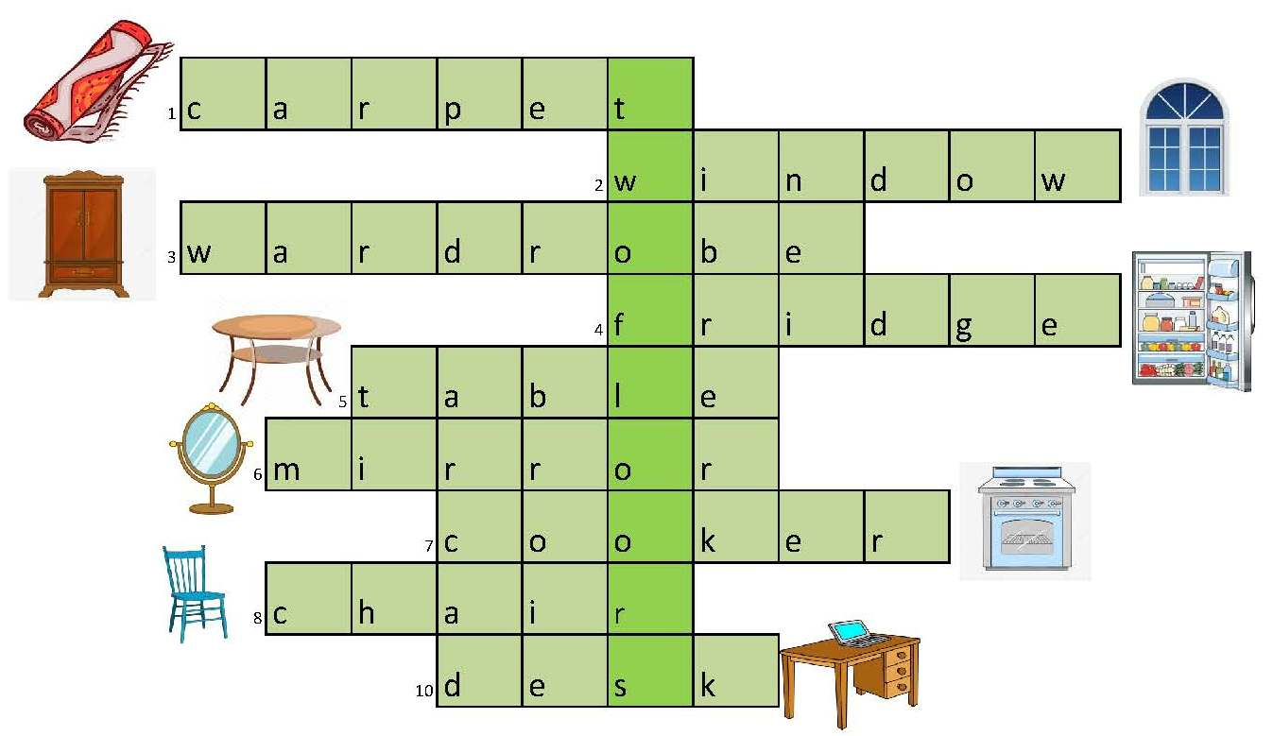
How many floors does a typical American house have?

Slide 7
What is there in the rooms?
a bathroom
a bedroom
a kitchen
a living room

Slide 10
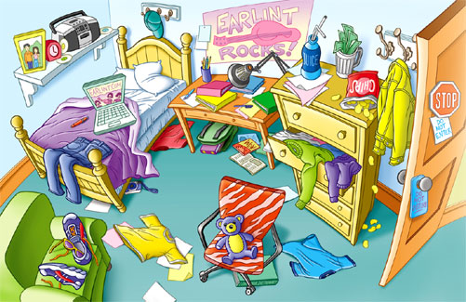

Slide 11
Check your answers:
1. There is a camera under the bed. -T
2.There are trainers on the table.- F
3.There is a cap on the wall. - T
4.There are two teddy bears on the chair. -F
5.There are four books on the table. - T
6.There is a schoolbag under the table. - T
6
5
> 4
4

