Slide 1
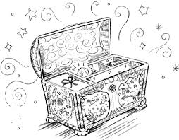
subjects about school Talking

Slide 2
Talking about school subjects

Slide 3
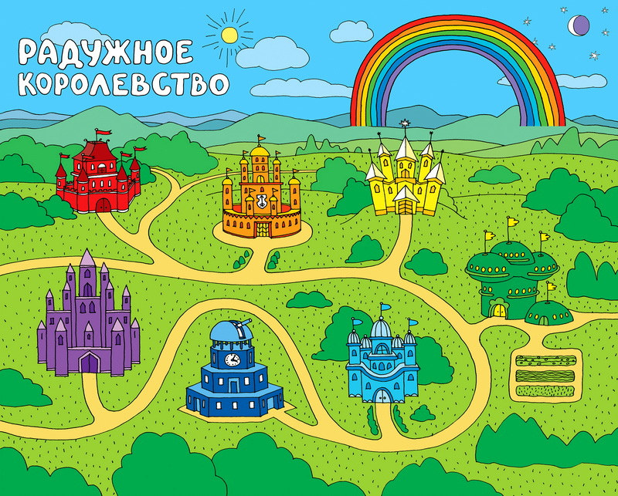
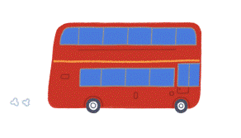
The Kingdom of Knowledge

Slide 4
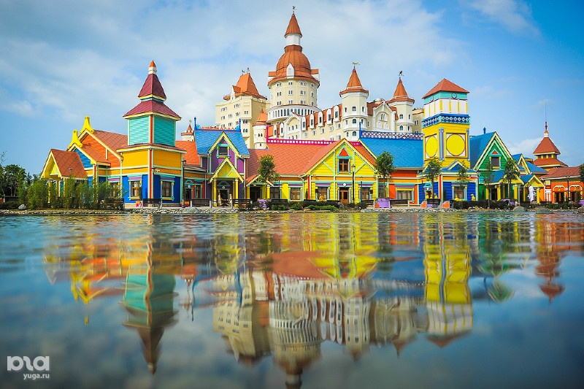
“The Town of Sounds”
[t] – timetable, Tuesday, Art, subject, Technology, Information technology, Mathematics; [k] – clever, nickname, mark, speak, speak English, speak correctly, Chemistry; [l] – Literature, lesson, school uniform, learn, local; [f] – form, Physics, Physical education, Geography [h] – how, happy, homework, to do homework, History; [e] – spend, Technology, friend, help;
[b] – break, Biology, black board
[r] - Reading, Russian language

Slide 5
School subjects
Art
Technology
Information technology (IT)
Literature
Russian language
Physics
Physical Education (PE)
Geography
History
Mathematics
Chemistry

Slide 6
School subjects
Art | Рисование
Technology
Information technology (IT)
Literature
Russian language
Physics
Physical Education (PE)
Geography
History
Mathematics
Chemistry

Slide 7
School subjects
Art | Рисование
Technology | Технология
Information technology (IT)
Literature
Russian language
Physics
Physical Education (PE)
Geography
History
Mathematics
Chemistry

Slide 8
School subjects
Art | Рисование
Technology | Технология
Information technology (IT) | Информатика
Literature
Russian language
Physics
Physical education (PE)
Geography
History
Mathematics
Chemistry

Slide 9
School subjects
Art | Рисование
Technology | Технология
Information technology (IT) | Информатика
Literature | Литература
Russian language
Physics
Physical Education (PE)
Geography
History
Mathematics
Chemistry

Slide 10
School subjects
Art | Рисование
Technology | Технология
Information technology (IT) | Информатика
Literature | Литература
Russian language | Русский язык
Physics
Physical Education (PE)
Geography
History
Mathematics
Chemistry

Slide 11
School subjects
Art | Рисование
Technology | Технология
Information technology (IT) | Информатика
Literature | Литература
Russian language | Русский язык
Physics | Физика
Physical Education (PE)
Geography
History
Mathematics
Chemistry

Slide 12
School subjects
Art | Рисование
Technology | Технология
Information technology (IT) | Информатика
Literature | Литература
Russian language | Русский язык
Physics | Физика
Physical Education (PE) | Физкультура
Geography
History
Mathematics
Chemistry

Slide 13
School subjects
Art | Рисование
Technology | Технология
Information technology (IT) | Информатика
Literature | Литература
Russian language | Русский язык
Physics | Физика
Physical Education (PE) | Физкультура
Geography | География
History
Mathematics
Chemistry

Slide 14
School subjects
Art | Рисование
Technology | Технология
Information technology (IT) | Информатика
Literature | Литература
Russian language | Русский язык
Physics | Физика
Physical Education (PE) | Физкультура
Geography | География
History | История
Mathematics
Chemistry

Slide 15
School subjects
Art | Рисование
Technology | Технология
Information technology (IT) | Информатика
Literature | Литература
Russian language | Русский язык
Physics | Физика
Physical Education (PE) | Физкультура
Geography | География
History | История
Mathematics (Maths) | Математика
Chemistry

Slide 16
Art | Рисование
Technology | Технология
Information technology (IT) | Информатика
Literature | Литература
Russian language | Русский язык
Physics | Физика
Physical Education (PE) | Физкультура
Geography | География
History | История
Mathematics (Maths) | Математика
Chemistry | Химия

Slide 17
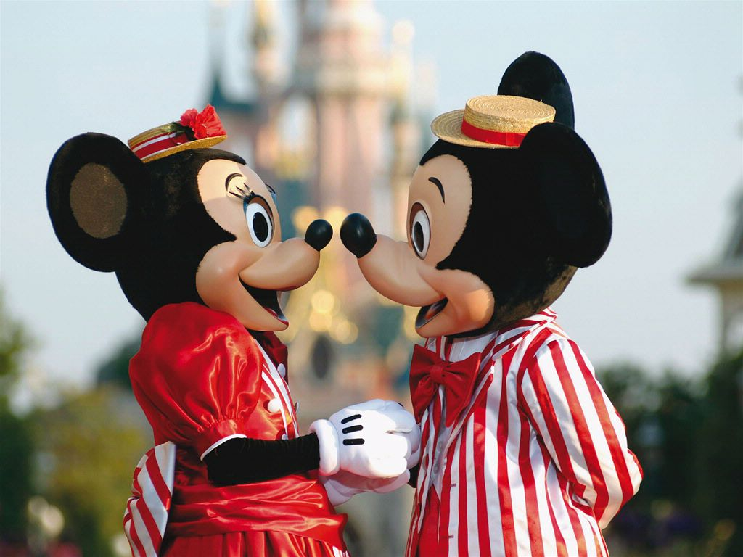
“The Town of Speech”

Slide 18
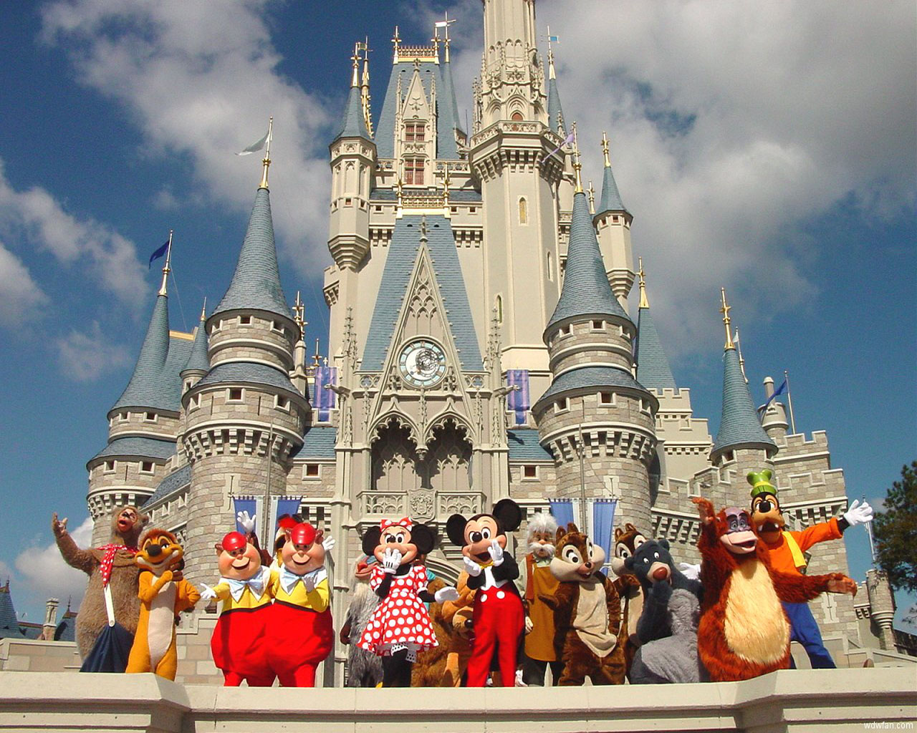
“The Town of Communication”

Slide 19
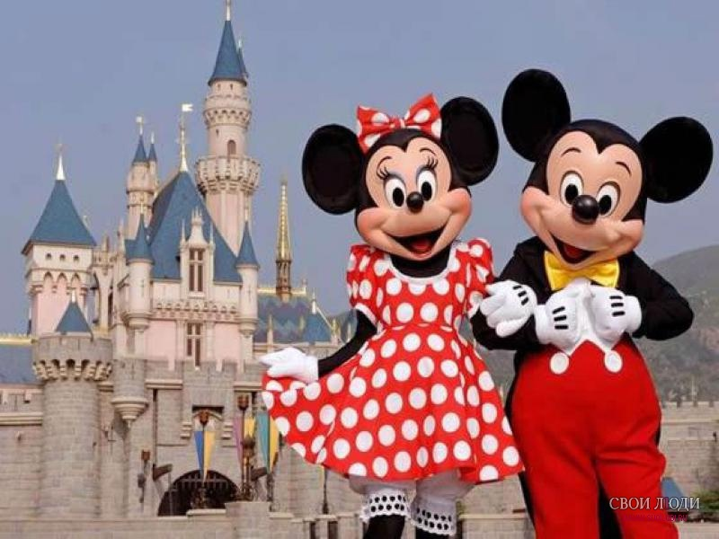
“The Town of the Rest”

Slide 20
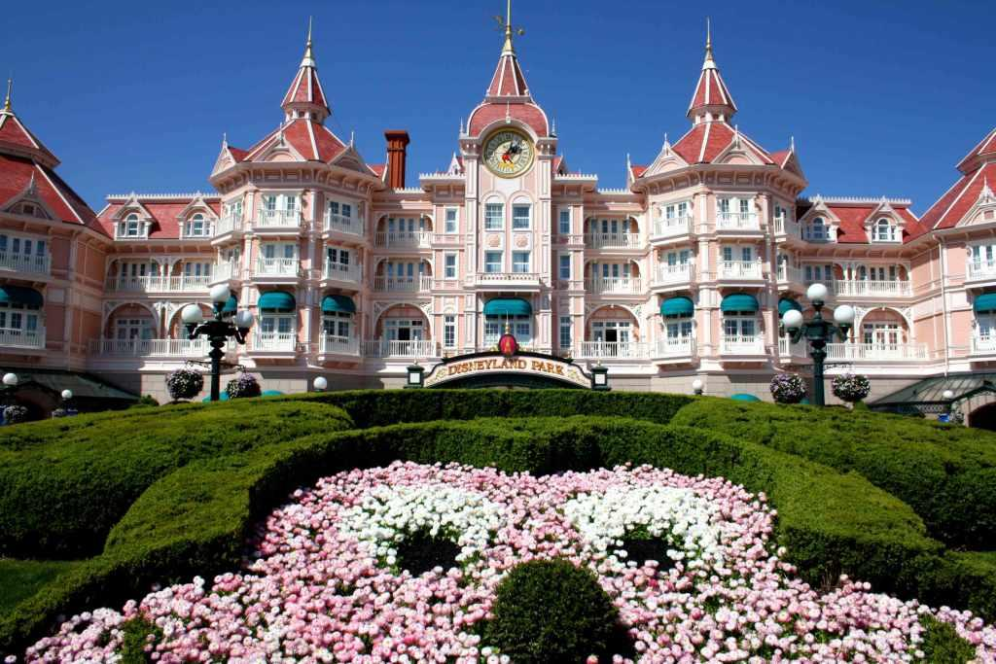
“The Town of Education”
school

Slide 21
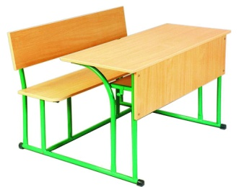
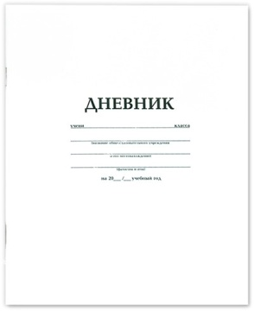
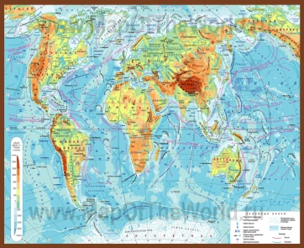
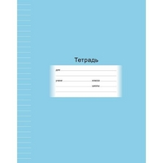
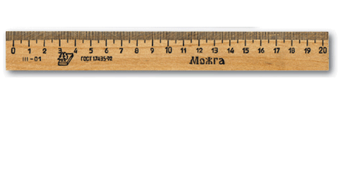
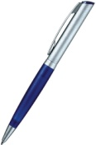
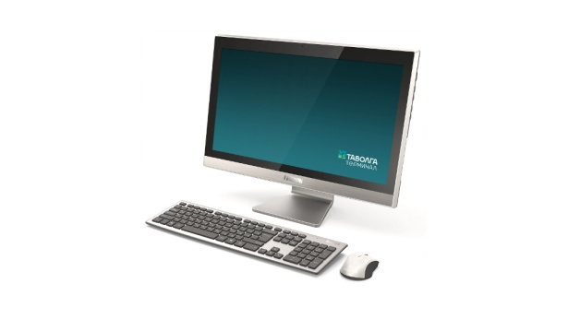
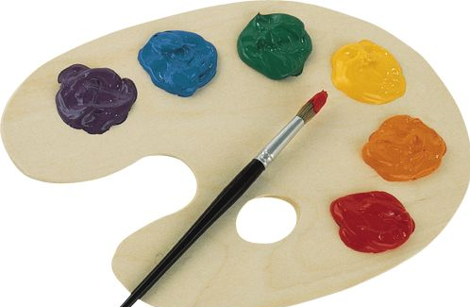
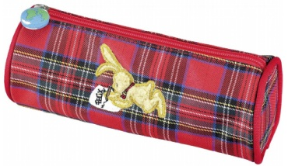
“The Town of Education”
a desk
the board
the map
a teacher’s desk
a home dairy
a ruler
a pencil
a pen
a notebook
a school bag
paints
a computer
a textbook
a pencil case

Slide 22
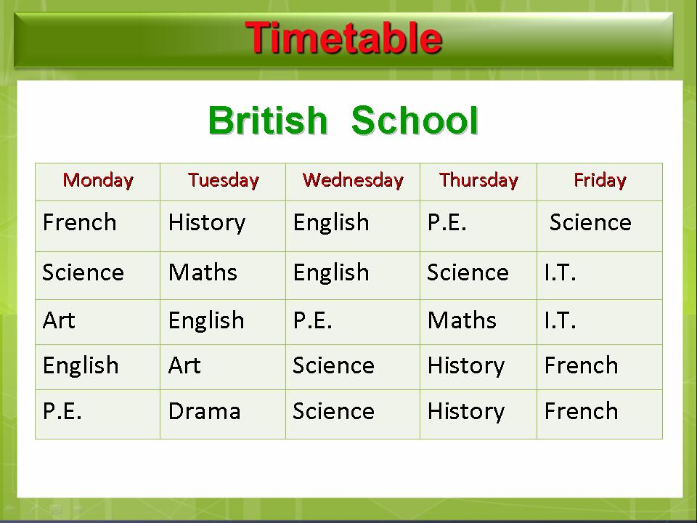
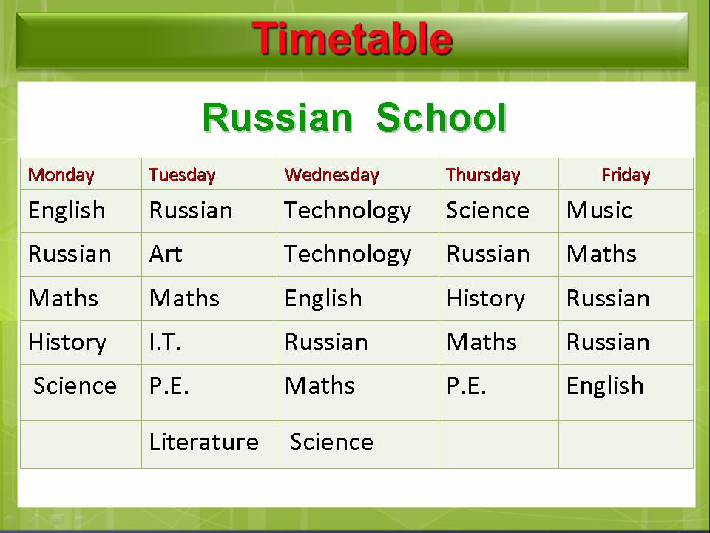

Slide 23
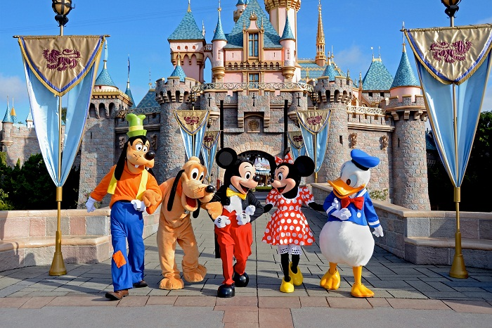
“The Town of the Game”

Slide 24
Checking list
Timetable
School
Biology
Literature
PE
Mathematics
Music
Art
IT
Geography

Slide 25
How have you done the work?
Very good
Good
Not so good

