Slide 1
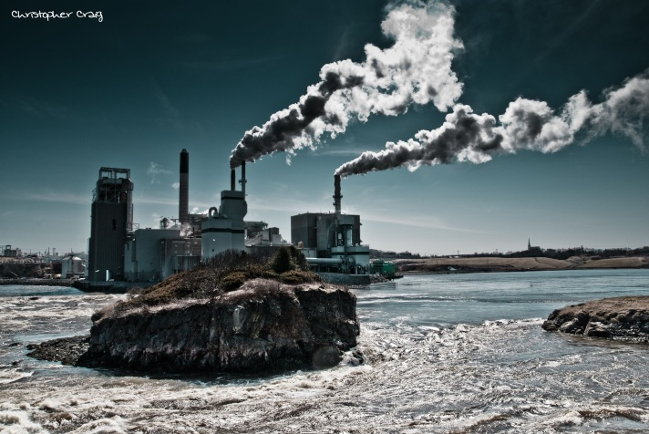
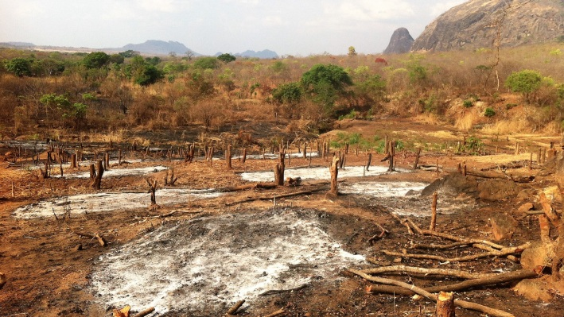
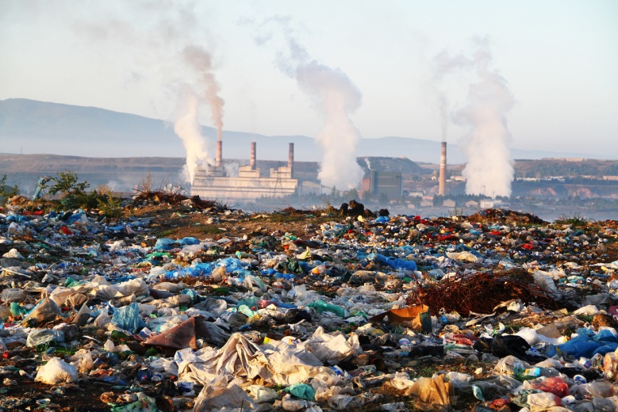
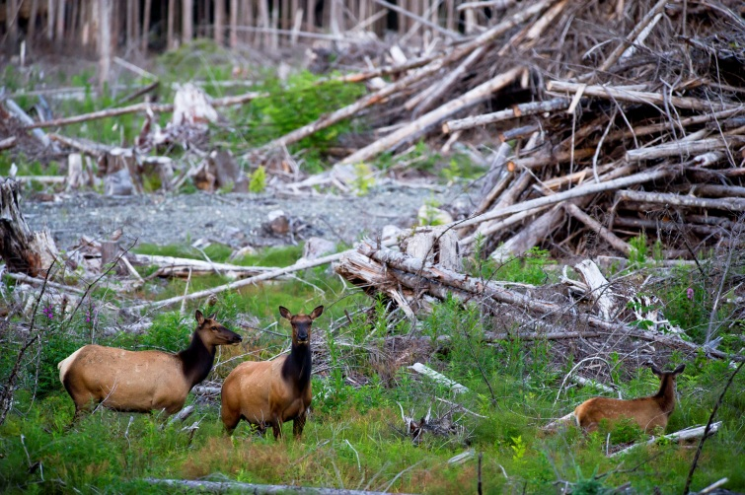
What are we going to talk about ?

Slide 2
Green issues = ecological problems
How to save the Earth?

Slide 3
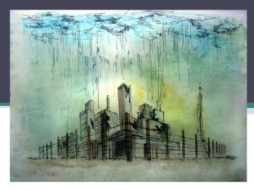
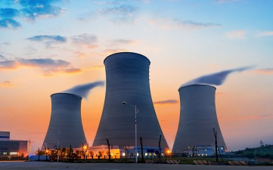
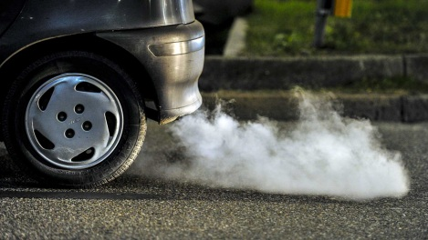
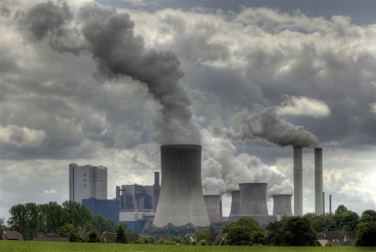
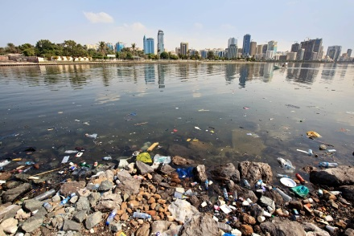
Match the words to the pictures
1 A power station a
2 Toxic fumes
3 Factory waste
4 Acid rain c
5 Polluted clouds
6 Loss of natural habitats
7 Water pollution
b
d
e
f
g

Slide 4
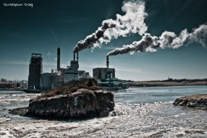
Check your answers
1 A power station b
2 Toxic fumes
3 Factory waste C
4 Acid rain a
5 Polluted clouds f
6 Loss of natural habitats d
7 Water pollution g
e

Slide 5
Look at the pictures and fill in the missing letters
1
1 a ____ r____
2 p_____ s_____ 2
3 f____ w______
4 l______ of n___ h___ 4
5 t_____ f______
6 p_____ c________ 5
7 w____ p_____ 6
3
7

Slide 6
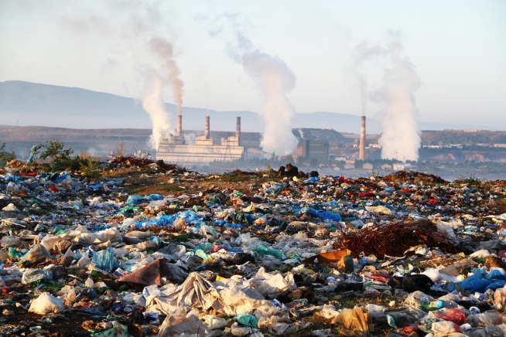
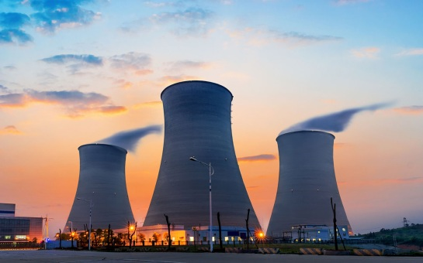
What can you see in the pictures?

Slide 7
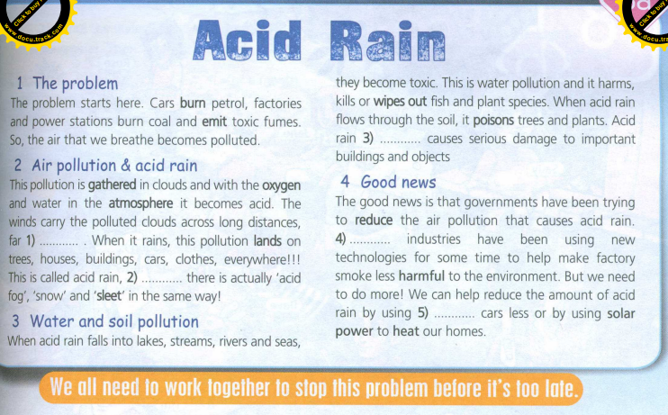
Read the text below and try to guess which words are missing
SB Spotlight 7 p. 76-77

Slide 8
Now listen to the text and check your answers.
SB Spotlight 7 p. 76-77

Slide 9
Answer the questions. Find the information in the text and prove your answers.
1. Why does the air that we breathe become polluted?
2. Why does the pollution gathered in the clouds turn into acid?
3. What’s acid rain? Why is it dangerous for the environment? What causes acid rain?
4. What is soil and water pollution?
5. What can we do to protect the environment?

Slide 10
Fill in the gaps the with the words bellow
Wipe out, petrol, carry, emit, land, poison, serious damage, heat, the amount of, harmful, reduce
1) burn________
2) _____toxic fumes
3)______ clouds across long distances
4) ______ on tress , houses, buildings
5)_______fish and plant species
6)_______trees and plants
7) cause ________
8) ________the air pollution
9) be________to the environment
10) reduce ________of acid rain

Slide 11
Check your answers
1) burn _petrol _______
2) _emit___ toxic fumes
3)__carry____ clouds across long distances
4) _land_____ on tress , houses, buildings
5)_wipe out___ fish and plant species
6)__poison___ trees and plants
7) cause __ serious damage __
8) _ reduce _______the air pollution
9) be __harmful ______ to the environment
10) reduce __ the amount of ____ acid rain

Slide 12
Replace the highlighted words with synonyms
1) petrol _______
2) emit___
3) carry__
4) _land_____
5)_wipe out___
6)__poison___
7) __ serious damage __
8) _ reduce _______
9) __harmful ______
10) __ the amount of ____

Slide 13
Check your answers
1) petrol (n) - gas, fuel
2) emit (v)- release, produce, let out, exhale
3) carry (v)__ transport, transmit
4) _land (v) _ set down, come, get
5)_wipe out (ph. V) _kill, eliminate,
6)__poison (v) - kill, spoil, destroy
7) __ serious damage __severe, damgerous harm,
8) _ reduce (v)__ make shorter, degrade, demote
9) __harmful (adj) __ adverse, bad, dangerous
10) __ the amount of (n) ____quantity, measure
Make up your own sentences with the words above.

Slide 14
Read the text again and guess what words are missing .

Slide 15
Check your answers

Slide 16
Discuss what we can do to help the environment.

Slide 17
Let’s sum up!
What new words and collocations do you remember?
What did you find out about acid rain ?
How can we protect the environment and save the Earth?
What are you personally going to do to make a difference?

