Slide 1
PERM IS MY HOMETOWN

Slide 2
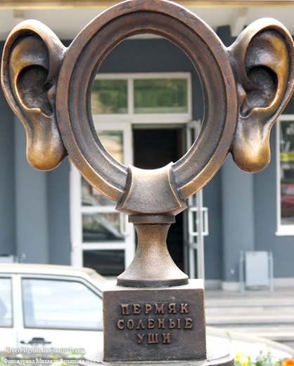
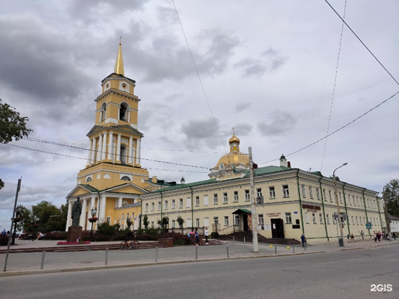
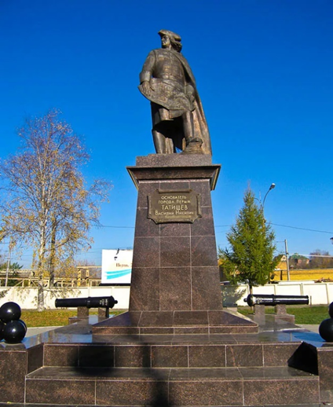
Where can you see the objects?
Perm State Art Gallery
the sculpture Permyak
Salty Ears
the monument to
Vasiliy Tatischev

Slide 3
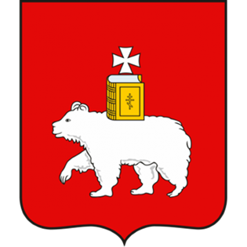
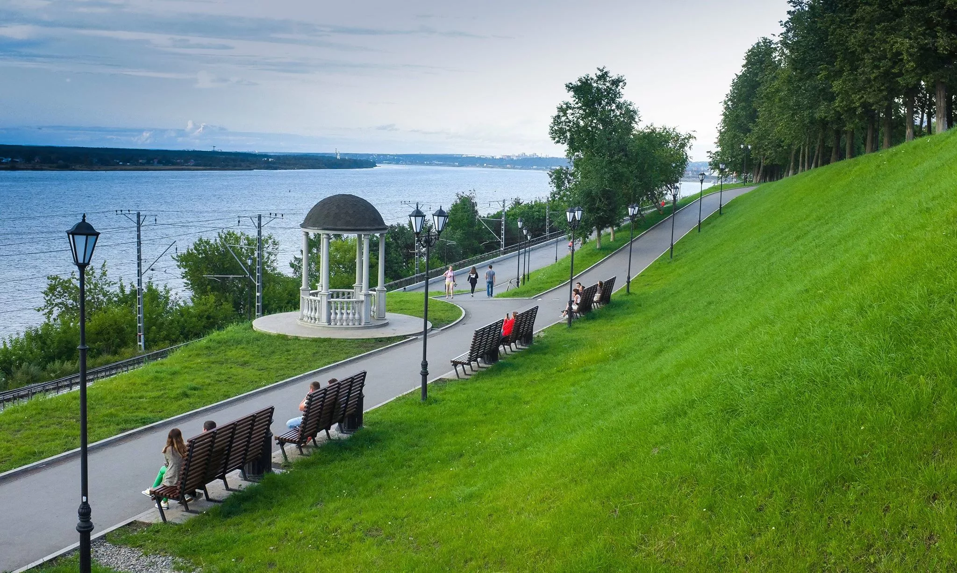
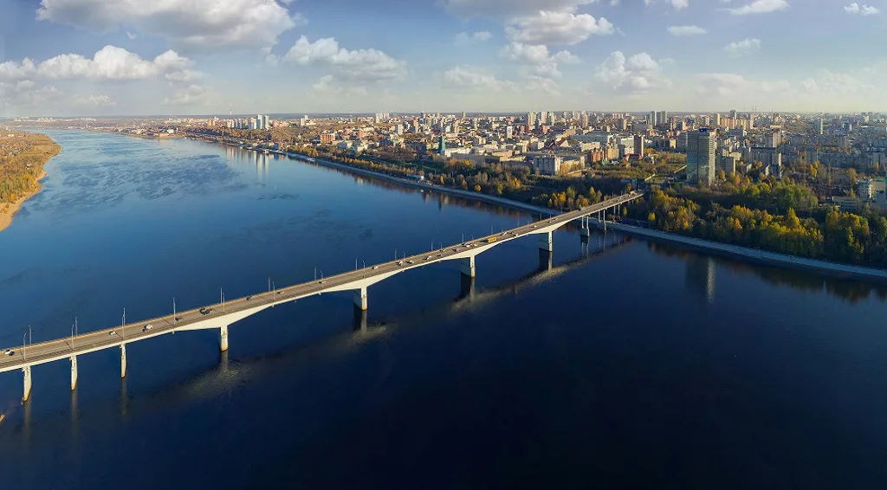
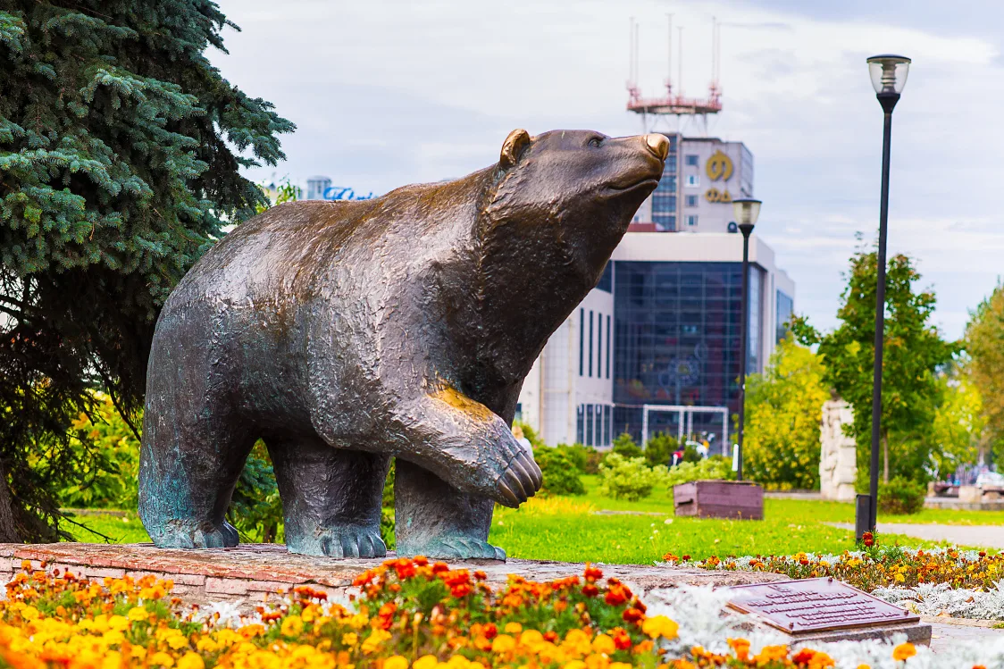
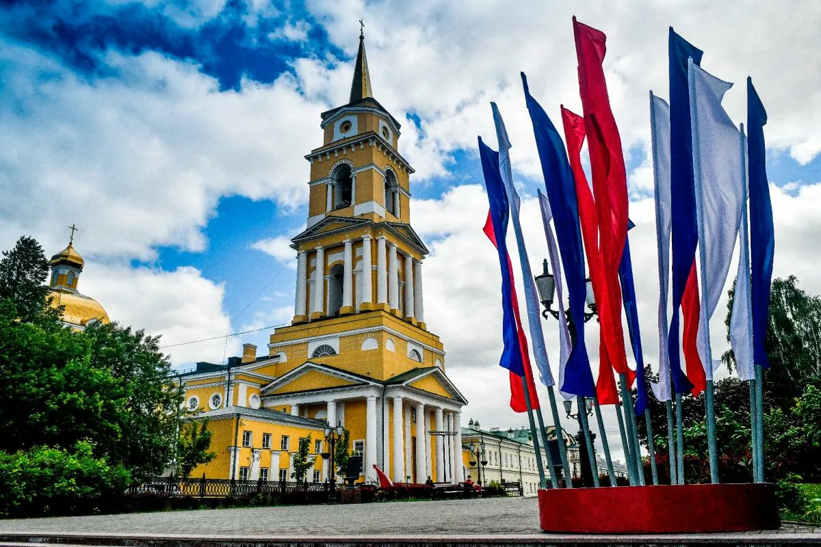
300th anniversary
of Perm

Slide 4
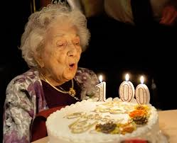
Anniversary is a date celebrated
every 10 years.
This is a cake for my mother’s …
The old lady is celebrating…

Slide 5
Fill in the words from the box.
paintings activities largest scientists Europe centre Saint-Petersburg known 1723 famous writers
Perm is the administrative centre (0) of the Perm region. It was founded in … (1). Perm is situated on the border of … (2) and Asia. It is the third largest Russian city after Moscow and … (3). The city is located on the bank of the Kama River, the fifth … (4) river in Europe after the Volga, the Danube, the Ural and the Dnieper. Today’s Perm is … (5) for its … (6) first-class ballet, for the collection of … (7) and ancient wooden sculptures in the Art Gallery. There are a lot of possibilities for most kinds of outdoor … (8) in the Perm region. Perm is associated with the names of such great … (9) and … (10) as …(name them).

Slide 6
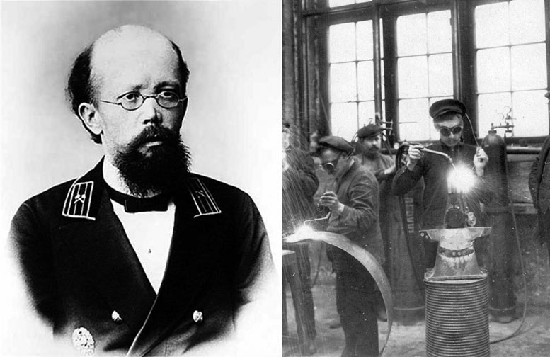
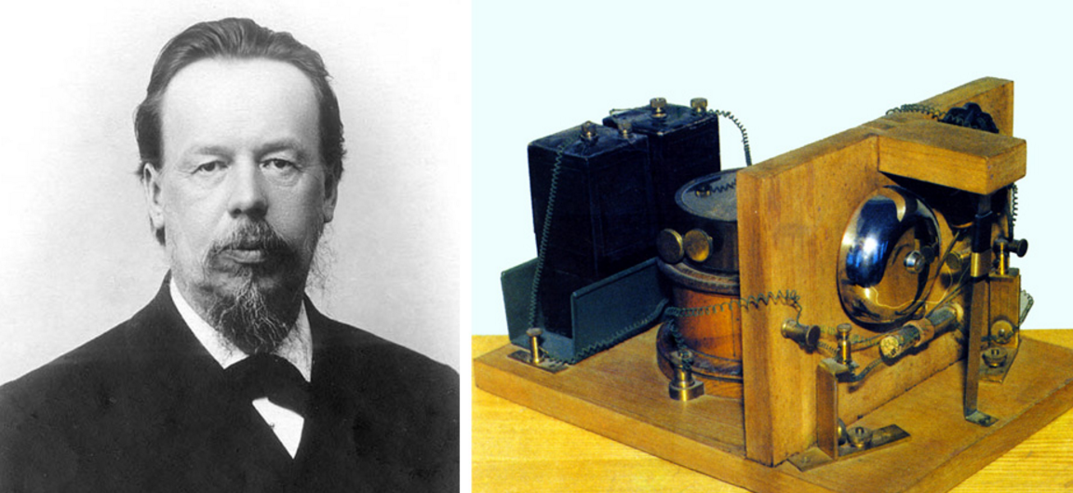
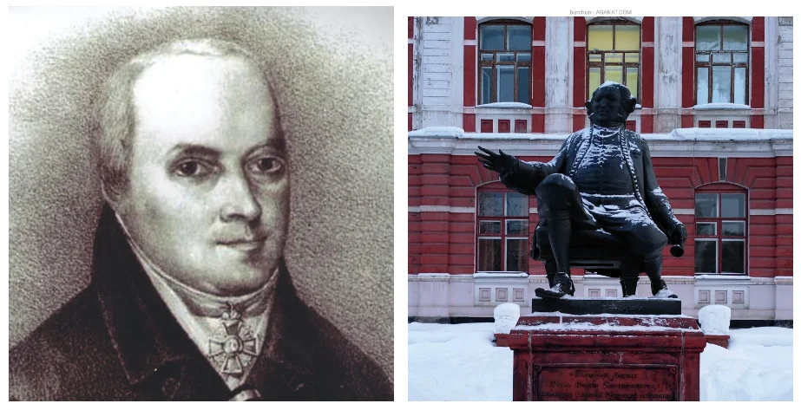
Aleksandr Popov,
an inventor of the radio
Nikolay Slavyanov,
a Russian engineer
Fyodor Gral,
a famous Perm professor of medicine

Slide 7
Work in groups and do the task given in your files. Be ready to present your page.
HISTORY, GEOGRAPHY AND GENERAL FACTS
SIGHTS (PLACES OF INTEREST) AND ART-OBJECTS
FAMOUS PEOPLE

