Slide 1


Slide 2
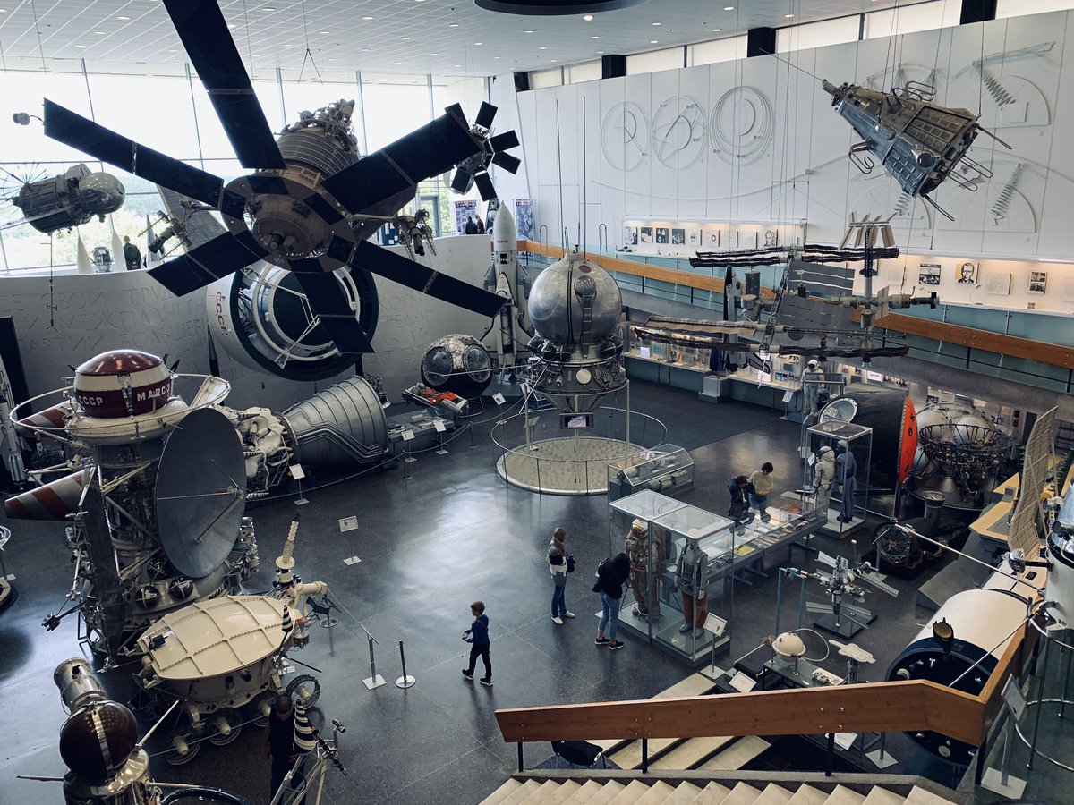
Space Exploration
February, 8,2022
February, 8,2022

Slide 3
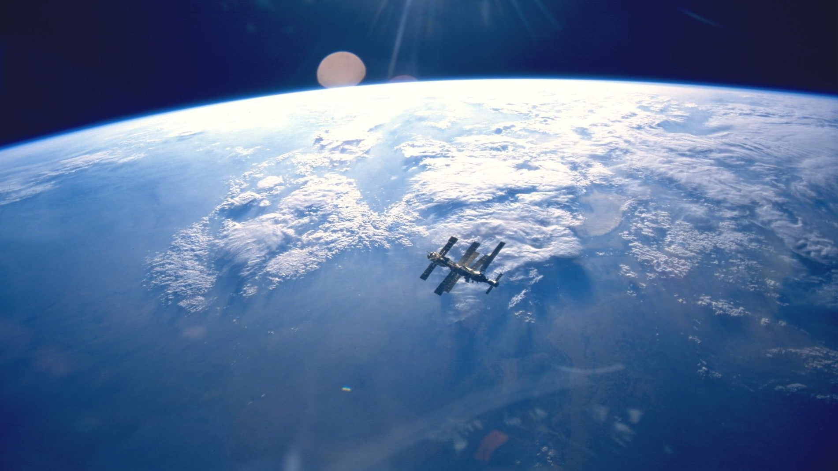
Complete the following quotation.
“That’s one s_____ll step for man; one g____t
leap for mankind.”
Neil Armstrong

Slide 5
Learning Outcome
to learn more about space exploration and astronauts’ lives
IrinaPapakhinac

Slide 6
Space Exploration
1)Neil Armstrong
Who was the first man to go into outer space?
Who was the first person to invent the idea of space rockets?
Who constructed the first spaceship?
Who was the first man to walk on the Moon?
Who was the first man to walk in space?
How long did the first spacewalk last?
Who was the first woman in space?
What does the number 108 mean?
2)Yuri Gagarin
3)Sergei Korolev
4) Konstantin Tsiolkovsky
5)Alexey Leonov
6)12 minutes
7 )Valentina Tereshkova
8) The amount of time Gagarin spent in space

Slide 7
Complete the following sentences.
The ISS goes round the Earth
_____ times a day.
The astronauts do __________
in the Science Laboratory and outside.
3. The astronauts exercise for _____ hours
every day.
Space food is __________ to eat!
Astronauts sleep for ___ hours
every night.
IrinaPapakhinac

Slide 8

Watch the video and complete the sentences.

Slide 9
Watch the video and complete the sentences.
The ISS goes round the Earth
_____ times a day.
The astronauts do __________
in the Science Laboratory and outside.
3. The astronauts exercise for _____ hours
every day.
Space food is __________ to eat!
Astronauts sleep for ___ hours
every night.
16
experiments
2
difficult
8

Slide 10
Compare your life with the astronauts’ one.
Use the ideas below .
Example: Astronauts get up early, but I get up not very early.
everyday activities
sport
food
sleep

Slide 11
Do you find today’s lesson exciting or boring?
What have you learnt about space exploration?
Today’s lesson is boring/exciting.
I have learnt that ……

