Slide 1
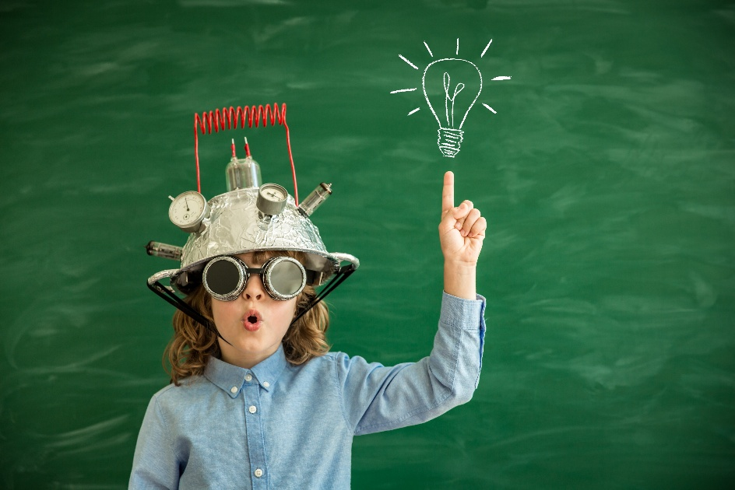
: “It’s d……………… to imagine it as an i…………………….”.
difficult
invention

Slide 2
It is Difficult to Imagine it as an Invention
Plan for the lesson:
Repeat the vocabulary on the topic
Discuss some inventions
Check homework
Watch the video
Express your own opinions

Slide 3
‘tic tac toe’

Slide 4
The Line of the History of Technology
2.5 mln. years ago
4000 BC
15th – 17th centuries
9000 BC
2000 BC
Name of the AGE
Inventions/ tools
People

Slide 5
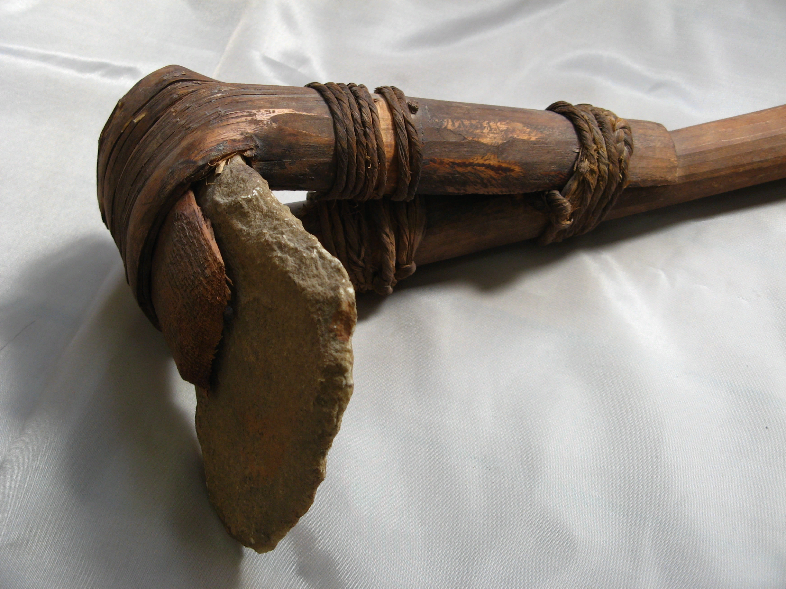
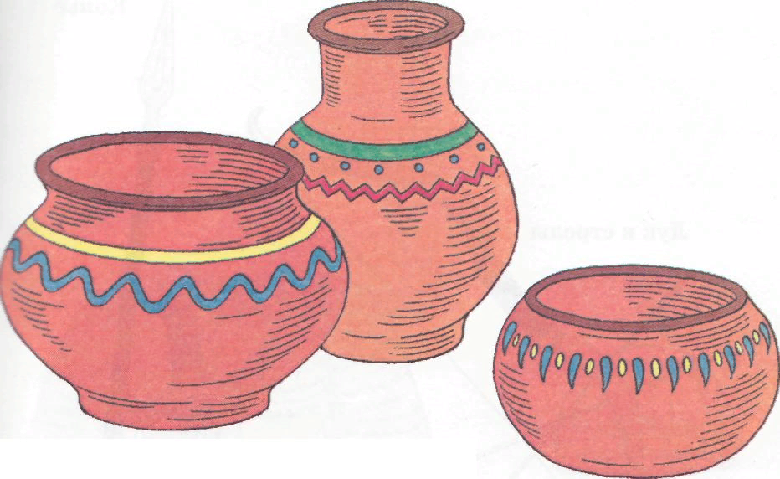
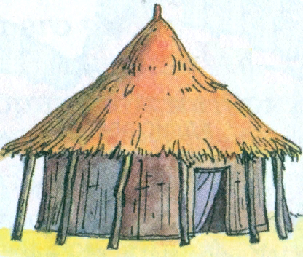
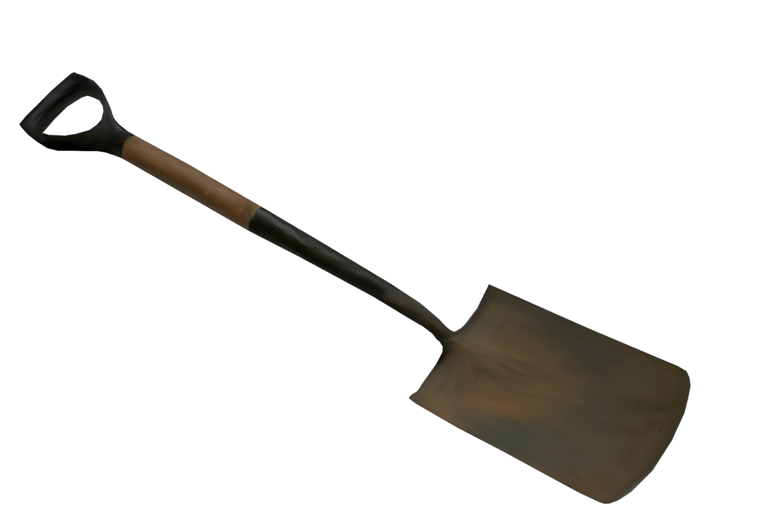

Slide 6
Ask your partner and find out…
Who?
When?
Where?
What for?

Slide 7
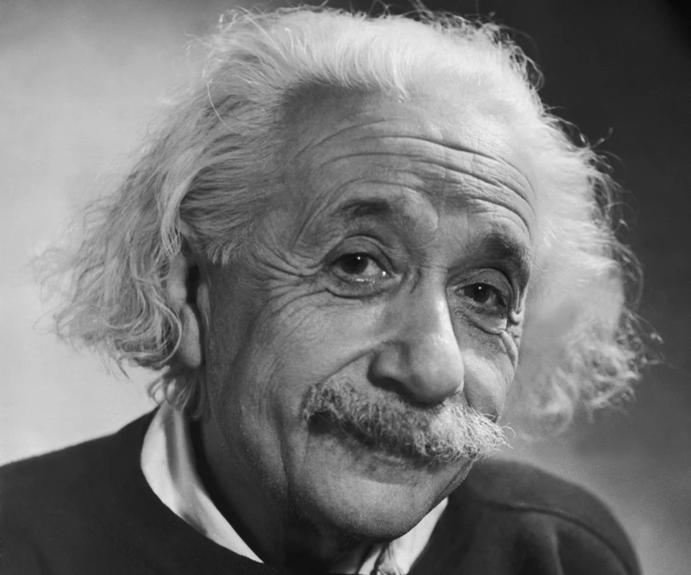
видео

Slide 8
In
Albert Einstein was the most famous … in the history of our world
He was born in …. In 18…
He didn’t … until 4 years old
One thing that he did quickly was…
He was also fascinated with …
Einstein wanted to become a ….
He became a ….
He got a Nobel Prize in ….
His inventions helped us to understand our ….

Slide 9
Einstein [ˈaɪnstaɪn]
Fascinate [ˈfæsɪneɪt]
Passion [pæʃn]
Release [rɪˈliːs]
Universe [ˈjuːnɪvɜːs]
Pattern office [pætn ofis].

Slide 10
Albert Einstein
Albert Einstein was the most famous scientist in the history of our world.
2. He was born in Germany in 1879.
3. He didn’t speak until 4 years old.
4. One thing that he did quickly was math.
5. He was also fascinated with physics.
6. Einstein wanted to become a teacher.
7. He became a professor.
8. He got a Nobel Prize in Peace.
9. His inventions helped us to understand our Universe.

Slide 11
