Slide 1
Урок английского языка 3 класс «День рождения»
МБОУ «Железногорская СОШ № 4»
Учитель:
Стадник Надежда Владимировна
2 марта 2022 года

Slide 2
March, 2nd
Who is on duty today? – I am…
Who is absent today? –… is absent…
What date is it today?
Today is the second of March.
What day of the week is it today?
It’s Wednesday.

Slide 3
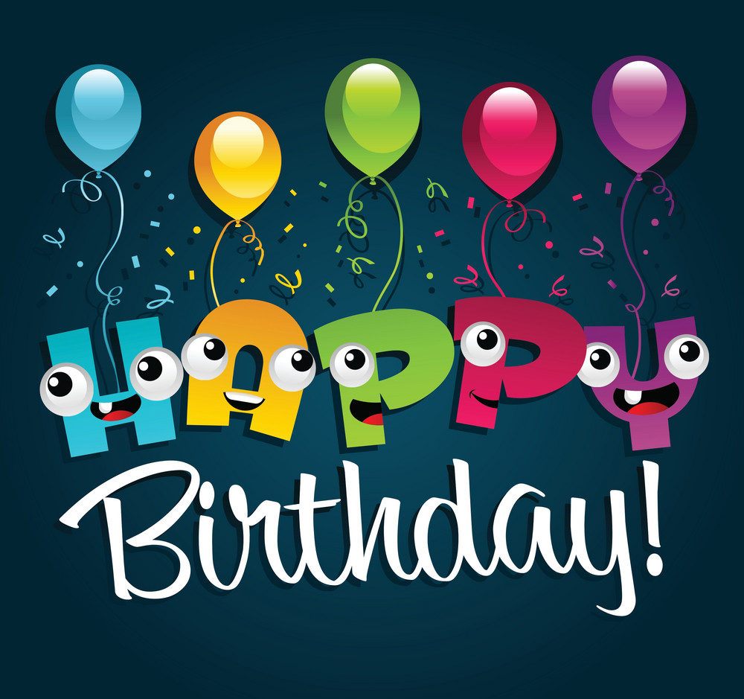

Slide 4
What are we going to speak about?
We'll speak about …
What shall we do at our lesson?
We shall … .

Slide 5
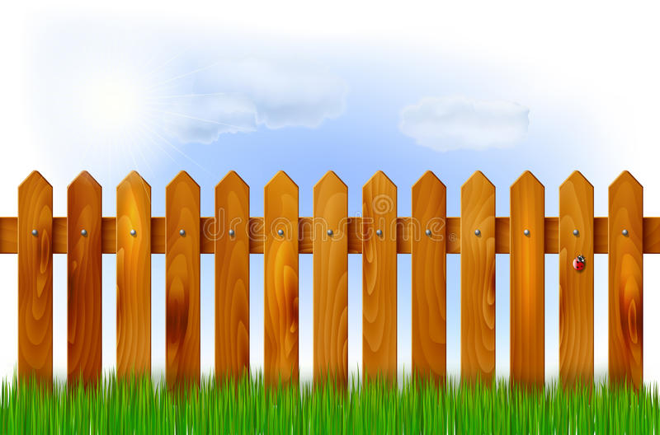

Slide 12
[ei]: snail, tail, train, day, today
[ͻi]: coins, pointer, toys, Roy, boy
[ð]: they, this, these, those, that
[θ]: three, Thursday, birthday
[w]: wife, we, Wednesday

Slide 14
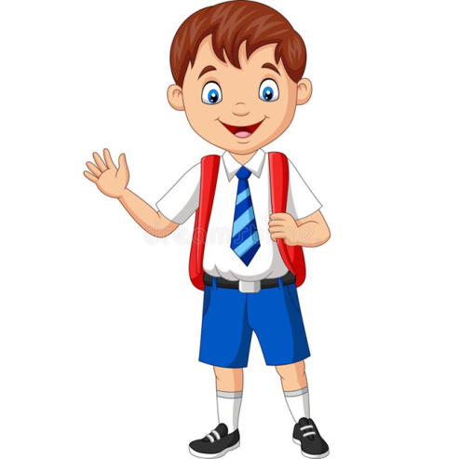
Dear friends,
I am from London. I have got a birthday. I am thirteen today. I am happy!
Your friend, Billy.
What's his name?
How old is … ?
Where is he from ?
His name is … .
He is … .
He is from …

Slide 15
What's his (her) name? His (her) name is … .How old is … ? He (she) is … .
Peter
Lizzy
Colin
Mary
Roy
11
13
10
9
12

Slide 16
Let's repeat the words.
day хвост
snail поезд
coins указка
today день рождения
tail день
pointer улитка
birthday монеты
train сегодня
toys друг
family муж
candle подарок
table игрушки
present семья
wife свеча
husband стол
friend жена

Slide 18
Let's repeat the days of the week.

Slide 19
Ex.4, p.78

Slide 20
Let's check the days of the week.

Slide 22
Ex.7, p.109

Slide 23
Let's check your homework.
Mr Raymond Harrison has a son Billy.
Billy has a grandmother. Her name is Mrs Mary Harrison.
Billy has a sister. Her name is May.
Billy is fourteen today.
You can’t see flowers on the table.
Peter, Roy and Colin are at the window.
A white football is their present for Billy.
Billy likes his presents.

Slide 24
Home task
РТ с. 80 – 81, № 3, 4.

Slide 25
Very good!
Good!
Not very good!

