Slide 3
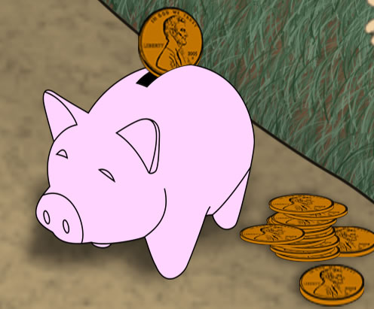
1. A penny saved is a penny earned
2. Go Dutch
3. Flat broke / break the bank
4. Bring home the bacon
5. Live from hand to mouth

Slide 4
1. A penny saved is a penny earned
Russian equivalent: копейка рубль бережет

Slide 5
2. Go Dutch
Russian equivalent: платить вскладчину / каждый сам за себя

Slide 6
3. Flat broke / break the bank
Russian equivalent: на мели / без гроша в кармане

Slide 7
4. Bring home the bacon
Russian equivalent: зарабатывать на жизнь

Slide 8
5. Live from hand to mouth
Russian equivalent: жить впроголодь / еле сводить концы с концами

Slide 9
A | B | C | D | E
2 | 3 | 1 | 5 | 4

Slide 10
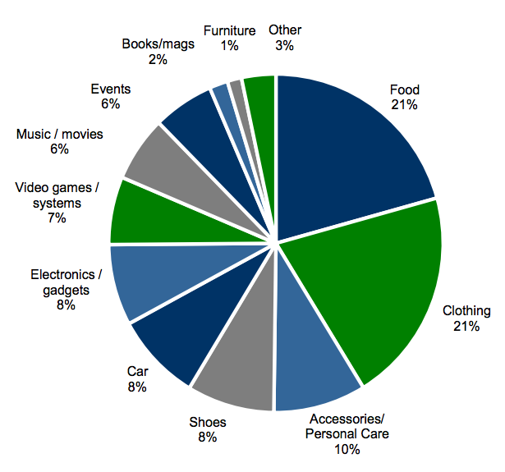
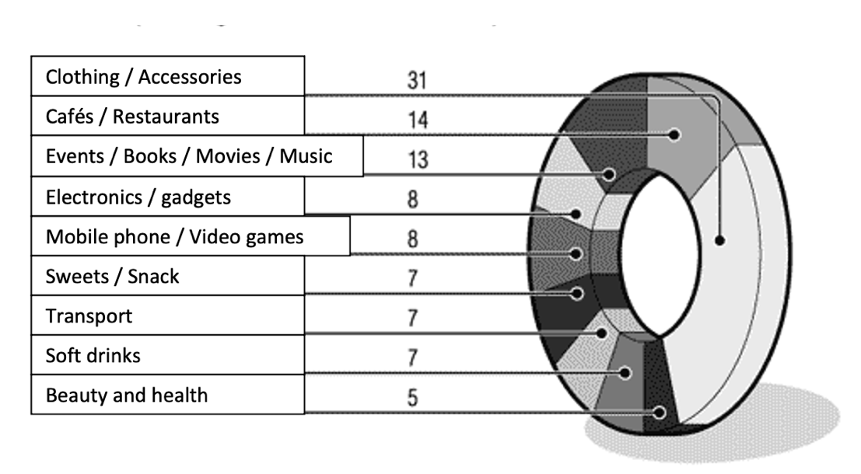
The pie chart shows …
At first glance it is clear that the biggest amount of money is spent on …
As we can see from the chart, … while ….
Another interesting feature of the poll …
I would like to conclude by saying that, ….

