Slide 1
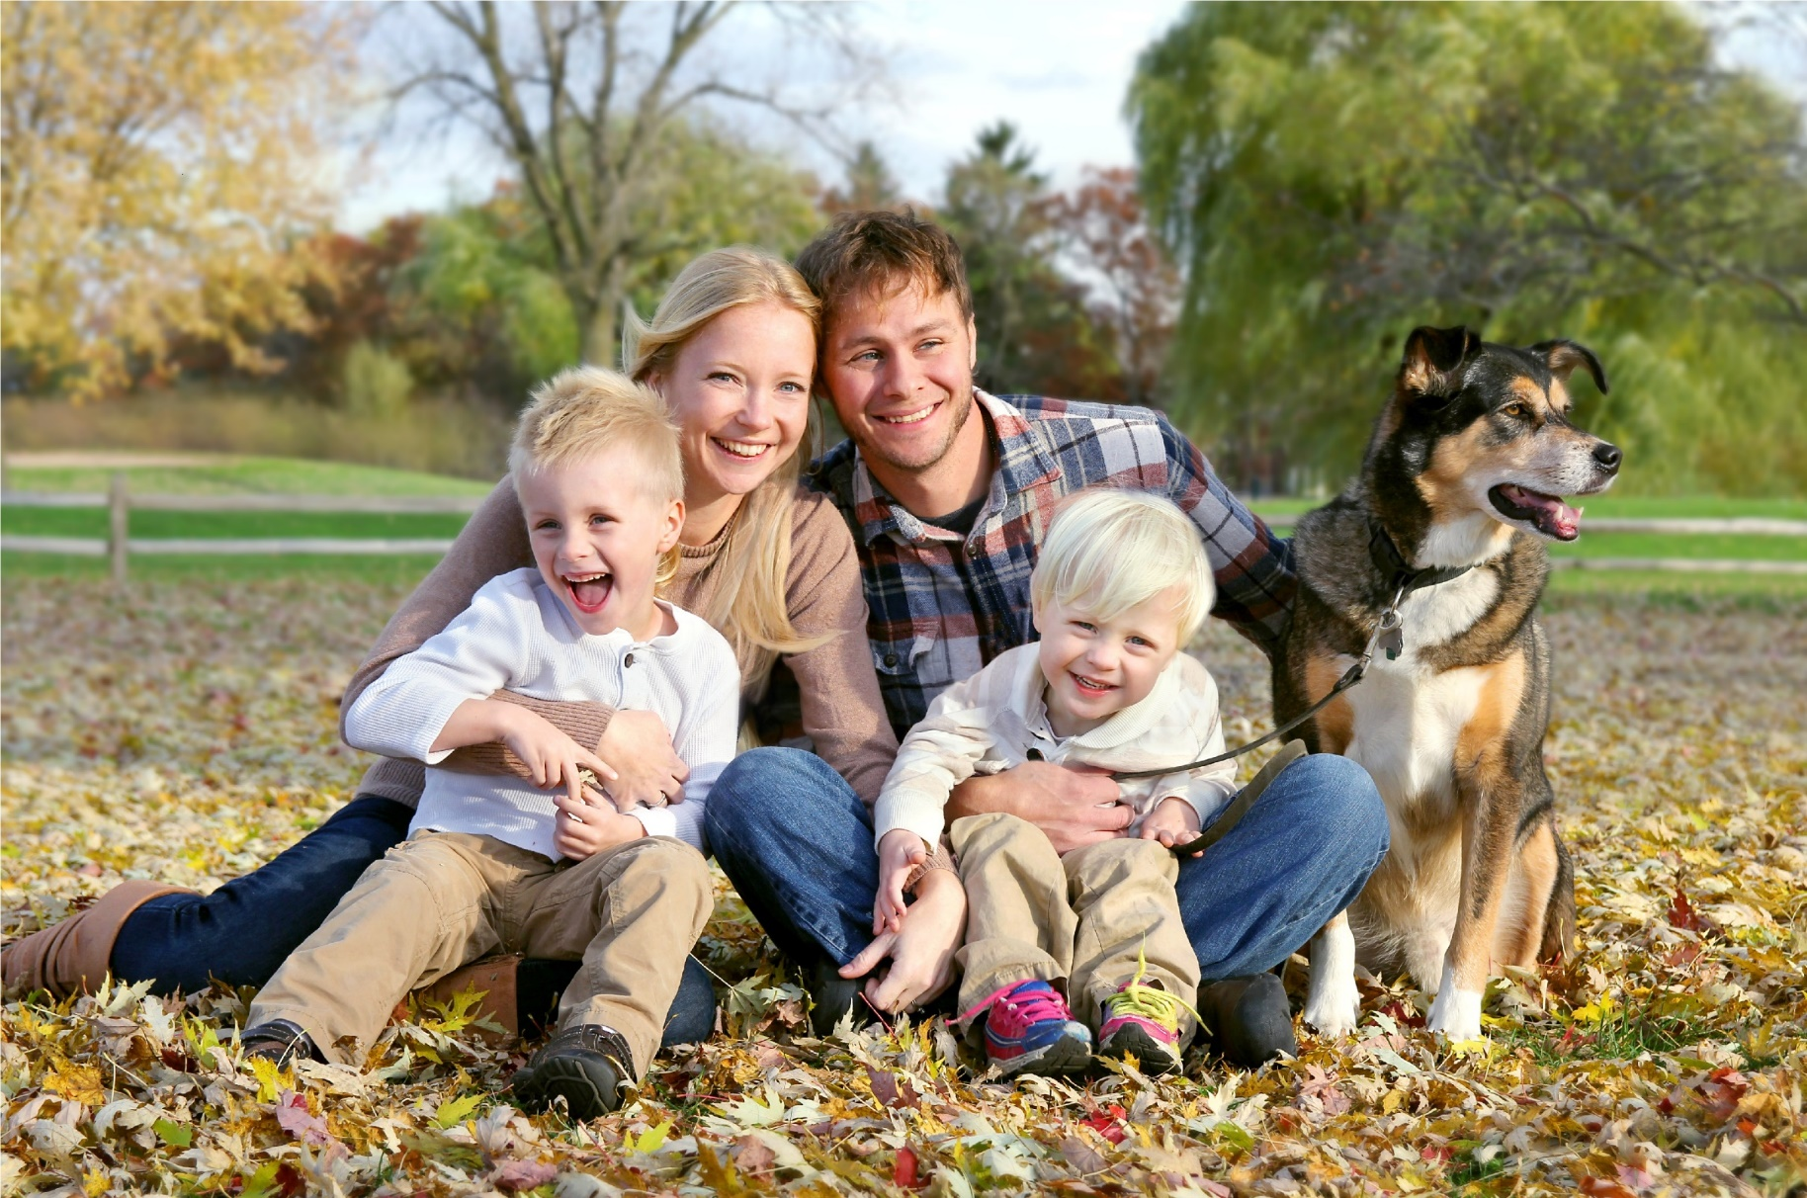
Friendly
Happy
Kind
Big / small
Cool
Caring

Slide 2
MY FAMILY

Slide 3
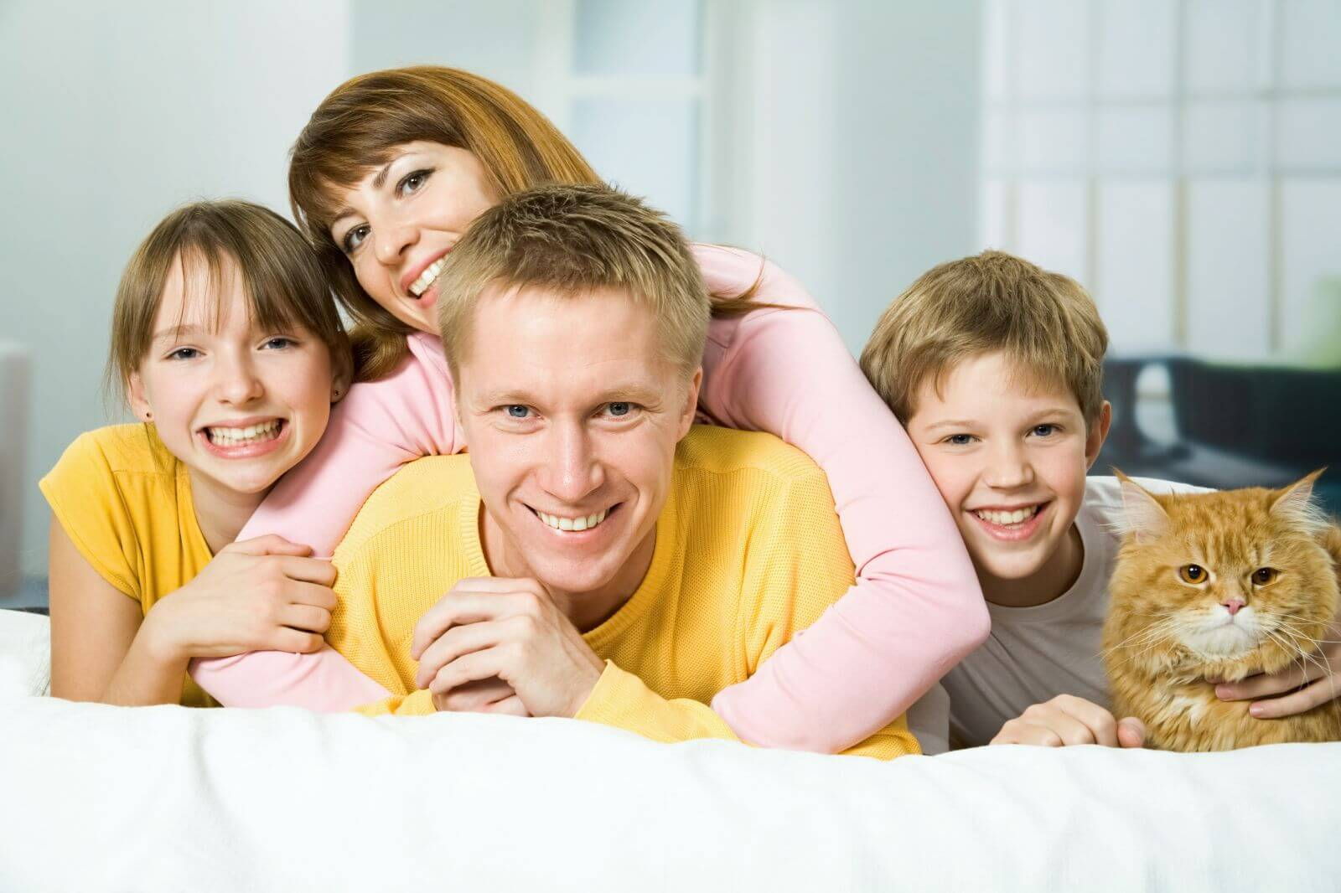
MY FAMILY
I`ve got a mother,
I`ve got a father,
I`ve got a sister,
I`ve got a brother,
We live together,
We love each other!
(and a cat)

Slide 4
MY FAMILY

Slide 5
TELL ABOUT YOUR FAMILY
- I have got a big/small family.
- We are … in the family.
- I have got a mother/a father/a sister …
- My mother’s/father’s name is …
- She/he is …years old.
- She/he is …(clever, kind, friendly, caring …)
- She/he can …
- I love my family very much.

Slide 6
Look and point

Slide 7
Make up sentences using these words.
1. is, My, family, big.
2. you, Have, family, a got?
3. got, mother, a, has, Kate.
4. have, I, got, a, brother.
5. father, Have, you, a, got?
My family is big.
Have you got a family?
Kate has got a mother.
I have got a brother.
Have you got a father?

