Slide 1
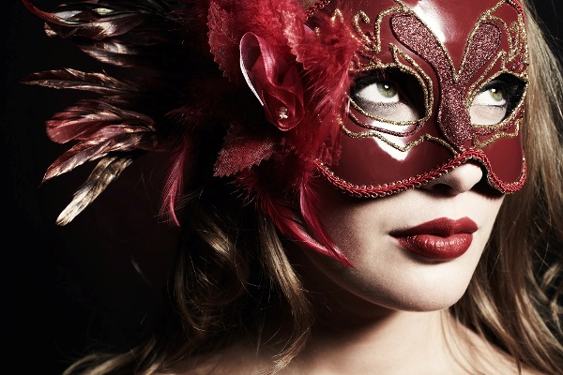
January, 27.
Class work.
A perfect day for a carnival
Have you ever seen a carnival?
Have you ever taken part in a carnival? What is a carnival?

Slide 2
1. Find 6 words.
a | i | r | p | o | r | t | y | h
m | p | e | v | h | p | e | q | t
u | r | u | l | a | y | r | x | r
s | a | n | j | p | t | m | x | h
e | d | i | z | p | u | i | a | h
d | k | t | m | i | h | n | d | d
v | r | e | k | l | i | a | q | l
s | c | a | n | y | j | l | u | p
o | i | i | k | m | y | f | e | k

Slide 3
2. Correct order
Put these words in the correct order to get 3 sentences.
a I very beautiful platform on carnival . the decorated saw
she . didn't exam felt because miserable She her pass successfully
saw year tower . last a gigantic I
3. Cross the odd ONE out.
Scared, terrified, bored, frightened
Depressed, annoyed, anxious, amused
Happy, violent, pleased, glad
Glad, refreshed, confused, relieved

Slide 4
4. Complete the sentences with the correct form of the words
.
Airport ………….. was full of people.
She was waiting ……………….for her mother to come.
There were a lot of different goods on the street ……………
We always ……………….. our house before Christmas.
It was hot and the sky stayed ……………………
The end of the film was very ……………………
Terminal patiently stalls decorate cloudless unpredictable

Slide 5
5. Choose the right answer.
I feel familiar/uncertain about this situation.
I woke up late and I need to hurry up to have/catch my flight.
It was pouring /chilling with rain and I soaked wet.
He was really annoyed and his actions were unpredictable/amusing.
She looked scream/refreshed after her vacation.
His voice sounds familiar/wander.

Slide 6
6. Match the phrases to get the sentences.
.
1. Liza was lying on the beach 2. She was terrified 3. It has been pouring 4. There were hundreds 5. The violent storm | a. and sipping juice. b. with rain for a week. c. of handicrafts on the stalls. d. destroyed the village. e. when she saw a ghost.

Slide 7
7. Choose the right answer.
One more very popular carnival is the Carnival of Venice. It is held every ……1………. . It is believed that the first Carnival was held in 1162 in the Venice Republic to celebrate the victory. People ……2… Square.
Later in the 17th century the Carnival of Venice was an …3……. image of Venice. It started being really popular in the 18th century.
Nowadays, a ……4……..the carnival of Venice each year.
The carnival of Venice …5…… masks. Traditionally a lot of people wear masks to hide their identity.
a. year in Venice, Italy
b. started dancing in San Marco
c. attempt to save the prestigious
d. lot of famous people attend
e. is famous for its

Slide 8
GOOD LUCK!

