Slide 1
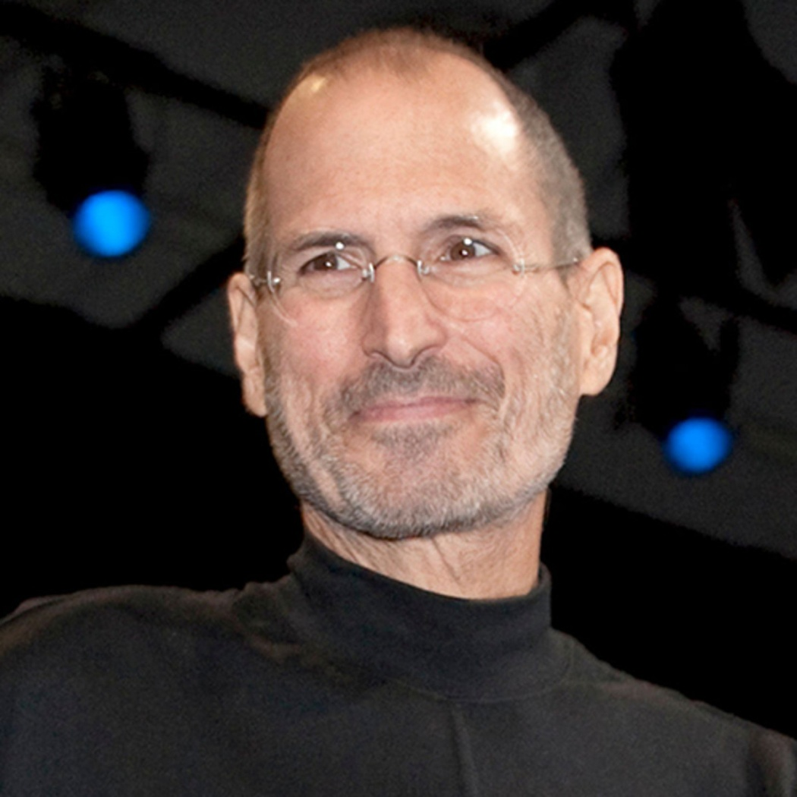
Take a step and you`ll see the way Steve Jobs

Slide 2
Правила перевода прямой речи в косвенную
1. Все знаки препинания опускаются
2. Возможен союз «ЧТО» - that
3. Личные и притяжательные местоимения изменяются по смыслу
4. Правило согласования времен
Present Simple Past Simple
Past Simple Past Perfect
Present Perfect Past Perfect
Present Continuous Past Continuous
Future Simple Future-in-the Past
May- might
Can-could
Must –had to
Shall-should
Will-would
Today – that day
Yesterday – the day before
Tomorrow –the following day

Slide 3
Найдите и исправьте ошибки в предложениях:
He said: “I will read a newspaper in the evening”.
He said that I would read a newspaper in the evening.
2. My friend said:” I prefer to listen to the radio”.
My friend said that he prefer to listen to the radio.
3. My sister said:” I `m watching my favourite TV programme at the moment”.
My sister said that “she was watching her favourite TV programme at the moment.

Slide 4
Найдите и исправьте ошибки в предложениях:
He said: “I will read a newspaper in the evening”.
He said that he would read a newspaper in the evening.
2. My friend said:” I prefer to listen to the radio”.
My friend said that he preferred to listen to the radio.
3. My sister said:” I `m watching my favourite TV programme at the moment”.
My sister said that she was watching her favourite TV programme at the moment.

Slide 5
He asked if I liked watching TV.
He asked what I liked watching on TV.
Reported questions

Slide 6
He said: “Do you like watching TV?” | He said: “What do you like watch on TV?”
He asked if I liked watching TV. | He asked what I liked watching on TV.

Slide 7
Общий вопрос | Специальный вопрос
He said: “Do you like watching TV?” | He said: “What do you like watch on TV?”
He asked if I liked watching TV. | He asked what I liked watching on TV.
asked If Прямой порядок слов | asked Вопр.слово what Прямой порядок слов

Slide 8
Соотнесите прямые и косвенные вопросы:
1.He said: “ Do you buy this magazine?” | a) He asked why I had decided to be a reporter.
2.He said: “ Will you be a reporter?” | b) He asked when I bought that magazine.
3.He said: “When did you buy this magazine?” | c) He asked if I bought that magazine.
4. He said: “Why have you decided to be a reporter?” | d) He asked if I would be a reporter.
1-c | 2-d | 3-b | 4-a

Slide 9
Переделайте прямые вопросы в косвенные:
Tom said: “Will you use the Internet to find information for your project?”
My mum said: “ Why have you switched TV over to another channel?”
Tom asked if I would use the Internet to find information for my project.
My mum asked why I had switched TV over to another channel.
2
0
1

Slide 10
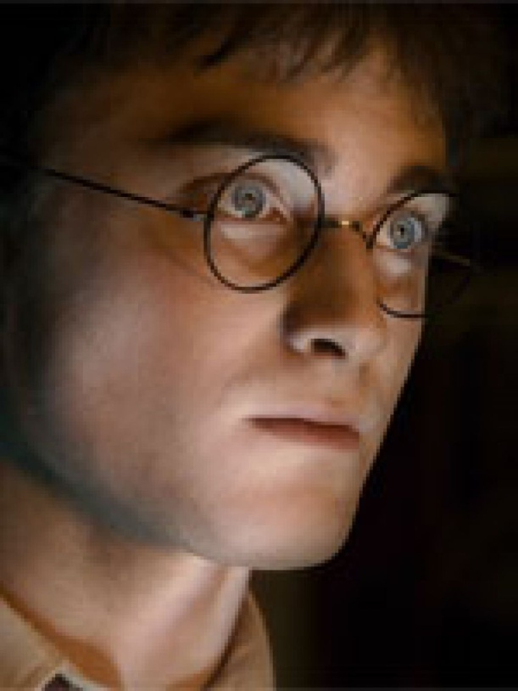
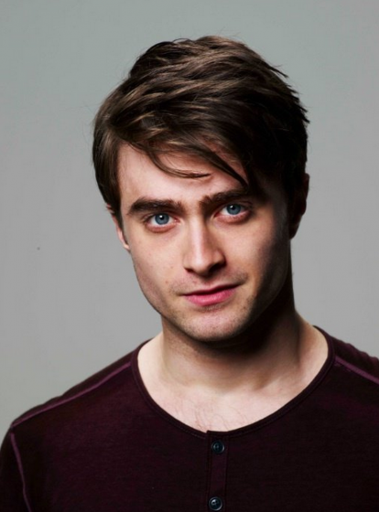
Передайте вопросы в косвенной речи:
What book are you reading now?
What is your favourite place in New York?
Do you like cinema or theatre?
What do you know about Harry Potter that no one else knows?

Slide 11
№ | задание | + | +/- | -
1 | Правило
2 | Исправь ошибки
3 | Новая тема
4 | Соотнеси предложения
5 | Переделай предложения
6 | Гарри Поттер

