Slide 1
World-famous London’s art galleries

Slide 2
The National Portrait Gallery

Slide 3
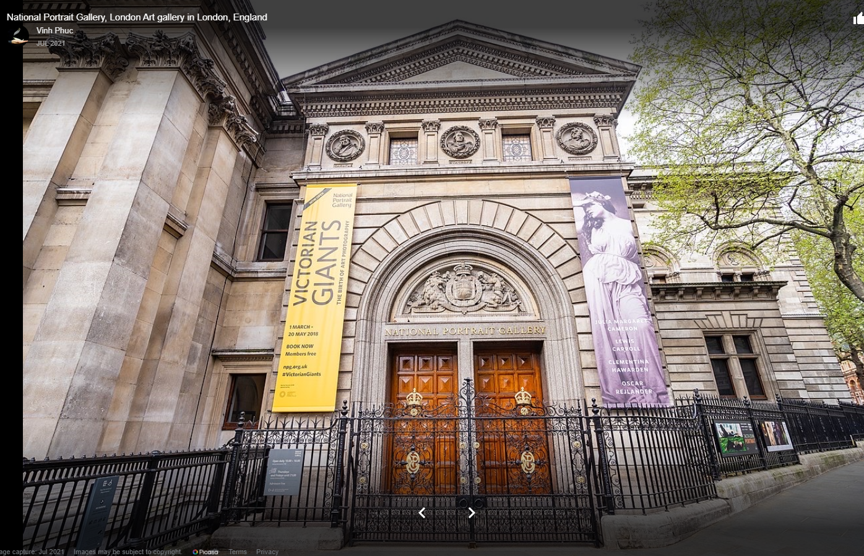
The National Portrait Gallery was founded in 1856 to collect the likeness of famous British men and women. Today the collection is the most comprehensive (complex) of its kind in the world, and constitutes [ˈkɒnstɪtjuːts] a unique record of the men and women who created (and are still creating) the history and culture of the nation. The Gallery houses a primary collection of over 9,000 works, as well as an immense archive [ˈɑːkaɪv].

Slide 4
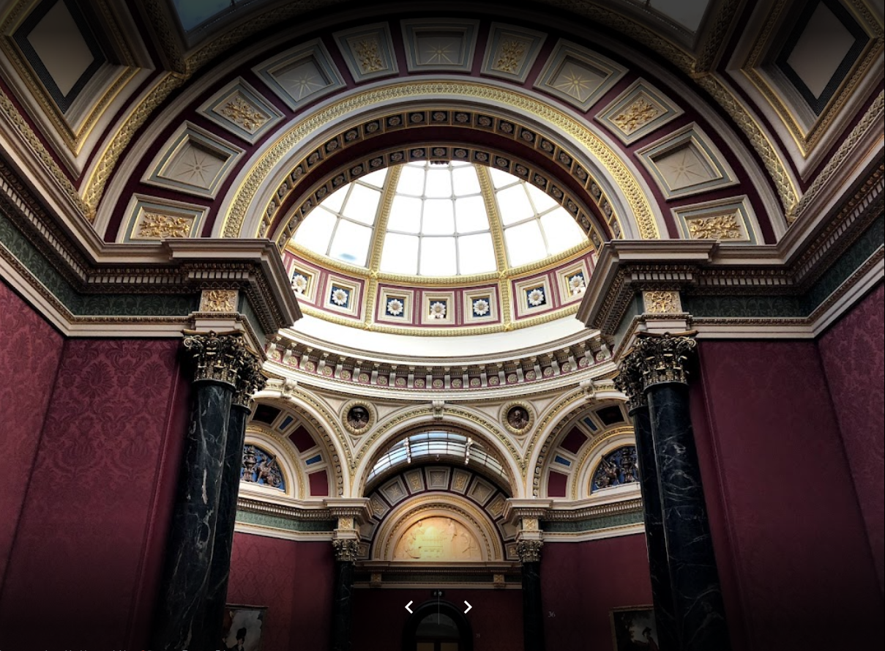
There is no restriction on medium – there are oil paintings, watercolour, drawings, miniatures, sculptures, caricatures, silhouettes [sɪluːˈets] and photographs.
The Gallery continues to develop its role through its:
- constantly changing displays,
- programme of international exhibitions,
Acquisitions [ækwɪˈzɪʃnz] and commissions,
the annual portrait competition for young artists.

Slide 5
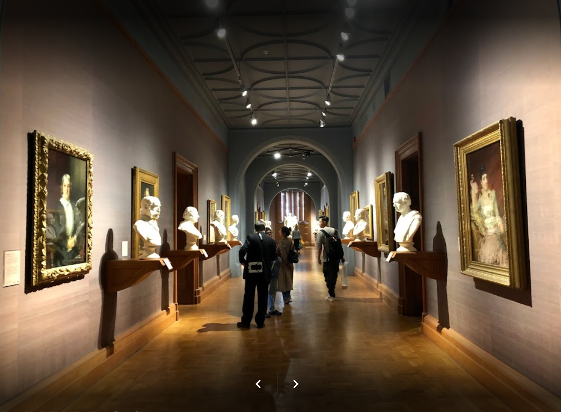
The collection which is arranged chronologically begins with the Tudors and their predecessors [ˈpriːdɪsesəz]. Each room has been given a particular historical theme, and furnishings, engravings, and other documentary material set the portraits in context.

Slide 6
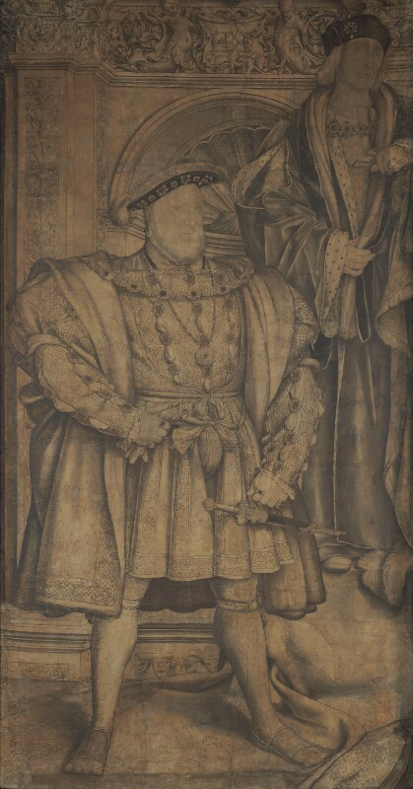
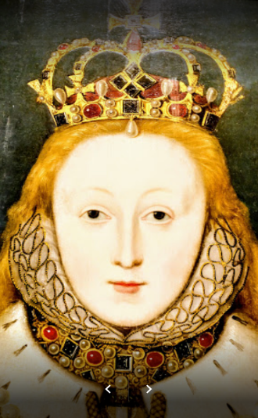
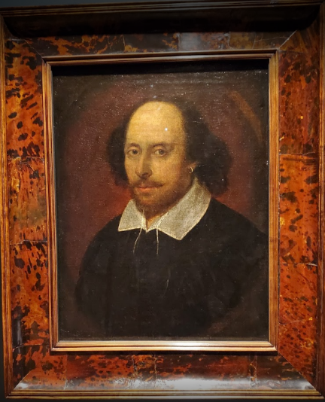
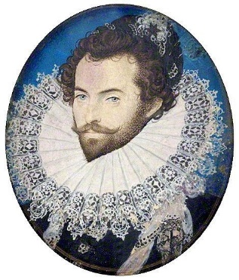
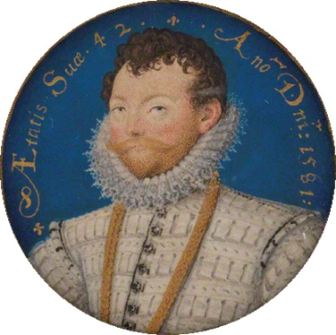
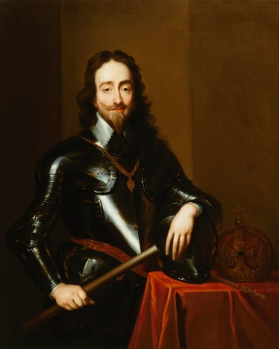
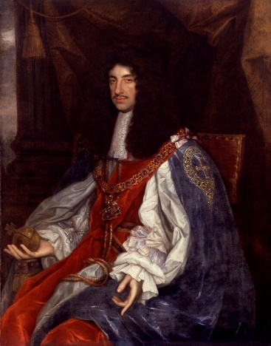
The collection includes such treasures as Holbein’s Cartoon of Henry VIII, portrait of Queen Elizabeth I, Hilliard’s miniatures [ˈmɪnɪ(ə)ʧəz] of Raleigh and Drake,
the portrait of Shakespeare and celebrated images of Charles I,
Charles II and his mistress.

Slide 7
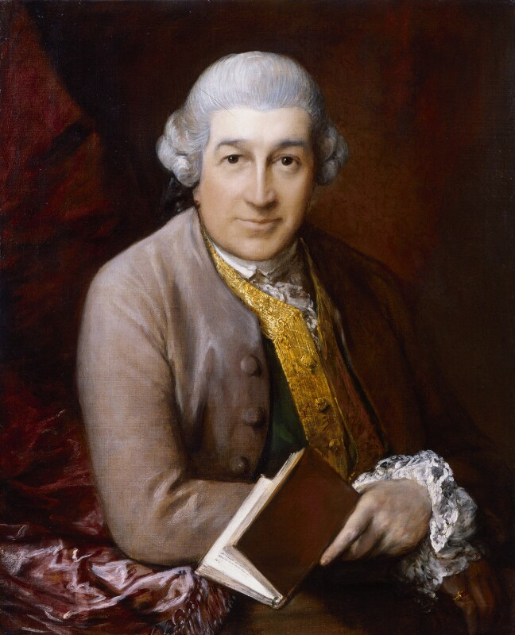
A room is devoted to the members of the famous Kit-Cat Club
and nearby hang masterpieces by Reynolds and Gainsborough painted in the grain manner.

Slide 8
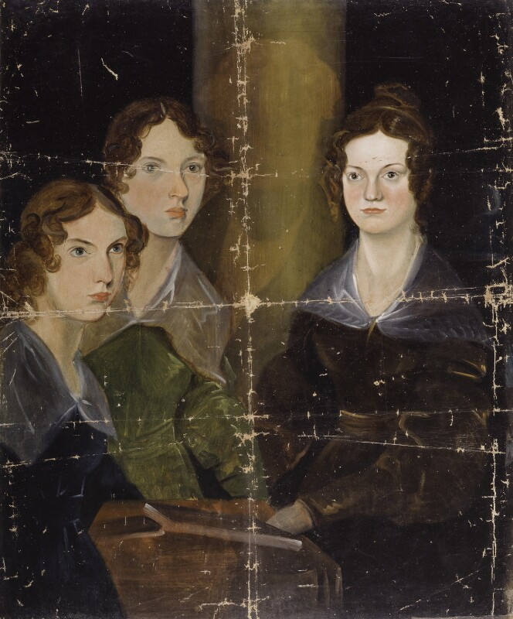
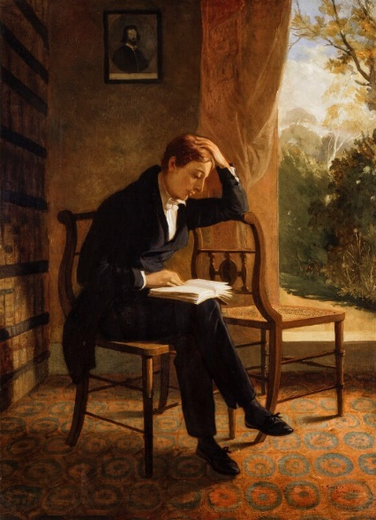
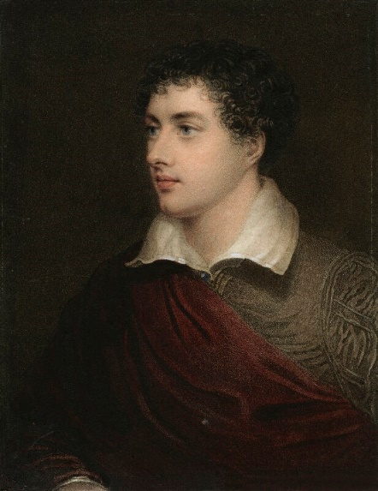
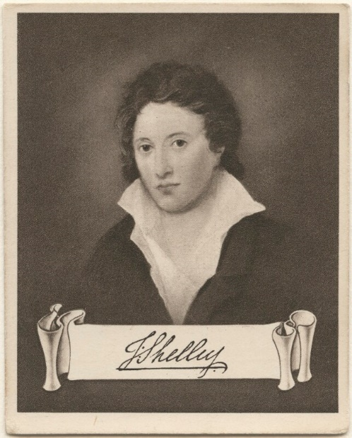
These contrast with unique documentary study of the Bronte sisters by their brother Branwell and the matchless series of portraits of the great romantics
Keats, Byron and Shelley.

Slide 9
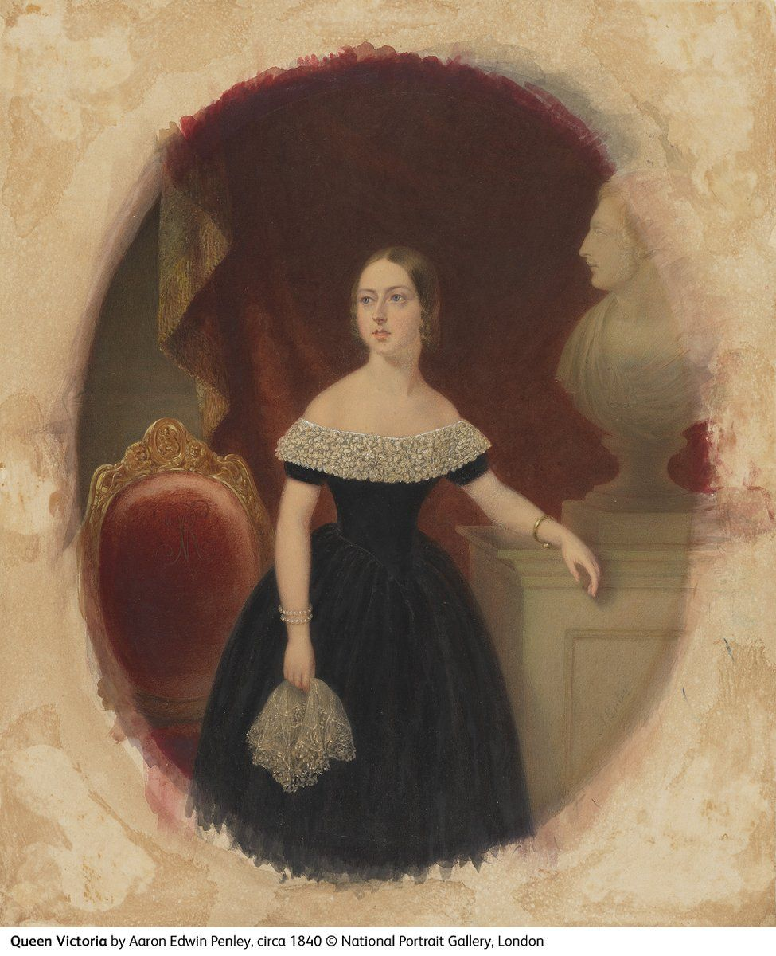
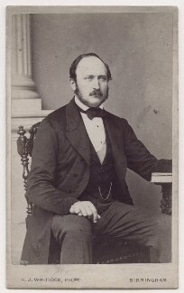
The splendor of the Victorian era is captured [ˈkæpʧəd] in the paintings of the Queen herself, and of Prince Albert.

Slide 10
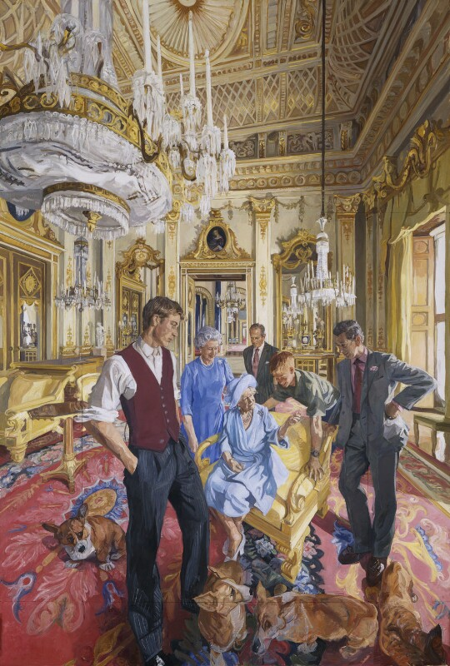
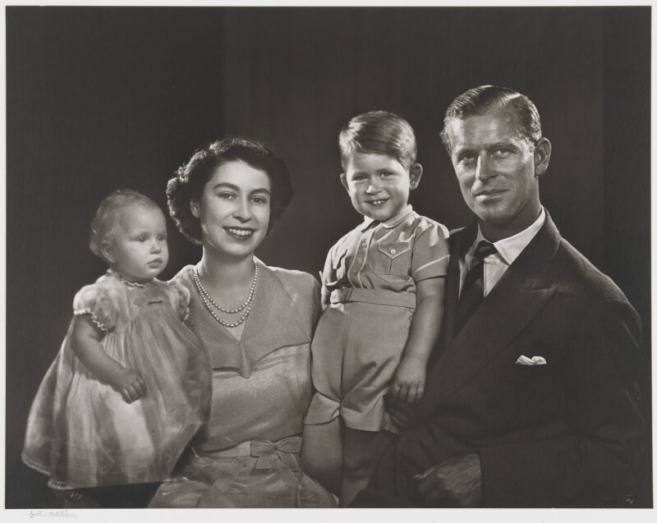
‘The Royal Family: A Centenary Portrait’
Portraits of the Queen and the present Royal Family are displayed in the mezzanine [ˈmetsəniːn].

