Slide 1
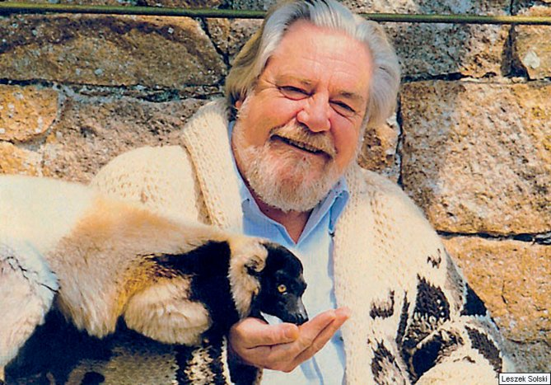
My Family and other Animals by Gerald Durrell

Slide 2
Leslie
Larry
Mother
Margo
Gerald

Slide 3
ENGLAND

Slide 4
GREECE
CORFU
GREEK

Slide 5
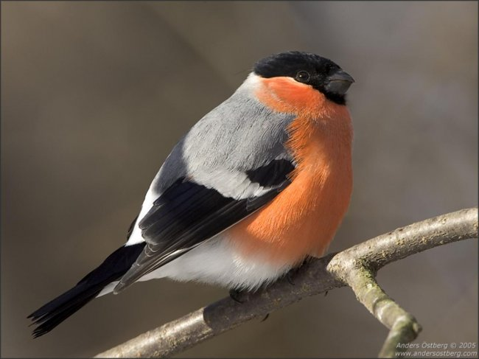
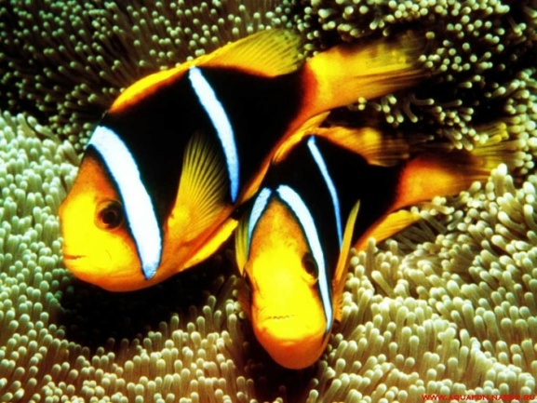
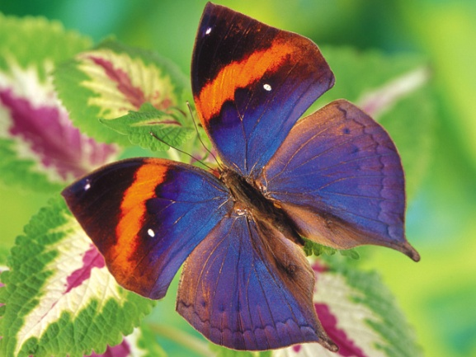
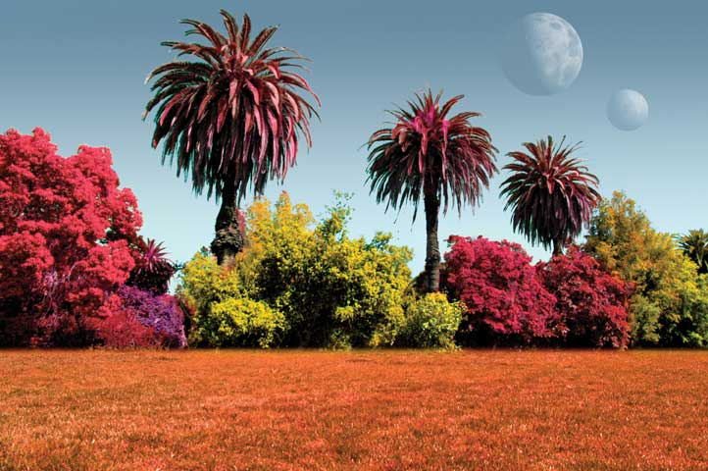
FLORA AND FAUNA
ANIMALS
BIRDS
FISH
INSECTS
PLANTS

Slide 6
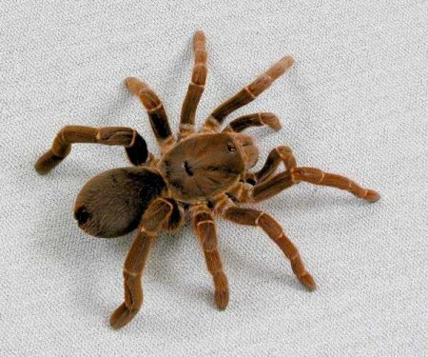
INSECTS
A BUTTERFLY
A SPIDER
A LADYBIRD

Slide 7
ANIMALS
A LIZARD
A SNAKE

Slide 8
A SPECIAL COLLECTION OF JARS

Slide 9
SUBJECTS
GEOGRAPHY
MATHS
FRENCH

Slide 10
TO DECIDE
TO EXPLORE
TO ENJOY

Slide 11
AS WELL AS
EXCITING
LOVELY
AN ADVENTURE
AN ISLAND
OLDER

Slide 12
England
Greece
Corfu
Greek
French
to decide
lovely
to enjoy
an insect
a lizard
to explore
a spider
a snake
as well as
a collection
a jar
maths
geography
an adventure
exciting
a butterfly
a ladybird
older
an island

Slide 13
The second form of the verbs in Past Simple.
Regular
Irregular
to travel – travelled
to enjoy - enjoyed
to learn – learnt
to eat - ate

Slide 14
Past Simple
yesterday, last time (year, week), … ago.
+ | I We You He/She/It They | talked came
? | Did | I We You He/She/It They | talk come
- | I We You He/She/It They | did not | talk come

Slide 15
The past of be (am/is/are) is was/were.
+ | I / he/ she/ it We/you/they | was were
? | Was Were | I / he/ she/ it We/you/they
- | I / he/ she/ it We/you/they | was not were not

Slide 16
Fill in the table.
infinitive | past | translation
 | was/were
 | lived
 | decided
 | travelled
 | had
 | learnt
 | enjoyed
 | explored
 | liked
 | put
 | kept
 | met
 | started

Slide 17
Fill in the table.
infinitive | past | translation
to be (am/is/are) | was/were | быть
to live | lived | жить
to decide | decided | решать
to travel | travelled | путешествовать
to have/has | had | иметь
to learn | learnt | учить
to enjoy | enjoyed | наслаждаться
to explore | explored | исследовать
to like | liked | любить
to put | put | класть
to keep | kept | хранить
to meet | met | встречать
to start | started | начинать

