Slide 1
Gerund
ing

Slide 2
Подлежащее
(Eat ) vegetables is good for you.
Listen ……. to music is very relaxing
Go …… to museums can help you study better
Cook …… is a good hobby
Ride …… a bike can help you keep fit
ing
ing
ing
ing
ing

Slide 3
После глаголов
Like
Enjoy
Don’t mind
Dislike
Hate
listen
ing

Slide 4
После глаголов
ing
Imagine - воображать
Avoid - избегать
Appreciate - ценить
Be used to - привыкать
Consider - рассматривать
Continue - продолжать
Deny - отрицать
Fancy – нравиться, любить
Go ( sport) skiing/skating
Miss - скучать
Suggest - предлагать
Practise - практиковаться
Prevent - предотвращать
Spend/waste time ( money) - тратить время, деньги
Admit
Quit
Save

Slide 5
Imagine - воображать
She imagines travelling to space

Slide 6
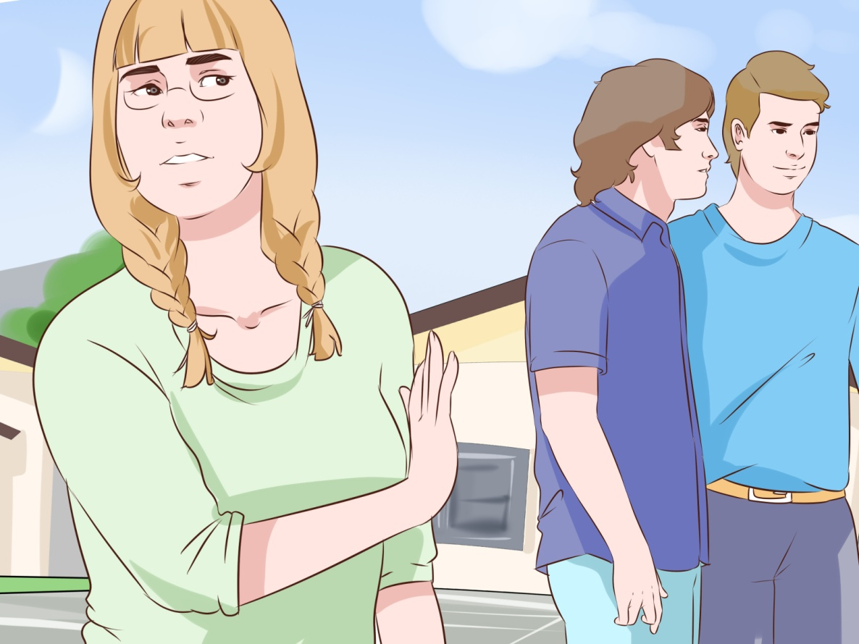
Avoid - избегать
She avoids speaking to strangers

Slide 7
Appreciate- ценить
He appreciates working with him

Slide 8
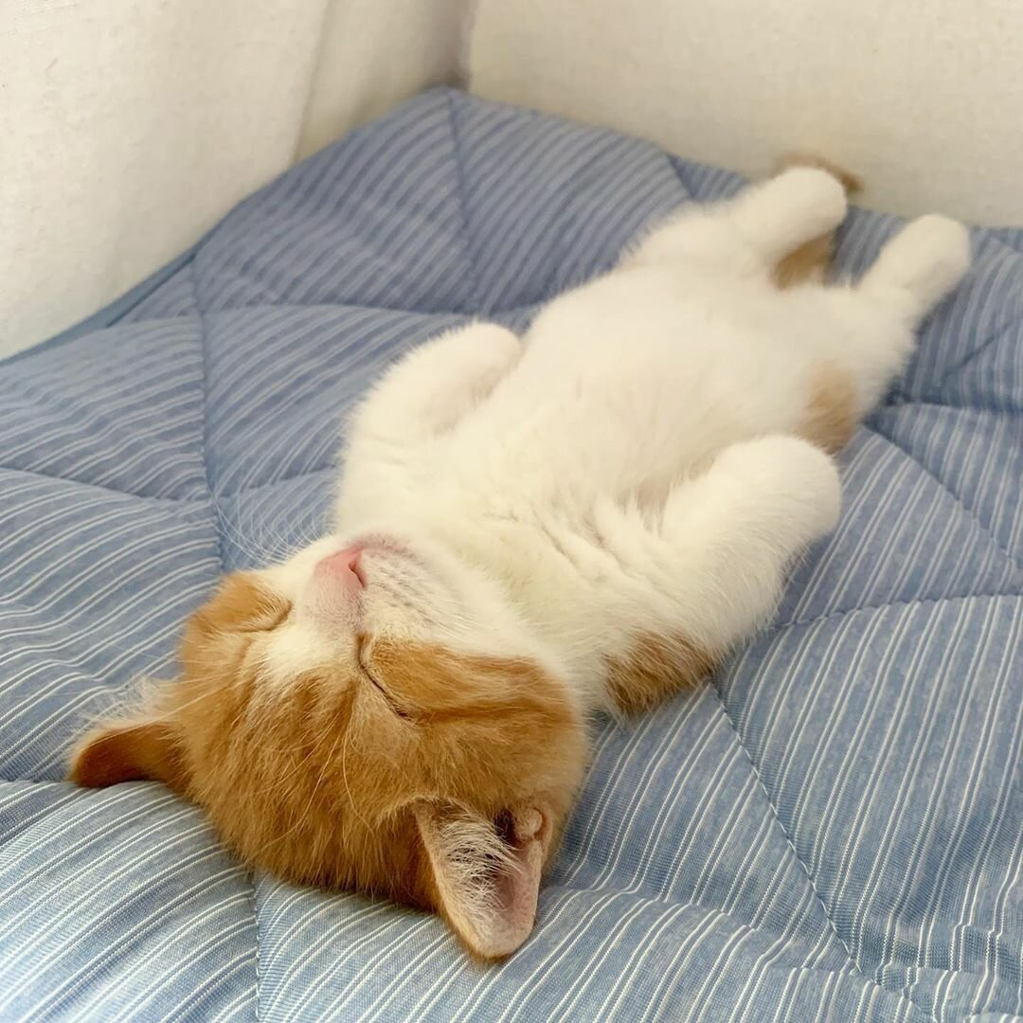
Be used to - привыкать
My cat is used to sleeping here

Slide 9
Consider - рассматривать
She is considering buying a new car

Slide 10
Continue-продолжать
Let’s continue reading

Slide 11
Deny - отрицать
He denies stealing your money

Slide 12
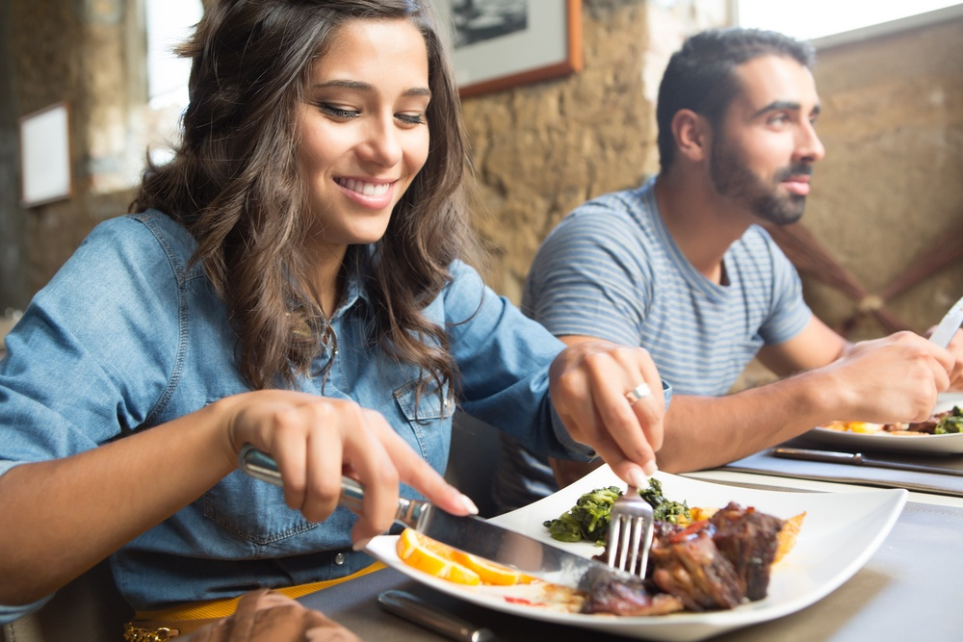
Fancy – нравиться, любить
I fancy eating out

Slide 13
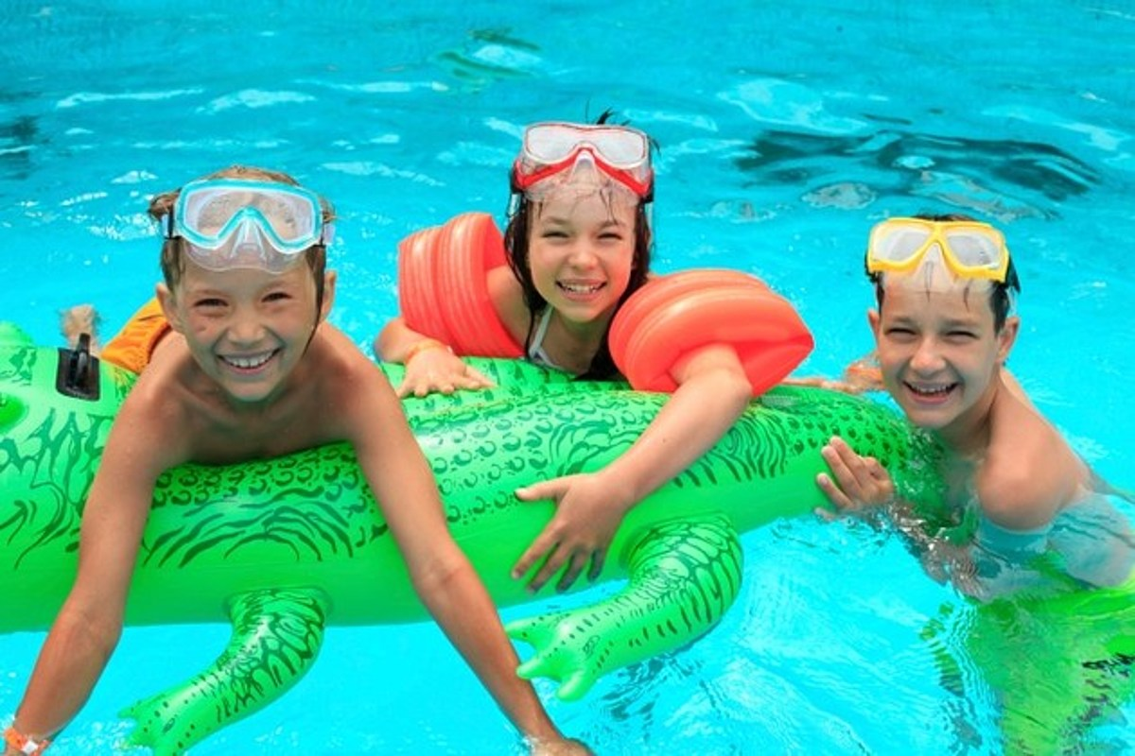
Go ( sport) skiing/skating
Let’s go swimming

Slide 14
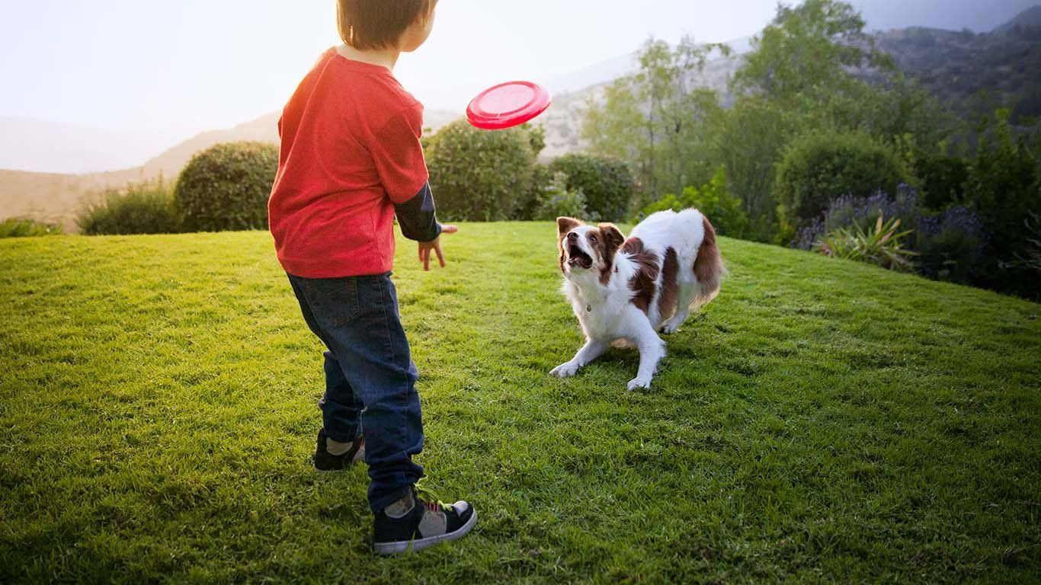
Miss - скучать
I miss playing with my dog

Slide 15
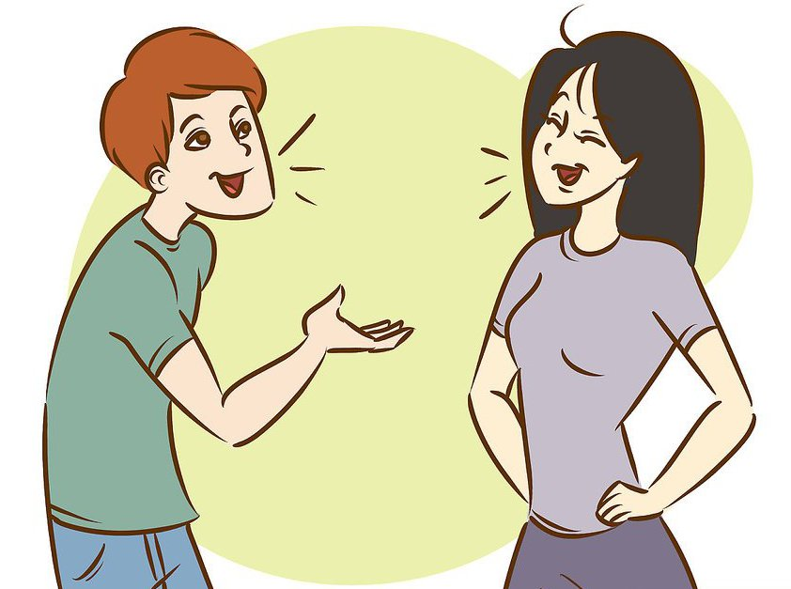
Suggest - предлагать
I suggest visiting this museum

Slide 16
Practise - практиковаться
He is practising playing football

Slide 17
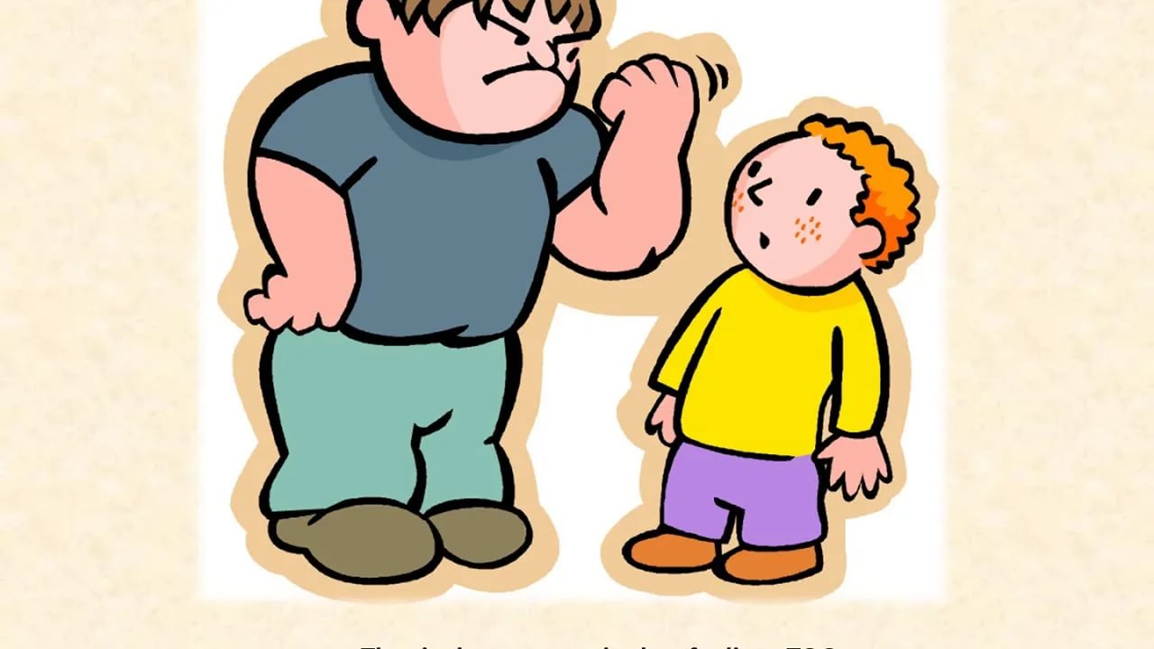
Prevent - предотвращать
We must prevent bullying

Slide 18
Spend/waste time ( money)
He shouldn’t waste money buying expensive things

Slide 19
После предлогов
ing
in/at/about/with………
How about making a cake?

Slide 20
sending
The doctor insisted on (send) the sick man to hospital.
He was good at (repair) cars.
She was sorry for (come) late.
The children ran out the room and began (play).
He seemed sorry for (be) rude.
The girl had no talent for (dance).
After (check) the students’ papers, the teacher handed them back.
Excuse her for (break) her cup.
She was proud of (win) the prize.
reparing
coming
playing
being
dancing
checking
breaking
winning

Slide 21
После фраз
It’s worth – оно того стоит
Can’t stand – не выносить
Have difficulty in – иметь сложности, затрудняться
Look forward to – ждать с нетерпением
Can’t help – не мочь не сделать что-либо
Be busy
It’s no use
There is no point
What’s the use of
Object to

Slide 22
To Infinitive
Цель
He went out to buy some milk
He phoned to speak with her
He bought some flowers to give them to his mum
They
to

Slide 23
Would like
Would prefer
Would love
To - infinitive

Slide 24
After too/enough

Slide 25
После прилагательных, описывающих чувства и эмоции, характер людей, желание/нежелание
Eager to
Willing to
Happy
Sad
Clever
kind

Slide 26
To tell the truth
To be honest
To sum up
To begin with

Slide 27
After
Ask – спрашивать
Advise – советовать
Agree - соглашаться
Decide - решить
Explain – объяснять
hope – надеяться
Manage – удаваться
Offer – предлагать
Plan - планировать
Want - хотеть
Expect – ожидать
Promise - обещать
Refuse - отказываться
Seem - казаться

Slide 28
Ask – спрашивать, просить
I asked to feed my cat

Slide 29
Advise – советовать
The doctor advised to eat more fruit

Slide 30
Agree - соглашаться
They agreed to meet after classes

Slide 31
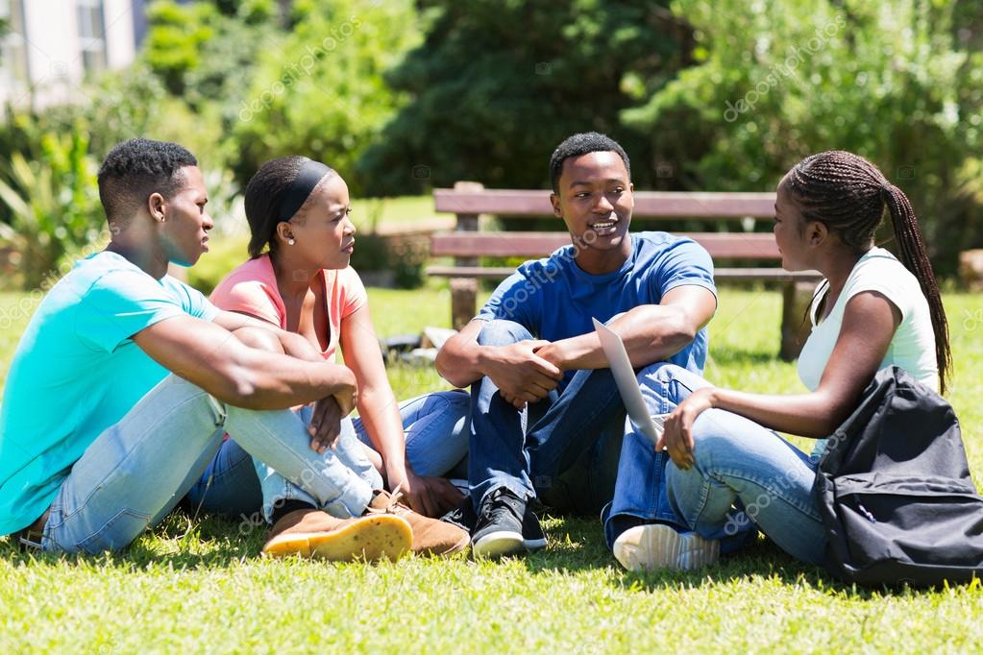
Decide - решить
They decided to meet after classes

Slide 32
Explain – объяснять
He explained how to drive

Slide 33
hope – надеяться
They hope to buy a new house

Slide 34
Manage – удаваться
He managed to win a game

Slide 35
Offer – предлагать
She offered to drink some tea

Slide 36
Plan - планировать
She plans to study abroad

Slide 37
Want - хотеть
I want to travel around the world

Slide 38
Expect – ожидать
They did not expect him to come

Slide 39
Promise - обещать
He promises to help

Slide 40
Refuse - отказываться
He refused to take medicine

Slide 41
Seem - казаться
He seems to be happy

Slide 42
Want ( go)
Fancy (go)
Good at ( dance)
Went to the supermarket ( buy)
Promise ( help)
Too noisy (live)
(Listen) to music is fun
to go
going
dancing
to buy
to help
to live
listening

Slide 43
Avoid ( speak)
Suggest ( go)
Hate ( read)
Interested in ( play)
Hope ( buy)
Dream of ( live)
( Draw ) is a great hobby
speaking
going
reading
playing
to buy)
living
Drawing

Slide 44
Инфинитив без частицы to
После модальных глаголов ( can, may, must, should….)
После глаголов make/let
После would rather/had better

Slide 45
You may eat some cake
Let’s go to the beach
I’ d rather stay in tonight
You should call

