Slide 1
Lyudmila Gennadyevna
Mikhaylova
Grade 6 Unit 5
Wonderful Wildlife

Slide 3
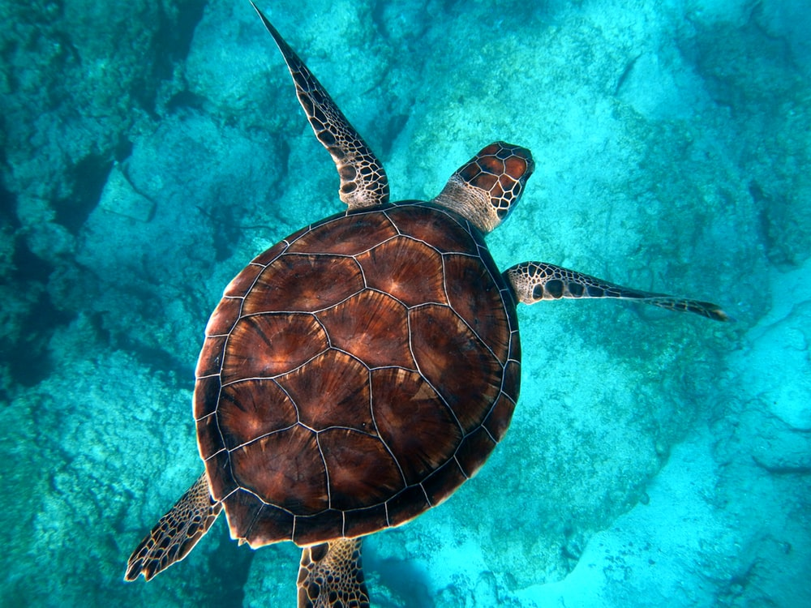
Turtle

Slide 4
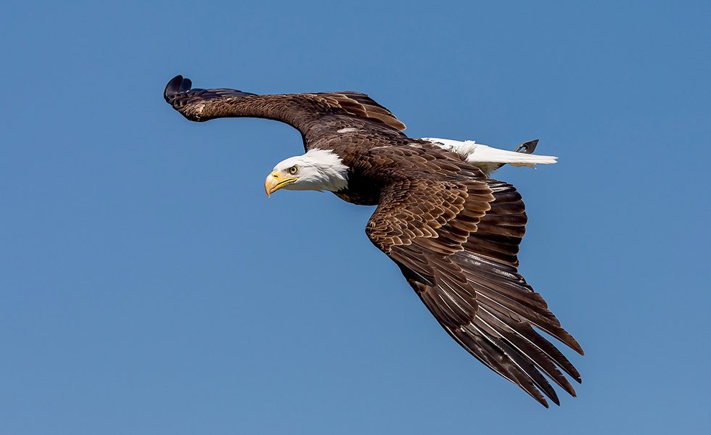
Eagle

Slide 5
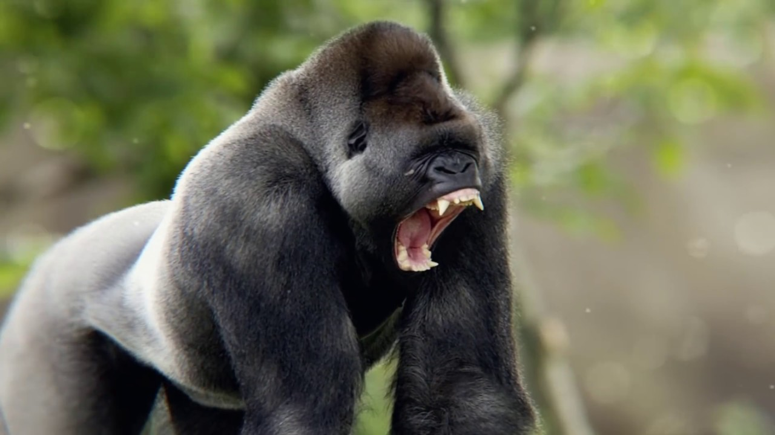
Gorilla

Slide 6
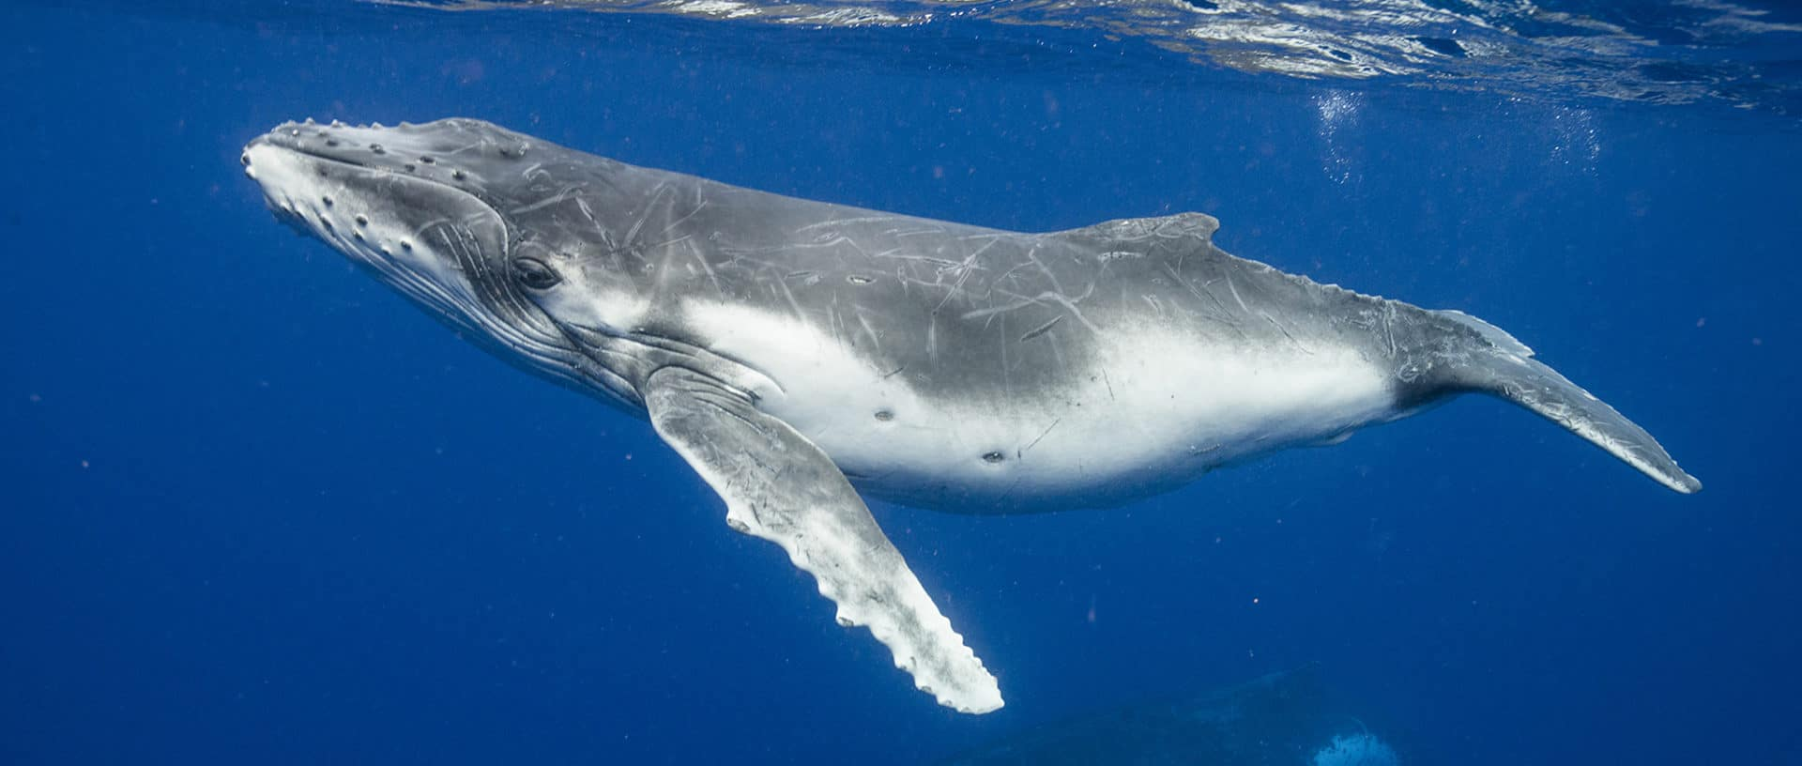
Whale

Slide 7
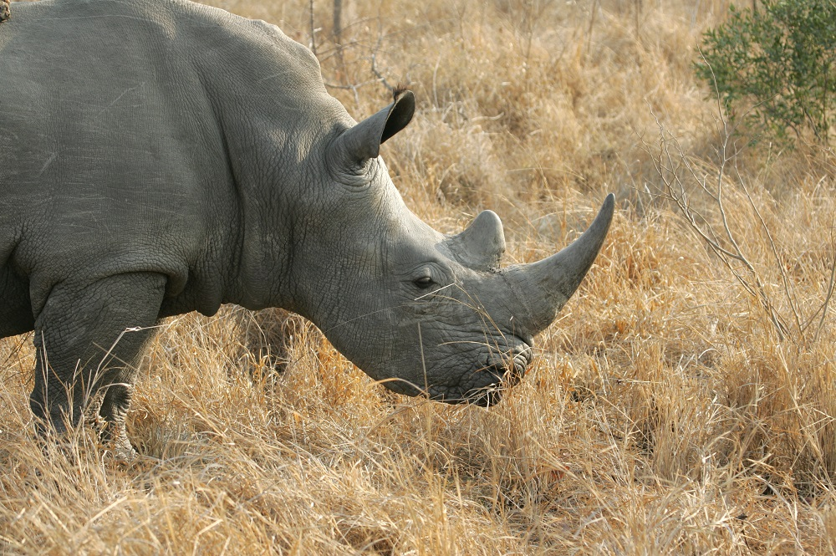
Rhino

Slide 8
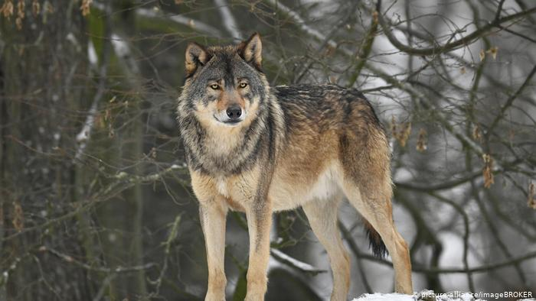
Wolf

Slide 9
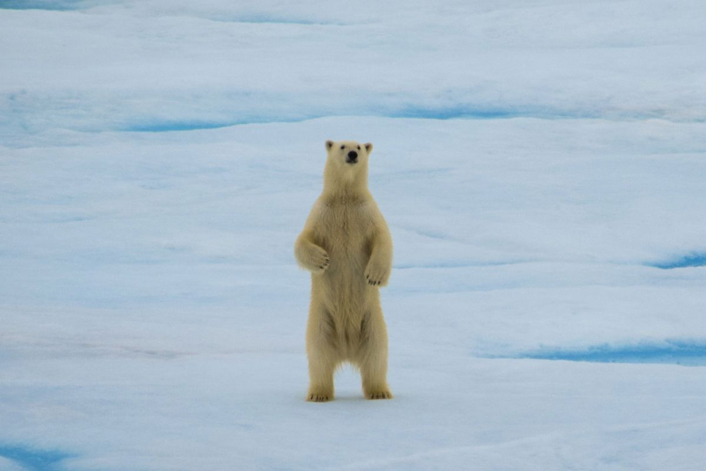
Polar bear

Slide 10
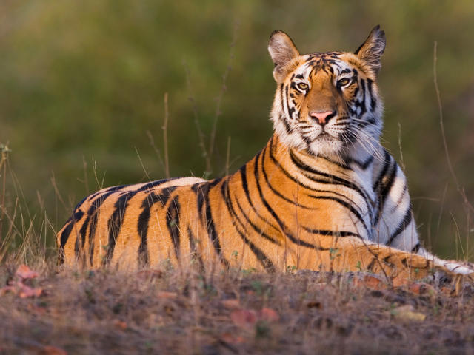
Tiger

Slide 11
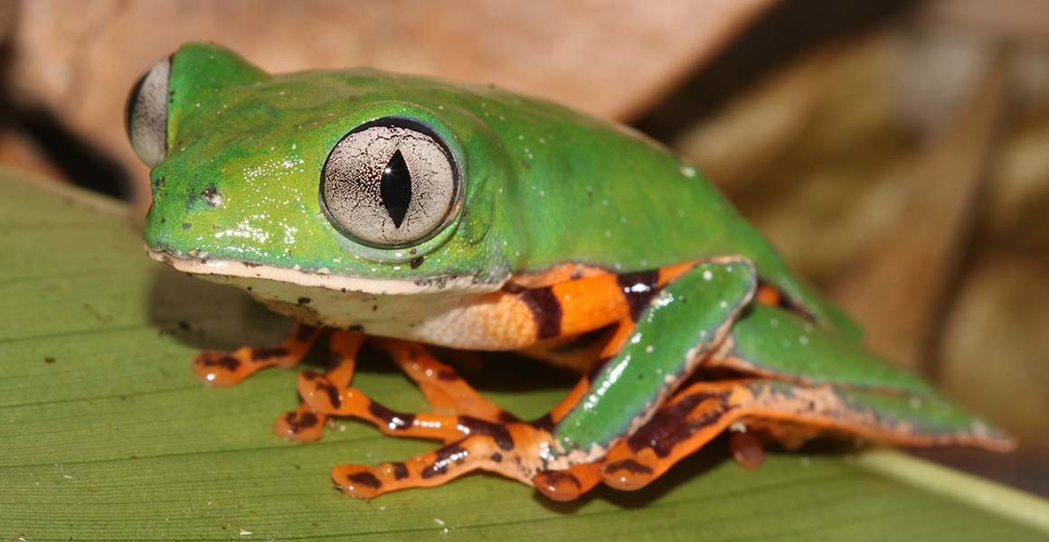
Frog

Slide 12
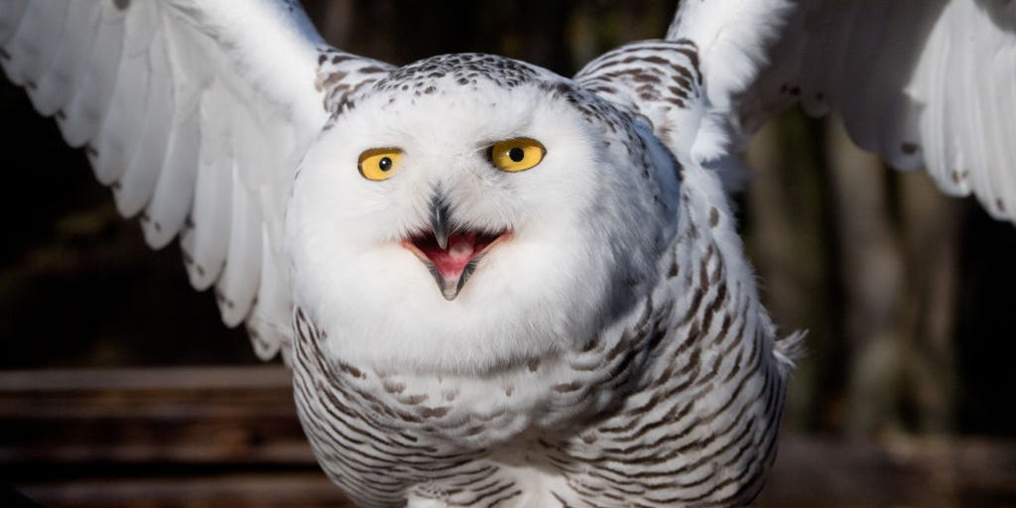
Owl

Slide 13
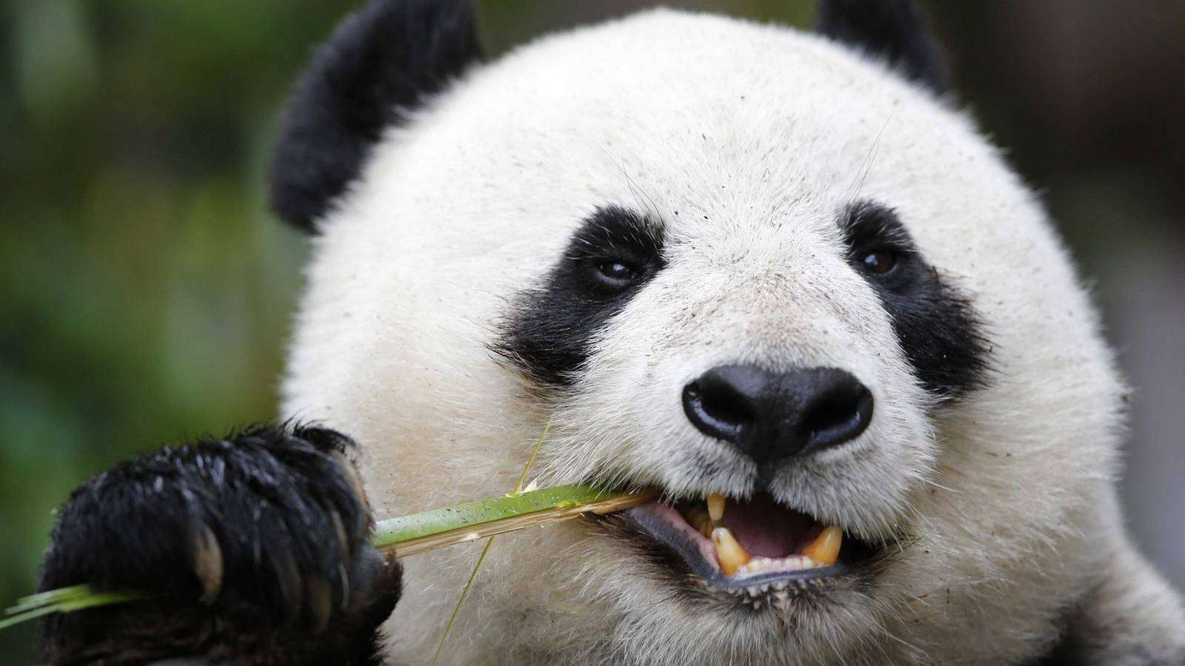
Panda

Slide 14
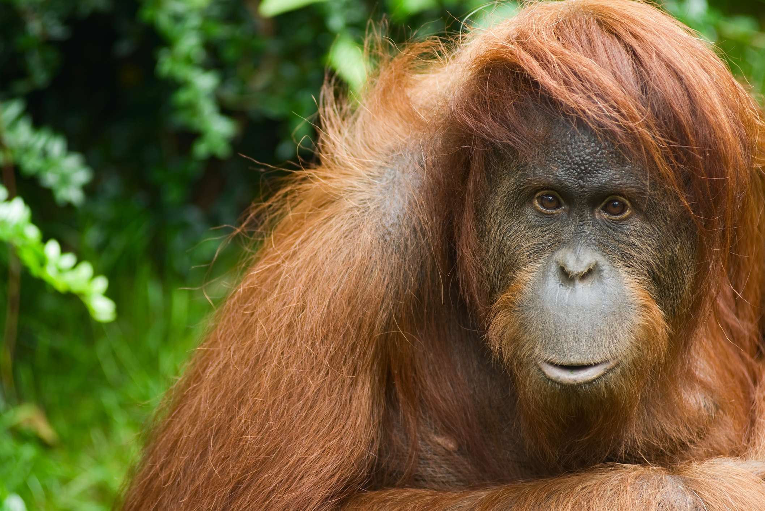
Orang-utan

Slide 15
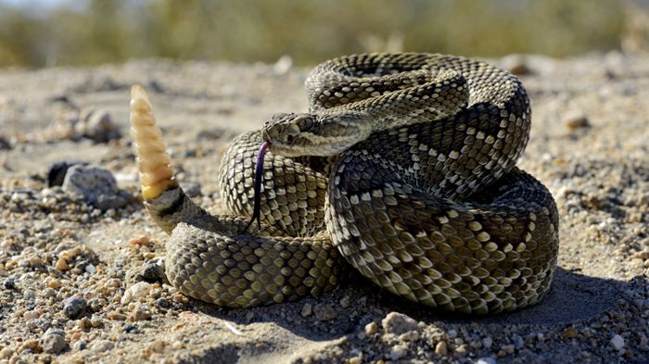
Rattlesnake

Slide 16
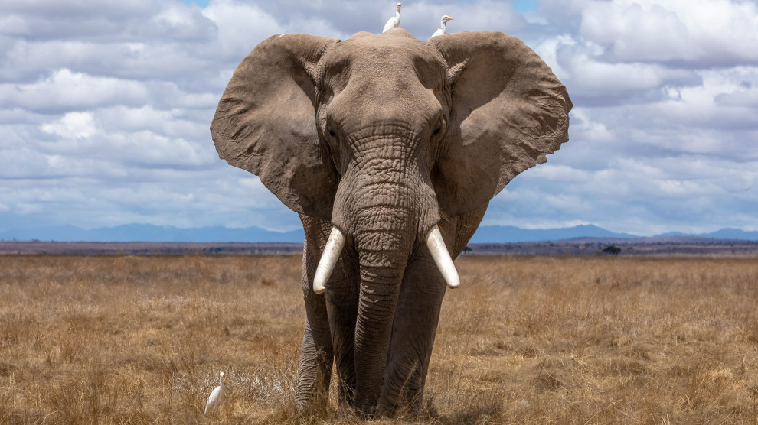
Elephant

Slide 17
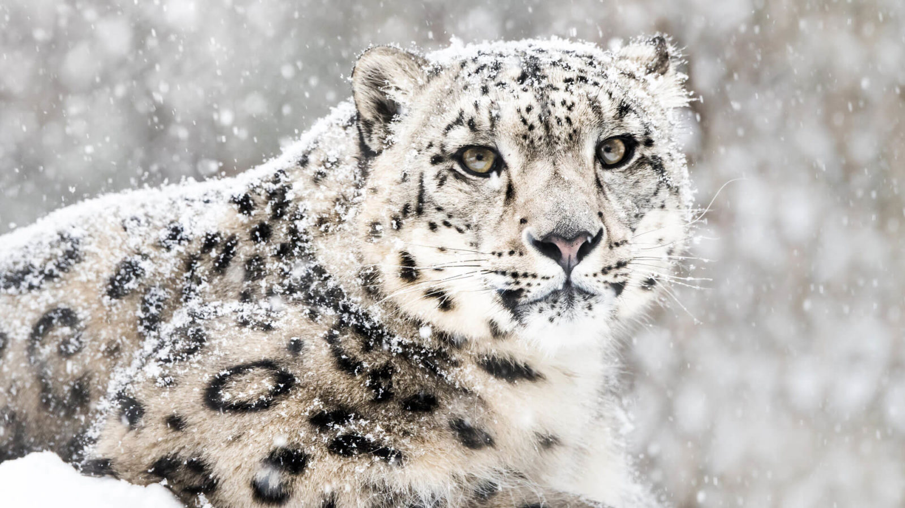
Snow leopard

Slide 18
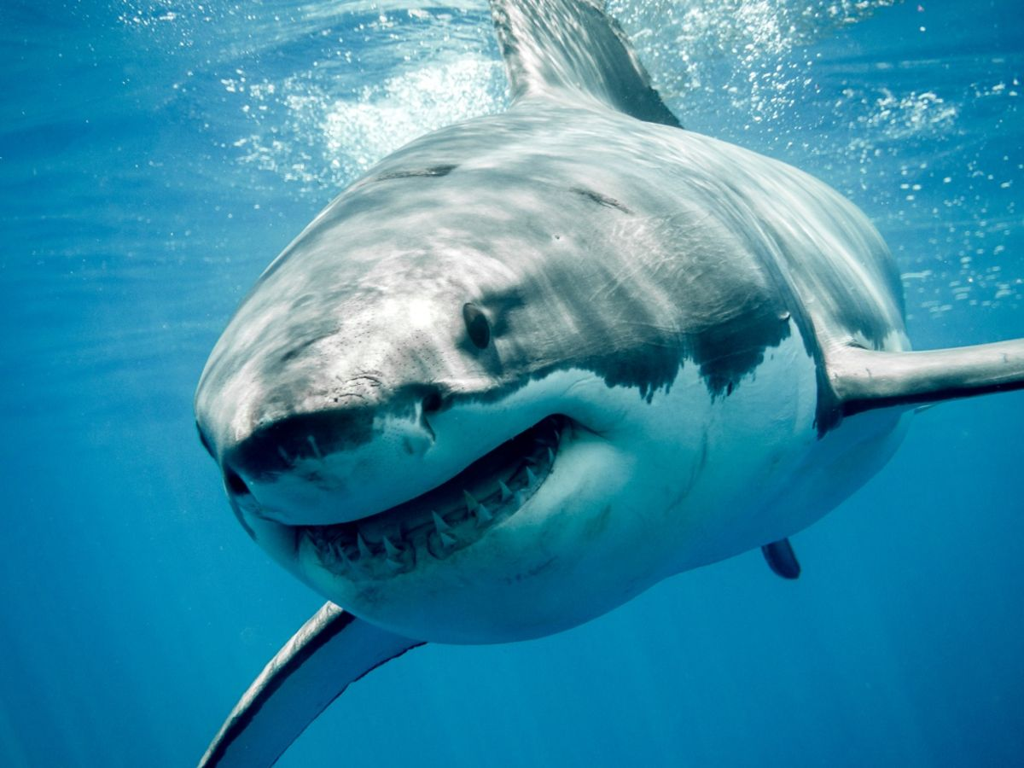
Shark
I am an endangered animal

Slide 19
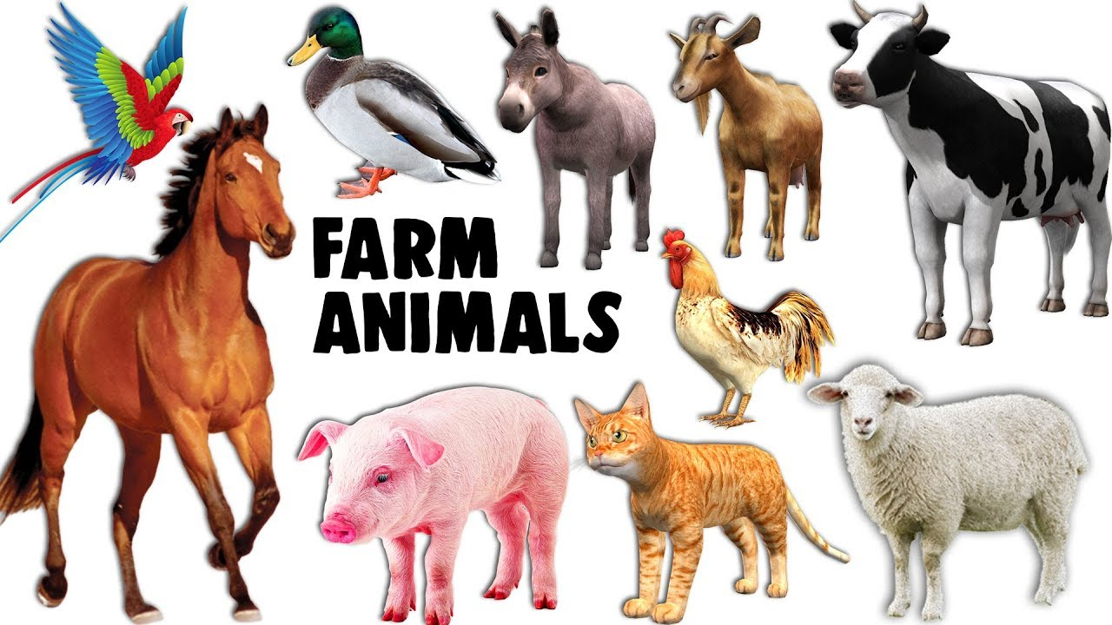

Slide 20
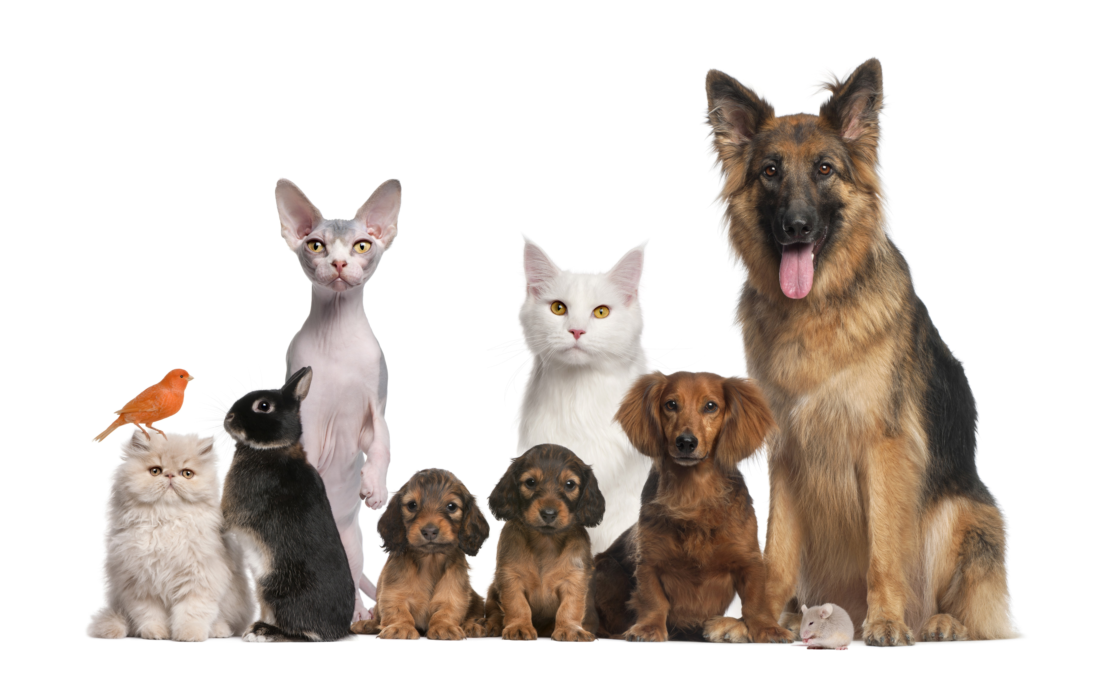
Pets
Pets

Slide 22
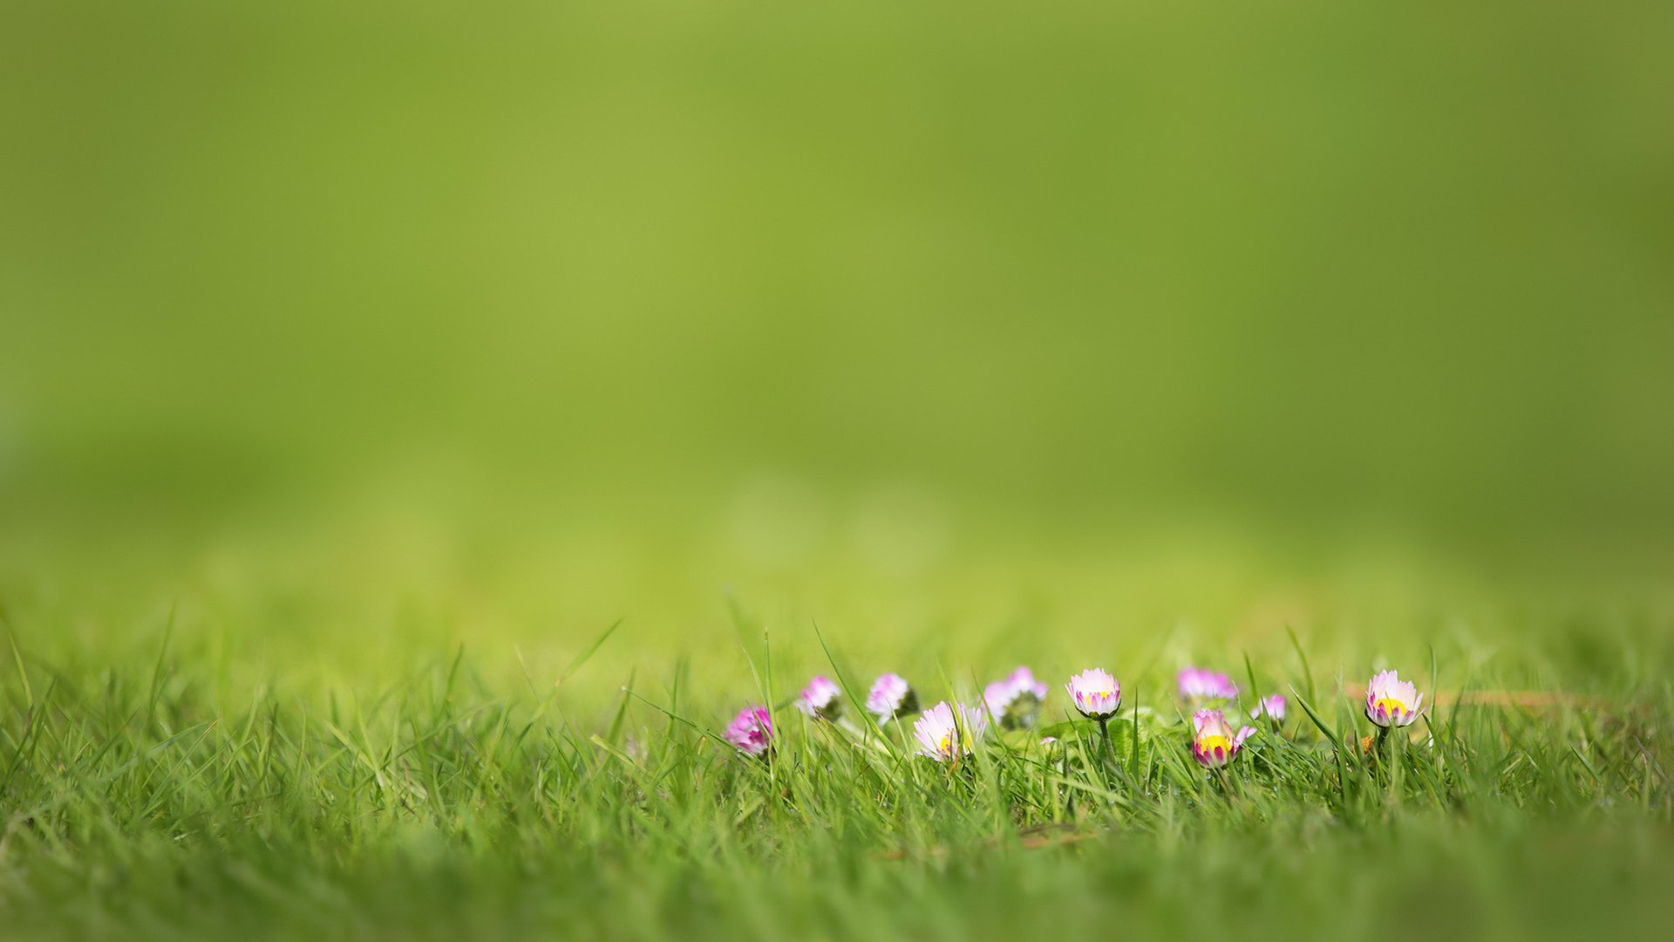
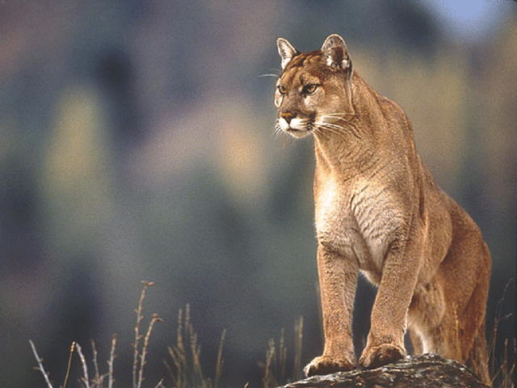
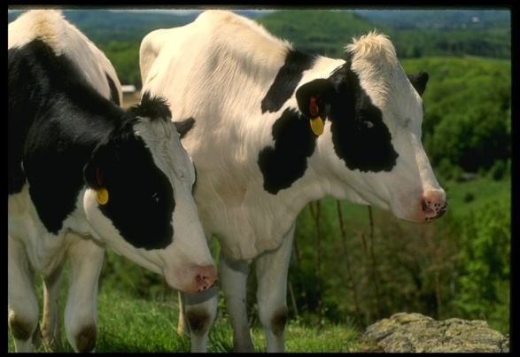
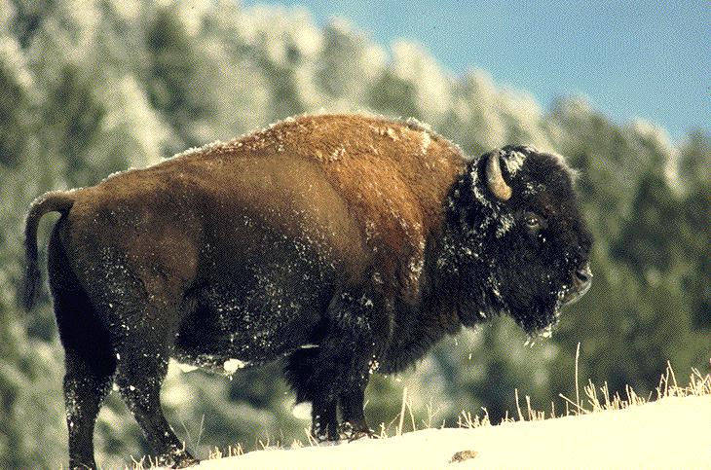
The animals can be: wild domestic endangered
A fox is a wild animal.
Make a sentence as in the example. Use the words:
An elephant, a duck, a rhino, a camel, a snake, a zebra, a horse, a fox, a bear, a cow, a whale, a rabbit, an eagle, a wolf, a dolphin, a giraffe, a hen, a monkey, a lion.

Slide 23
1. Read the text about a tiger. And then complete the fac tfile for a tiger with this information.
Tigers live in Russia and China. They are yellow and dark brown. Their body is 155-265 long and they have got a long tail. They eat small and big animals and they hunt mostly at night. Tigers can run fast and they are good hunters.
2. Answer the questions.
1. What is the habitat of the tiger?
2. What colour is the tiger?
3. What size is the tiger?
4. What is the food of the tiger?
5. What abilities does the tiger have?
6. What other information can you say about the tiger?
3. Make up a fact file of any animal as an example:
1.Habitat- it’s a place where animals live.
2. Colour, 3. Size, 4. Food, 5. Abilities, 6. Other information.

Slide 24
London Zoo
They say exotic animals were first taken to Britain in the thirteenth century when King Henry3 received a gift of leopards and elephants.
The animals lived in the Tower of London in a special place.
Later the King of Norway presented Henry3 with a polar bear. The bear liked to go fishing in the Thames at the end of a long rope.
Five hundreds years later, Queen Charlotte was given the first zebra to come to Britain. Giraffes have been an attraction at London Zoo since four of them arrived in 1839.
Today there are many thousands of animals in the Zoo.

Slide 25
Check yourself
They say exotic animals were first taken to Britain in the ______century when King Henry3 received a gift of _______ and elephants.
The animals lived in the _____ of London in a special place.
Later the King of _____ presented Henry3 with a _____. The _____ liked to go fishing in the Thames at the end of a long rope.
Queen Charlotte was given the first _____to come to Britain. Giraffes have been an attraction at London Zoo since four of them arrived in ___.

Slide 26
Listening
Which animals can you hear about?

Slide 27
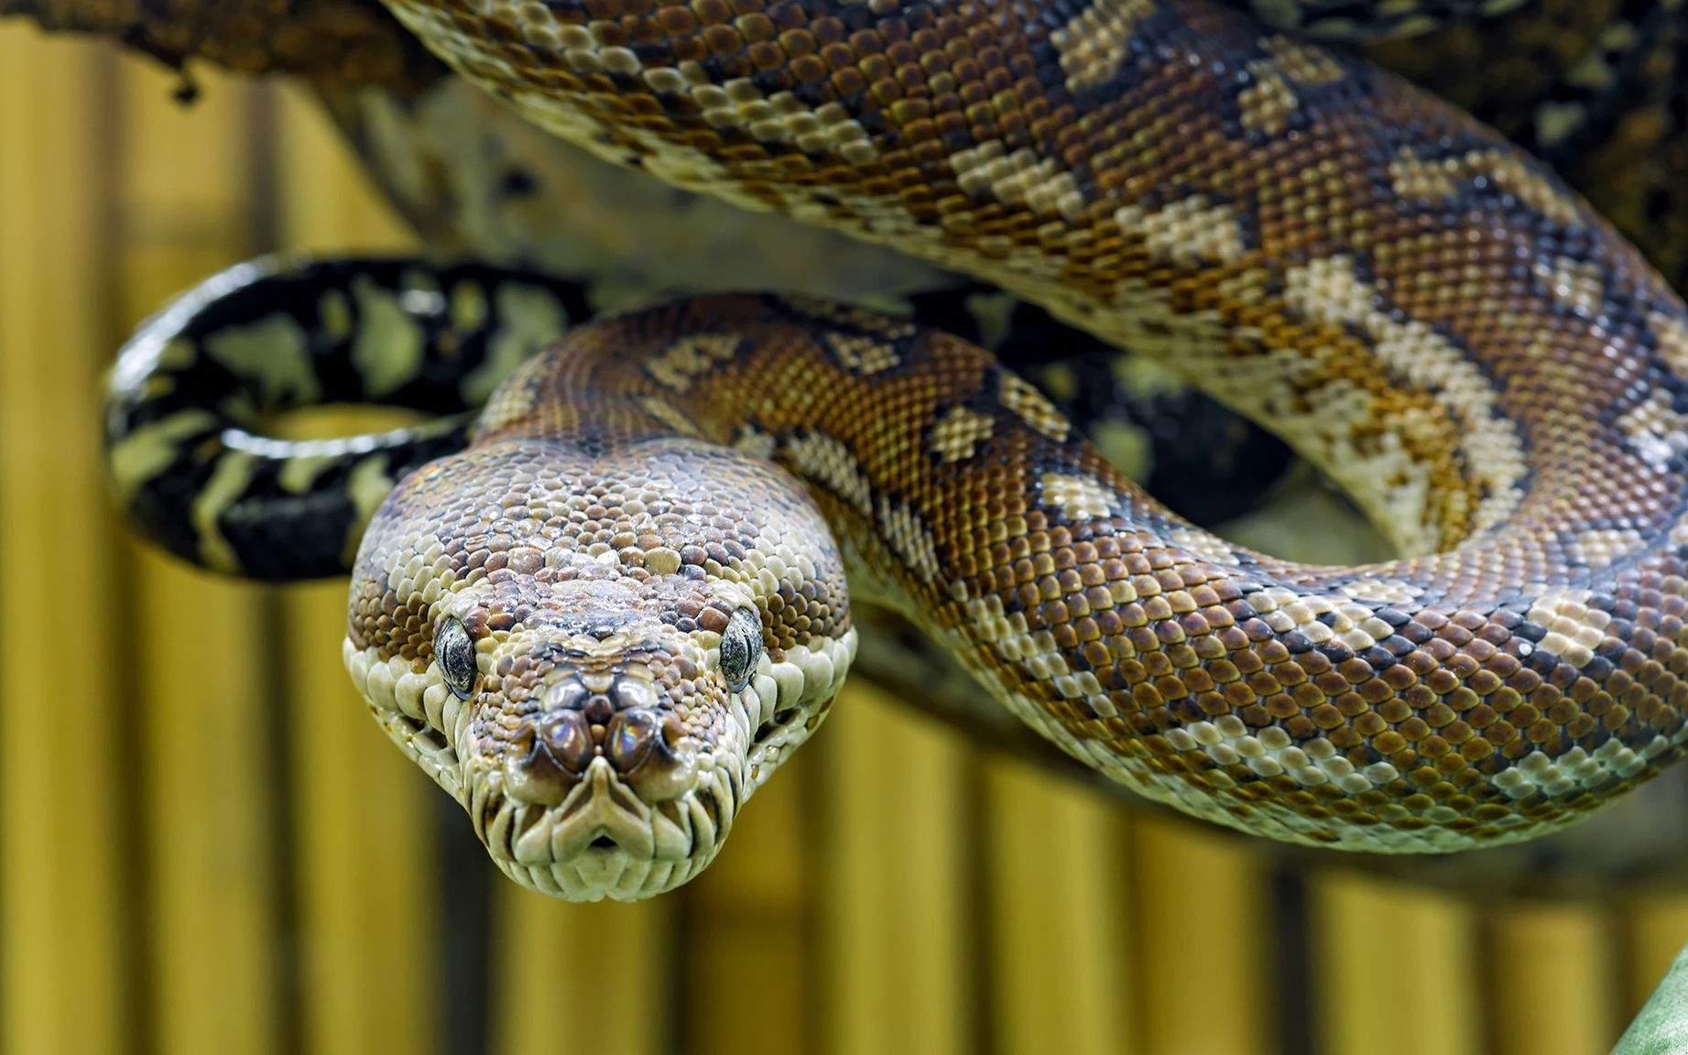
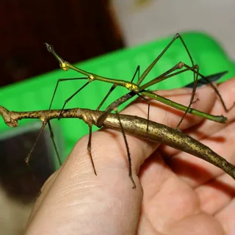
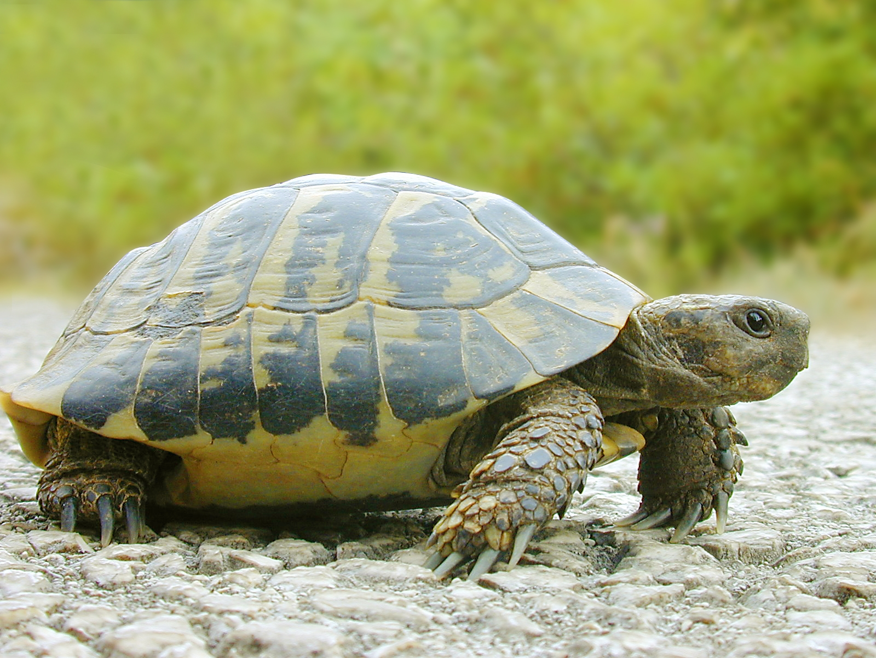
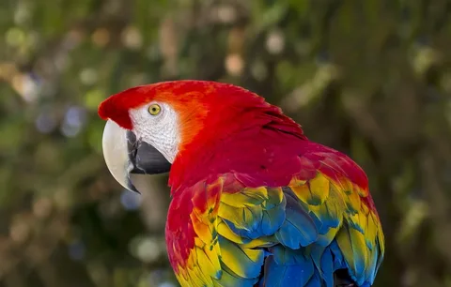

Slide 31
Listening
1. How many people are giving the talk?
2. Is the snake dangerous?
3. What are the stick insects doing?
4. How old are the turtles?
5. What is the parrot saying?
6. Are the animals staying at the school all week?
Answers
1. Two people are giving the talk.
2. No, it isn’t.
3. They’re moving very slowly.
4. They’re 40 years old.
5. The parrot is saying «Hello».
6. No, they aren’t. They’re staying at the school all day.

Slide 32
Answers
1. Two people are giving the talk.
2. No, it isn’t.
3. They’re moving very slowly.
4. They’re 40 years old.
5. The parrot is saying «Hello».
6. No, they aren’t. They’re staying at the school all day.
:

