Slide 1
The 11th of October Classwork
VANISHED

Slide 2
Video

Slide 3
The name of the case is…
Vanished!
Our aim is to …
We need to …
- help the boy/ solve the mysterious case.
- find the clues.
learn & use new words
Complete the sentences
Read the text

Slide 4
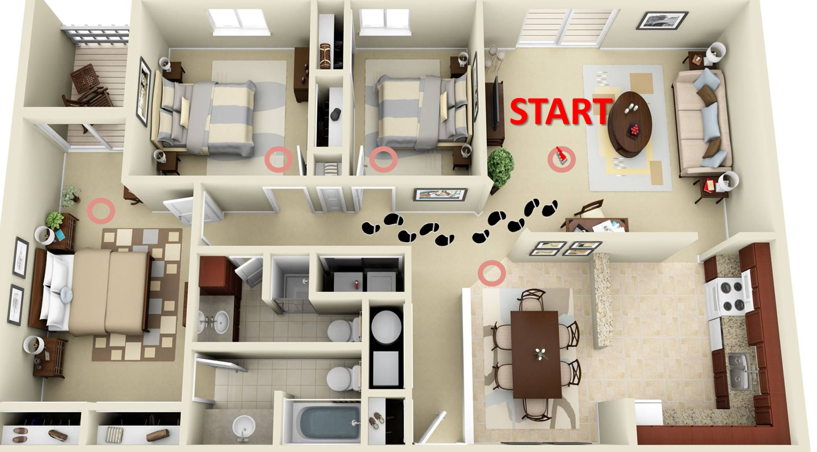
The map

Slide 5
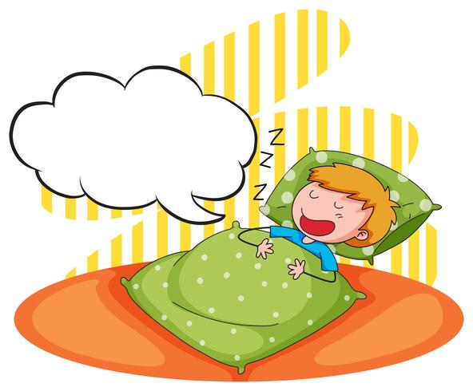
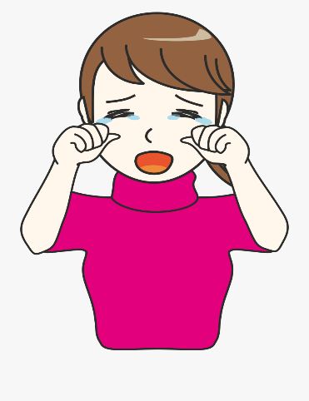
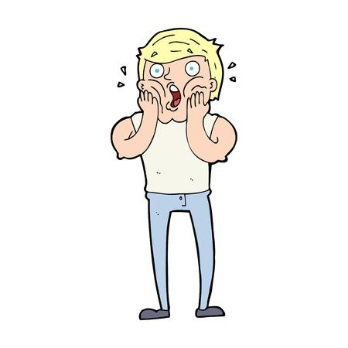
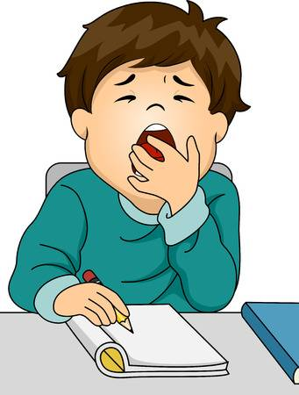
a)sigh
8
b)snore
6
c)Cry
9
Task 1. Listen and match
Count your points!
d)Gasp
5
e)Laugh
10
f)Chat
7
g)Storm
4
h)Gust of wind
3
i)Whisper
1
j)Yawn
2

Slide 6
Great! You’ve got the 1st clue!
START

Slide 7
- stormy - to gasp - lightning - to sigh - confused
- to snore - cosy - to yawn - power cut - to whisper
Task 2. Use new words
Count your points!
confused
Mary was scared and ______________ when she found the door of her house open.
Everyone _________ because they were shocked!
It was quite _________ last night. There were so powerful gusts of wind.
Did you see the bright flash of ______________?
We don’t want to go home. We’re having a ____________ evening here.
Is that Dad __________________ in the bedroom?
Greg ________________ with relief when he found out that his children were at home.
We are allowed to ______________ in the library but not to talk.
It was a ________________. The lights flickered and then went out.
The baby is rubbing his eyes and ____________ a lot. He will be fast asleep soon.
gasped
stormy
lightning
cosy
snoring
sighed
whisper
power cut
yawing

Slide 8
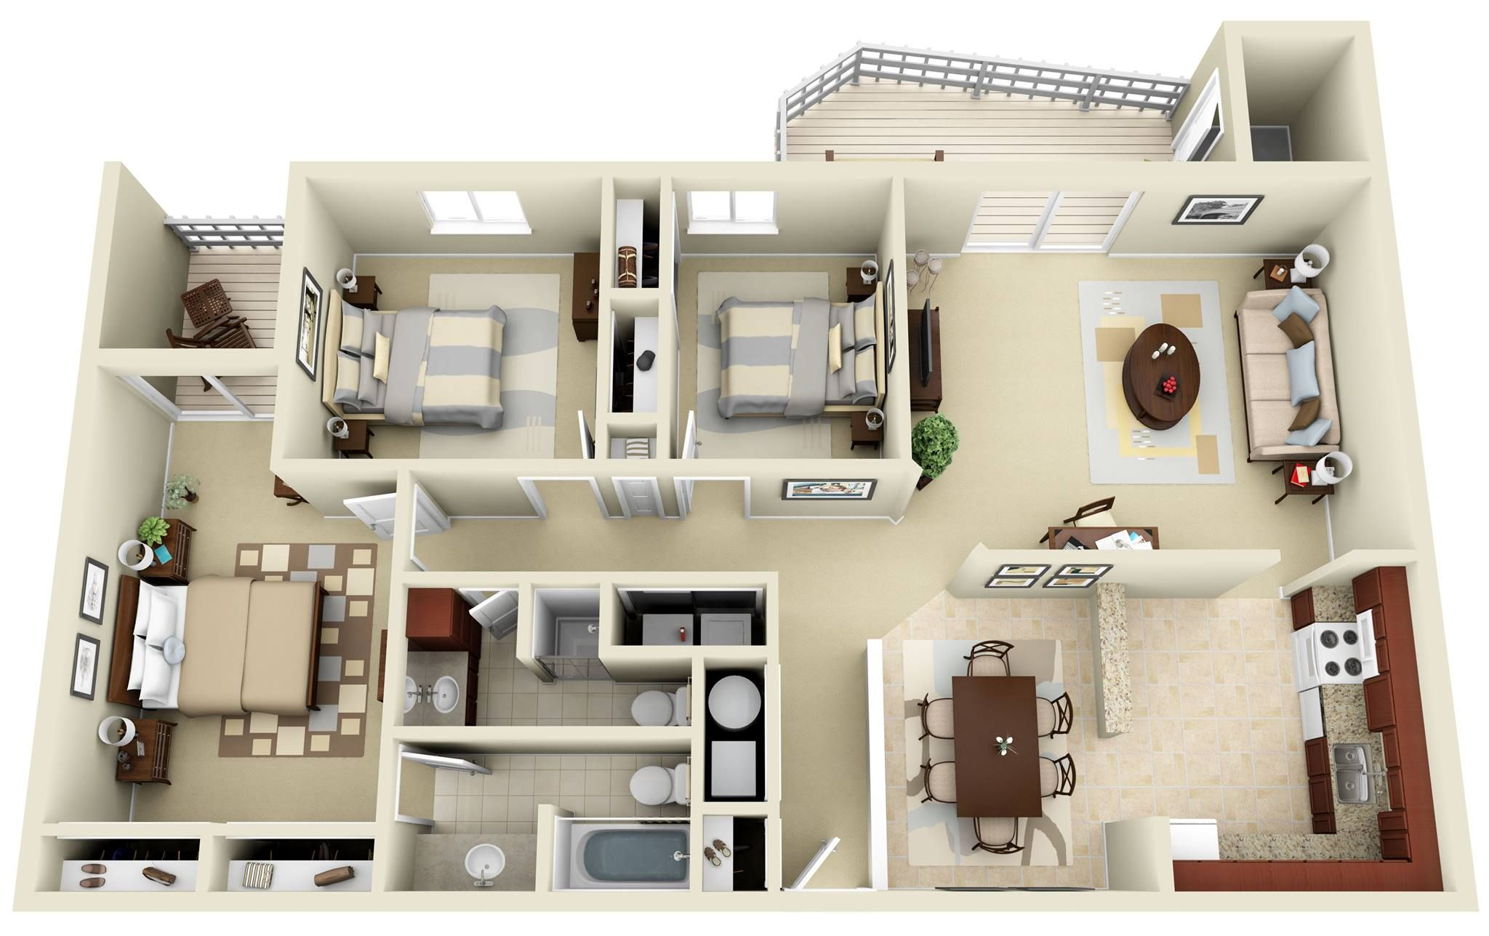
Great! You’ve got one more clue!
START

Slide 9
Let’s have a rest and play Domino!
спать | To laugh
+
+
смеяться | To flicker
мерцать | To sleep

Slide 10
Task 3. Order of events
Count your points!
3. One Saturday last winter, some friends Amy, Maria, Andy, Greg and John decided to spend the weekend in John’s uncle's big, old house in the country.
1. Suddenly it was a powerful gust of wind. The lights flickered and went out altogether. It was a power cut.
2. THEY felt their way around the house, but there was no reply.
7. It was stormy outside, so the children decided to spend a cosy evening chatting together in the living room downstairs.
3. One Saturday last winter, some friends Amy, Maria, Andy, Greg and John decided to spend the weekend in John’s uncle's big, old house in the country.
1. Suddenly it was a powerful gust of wind. The lights flickered and went out altogether. It was a power cut.
4. They carried on laughing and telling scaring stories.
4. They carried on laughing and telling scaring stories.
5. They looked at each other confused and scared, because no one had seen Andy leave the room.
6. After a while, there was a bright flash of lightening that lit up the whole room.
6. After a while, there was a bright flash of lightening that lit up the whole room.
5. They looked at each other confused and scared, because no one had seen Andy leave the room.
7. It was stormy outside, so the children decided to spend a cosy evening chatting together in the living room downstairs.
2. THEY felt their way around the house, but there was no reply.
8. They went to the living room and tried to think of what to do next...
8. They went to the living room and tried to think of what to do next...

Slide 11
Excellent! One more step is done!
START

Slide 13
Task 4. T, F, NS
Count your points!
It was a Saturday evening and there were 5 children. _____
They didn’t want to go out so they decided to spend that evening in the dining room. ___
Greg didn’t know why the light went out. ___
The house was 20 miles from Oxford. ___
Andy was fast asleep and snored on a big velvet sofa. ___
Andy didn’t want to listen to their stories and that’s why he crawled to the sofa. ______
T
F
F
NS
T
F

Slide 14
We’re getting very close to the finish!
START

Slide 15
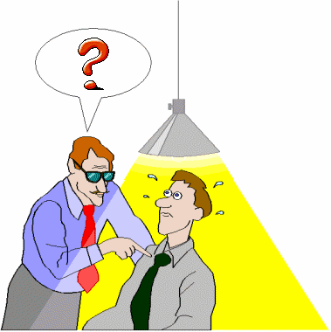
Task 5.
Ask eyewitness
Who ___________________?
Where _________________?
When __________________?
Why ___________________?
What __________________?

Slide 16
We’ve solved the mysterious case!
START

Slide 17
What clues have we found?
WORDS
SENTENCES
TEXT

Slide 18
Count your points and get the prize!
34 – 31 = “5”
30 – 24 = “4”
Check answers
23 – 17 = “3”

Slide 19
Your Home Task
WB page 13, ex. 1 a),b)
***SB page 20, ex. 3

