Slide 1
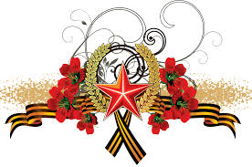
Tuvan volunteer young girls in the Great Patriotic war

Slide 2
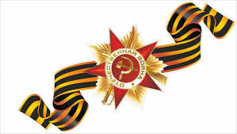
We are proud of them! Always remember these Tuvan young girls with brave hearts:
Kyrgys Norgun
Chaskal Saryglar
Synaa Kyrgys
Sevil Orjak
Polya Oyun
Amaa Mongush
Bichen Khovalyg
DariyaKhovalyg
BagbuzhapIrgit
Vera Bailak

Slide 3
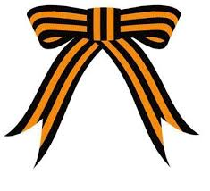
Meet our heroes!

Slide 4
Kyrgys Norjun was born in 1923 in place called called Urbun of Chaa-Khol region. In 1940 she was elected as a secretary of Urbun village. She worked in the panel which was working to help Red Army. In 1943 Norjun worked as a radio operator and then joined militia troops and she learned to be a combat medic. Kyrgys Norjun fought bravely and took part in the battles for the cities and villages of Ukraine. She was awarded the medal “For Courage and Bravery” and Medal of Labour of Tuvan People’s Republic. After the war she worked as a court secretary and before retiring worked at a garment factory.

Slide 5
Chaskal Saryglar was born in the village of Khondergey. She worked as a nurse at the hospital of the town Chadana. She went to the war together with her husband Koshkar-ool who died heroically during the battle for town Rovno. They were both awarded medals “For Courage and Bravery” and Order of Labour of Tuvan People’s Republic.

Slide 6
Kyrgys Sanaa was born in Erzin. She finished only seven classes. At the age of twelve she was able to ride a horse perfectly. With her horse Ezir –Dorug she won horse racings five times and she became a famous female horsewoman. She also was a ski champion. During the War she worked as a nurse. After the war she occupied high posts in Kyzyl. She is an owner of numerous medals and awards.

Slide 7
Sevil Orjak was born in Chadana. She studied in Moscow and knew Russian well. She was well-brought and kind. During the War she saved many lives and gave first aid many soldiers. She is also an owner of numerous medals and awards. After the War she worked for State Security Service.

Slide 8
Polya Oyun was born in 1915 in Chaa-Khol region. She graduated from the college in Ulan-Ude and worked as an accountant in Kyzyl. She went to the War voluntarily. She knew Russian well and worked as a nurse of number three company during the war. She was fond of singing. For her courage heart and dedication she was awarded medals “For Courage and Bravery “ and “Military Heroism”. After the war she worked for State Security Service for many years.

Slide 9
Amaa Mongush is one of the 10 Tuvan volunteer nurses. She started her working career at the hospital of town Chadana. In 1943 with the other volunteers she arrived to Kyzyl. She was accepted the tenth nurse to the front. In the battles for Surmich she killed three fascists. Also, in the battles on the river Ikwa she killed more a score of germies. She was awarded The Order of Great Patriotic War I degree for her courage. After the war she worked at school in Chadana, then at kindergarten as a teacher. She made an invaluable contribution to the education of the younger generation.

Slide 10
Bichen Khovalyg was born in 1923 in the village of Eilyg-Khem, Ulug-Khem region. She went to the war together with her husband on 1 September in 1943. During a battle when she was helping wounded soldiers with her friend, German soldiers suddenly approached to them. Two young girls managed to dispose of seven men. Fortunately, she with her husband came back from the war safe. After the war they lived and worked in different parts of the republic.

Slide 11
Kular Dariya was born in 1924 in the place called Shivilig of Bay-Taiga region. She finished only four classes. Before the war she worked at a secondary school as a clerk. Dariya was disciplined, obedient and knew how to keep a military secret. In the battles in Rovno she personally killed more than ten fascist soldiers. She was awarded the Order of Labour of Tuvan People’s Republic for her courage.

Slide 12
Vera Bailak was born in 1923 in the village of Khayrakan of Chon-Khemchik region. After 7 years of studying at school she left it. When Nazi Germany attacked the USSR she worked at school. She learned how to use the gun and how to provide first aid. Then she went to the war with her brother as volunteers. In the battles for Surmich, Dubno she worked not also as a nurse but took part in assaults and showed heroism many times. Soviet Government appreciated her heroism and awarded her the Order of Great Patriotic War I degree. Vera Bailak is a hero of war and labour as well as mother heroine. She gave birth to ten children. Such orders and medals as Orders of Great Patriotic War I, II degrees, Order of Tuvan People’s Republic, Order of Labour and many others decorate her breast.

Slide 13
Bagbuzhap Irgit was born in 1924 in the place called Soolcher of Erzin region. She attended teacher courses in Kyzyl and worked at Bay-Khaak secondary school. She was a combat medic of fourth class. During the war she provided first aid to many soldiers and commanders. In autumn of 1944 she died from illness in Samagaltay. She was awarded the medal “For Courage and Bravery” and the Order of Labour of Tuvan People’s Republic.

Slide 14
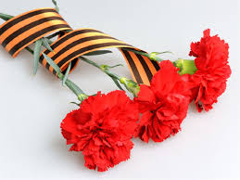
Thank you for peace!

Slide 15
