Slide 1
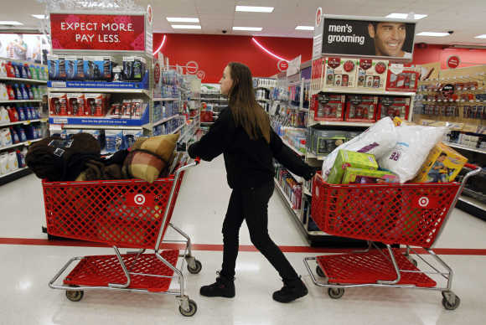
Shopping!

Slide 2
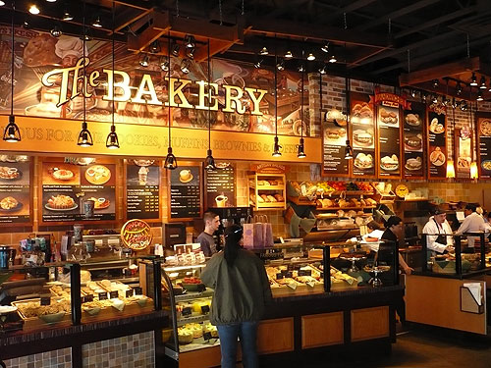
A Baker’s

Slide 3
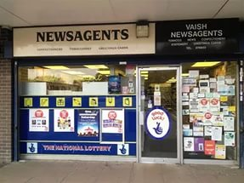
A Newsagent’s

Slide 4
A Greengrocer’s

Slide 5
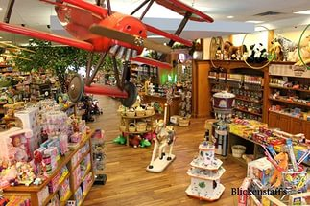
A Toy shop

Slide 6
A Chemist’s

Slide 7
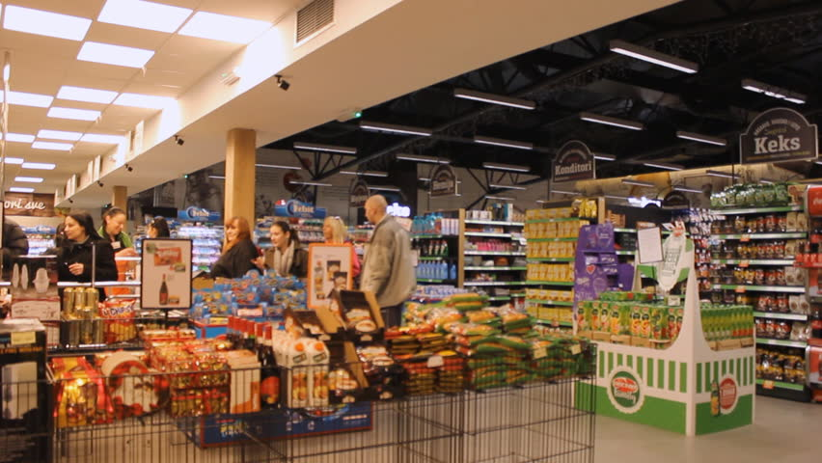
A Supermarket

