Slide 2
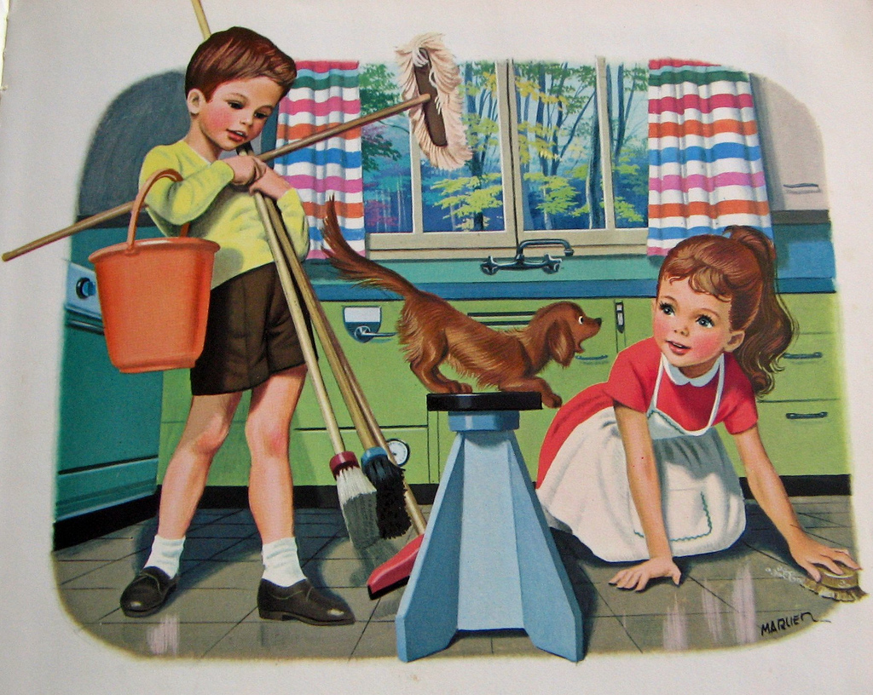
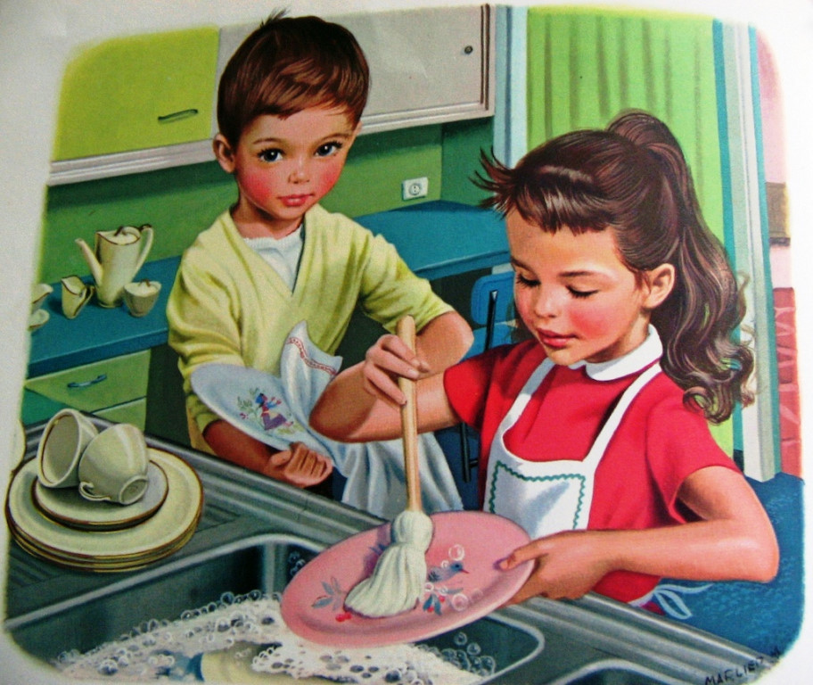
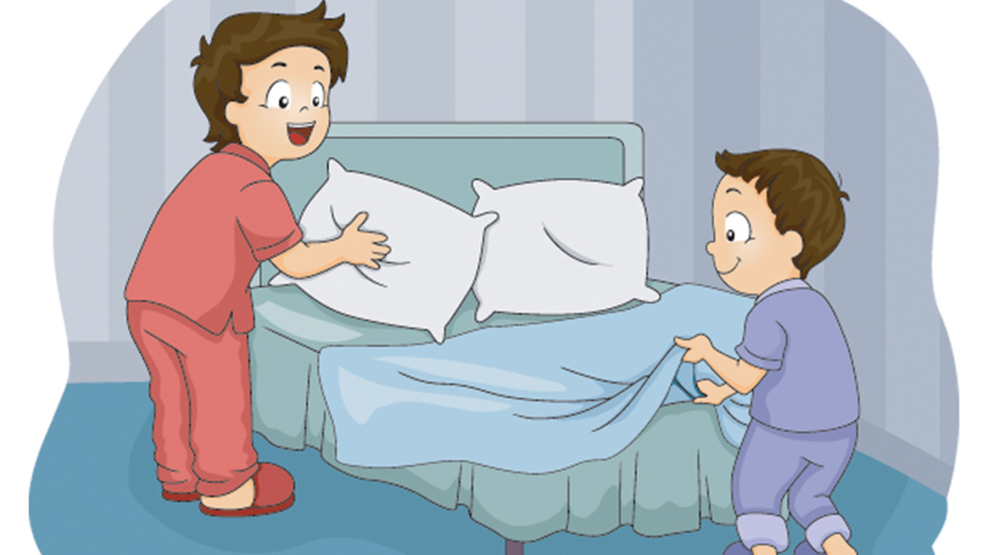

Slide 3
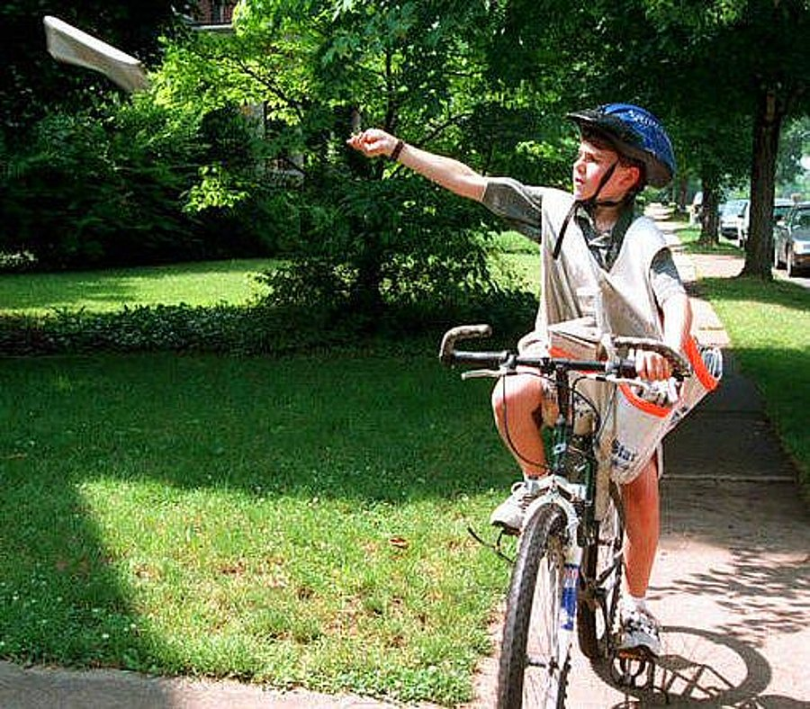
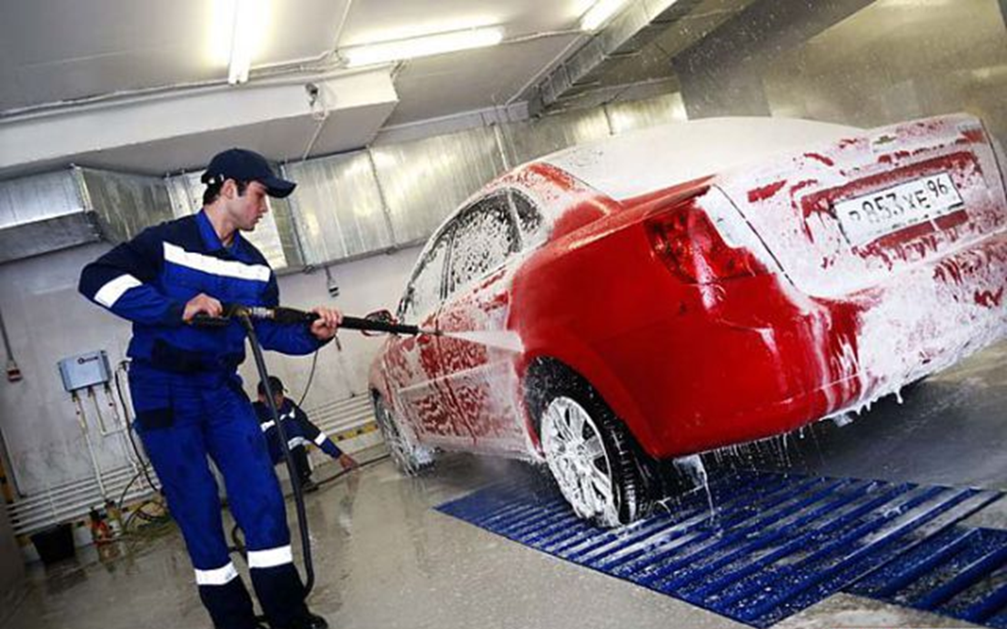

Slide 4
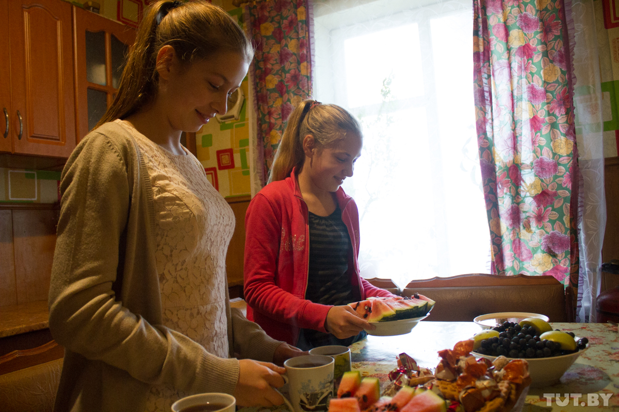
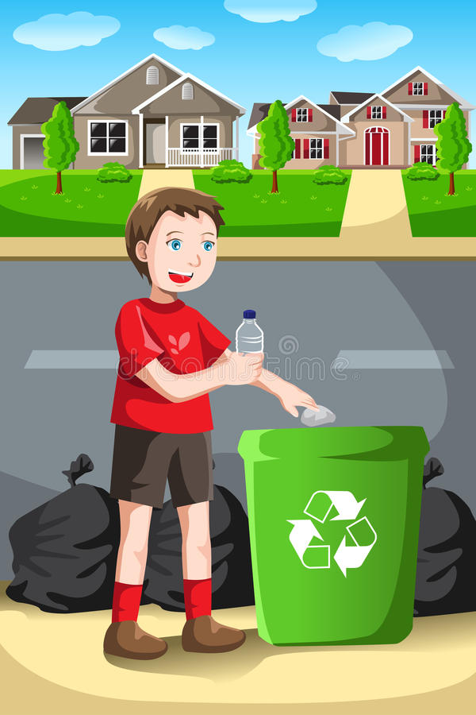

Slide 5
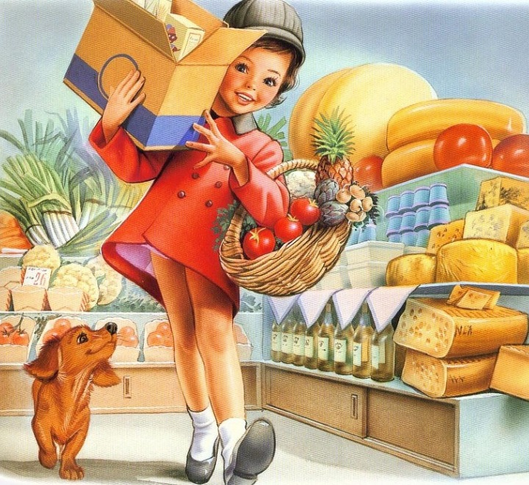
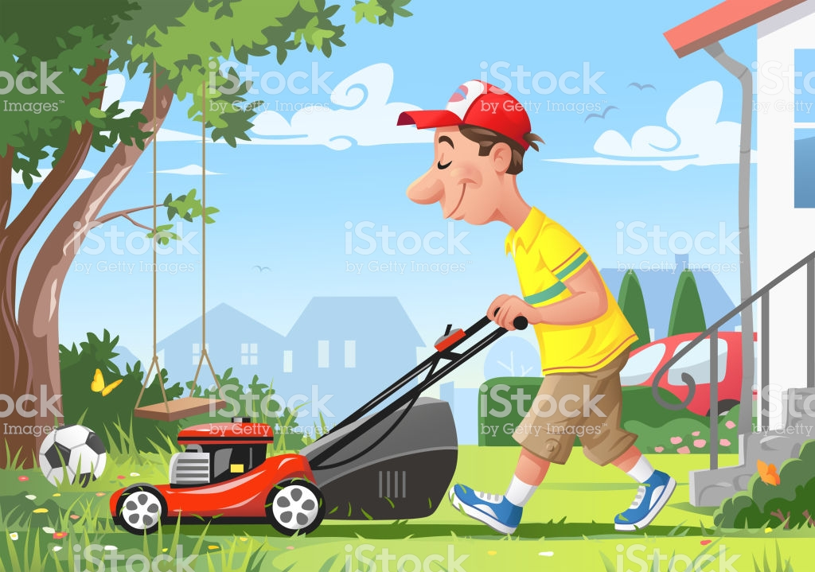
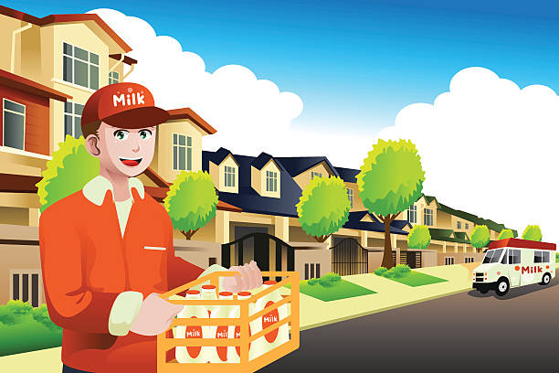

Slide 7
How can teenagers get money?
Do they:
have a part time job?
run errands for mother/father?
tidy the room?
do the washing-up?
make the bed?
do the shopping?
buy the newspaper?
lay the table?
cut the grass?
do baby-sitting?
take out the rubbish?
do paper rounds?
help with milk rounds?

Slide 8
Match the phrases
Получать карманные деньги
Откладывать (копить) деньги
Получать меньше/больше денег
В среднем
По сравнению с
Тратить деньги на что-либо
Получать на 7% меньше
Разносить газеты по домам
Зарабатывать деньги
Save money
On average
Get 7% less
Get pocket money
Get less/more money
Earn money
Do paper rounds
Spend money on smth
Compared to

Slide 9
It is better to have many friends than to have much money

