Slide 1
Our school life 5 класс
Хангуева Александра Аполлоновна
МОУ Корсукская СОШ
2015-2016 уч.г.

Slide 2
My school

Slide 3
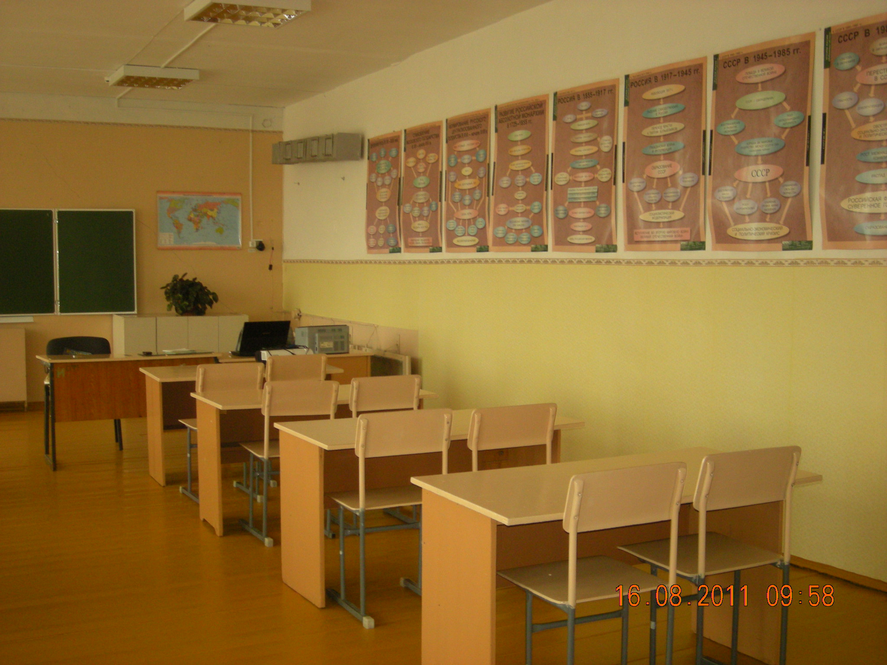
Timetable
1.Monday
A Phonetic lesson
2.Tuesday
A Lexical lesson
3.Wednesday
A Musical lesson
4.Thursday
A Grammar Lesson
5.Friday
A Drama lesson
6. Saturday
A Creative lesson

Slide 4
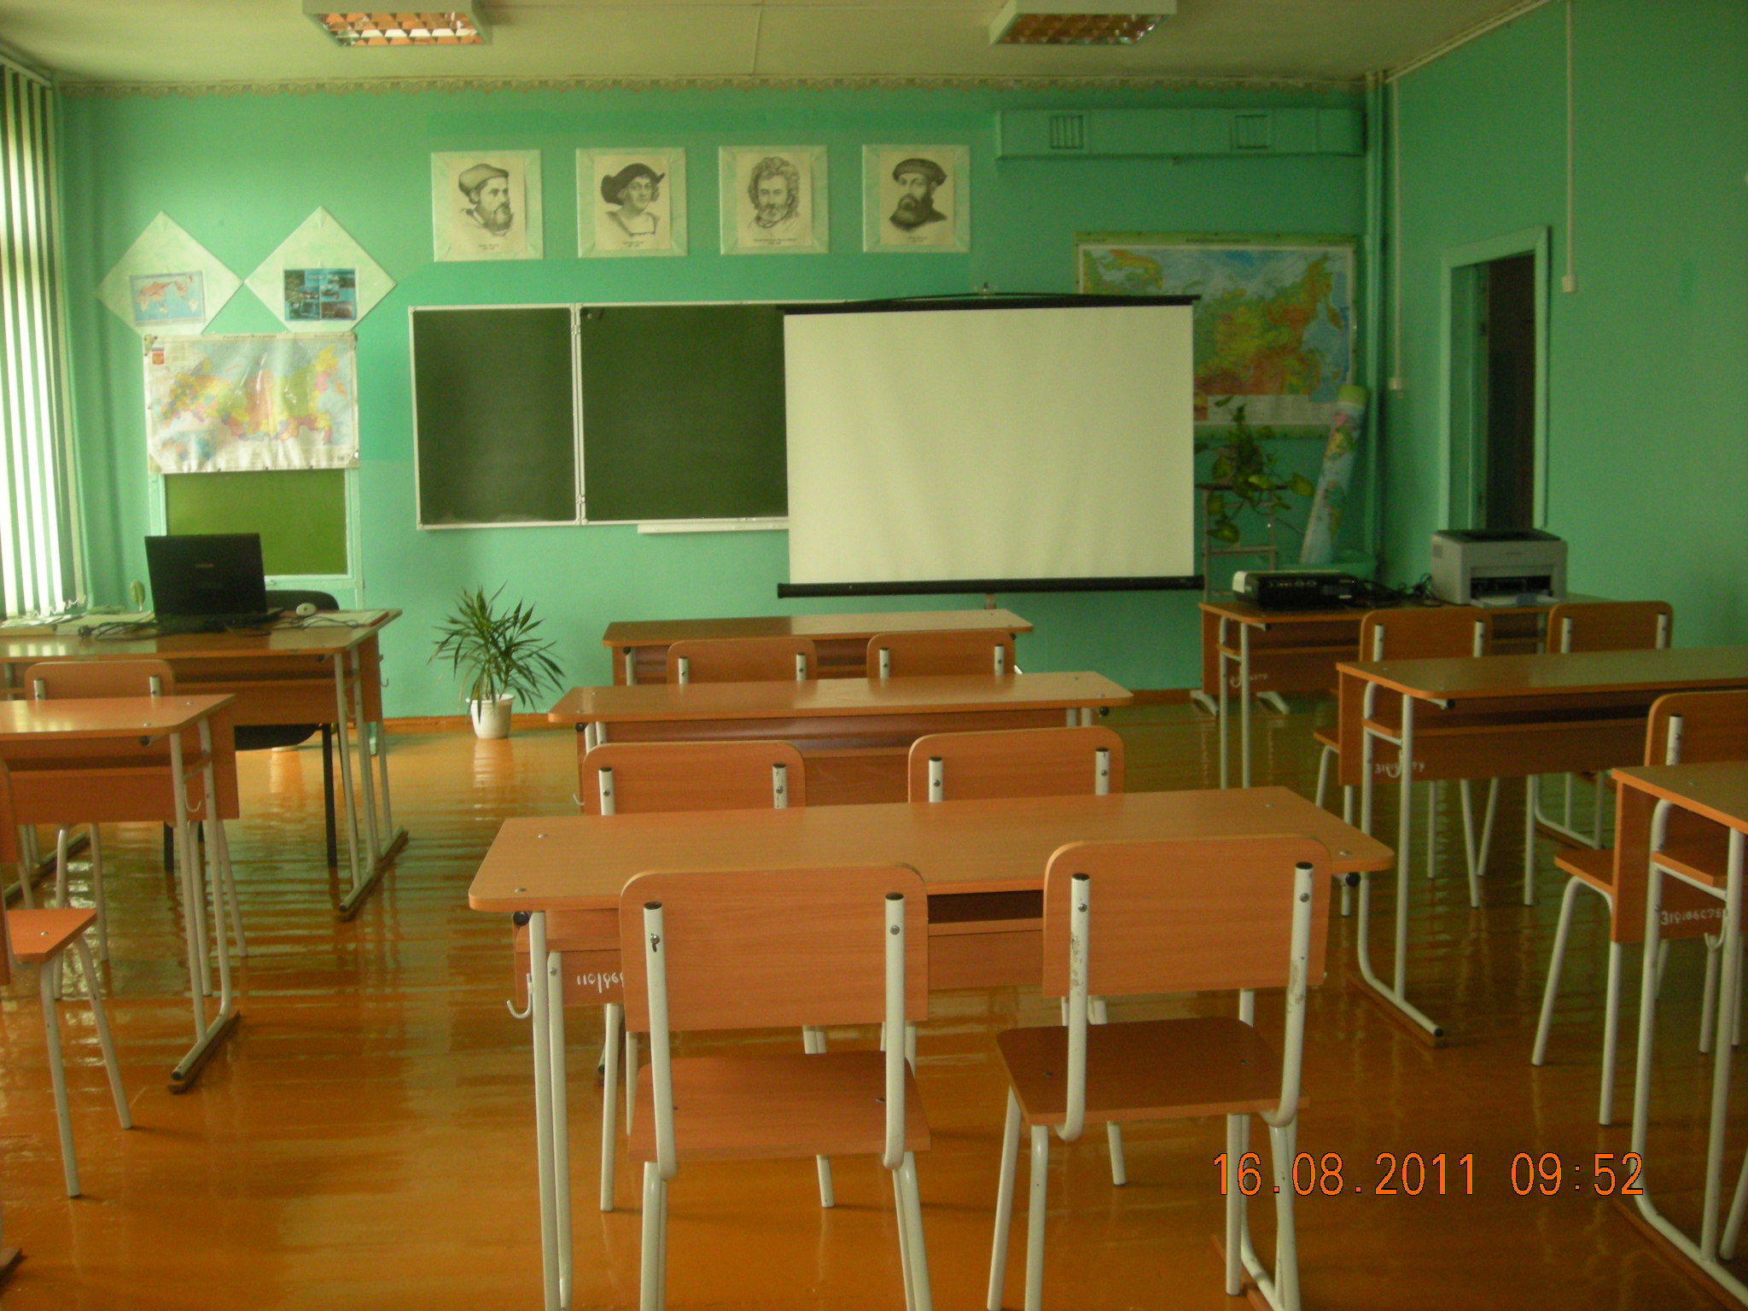
Игра «Аукцион»
Тема: «Школьные предметы»

Slide 5
Put the missing sounds, read the words:
1, [ ni__neim]
2. [ t__mteibl]
3. [h__lidei]
4. [s__bdзikt]
5 [ju:nif__m]

Slide 6
Make up the words (the things you use at school):
ulrer
ainpst
tcmouper
beburr
oobkextt

Slide 7
Solve the crossword and find the key word:
1.Школа
2.Школьная форма
3.Класс, урок
4.Карандаш
5.Парта
6.Расписание уроков
7.Город (большой)
8.Русский язык
1
2
3
4
5
6
7
8

Slide 8
A song: “At our school”
1.In the playground
We have lots of fun
We play, we talk,
We jump, we run.
At our school,
At our school,
At our school.
2.On the sports field
We do P.E.
We play sports together
You and me
At our school,
At our school,
At our school.
3.In the art room
We paint and draw,
We put our pictures
On the walls.
At our school,
At our school,
At our school.
4.In the computer room
We look and hear,
We put the headphones
On our ears.
At our school,
At our school,
At our school.

Slide 9
Choose the correct answer:
1.Last September my mother and I ………..to the sea.
went b) go c) will go
2.Sam ………football with his friends tomorrow.
plays b) played c) will play
3.I …….a pupil of the fifth form.
am b) is c) do
4.My sister often ………… books in the evening.
read b)reads c) will read
5.We ……………..not at school yesterday.
Are b) was c) were

Slide 10
Take an interview, use these questions:
1.Hello! What is your name?
-Hello! My name is…….
2. Where are you from?
- I am……
3. How old are you?
-I am…..
4. Are you in the fifth form?
-……….
5. What subjects do you study at school?
-We study……..
6. What is your favorite subject? Why?
-My favorite subject is……. because I like to……..

Slide 11
Темы проектов :
1. “My school in the past”
2. “Our headmasters”
3. “Our teachers”

Slide 12
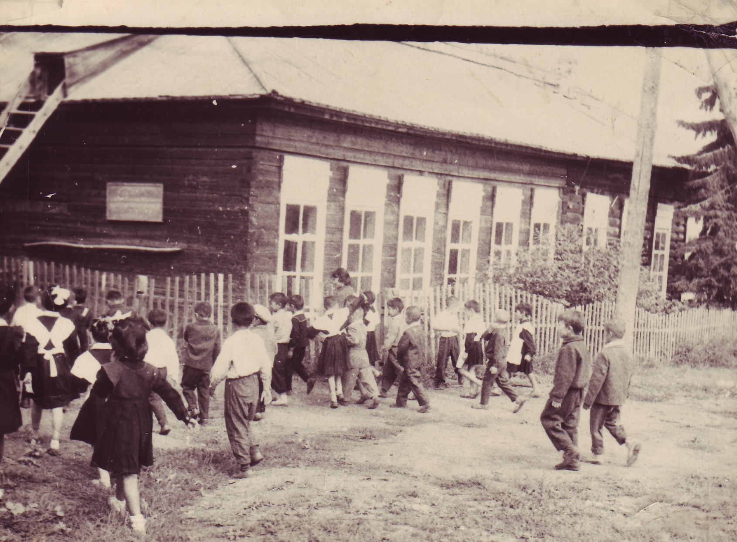
Our old school

Slide 13
Read and translate the text
and had classes from
09.00 till 14.00. There were 9 headmasters in our school. The first of them was Khutanov A.S.
The teachers are kind and patient. One of them is a great master. Her name is Darima Petrovna. There are 3 gold and 12 silver medalists in our school. We are proud of them.
Our school was founded in 1912.
It was free and compulsory
for all children.
At the age of 7 children
went to primary school.
Boys and girls studied
together. When children
were 11, primary school was over.From 12 to 17 children went to secondary school. Students went to school from Monday to Saturday

Slide 14
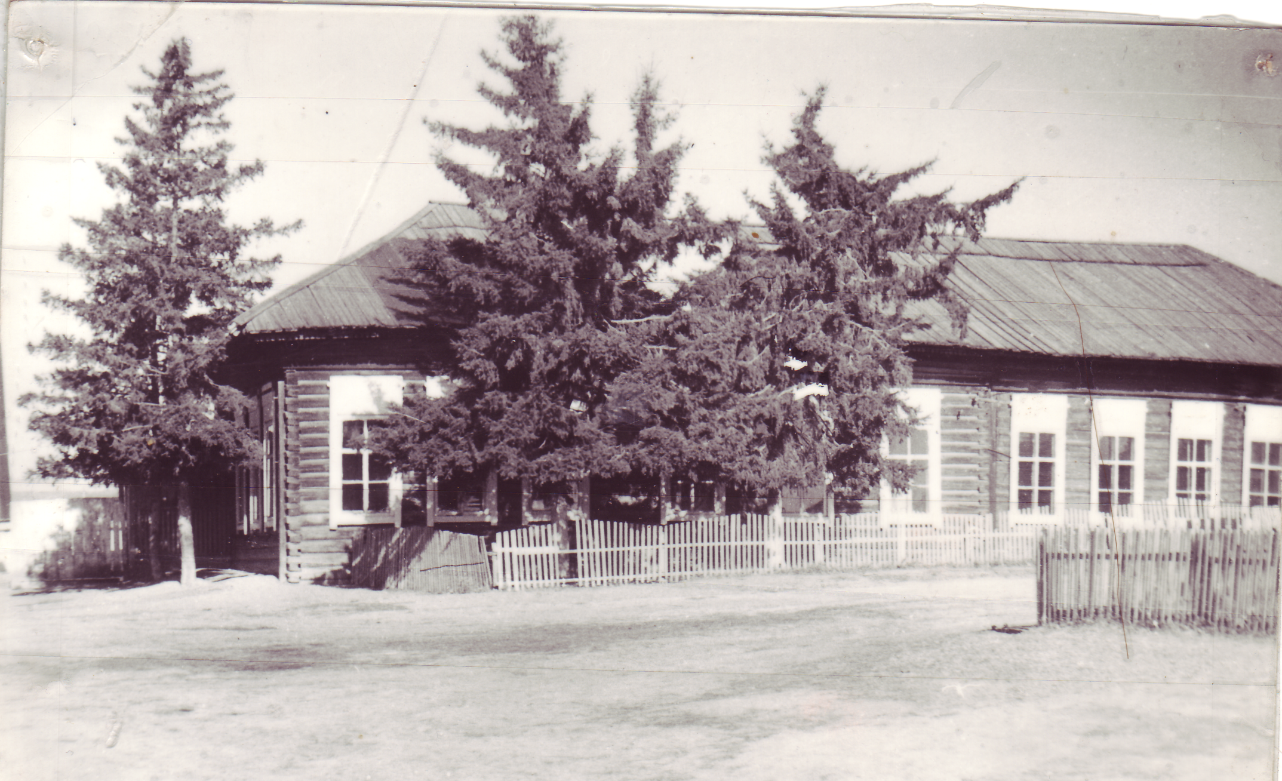

Slide 15
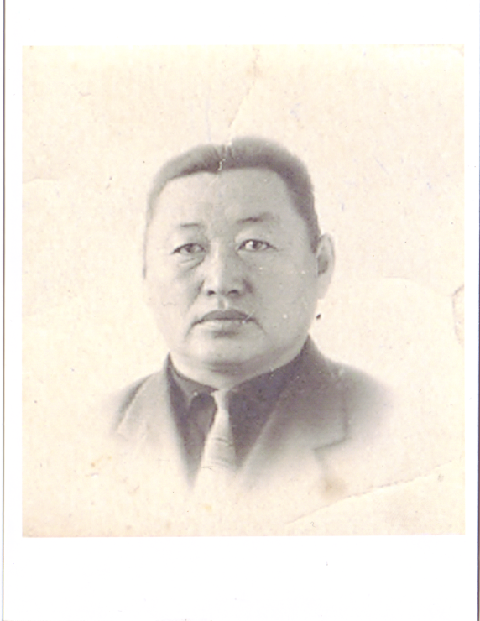
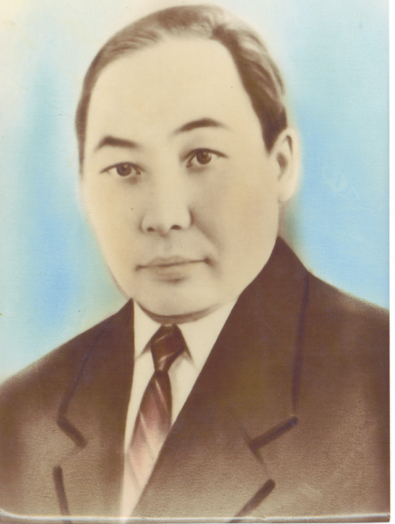
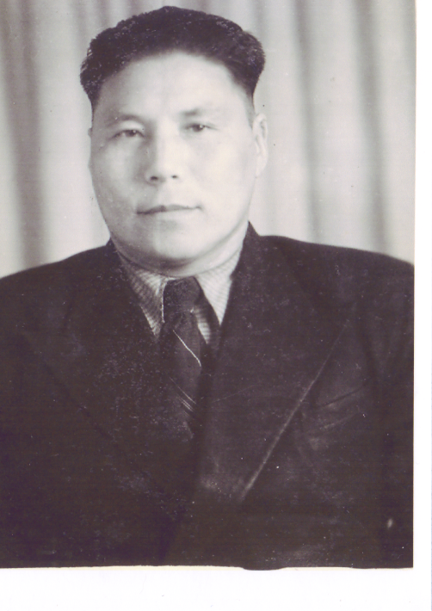
Project: “Our headmasters”
Khutanov A.S.
Romanov N.A.
Duhaev D.D.

Slide 16
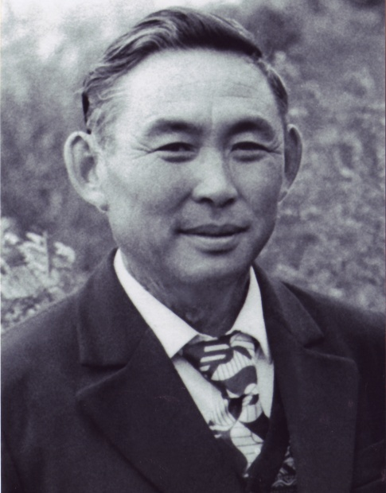
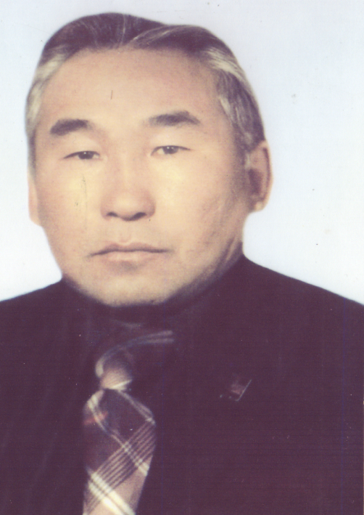
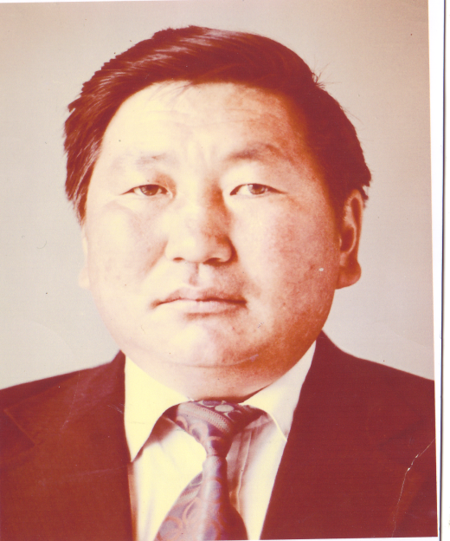
Our headmasters are strong and clever.
Modonov K.A.
Ikhinyrov A.A.
Batuev V.Z.

Slide 17
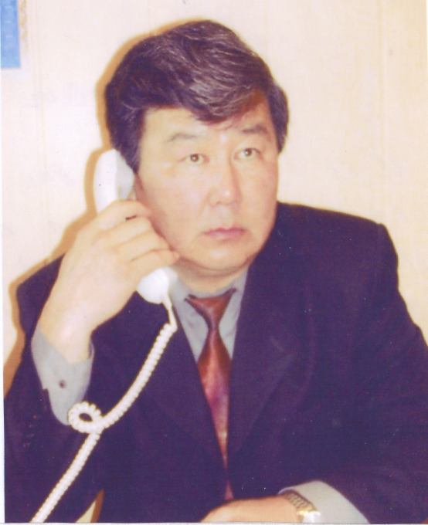
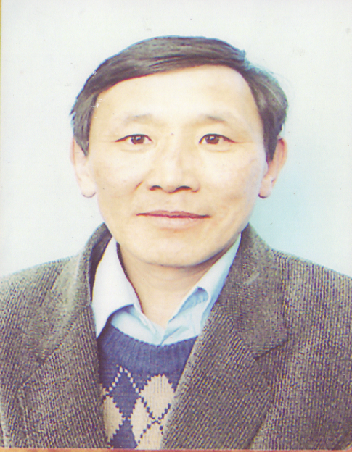
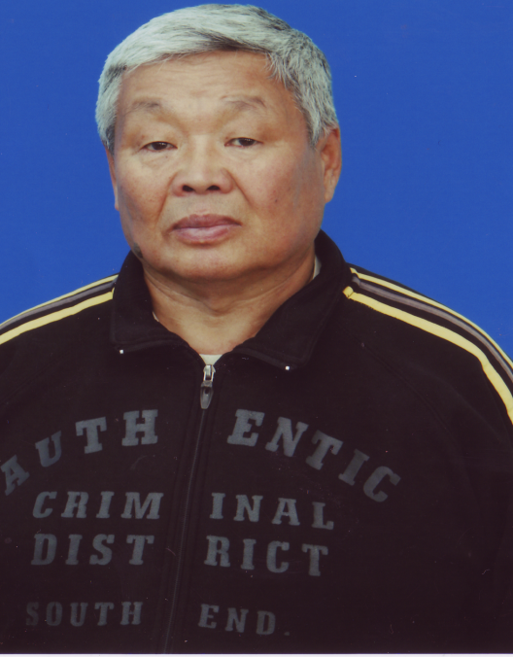
We respect and love them.
Mantaguev A.T.
Botonov V.I.
Idanov A.B.

Slide 18
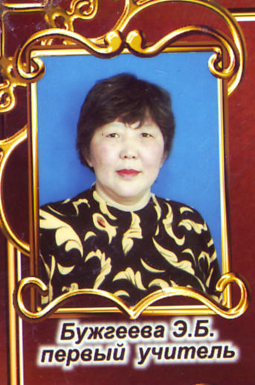
Project: “Our favourite teachers”
Our first teacher is Elvira Borisovna. She is a very kind and patient woman. Thanks her we can read, write and count. We like our first teacher very much
Мы Вас любим!
Ваши любимые ученики.

Slide 19
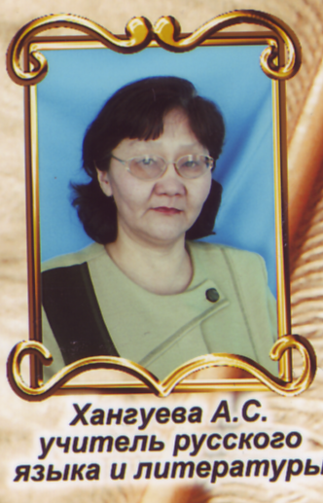
Our Russian teacher is Antonida Savelyevna
Smile, though your heart is aching Smile, even though it's breaking When there are clouds in the sky You'll get by...
Be super!!!

Slide 20
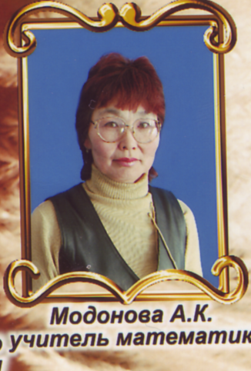
Our math’s teacher is Albina Konstantinovna
I'm happy that you're my teacher; I enjoyed each lesson you taught.
GOOD LUCK!!!

Slide 21
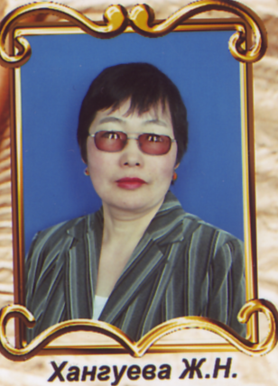
Zhanna Nikolaevna!
We are grateful to her for the lessons of history in the 5-th class!!!!!!!!!!! Now she is a big person at school. She always looks great!
Be happy!
Be healthy!

Slide 22
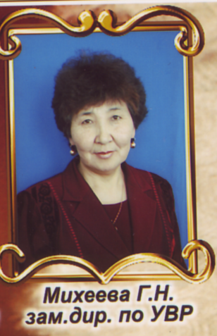
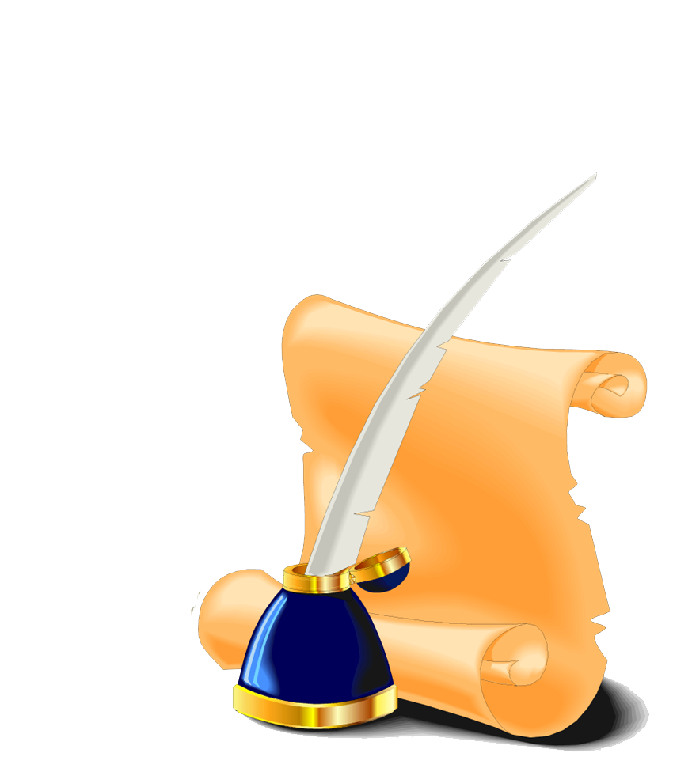
Galina Nikolaevna
You are my life, You are my Horse. Do I love school? Of course! Of course.

Slide 23
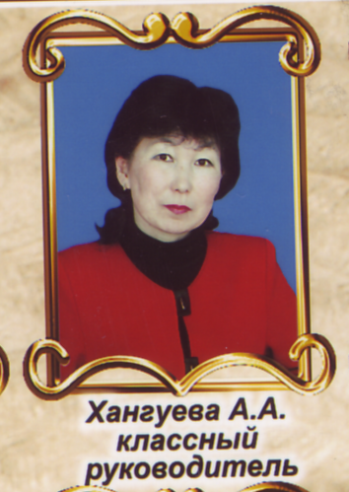
Alexandra Apollonovna
is a Teacher of English! She is a very good teacher. She always looks perfect and I never see her face angry or unfriendly. She loves children, and it is very important in a teacher's work.

Slide 24
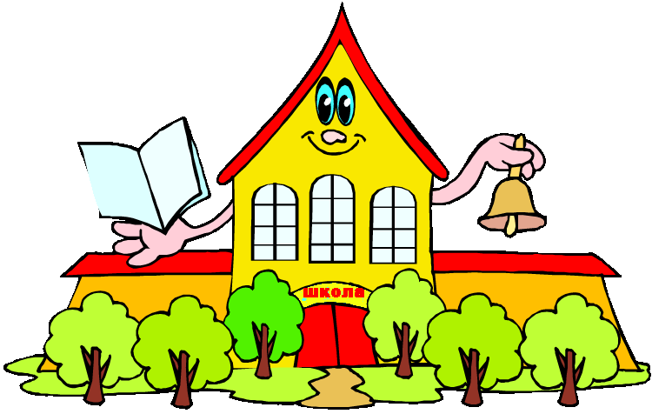
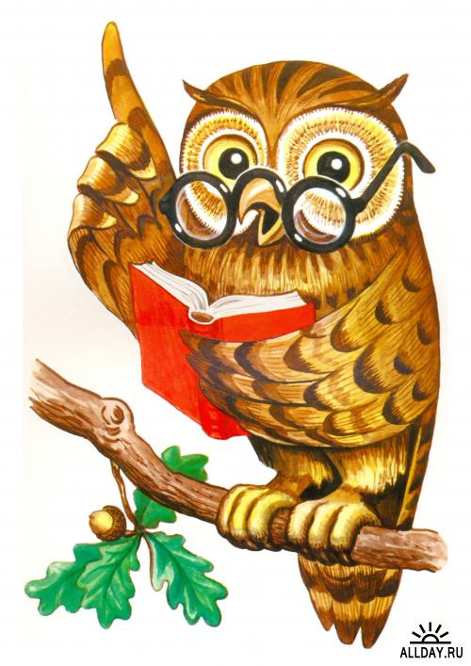
Quiz:
When was our school founded?
a) 1910
b) 1912
c) 1930

Slide 25
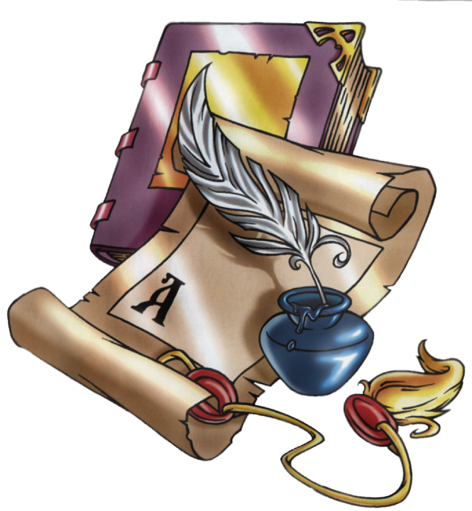
2. Who was the first headmaster
of our school?
a) Romanov N.A.
b) Botonov V.I.
c) Khutanov A.S.
3.Who is a great teacher of our school?
a) Modonova N.N.
b) KhaKhalova D.P.
c) Etobaeva E.B.

Slide 26
4. How many medalists are there in
our school?
a) 15
b) 12
c) 9
5. How old is our school?
a) 100
b) 103
c) 150

Slide 27
The lesson is over.
Good bye!

