Slide 1
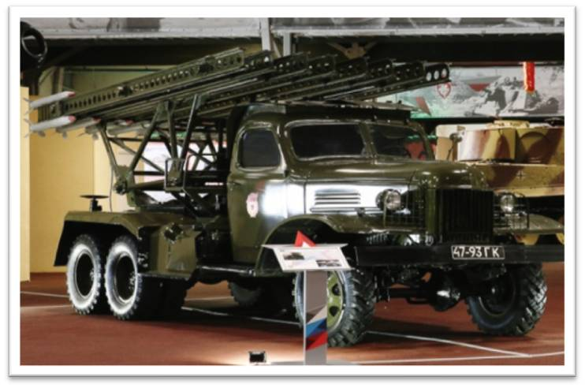
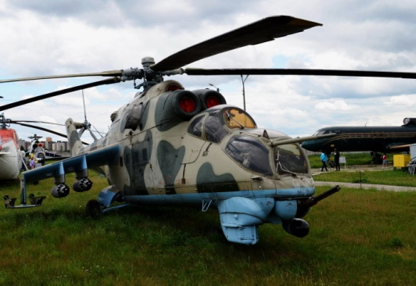
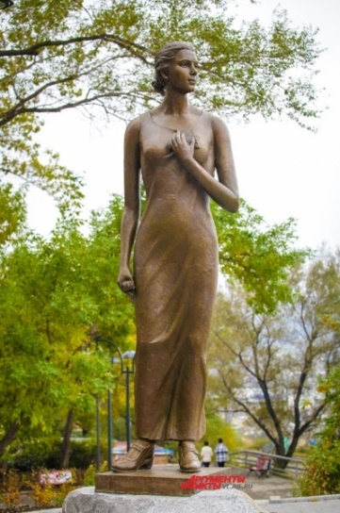
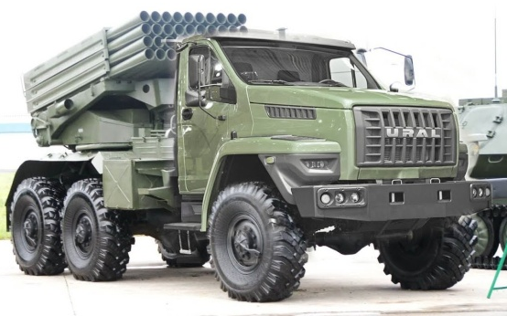
BM – 13
“KATIUSHA”
MI - 24
“CROCODILE”
Отличительные характеристики перевода технических и художественных текстов на иностранный язык
(на примере перевода песни «Катюша» и некоторых образцов военной техники на английский язык)
“KATIUSHA”
URAL – 375
“GRAD”
Москва, 2021

Slide 2
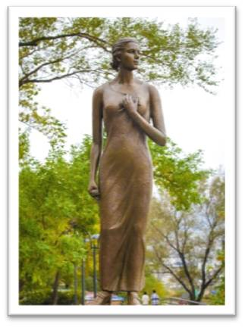
Katiusha
Apples, pears, all of them in blossom,
Fog was floating above the river bank.
Though Katiusha was early coming out
On the crag ground of the riverside.
Coming out, singing for a loved one,
Who was far away from her alone,
Someone who was loved by her so tender,
Keeping gently letters of his soul.
Oh, the love song singing by a young girl
To beloved one, follow up the sun,
To a soldier defending our homeland
Pass her love song truly from her heart.
Let remember a simple girl and faithful,
Let him sense her singing all around,
Let protect him native our motherland,
While Katiusha saves their love in faith.

Slide 3
сapacity / вместимость
was created / был создан
Точность/ однозначность
Официальный стиль
ЦЕЛЬ:
сравнение особенностей и способов перевода технических характеристик военной техники и военно-патриотических песен на английский язык.
keeping gently / беречь
Эмоциональная окраска
Художественный стиль
a loved one,
who was far away from her alone

Slide 4
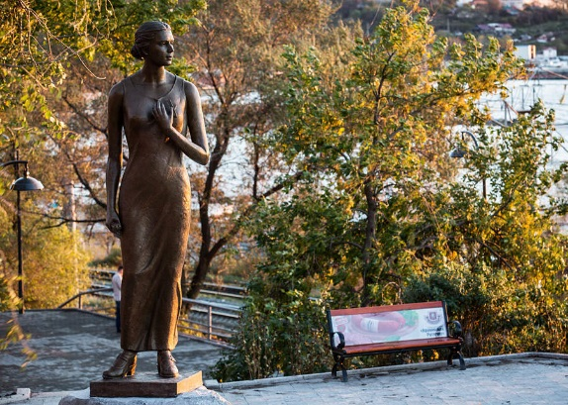
Задачи:
изучить основные приемы перевода технических и поэтических текстов на английский язык;
сравнить приемы перевода технических и поэтических текстов на английский язык;
выявить на практике лексико-грамматические изменения, возникающие при переводе технических и поэтических текстов;
подобрать ТТХ на английском языке для описания образцов военной техники для создания аудиогида;
самостоятельно перевести текст военно-патриотической песни «Катюша» на английский язык.

Slide 5
Баранова С. Ю.
«Музыкальный текст: язык, знак, сигнал, символ»
КазаковаТ. А.
«Практические основы перевода»
Комиссаров В.Н.
«Современное переводоведение»
Перевод технического
текста
Перевод музыкально-
поэтического текста
Изобразительно-
выразительные средства
Эмоциональность
Точность
Эмоциональность

Slide 6
Тип текста перевода Характеристики | Перевод технического текста на английский язык | Перевод музыкально-поэтического текста на английский язык
Точность
Однозначность
Эмоциональная окраска
Безличные выражения
Интонация
Ритм
Наличие изобразительно-выразительных средств
Нормирование языковых средств

Slide 7
Анализ ТТХ образцов военной техники:
Общие лексические единицы для описания и перевода:
военных автомобилей: скорость, объем двигателя, коробка передач, тормоза;
вертолетов: дальность полета, диаметр винта, взлетная масса;
боевых реактивных установок: калибр снаряда, залп, ракетное вооружение.

Slide 8
Анализ текста песни «Катюша»:
Изобразительно-выразительные средства:
эпитеты: «крутой берег», «ясное солнце», «простая девушка»;
олицетворение «Ой, ты песня, песенка девичья, ты лети...»;
метафора «про степного сизого орла»;
анафора «пусть он вспомнит…,пусть услышит…, пусть бережет…».

Slide 9
Переводческие трансформации:
Технического текста
BM-13 “Katiusha”
It is the first multiple rocket launcher that
in Voronezh and the Soviet Union started to produce it in 1941. The design of it was rather simple. It is consisted of racks of parallel rails on which rockets were mounted.
The M-13 rocket of the BM-13 system was 80 cm long, 13, 2 cm in .
A battery of four BM-13 launchers could fire in 7-10 second the territory over 400,000 square meters. The German soldiers were feared by it. were installed on ZiS -6 trucks. The invention of BM-13 was secret. They were marked with the letter “K” (for Voronezh Komintern plant). Because of this letter BM-13 got its nickname “Katiusha” from Mikhail Isakovsky’s popular war song “Katiusha”.
was invented
Пассивный залог
Буквальный перевод
diameter
It weighed 42 kg.
Транслитерация
«Katiushas»

Slide 10
Переводческие трансформации:
Музыкально-поэтического текста
Katiusha
Apples, pears, all of them in blossom,
Though Katiusha was early coming out
On the crag ground of the riverside.
Someone who was loved by her so tender,
Keeping gently letters of his soul.
Oh, the love song singing by a young girl
To beloved one, follow up the sun,
To a soldier defending our homeland
Pass her love song truly from her heart.
Let protect him native our motherland,
While saves their love in faith.
Apples, pears, all of them in blossom,
Fog was floating above the river bank.
Though Katiusha was early coming out
On the crag ground of the riverside.
Fog was floating above the river bank.
Изменение порядка слов
Coming out, singing for a loved one,
Who was far away from her alone,
Опускание /добавление части речи
Let remember a simple girl and faithful,
Let him sense her singing all around,
Транслитерация
Katiusha

Slide 11
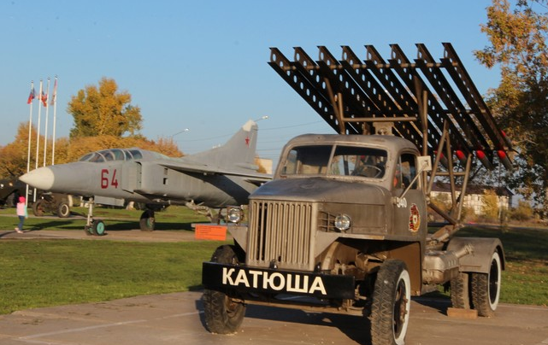
BM-13 “Katiusha”
It is the first multiple rocket launcher that was invented in Voronezh and the Soviet Union started to produce it in 1941. The design of it was rather simple. It is consisted of racks of parallel rails on which rockets were mounted. The M-13 rocket of the BM-13 system was 80 cm long, 13, 2 cm in diameter. It weighed 42 kg. A battery of four BM-13 launchers could fire in 7-10 second the territory over 400,000 square meters. The German soldiers were feared by it. «Katiushas» were installed on ZiS -6 trucks. The invention of BM-13 was secret. They were marked with the letter “K” (for Voronezh Komintern plant). Because of this letter BM-13 got its nickname “Katiusha” from Mikhail Isakovsky’s popular war song “Katiusha”.

Slide 12
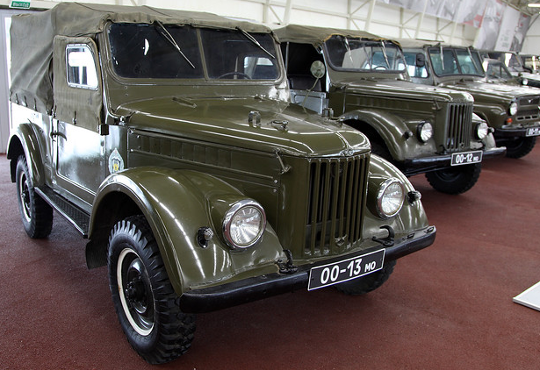
GAZ – 69
A legendary four-wheel drive light truck was created at Gorky Automobile plant in 1948. The head engineer was Gregory Wassermann. Its first prototype which is known as “Truzhenik” was built in 1947. Firstly, the truck was produced for the needs of the Soviet Army. It was a new Russian off-road vehicle. Later the production of the truck started in Ulyanovsk. So, the car has another popular name UAZ-69. The people’s name of the truck is “Kozlik”. The light truck was exported to 22 countries. It was one of most favorite cars of Fidel Castro – the president of The Cuba Republic. Nowadays you can see the Minister of Defense of Russian Federation Sergei Shoigu driving UAZ-69 himself during the “Army Games”.

Slide 13
The Soviet helicopter MI -24
In 1970s a famous Soviet Mil Moscow Helicopter plant produced attack helicopter MI-24. It can provide air support to ground troops, carrier weapon. Firstly it was created to conduct the classical operations but lately it was widely used in local conflicts. It is absolutely suitable to fight with partisans. It is considered to be a flying tank. It is a real symbol of war in Afghanistan. It is as popular as “Kalashnikov” machine gun in the world. It took part in different military operations all over the world, for example, in Algeria, Nicaragua, Iran and in many other countries. The modified helicopters are still used in the Russian Army. In the Army the soldiers informally call it “Crocodile”.

Slide 14
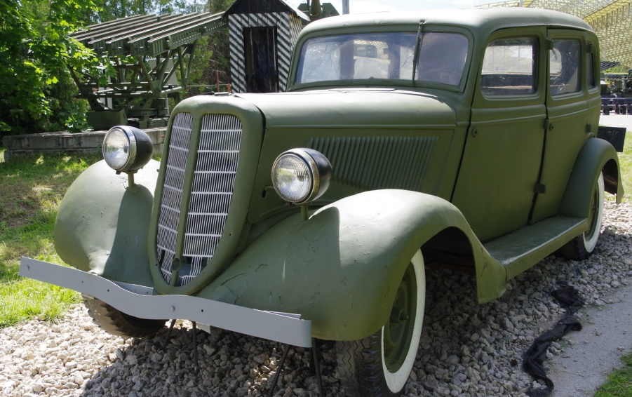
GAZ M-1
So called “Emka” or a “Black Crow”. This passenger car was created in 1935. It was also produced at Gorky Automobile plant. It became the symbol of the time. Number “1” in its name means that the car had become the first Soviet models of passenger autos. The car became very popular. It was used as a taxi. The letter”M” in the name of the car means “Molotov”, who was the head of the government in that time. The auto was reliable, powerful and comfortable. The car was the icon of its time. It was painted only in black. The car was used by NKVD. The people’s name of it is a “Black Crow”. The production of the car was stopped in 1942. Lately a lot of cars were built on its basis.

Slide 15
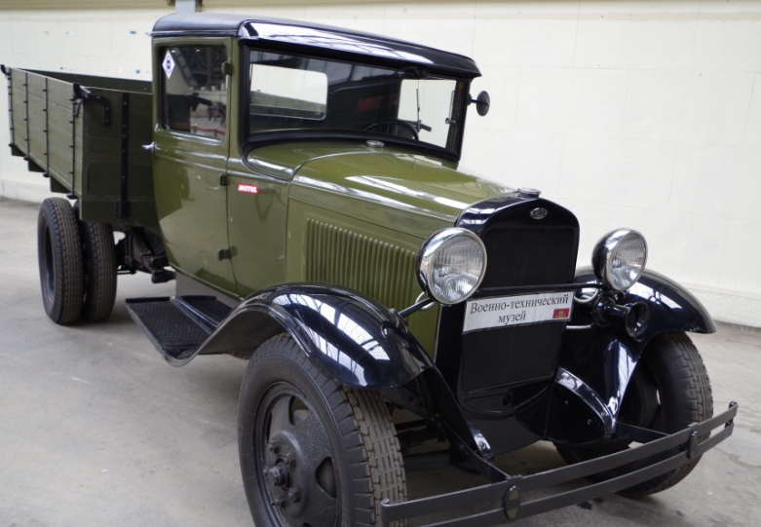
GAZ-AA
“The Legendary Polutorka” (One-and-a-Half-Tone)
The vehicle was created in 1932 at Gorky Automobile plant. In the Soviet Army it was used during the Great Patriotic War to deliver cargo and ammunition. This vehicle played an important role transporting food supplies and ammunition across the frozen lake Ladoga. This road was called “Road of Life”. The siege lasted for 29 months from 8 September 1941 to 27 January 1944. Due to “Gaz– AA” millions of people from the besieged city were saved. Nowadays you can see monuments to “polutorka” in different Russian towns. In this museum you can also see the model of GAZ–AA, which is crossing the frozen lake. In the background you can also see the ruined buildings of Leningrad.

Slide 16
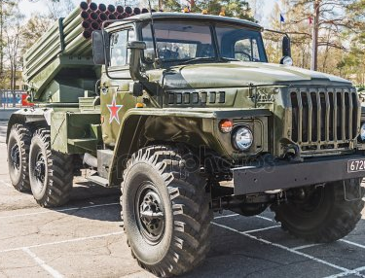
URAL -375
That is a standard truck that was used in the Soviet Army till 1979. The time of the beginning of the company in Afghanistan. This truck replaced the older model URAL 4320. It was created in Mias automobile plant in Chelyabinsk region. During the Great Patriotic war the plant produced different “Zis” models. The head engineer Svyatoslav Kurov designed the truck in 1959. The truck was able to work in different weather conditions. It was able to work at the temperature of 50 degrees below zero! The auto was widely used in civil life and in the Army. It became an ideal platform for the BM-21 rocket launcher due to its off-road characteristics. It also used for troop and supply carrier. You can see the model of URAL 375 in the museum in front of the Expo centre and on the territory of our Moscow Suvorov Military school.

Slide 17
ПЕРСПЕКТИВЫ
Перевод на другие языки.

