Slide 1
“Cambridge English Teacher” Festival
Exercise: Level Pre-A1
Teacher: Mitrukova Julia

Slide 2
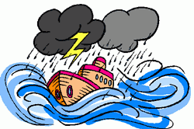
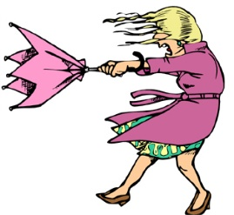
What’s the weather like today?
Look out of the window and answer the question “What’s the weather like today?”
Match the cards and the words. Write your answers on the board.
It is sunny | It is windy | It is raining | It is cloudy | It is snowing | It is stormy

Slide 3
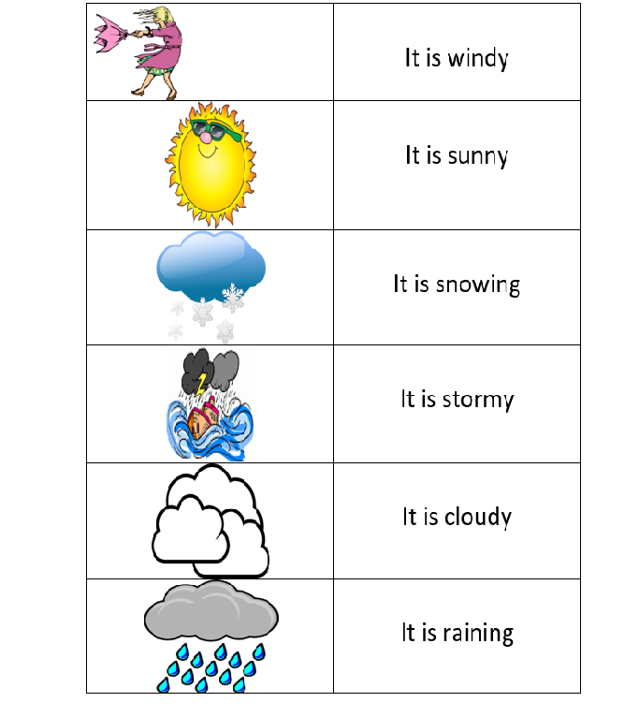
Match the pictures and the words

Slide 4
Bingo

Slide 5
Bingo
1
2
3
4
5
6

Slide 6
Bingo
Look at the numbers
Match the cards and the numbers in your chart
1
5
4
6
2
3

Slide 7
Ending the lesson
Which activity was your favourite?
Thank you for your attention!

