Slide 1
“Cambridge English Teacher” Festival
Exercise: Level A1
Teacher: Mitrukova Julia

Slide 2
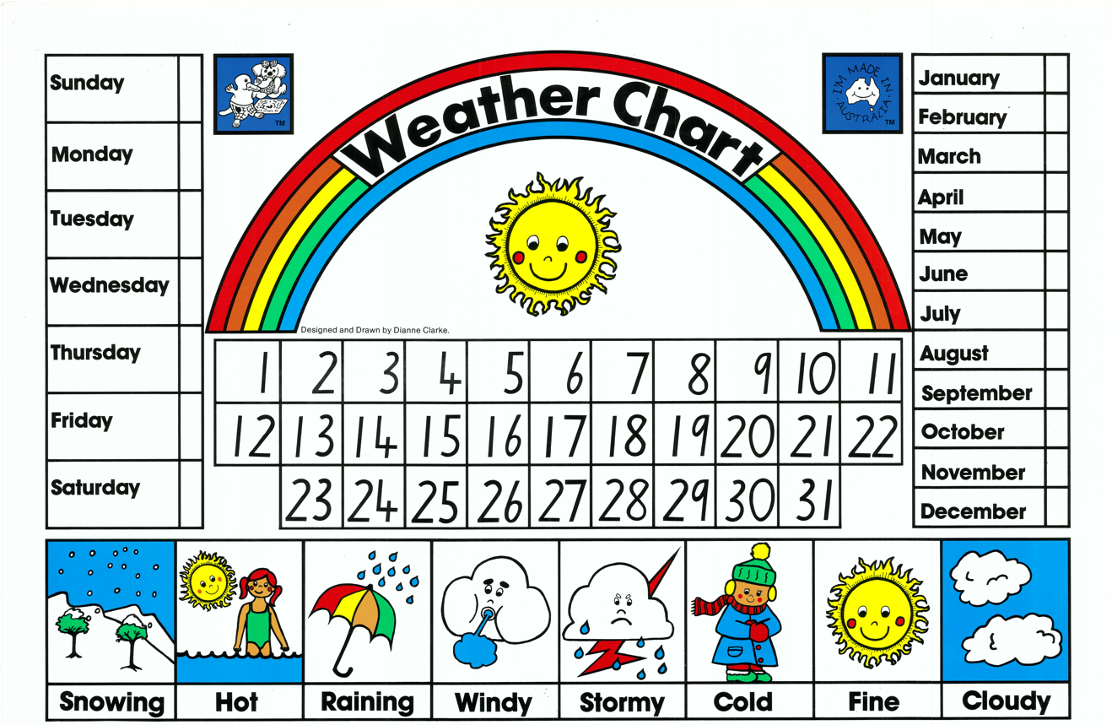
spring
summer
autumn
winter
morningmo
night
evening
night

Slide 3
What part of the day is it?

Slide 4
Bingo
Look at the numbers, choose and write your team’s name above your number
1
5
4
3
2

Slide 5
Match the question and your #
What date is it today? | What day of the week is it today? | What season is it now? | What’s the weather like today? | What part of the day is it now?
2
4
3
5
1

Slide 6
Ending the lesson
Which activity was your favourite?
Thank you for your attention!

