Slide 1
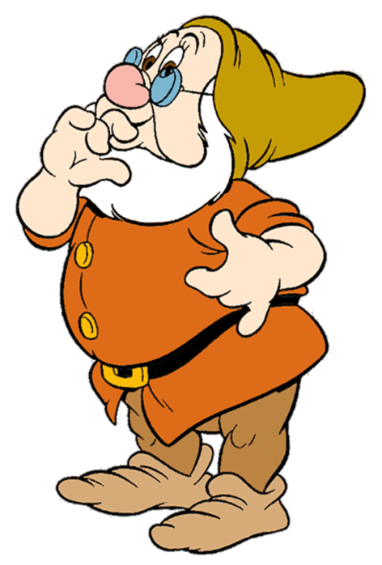

Slide 2
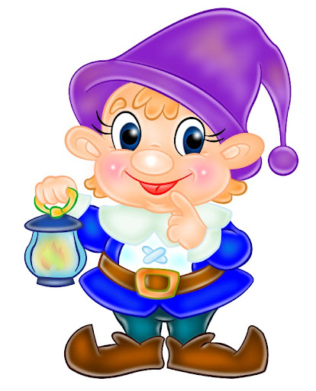

Slide 3

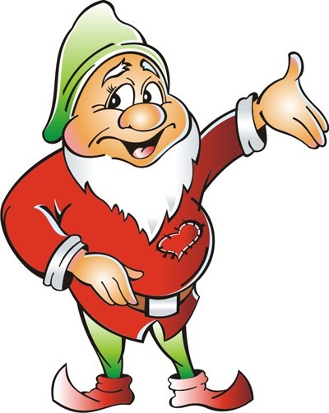

Slide 4
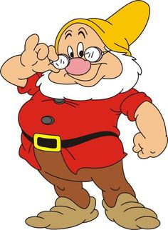

Slide 5
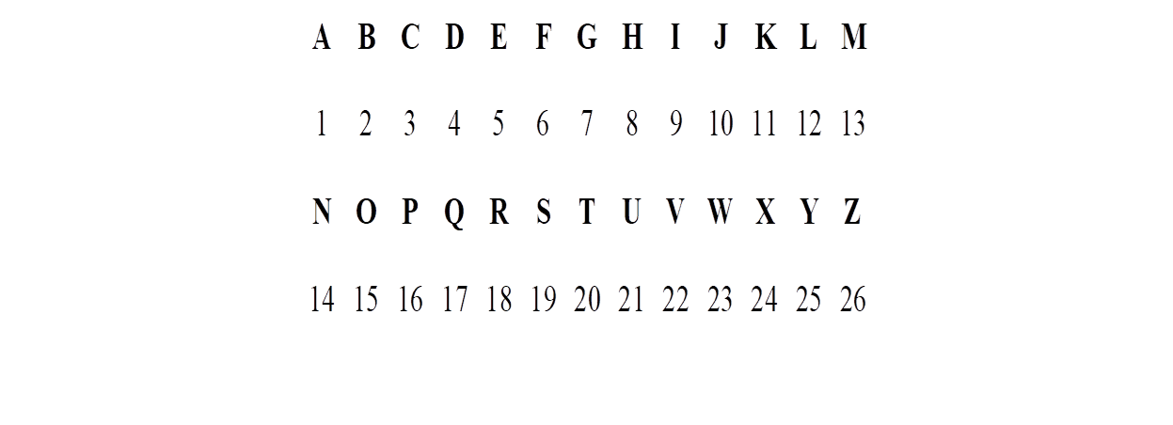
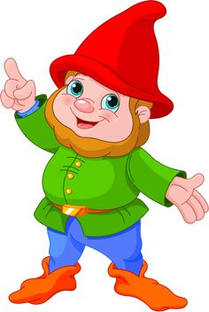

Slide 6
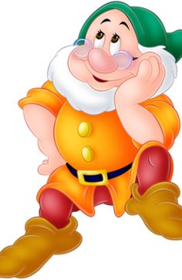

Slide 7
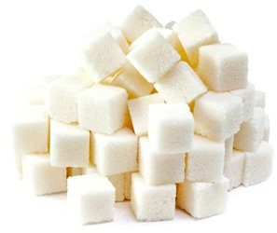
Clean, but not water,
White, but not snow,
Sweet, but not ice-cream,
What is it?

Slide 8
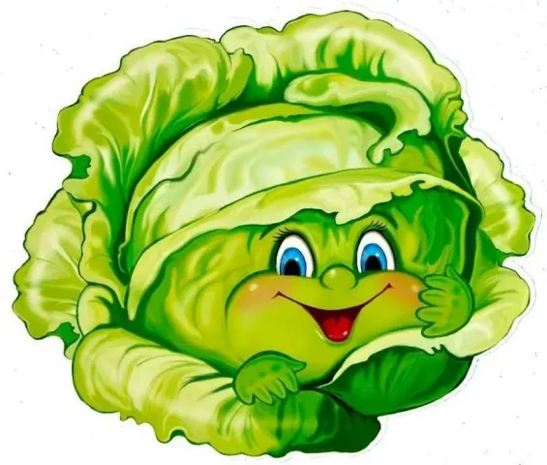
Green and round,
rabbits like it.

Slide 9
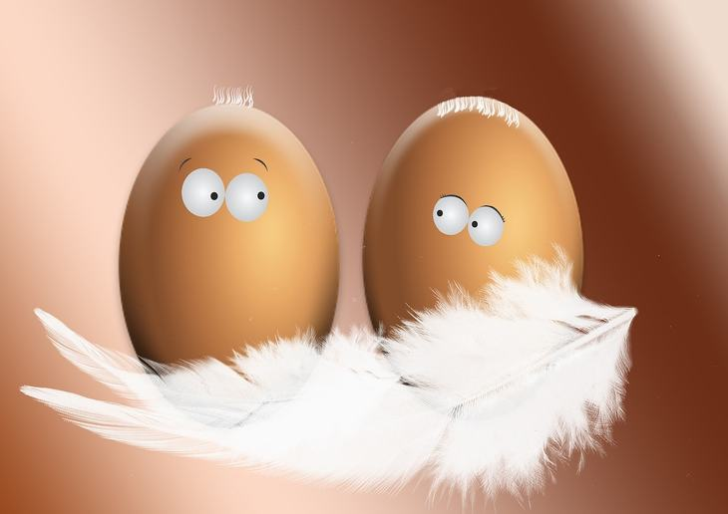
It’s white outside,
and yellow inside.

Slide 10
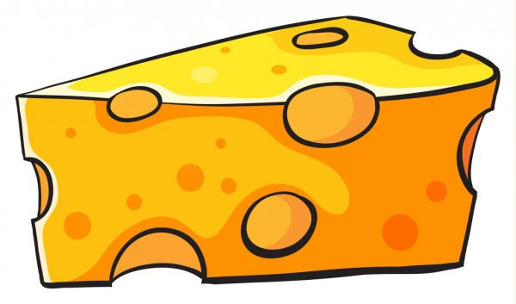
You smile when you name it.
The mouse likes it very much.

Slide 11
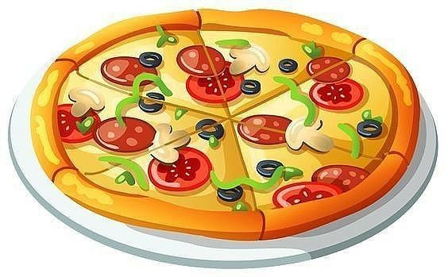
It is round,
with sausage, tomato and cheese on top.

Slide 12
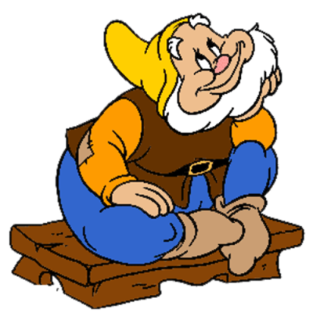
1. Elizabeth 2. Thomas 3. William 4. Susan 5. Michael 6. Robert 7. Patricia 8. Anthony 9. Pamela | a. Mike b. Bobby c. Pat d. Tony e. Sue f. Pam g. Bill h. Tom i. Liz

Slide 13
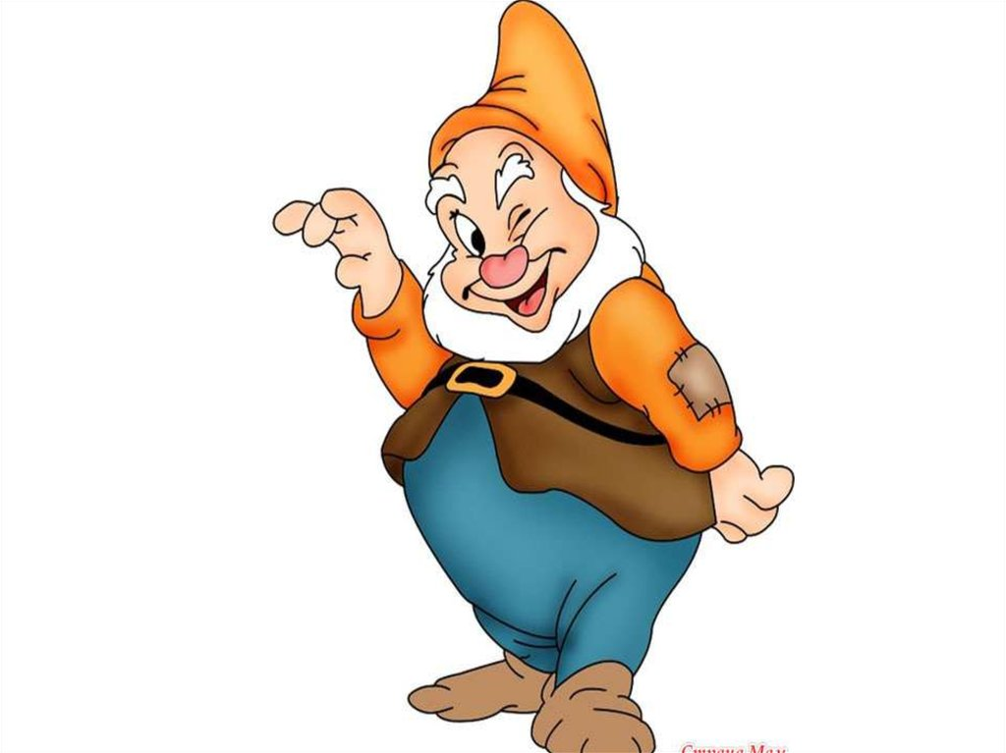
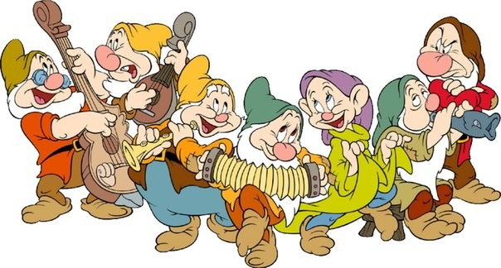
Thank you!

