Slide 1
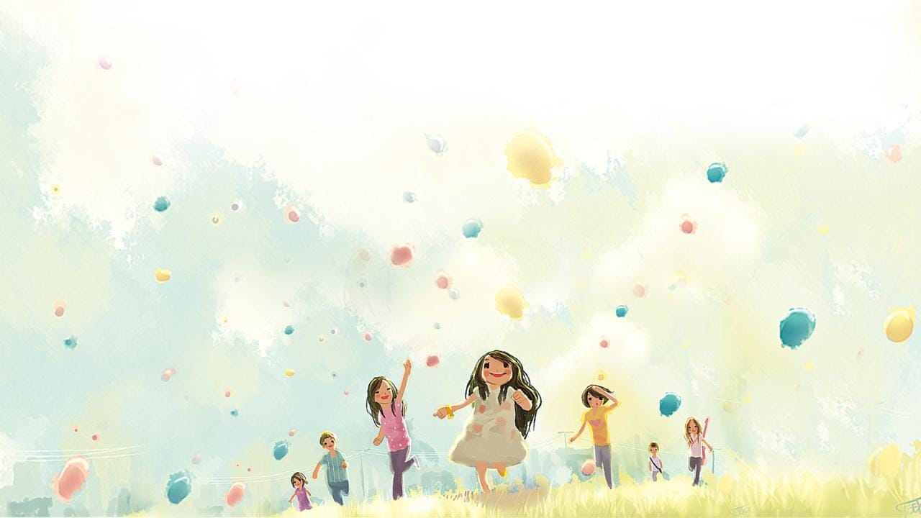

DAY BY DAY!
MODULE 8

Slide 2

Monday, Tuesday, Wednesday, Thursday, Friday, Saturday, Sunday
Days of the week, days of the week
Seven days are in the week
I can sing the seven days
Now I can sing by myself
Go,go,go! Hurray!

Slide 3

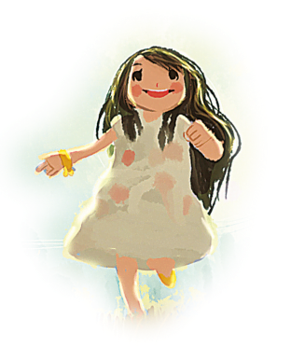
T
Monday, Friday, Saturday, Wednesday, Thursday, Tuesday

Slide 4
On Sundays
MORNING,AFTERNOON, EVENING, NIGHT

Slide 5
Утро-с 6 утра до 12 дня
День-с 12 дня до 6 вечера
Ночь-с 6 вечера до 6 утра
После 6 вечера мы можем употреблять at night

Slide 6
In the morning
In the afternoon
In the evening
BUT AT the night

Slide 7
Remember!
in the morning
in the afternoon
in the evening
at night
at seven o’clock
on Sundays
on Saturdays
in
at
on

Slide 8
I get up __AT_7 o’clock.
My brother watches a video_AT__night
I come home _IN___ the afternoon.
Mary visits her friends___ON_Sundays.
Vova has breakfast _at__8 o’clock.
Tim listens to music _on__Mondays.
She has a shower in___the morning.

Slide 9
Daily routines

Slide 10
Seven Days

Slide 11
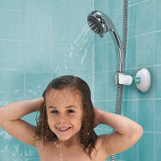
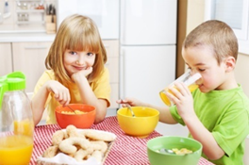
Remember!
What do you do in the morning?
What do you do in the afternoon?
What do you do in the evening?
What do you do at night?
For example:
A: What do you do in the morning?
B: I , then I .

Slide 12
Get up-вставать с кровати
Come home-приходить домой
Go to school-идти в школу
Watch TV-смотреть телевизор
Go to bed-ложиться спать

Slide 14
1.Lulu loves Sunday.
2.Lulu gets up early on Sundays.
3.In the morning, she goes to school.
4.She goes to bed at ten o’clock.

Slide 15
-What is Lulu’s favourite day?
-When does she get up on Sundays?
-What does she do in the morning?
-When does she have lunch?

Slide 16
Homework
SB Ex.6 p.127

Slide 17

NOW I …
Now I know
…
Now I remember …
Now I can
…

Slide 18

Do you like our lesson?
It was…
super
difficult
great
dull
interesting
boring

Slide 19
THANK YOU !

