Slide 1

What is Happiness?

Slide 2
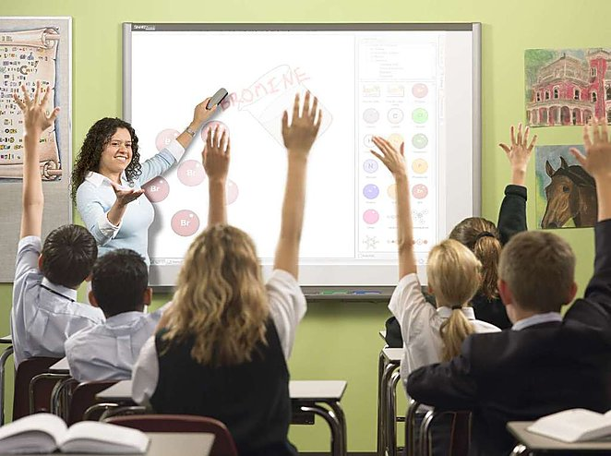

Slide 3

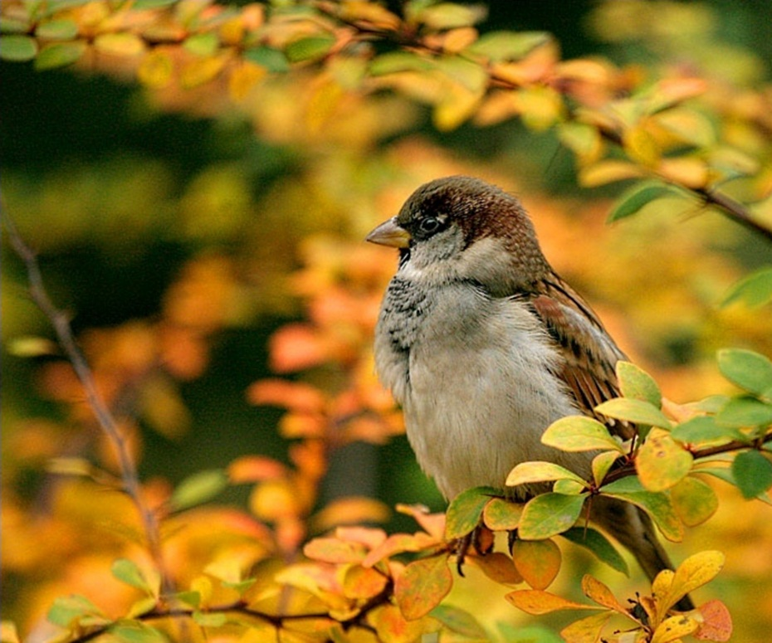
When do people feel pleased and satisfied?
I’m pleased when …
As for me …
A happy person is…

Slide 4

What is happiness?
Can you give a definition of
happiness?
What colours is happiness associated with?
Is there a magic formula for happiness?

Slide 5
“Happy” Words
cheerful
content
pleased, glad
delighted
thrilled
ecstatic

Slide 6
You think…
Happi-
ness
Family
friends
Job
hobby
Peace on the planet
Things
money

Slide 7




Magic formula for Happiness
Universal aspects of happiness
Interesting occupation
Freedom, peace
Sense of belonging
The family support
Welfare
Health

Slide 8

Sense of Belonging
society
exciting and interesting job
feeling of usefulness

Slide 9



Family Happiness
What are the most important aspects for family happiness?
Love
Care
Respect

Slide 10
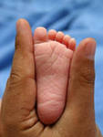
Views on Family
A happy marriage is a long conversation which always seems too short.
Andre Maurois
I was ever of opinion that the honest man who married and brought up a large family, did more service than he who continued single and only talked of population
Oliver Goldsmith

Slide 11

Can a person be happy at work?
Work is not man’s punishment. It is his reward and his strength and his pleasure.
George Sand

Slide 12
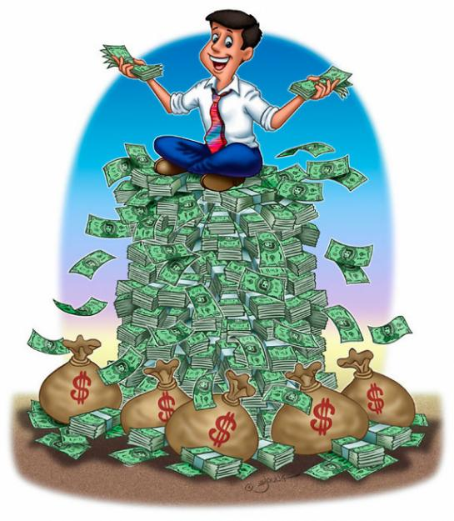
Do you need much money to make your dreams come true?
Can money make person happier than any other thing?

Slide 13

freedom
Associations with freedom:
Creativity
Hobby
Travelling
Right to do smth
Movement
The aim

Slide 14

Healthy lifestyle
What is healthy lifestyle for you?
Keeping daily routine
Sports activities
Healthy food
Mental health

Slide 15
Quotations
Susan B. Anthony
Independence is happiness

Slide 16
The summit of happiness is reached when a person is ready to be what he is.
- Erasmus

Slide 17
I have learnt to seek my happiness in limiting my desires, rather than attempting to satisfy them.
- John Stuart Mill

Slide 18
Happiness consists not in having much, but in wanting no more than you have.
- Lydia Maria Child

Slide 19
Happiness is where we find it, but very rarely where we seek it.
- J. Petit Senn

Slide 20
proverbs
Happiness takes no account of time.
Every man is the architect of his own fortune.
No man is happy who does not think himself so.
Happiness is not a destination. It is a method of life.

Slide 21
Happiness proverbs
Chinese Proverb
If you want happiness for an hour, take a nap. If you want happiness for a day, go fishing. If you want happiness for a year, inherit a fortune. If you want happiness for a lifetime, help somebody.

Slide 22
English Proverb
If you want to be happy for a year, plant a garden; if you want to be happy for life, plant a tree.

Slide 23


