Slide 1
LET’S CELEBRATE
Created by
E.Cherepanova
a teacher of English
School 453 named after S.Zukov
Saint-Petersburg

Slide 2
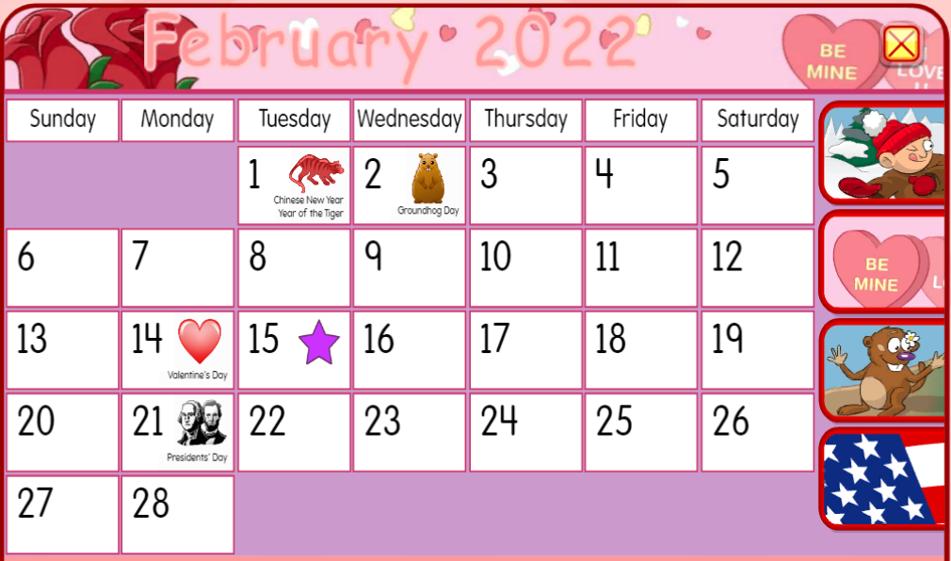

Slide 3
Saint Valentine’s Day

Slide 4
ХОЧУ
УМЕТЬ…
УЗНАТЬ…
НАУЧИТЬСЯ…
РАЗОБРАТЬСЯ…
ВЫЯСНИТЬ…

Slide 5






Saint Valentine's Day
kiss
Love birds
Cupid
true love
arrow
chocolates
love card
a date
love letter
heart
rose
CLICK ON A PICTURE TO READ AND LISTEN

Slide 6
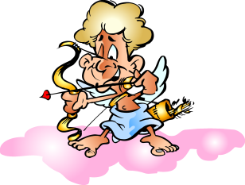
Look at the picture and choose the correct option
Cupid
Great Job!
heart
Try Again
NEXT

Slide 7

Look at the picture and choose the correct option
Love birds
Great Job!
heart
Try Again
NEXT

Slide 8

Look at the picture and choose the correct option
chocolates
Try Again
kiss
Great Job!
NEXT

Slide 9

Look at the picture and choose the correct option
chocolates
Try Again
heart
Great Job!
NEXT

Slide 10
Look at the picture and choose the correct option
Love card
Great Job!
Love poem
Try Again
NEXT

Slide 11
Look at the picture and choose the correct option
chocolates
Great Job!
cupid
Try Again
NEXT

Slide 12
Look at the picture and choose the correct option
chocolates
Try Again
arrow
Great Job!
NEXT

Slide 13

Look at the picture and choose the correct option
Love birds
Try Again
rose
Great Job!
NEXT

Slide 14




Let’s play the word searching game
Find the Valentine’s Day words below in the grid:
T | Z | V | U | K | I | S | S | G | N | V | S | N | A | H
K | X | V | A | U | R | O | M | A | N | T | I | C | T | T
F | B | B | T | L | T | L | L | M | Y | R | R | S | B | L
F | L | S | E | G | E | T | M | T | E | S | W | R | L | C
S | K | O | S | M | E | N | R | T | U | A | T | F | S | A
Q | E | C | W | T | I | A | T | U | C | N | H | E | K | R
P | F | Y | A | E | E | N | V | I | I | U | T | V | V | D
Q | A | D | D | H | R | U | E | A | N | A | P | Q | M | S
I | R | Y | N | X | N | S | S | F | L | E | V | I | S | U
H | R | O | T | Q | I | W | T | O | C | Y | Z | U | D | I
X | O | R | O | S | E | S | C | V | N | U | P | C | I | H
A | W | N | B | H | G | O | P | O | E | M | R | X | M | L
F | D | H | Z | H | H | U | G | I | F | T | Z | E | E | Y
V | H | S | W | C | E | G | Z | J | R | G | Y | O | D | K
F | G | O | L | O | V | E | F | R | I | N | G | K | G | P
Arrow
Be mine
Card
Chocolate
Cupid
Date
Flowers
Gift
Heart
Kiss
Love
Poem
Red
Ring
Romantic
Roses
Saint
Valentine

Slide 15

Let’s have a break

Slide 16
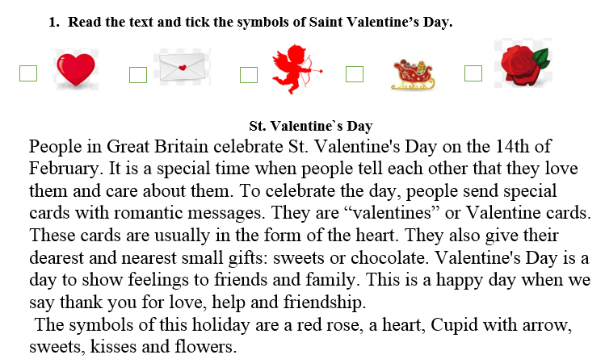

Slide 17
V
V
V
V

Slide 18
Read the text & Answer the Questions
When do people celebrate Saint Valentine’s Day?
March 8th
October 16th
February 14th
Valentine’s Day is a day of
chocolate
love
winter
To celebrate this day people send
cards
sandwiches
lunch boxes
The cards have the shape of
an apple
a heart
a star

Slide 19

Write Your Valentine Card

Slide 20
Сегодня на уроке
УЗНАЛИ…
СУМЕЛИ…
НАУЧИЛИСЬ…
РАЗОБРАЛИСЬ…
ВЫЯСНИЛИ…

Slide 21

HW
Draw all St. Valentines symbols you remember and label your pictures.
THANK YOU FOR THE LESSON

Slide 22
Sourses
https://www.starfall.com/h/holiday/calendar/?sn=main
https://www.starfall.com/h/holiday/valentine/?sn=main
https://www.youtube.com/watch?v=mLdfVgWJ_yk

