Slide 1
Презентация к уроку-экскурсии по городу Смоленску.
Учитель МБОУ «СШ №29 с углубленным изучением отдельных предметов»
Лагутина Надежда Сергеевна

Slide 2
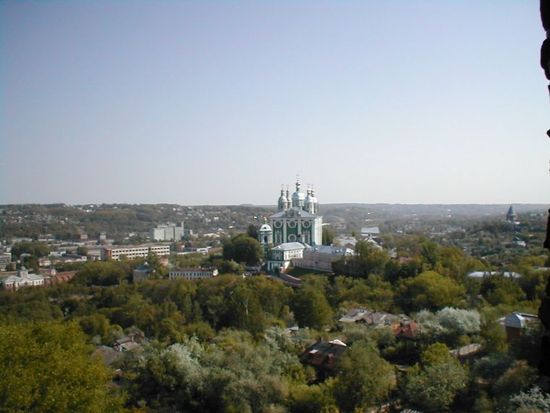

Slide 3
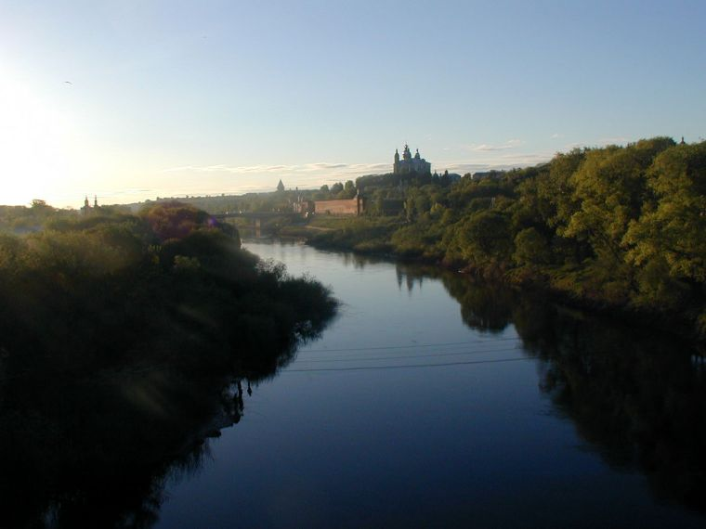

Slide 4
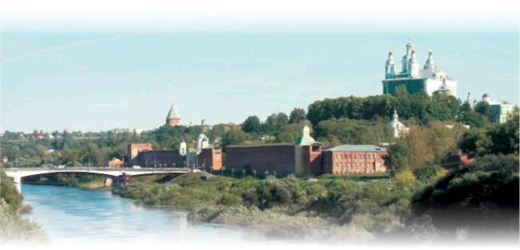

Slide 5
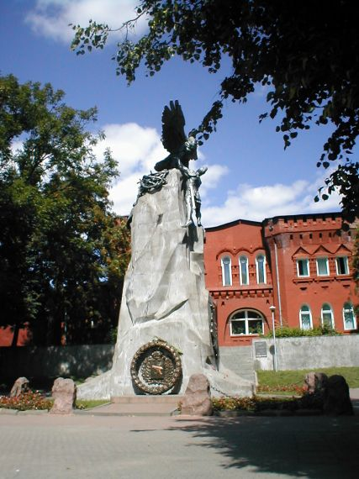
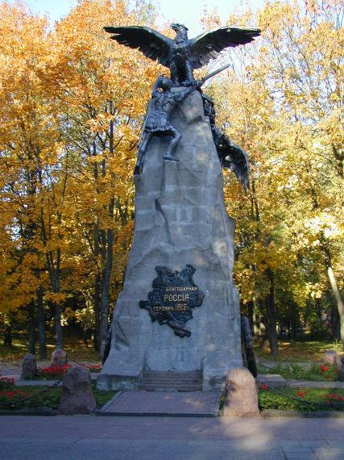

Slide 6
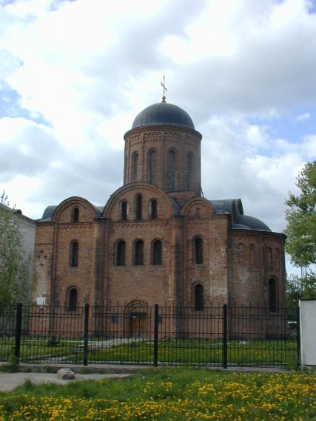
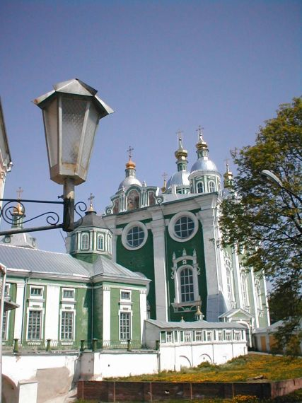

Slide 7
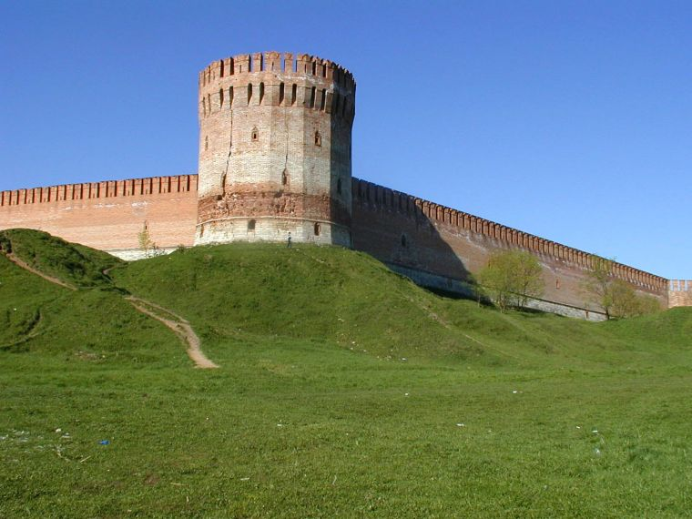

Slide 8
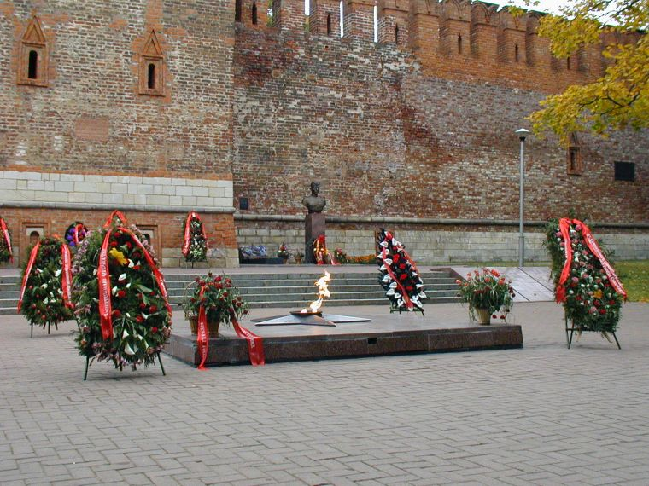
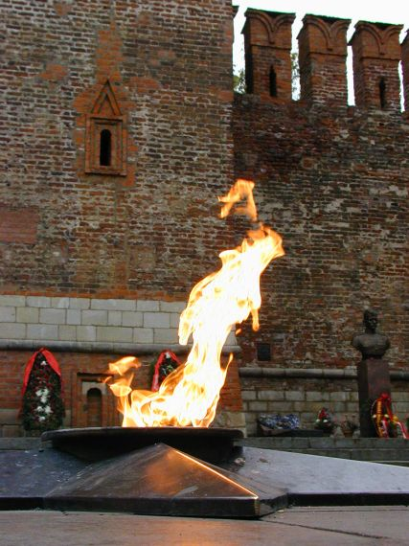

Slide 9
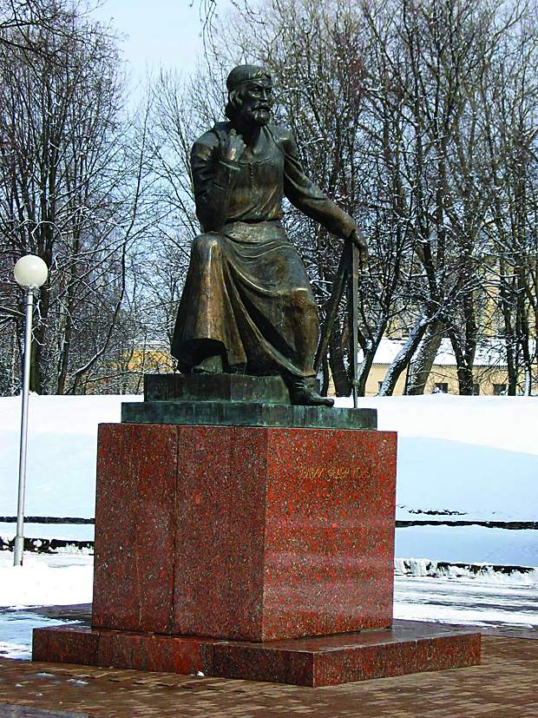
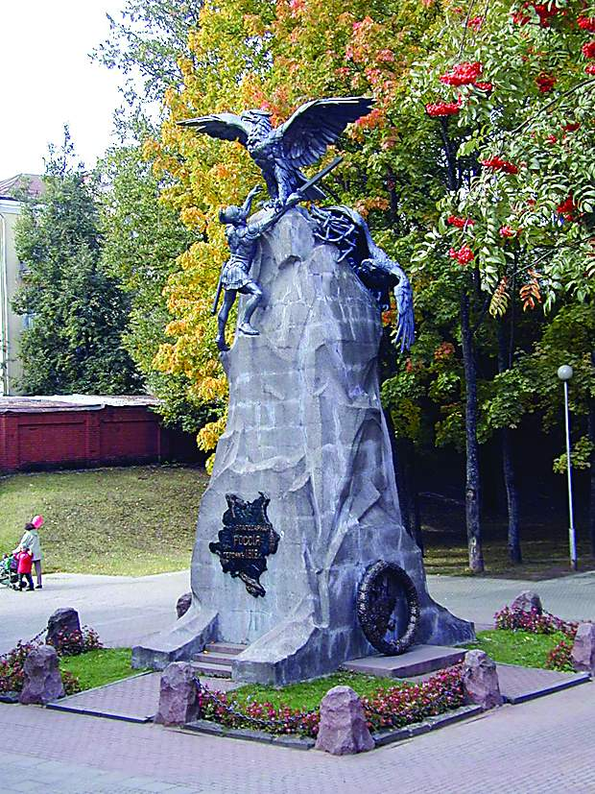
Match the monuments and their names.
1
2

Slide 10
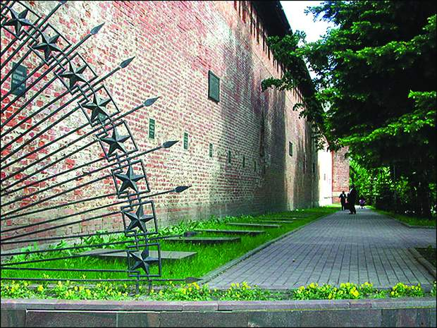
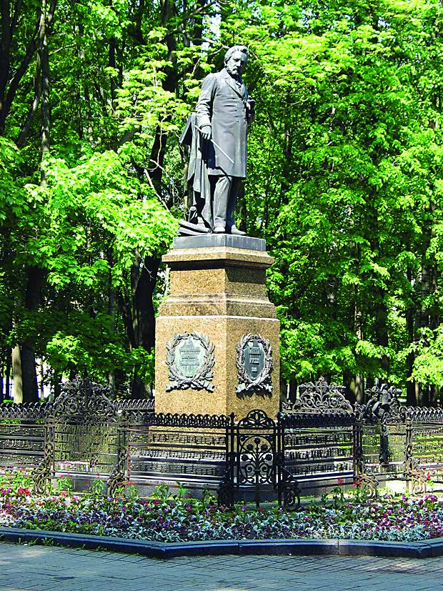
3
4

Slide 11
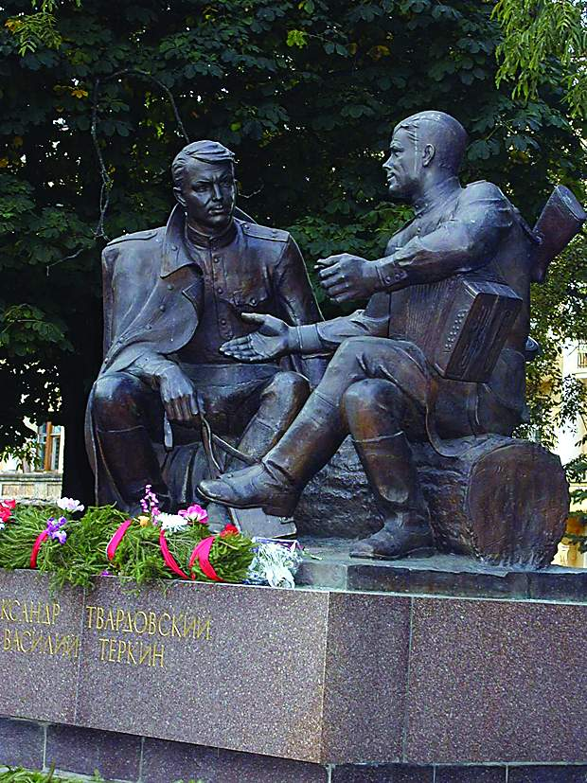
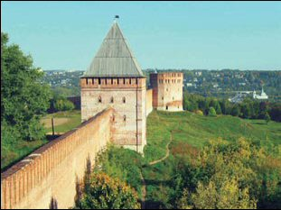
5
6

Slide 12
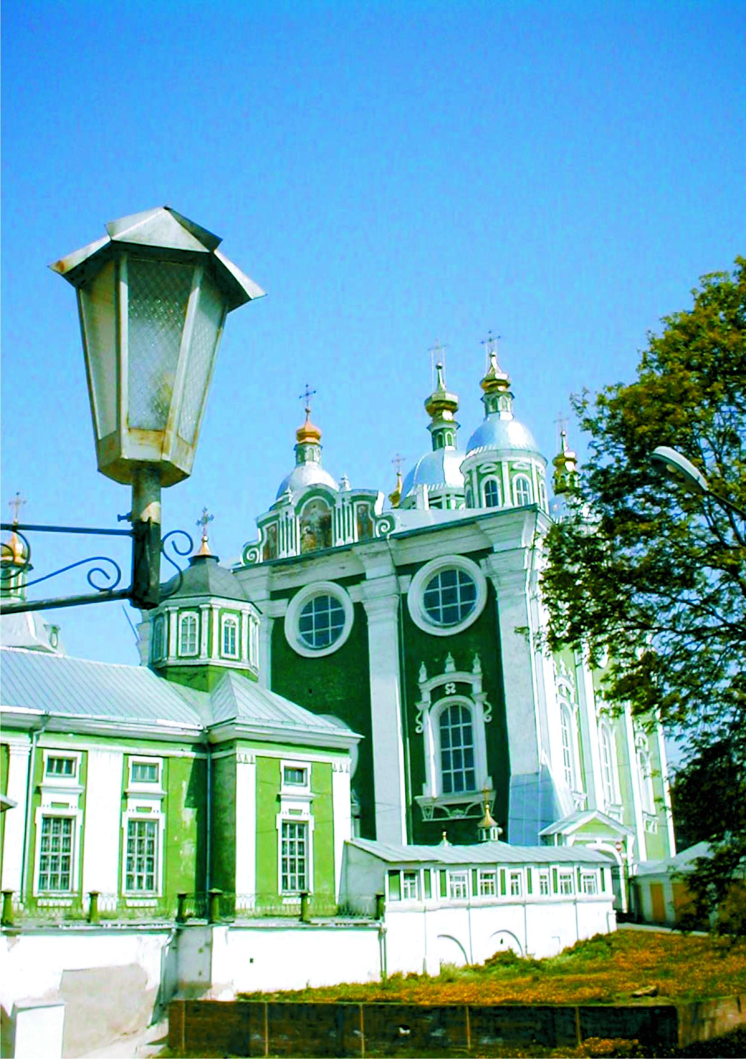
7
A). the Assumption Cathedral
B). the monument to M. Glinka
C). the Fortress Wall
D). the Monument with Eagles
E). the monument to A. Tvardovsky
F). the monument to Fyodor Kon
G). the Park of Glory

Slide 13
Well dear friends, after the excursion isn’t it a good idea to go to the cafe and have a snack?
Let’s ask somebody how to get to the nearest cafe. This hints will help you.
Greet a passer-by.
Say that you have come from another country, you are a tourist.
Ask for information: - how to get to the nearest cafe,
- if it is far from the place where you are,
- if you need to use any means of transport to get there,
- what food can you in the café.
Thank the passer-by for help.

Slide 14
Look at the screen and tell me what you know about these popular places of our town.

Slide 18
Thank you for your attention!

