Slide 1
First Aid
B2 – C1

Slide 2
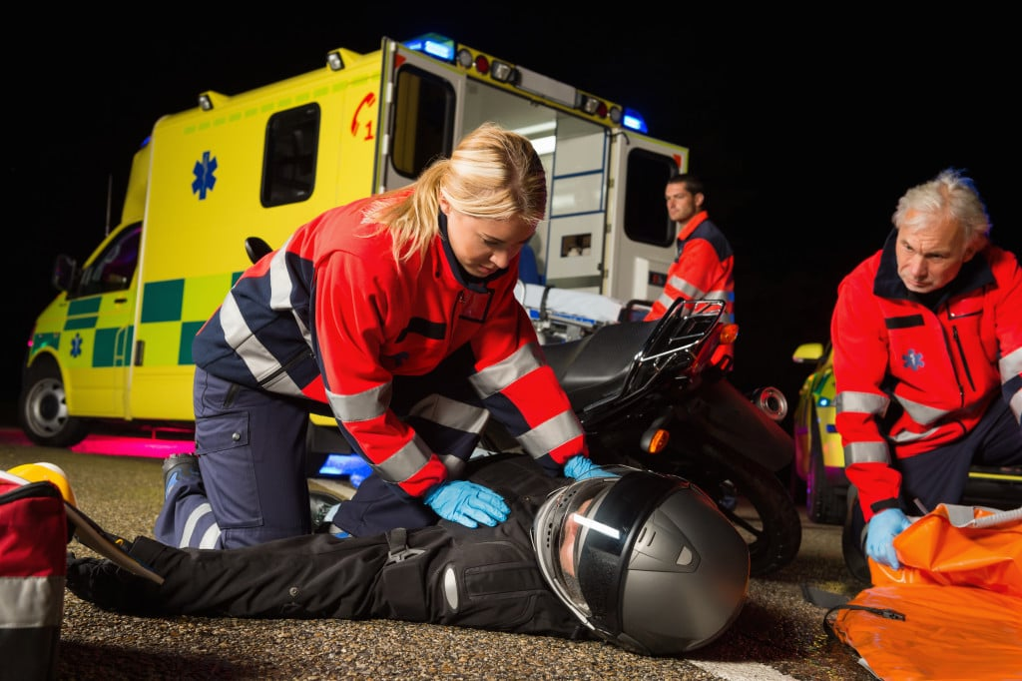
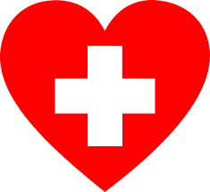

Slide 3
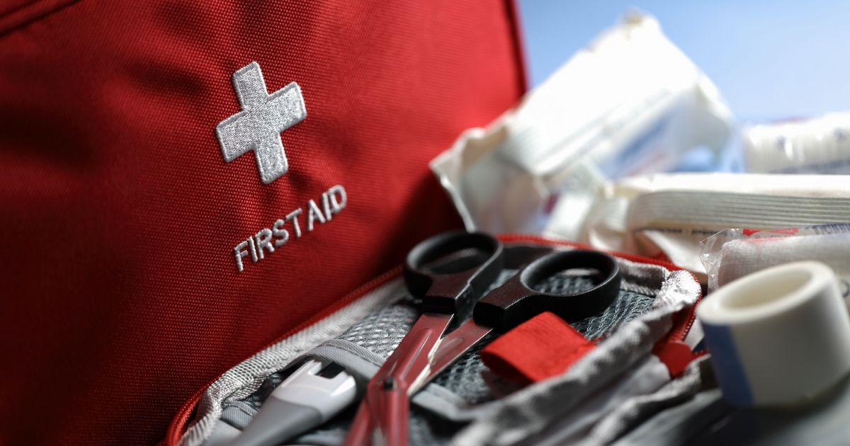

Slide 4
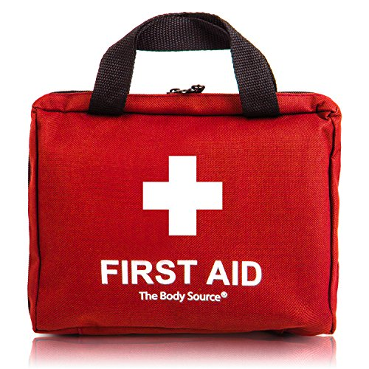
What’s in a first aid kit?
Use a _______________________ to support a sprained ankle.
Give ____________________ to someone who is suffering physically from an injury.
Wrap someone in a ______________________ to stop the effects of shock.
Use _______________________ on a wound to prevent infection.
Put ___________________ on small cuts or grazes.
bandage
painkillers
foil blanket
antiseptic cream
plasters

Slide 5
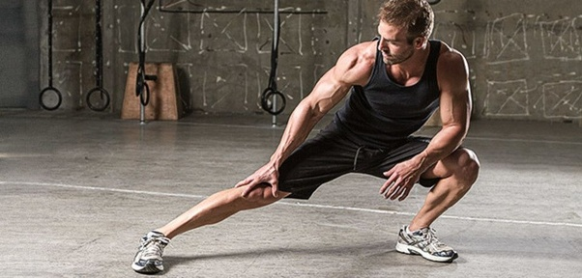
a torn muscle

Slide 6
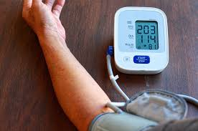
a heart attack

Slide 7
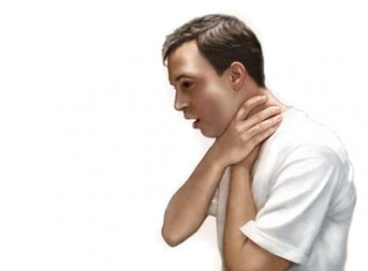
choking

Slide 8
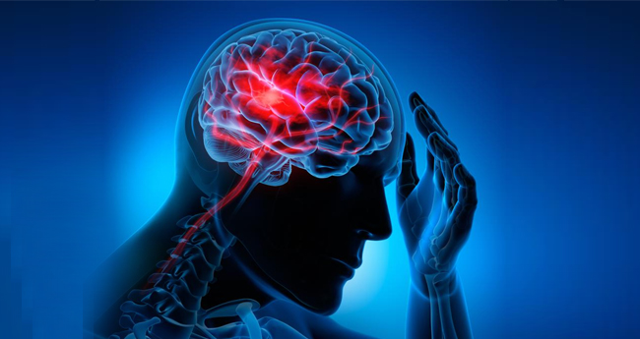
a stroke

Slide 9
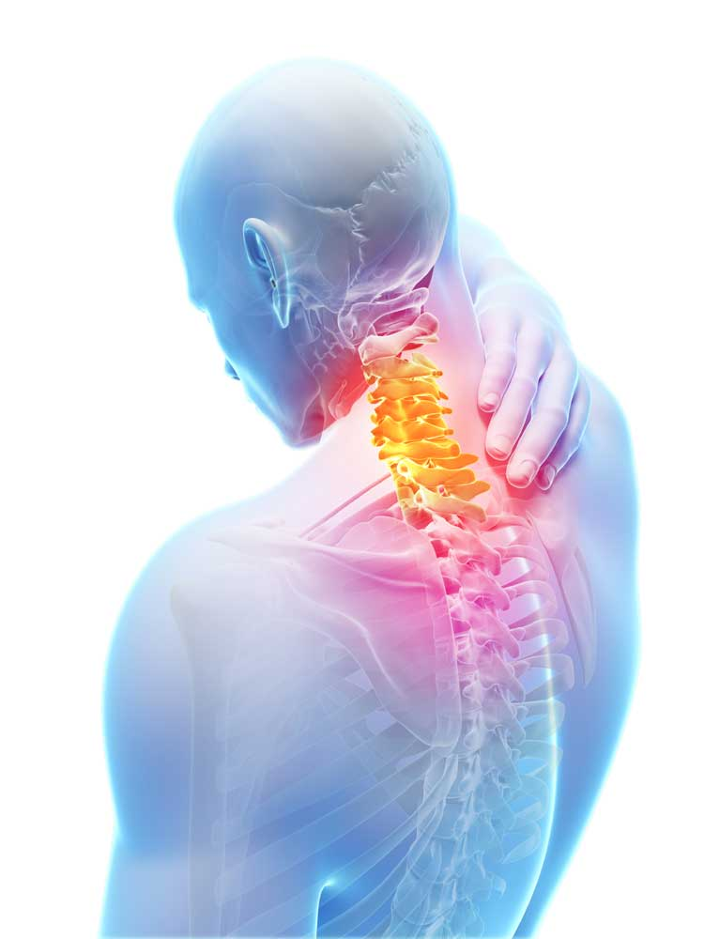
whiplash

Slide 10
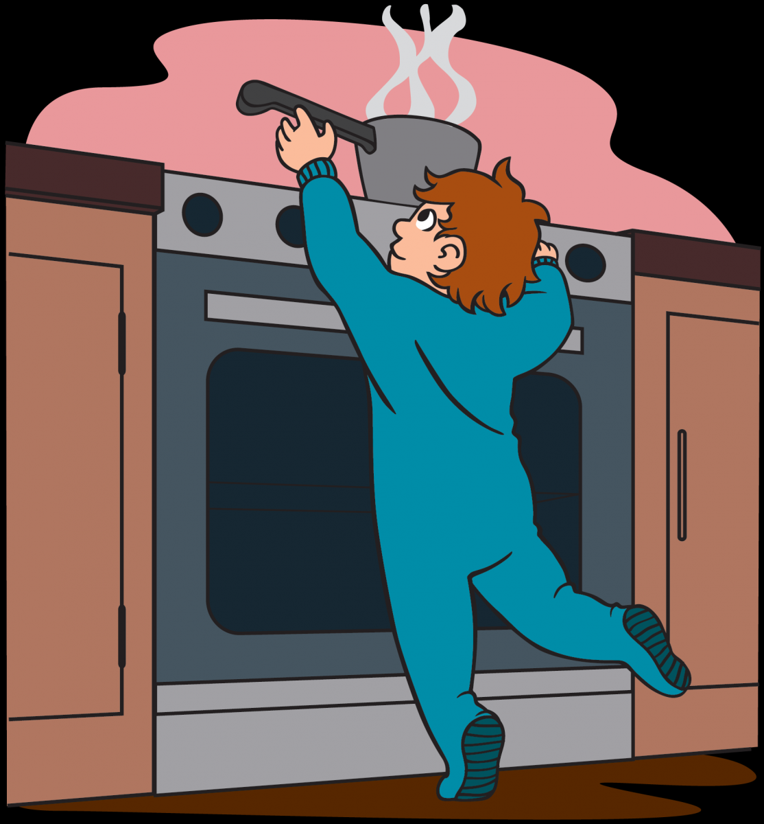
burn

Slide 11
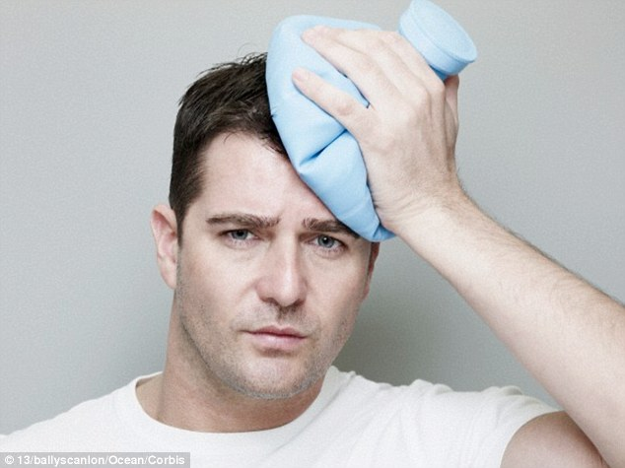
a concussion

Slide 12
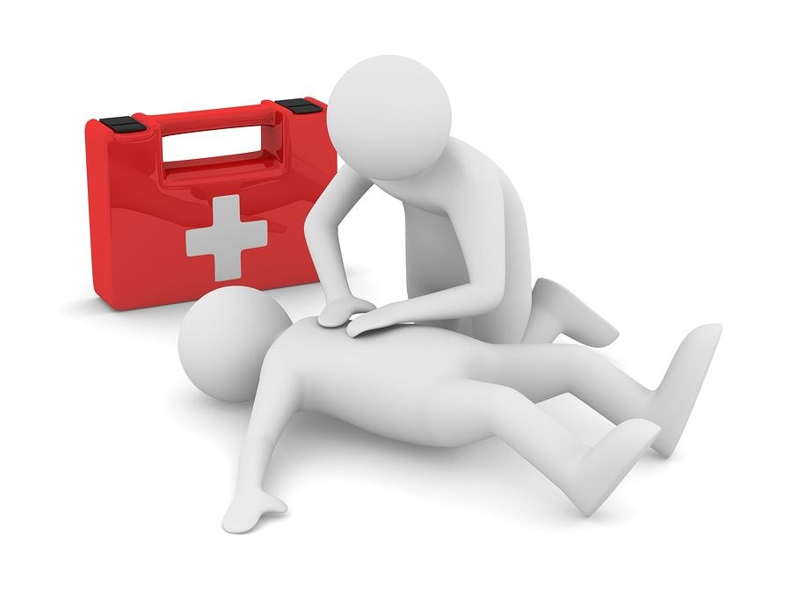
Why is first aid so important?

Slide 13
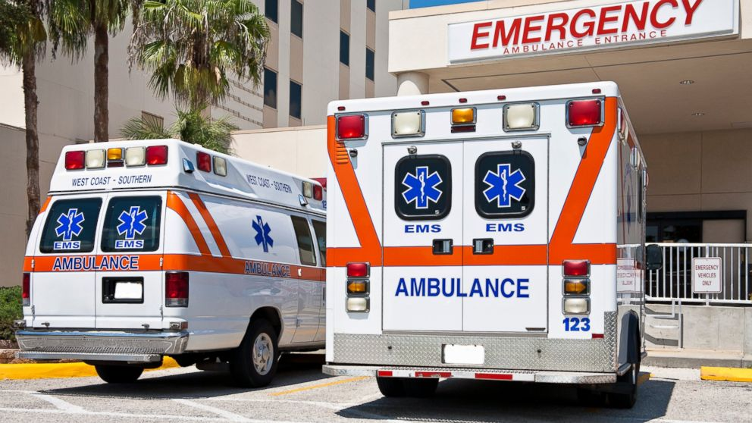
999, airway, ambulance, breathing, conscious, dangers, recovery
dangers
Check if there are _____________________ at the scene.
If the scene isn’t safe, call ____________ .
If the scene is safe, check if the person is ___________________.
If the person is unconscious, check that they are ______________________ .
If they aren’t breathing, open their __________________ .
If they are breathing, put the person in the __________________ position.
Call 999 for an ___________________________ .
999
conscious
breathing
airway
recovery
ambulance

Slide 14
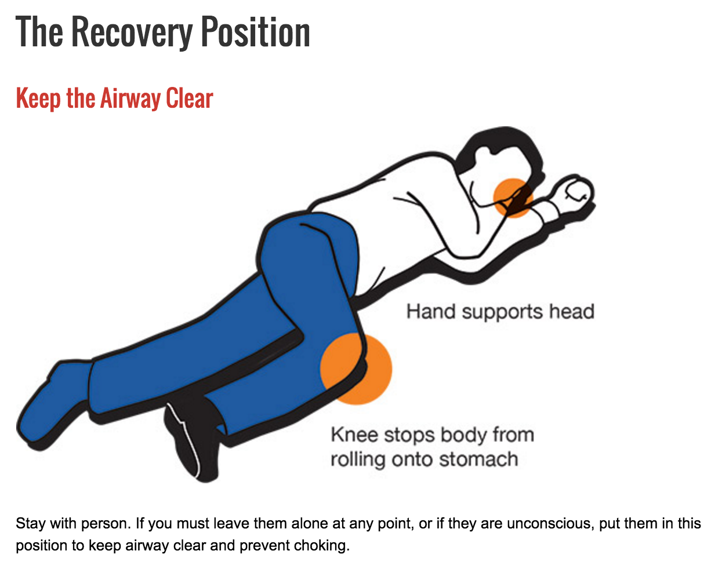

Slide 15
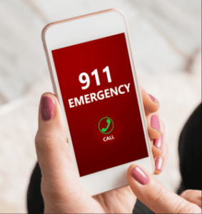
Calling 911 (or 999)

Slide 16
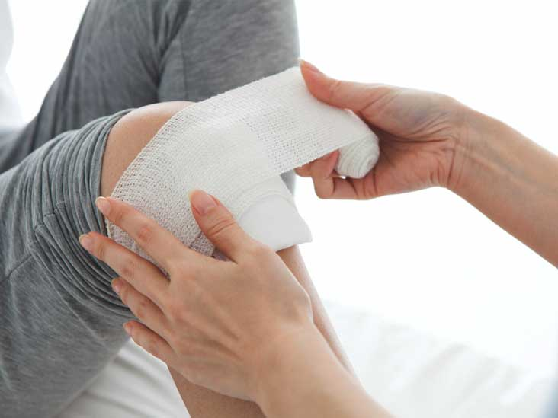
Treating a wound
medical gloves
a sterile dressing
adhesive tape
a bandage

Slide 17
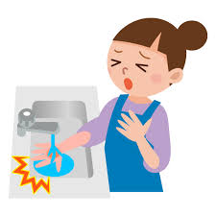
Treating a burn
Put the steps to treat a minor burn at home in the correct order.
Cool the burn with cool (not cold) running water as quickly as possible for 20 mins.
Do not apply creams or lotions to the affected area or break blisters.
Keep the person warm with a blanket, but not over the burnt area.
Put a sterile bandage or cling film loosely over the affected area.
Remove the person from the heat source, or the heat source from the person. 1
Treat any pain from the injury with painkillers such as paracetamol.
While cooling the burn, remove any clothing or jewelry that is not attached to the skin.

Slide 18
Treating a burn (the key)
1. Remove the person from the heat source, or the heat source from the person.
2. Cool the burn with cool (not cold) running water as quickly as possible for 20 mins.
3. While cooling the burn, remove any clothing or jewelry that is not attached to the skin.
4. Keep the person warm with a blanket, but not over the burnt area.
5. Do not apply creams or lotions to the affected area or break blisters.
6. Put a sterile bandage or cling film loosely over the affected area.
7. Treat any pain from the injury with painkillers such as paracetamol.

Slide 19
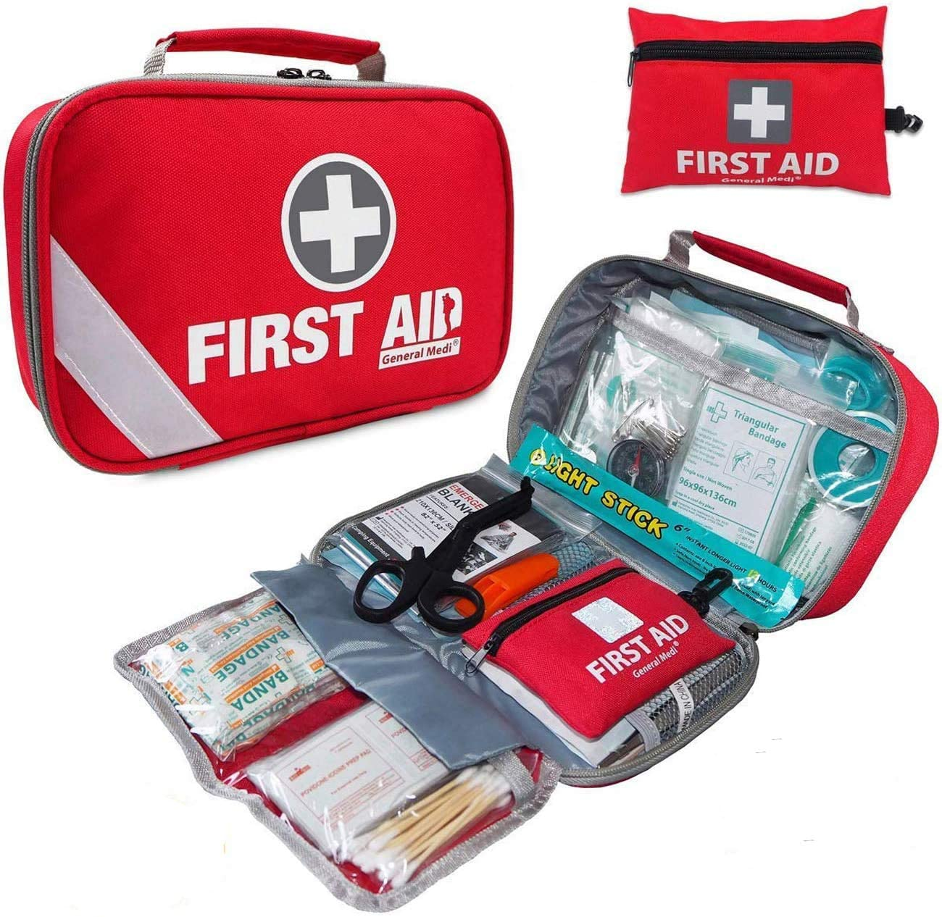
First aid kit

Slide 20
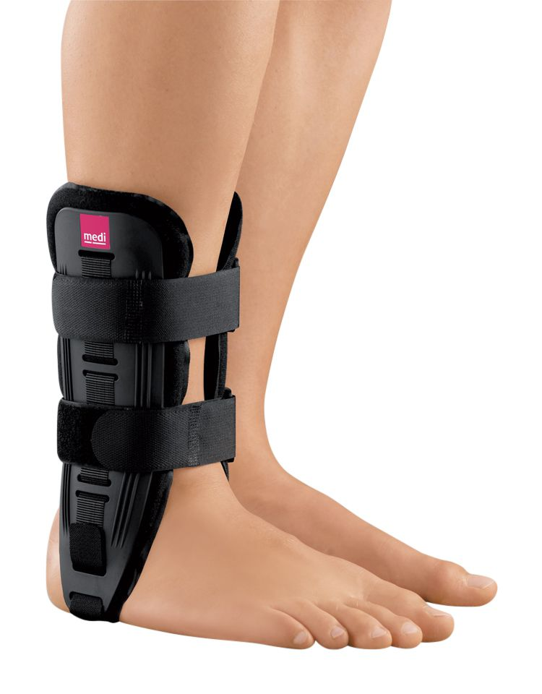
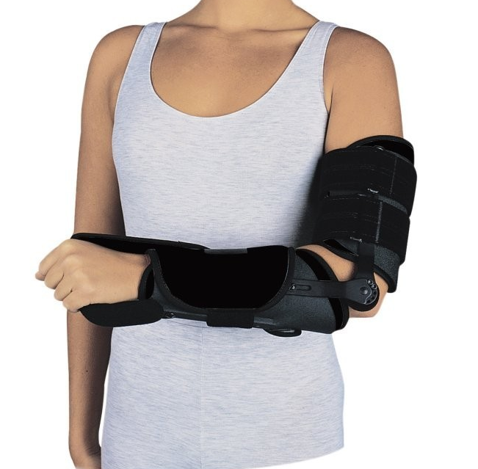

Slide 21
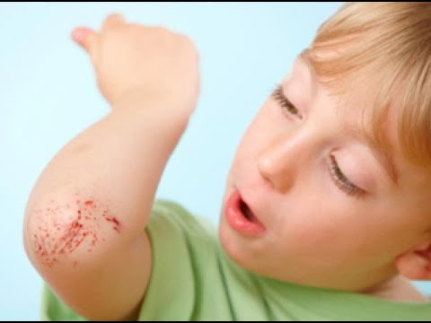
Quiz
What is a graze?
An injury to a joint
An injury to your skin made by something sharp
An injury to your skin caused by scraping it on something

Slide 22
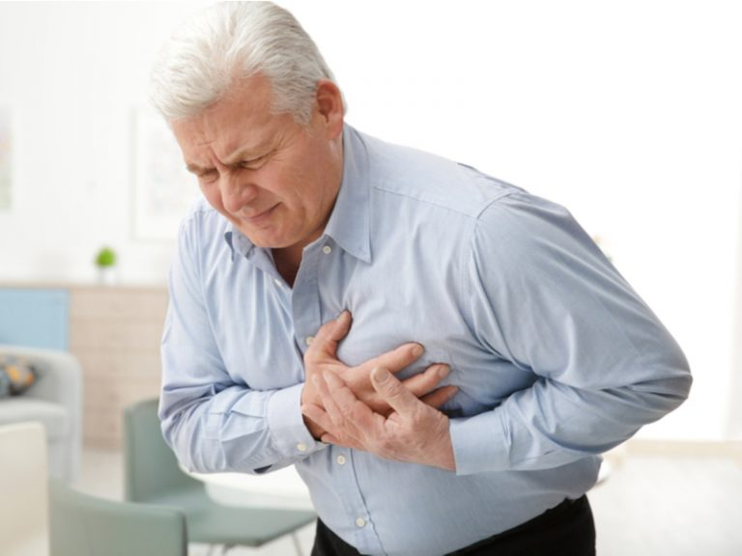
Quiz
Which of these signs means someone is having a stroke?
They have difficulty speaking
They are vomiting
They have pains in their chest

Slide 23
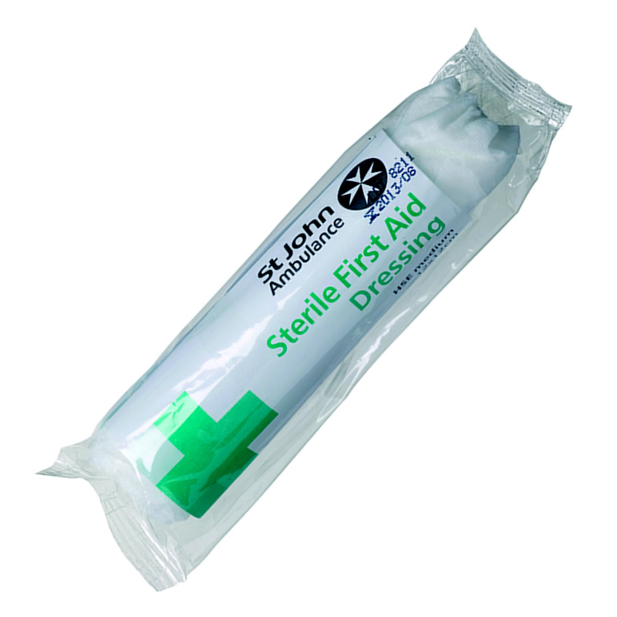
Quiz
When treating a wound you should use a sterile dressing. What does the word “sterile” mean?
Washed
Free from bacteria
New

Slide 24
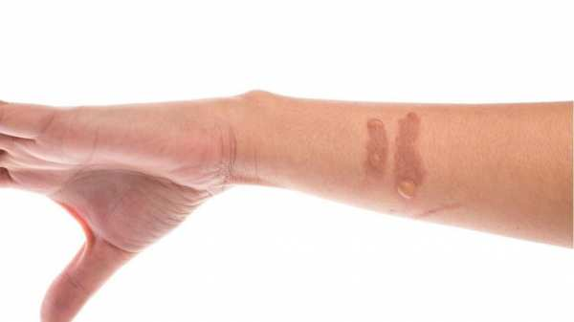
Quiz
Why shouldn’t you put a tight dressing on a burn?
To allow air to move around freely
To allow the dressing to be removed easily
To not put pressure on it

Slide 25
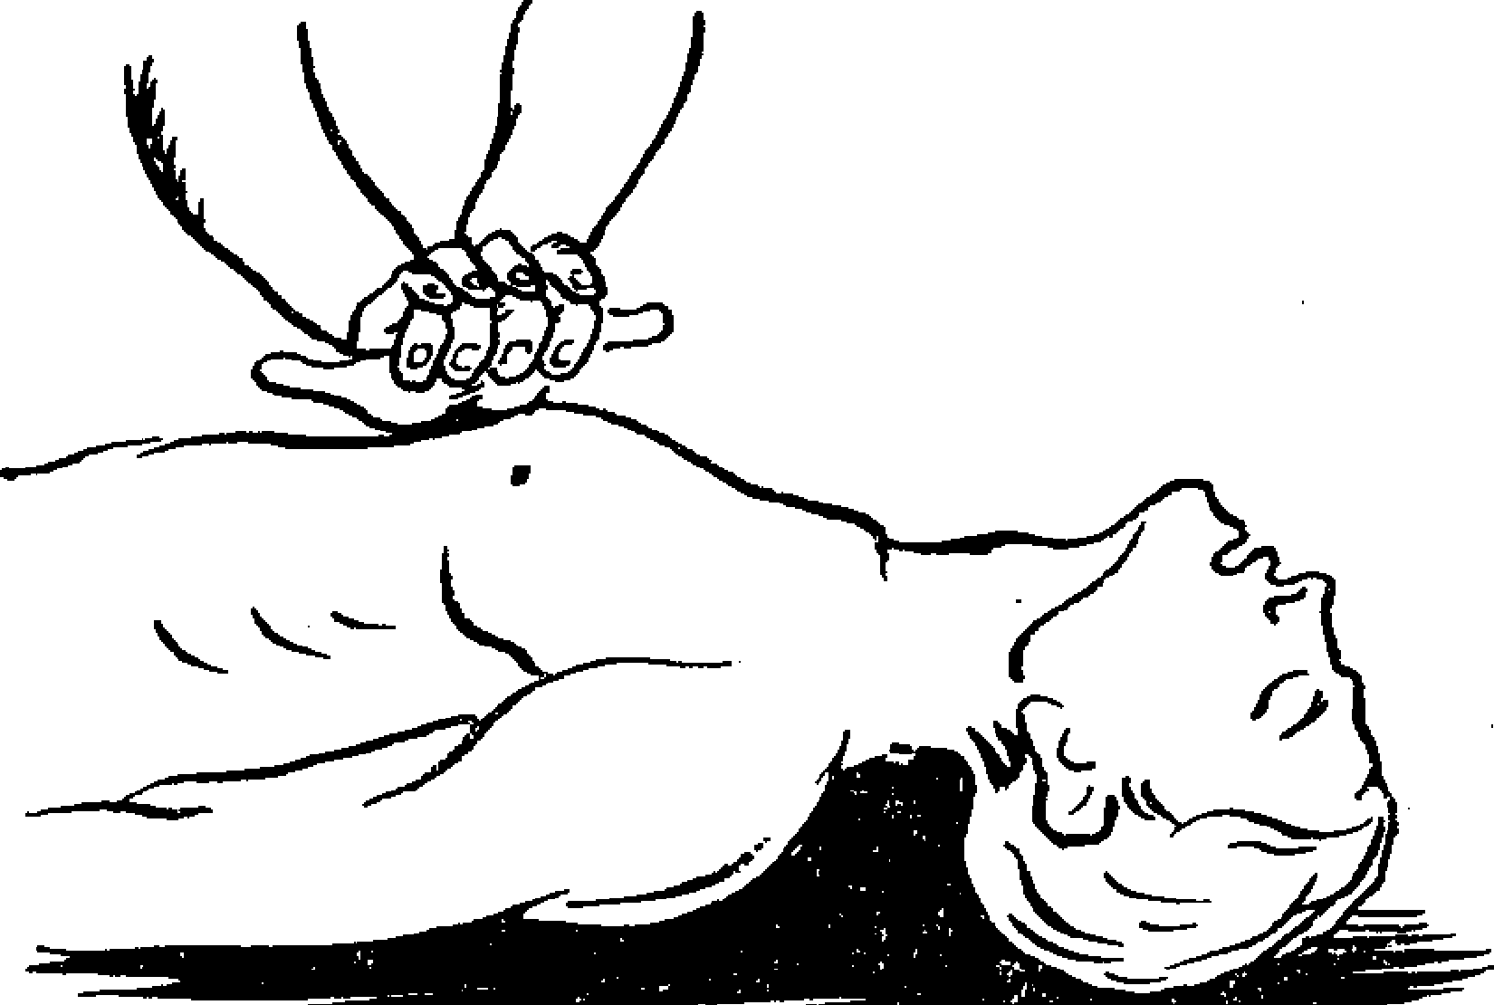
Quiz
How many chest compressions should you do per minute to restart someone’s heart?
80-100
100-200
120-140

Slide 26
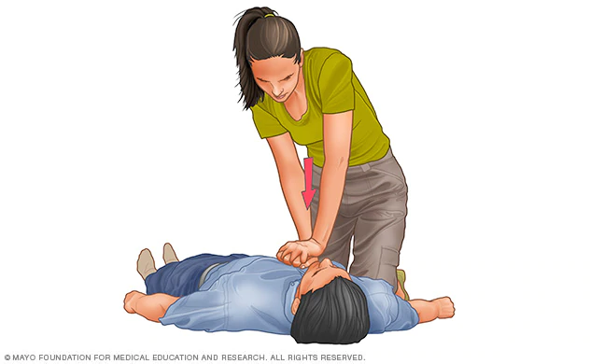
Performing CPR

