Slide 1
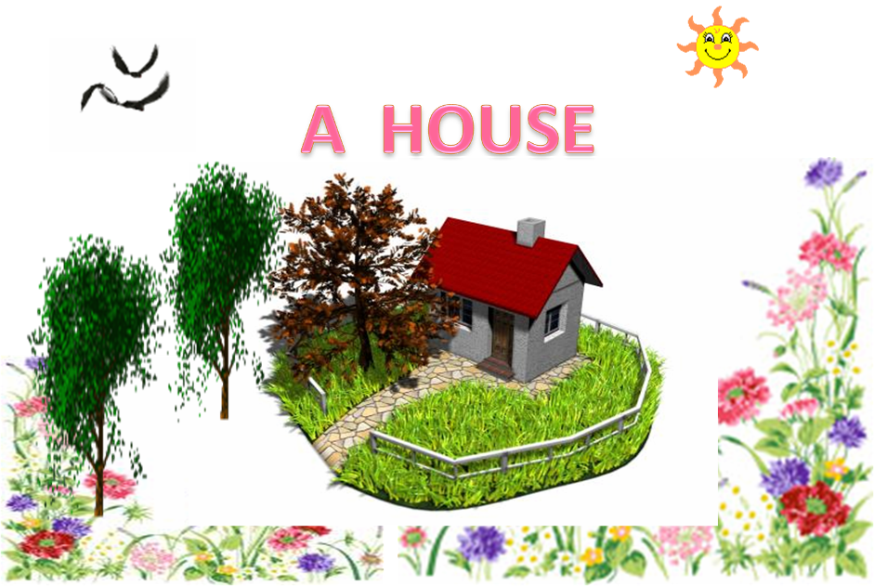

Slide 2
Read the text and give the title!

Slide 3
Houses in England

Slide 4
My house is my castle
Complete the sentenses!
1.Houses in England often have (2,3)floors
2.The kitchens are usually(upstairs,downstairs)
3.The bedrooms are often(upstairs,downstairs
4. In England they often(like,hate) gardens
5. You can (often,never) see roses in the gardens
6. In England the houses are often (big,small)

Slide 5
Imagine – you are a host of THE ENGLISH HOUSE
AND YOU ARE THE GUEST OF THIS HOUSE.
MAKE UP A DIALOGE! YOU CAN USE THE TEXT AND THE FOLLOWING PICTURERS!
Start so:
1.Where is (are)…?
2.What is (are…?
3.How many(rooms) are there …?

Slide 6
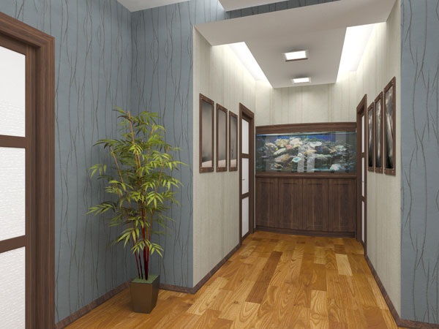
Hall

Slide 7
Kitchen

Slide 8
bathroom

Slide 9
BEDROOM

Slide 10
BEDROOM

Slide 11
Living room

Slide 12
The garden

Slide 13
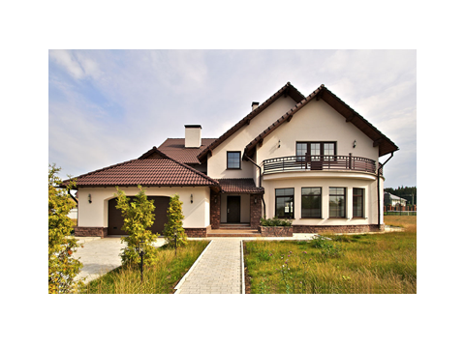
House of my dream Describe the house!

Slide 14
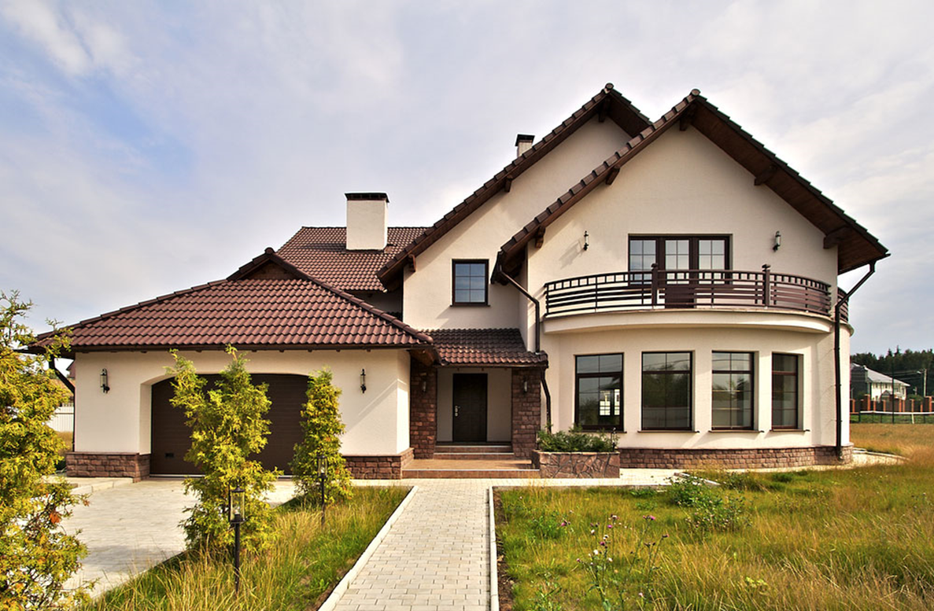

Slide 16
Thank you for your attention!

